Slide 1
Comparing Four Protein Homology Data Sources To Assess The Evolution Of TORC1 Complex In Plants. Implications For Conserved Domains Search
EEOB563 Final Project
Christian Montes-Serey
IGG PhD Program
PLPM

Slide 2
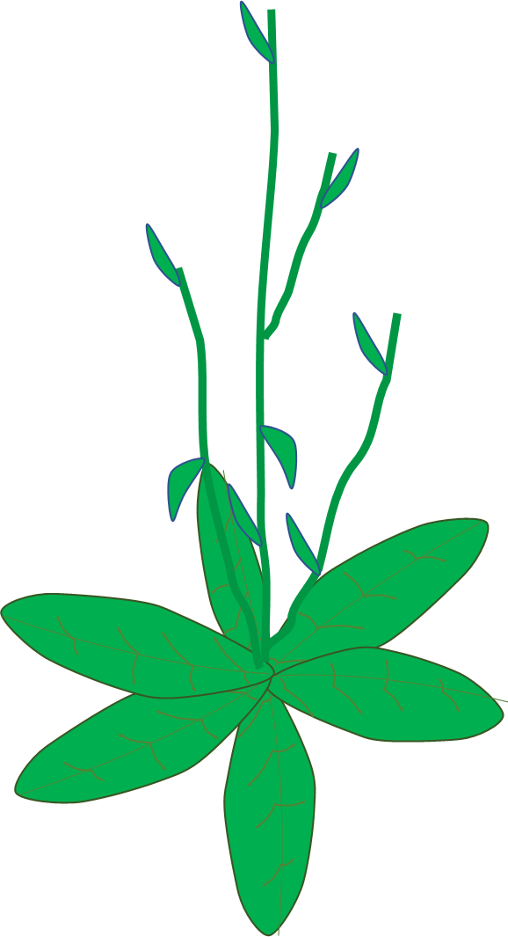
To grow or not to grow...
Every living organism must deal with stress throughout their life

Slide 3
To grow or not to grow...
Every living organism must deal with stress throughout their life
Drought

Slide 4
To grow or not to grow...
Every living organism must deal with stress throughout their life
Drought
Heat

Slide 5
To grow or not to grow...
Every living organism must deal with stress throughout their life
Drought
Heat
Cold

Slide 6
To grow or not to grow...
Every living organism must deal with stress throughout their life
Drought
starvation
Heat
Cold

Slide 7
To grow or not to grow...
Every living organism must deal with stress throughout their life
Drought
starvation
UV
Heat
Cold

Slide 8
To grow or not to grow...
Every living organism must deal with stress throughout their life
Drought
starvation
UV
Heat
Cold
Pathogens

Slide 9
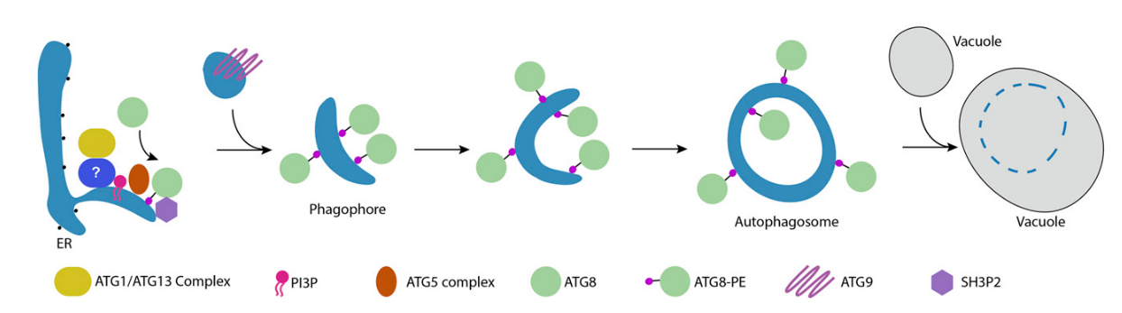
Autophagy
Recycling of sub-cellular components.
It is highly conserved in all eukaryotes.
It can occur during normal development or as a response to stress.
It is characterized by the formation of a double membrane vesicle, called autophagosome
Soto-Burgos et al, 2018

Slide 10
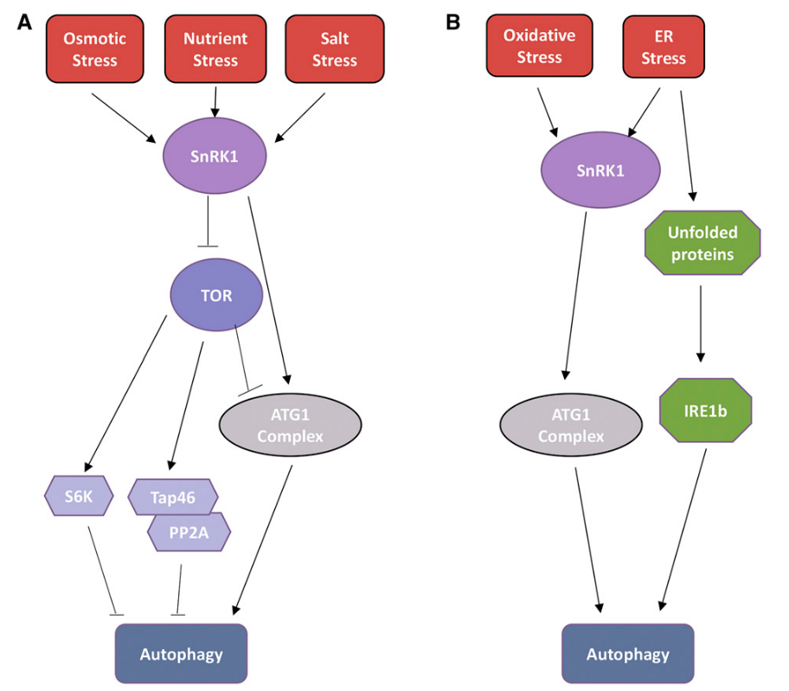
Autophagy response pathway
Soto-Burgos et al, 2018
Notes:
Can be TOR-dependent or independent, depending on the stress

Slide 11
TOR-dependent autophagy response pathway
Soto-Burgos et al, 2018
Notes:
SnRK1 kinase complex is a sensor that initiates autophagy response
Phosphorylates ATG1 to activate autophagy
Inhibits TOR complex to activate autophagy
TOR complex is activated when nutrient is abundant, and it inhibits autophagy.
TOR complex is formed by three components
TOR kinase
RAPTOR, presents substrates to TOR kinase
LST8 stabilizes the complex

Slide 12
Target of Rapamycin (TOR) complex
TOR
LST8
RAPTOR

Slide 13
Target of Rapamycin (TOR) complex
TOR
Target Of Rapamycin:
(Ser/Thr kinase)
LST8
RAPTOR

Slide 14
Target of Rapamycin (TOR) complex
TOR
Target Of Rapamycin:
(Ser/Thr kinase)
LST8
RAPTOR
Regulatory-Associated Protein of TOR:
(presents substrates to TOR)

Slide 15
Target of Rapamycin (TOR) complex
TOR
Target Of Rapamycin:
(Ser/Thr kinase)
LST8
RAPTOR
Lethal with Sec Thirteen 8:
(stabilizes the complex)
Regularoty-Associated Protein of TOR:
(presents substrates to TOR)

Slide 16
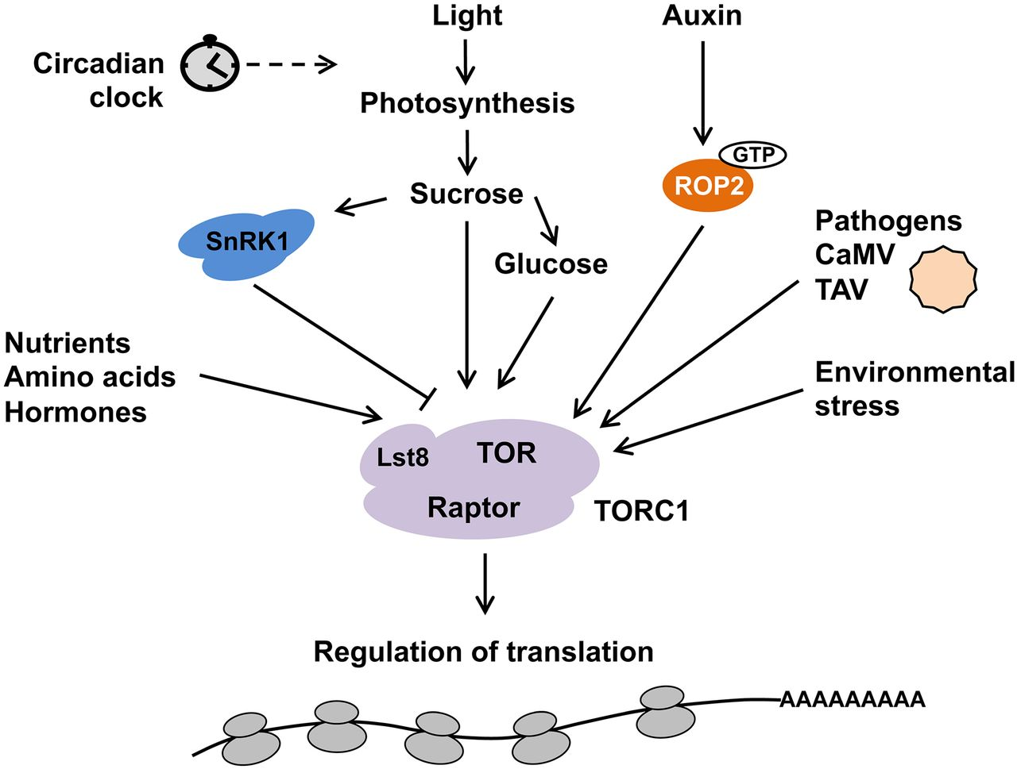
TOR is central in stress/grow regulation
Schepetilnikov and Ryabova, 2018

Slide 17
Then, how is TOR regulated?
Its...complicated

Slide 18
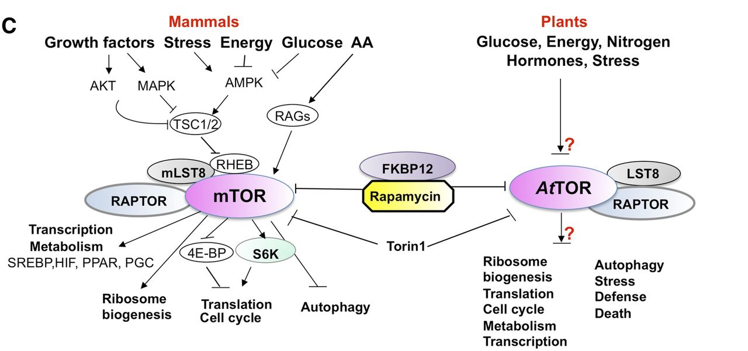
Then, how is TOR regulated?
Its...complicated...and largely unknown (in plants)
Xiong and Sheen, 2014

Slide 19
Then, how is TOR regulated?
Its...complicated...and largely unknown
What do we know, then?
There are reports of TORC regulation by phosphorylation of its components.
But some reports are in one species, and others in another species.

Slide 20
Is this site conserved? Let’s find homologs!
More than one homology database
With different datasets
With different homology search strategies each

Slide 21


Is this site conserved? Let’s find homologs!
More than one homology database
With different datasets
With different homology search strategies each

Slide 22
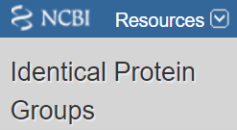



Is this site conserved? Let’s find homologs!
More than one homology database
With different datasets
With different homology search strategies each

Slide 23


Is this site conserved? Let’s find homologs!
More than one homology database
With different datasets
With different homology search strategies each

Slide 24
Is this site conserved? Let’s find homologs!
More than one homology database
With different datasets
With different homology search strategies each
Which one is “the right one”?

Slide 25
Is this site conserved? Let’s find homologs!
More than one homology database
With different datasets
With different homology search strategies each
Which one is “the right one”?
Can I use my newly acquired EEOB563 knowledge to assess this?

Slide 26
My journey to find the best dataset of homologs
Obtaining the data
Aligning the data
Maximum likelihood phylogenetic analysis

Slide 27
My journey to find the best dataset of homologs
Obtaining the data
Aligning the data
Maximum likelihood phylogenetic analysis

Slide 28
Obtaining the data
Used four data sources:
NCBI BLAST
Used blastp against ref_seq_protein database, vidiplantae taxa, retrieve top 100 hits
NCBI HomoloGene
This database provides around 20 hits from different taxa
ENSEMBL Plants (Compara database)
Used complete dataset from “gene tree” information
Phytozome
Got first 100 best scoring homologs.

Slide 29
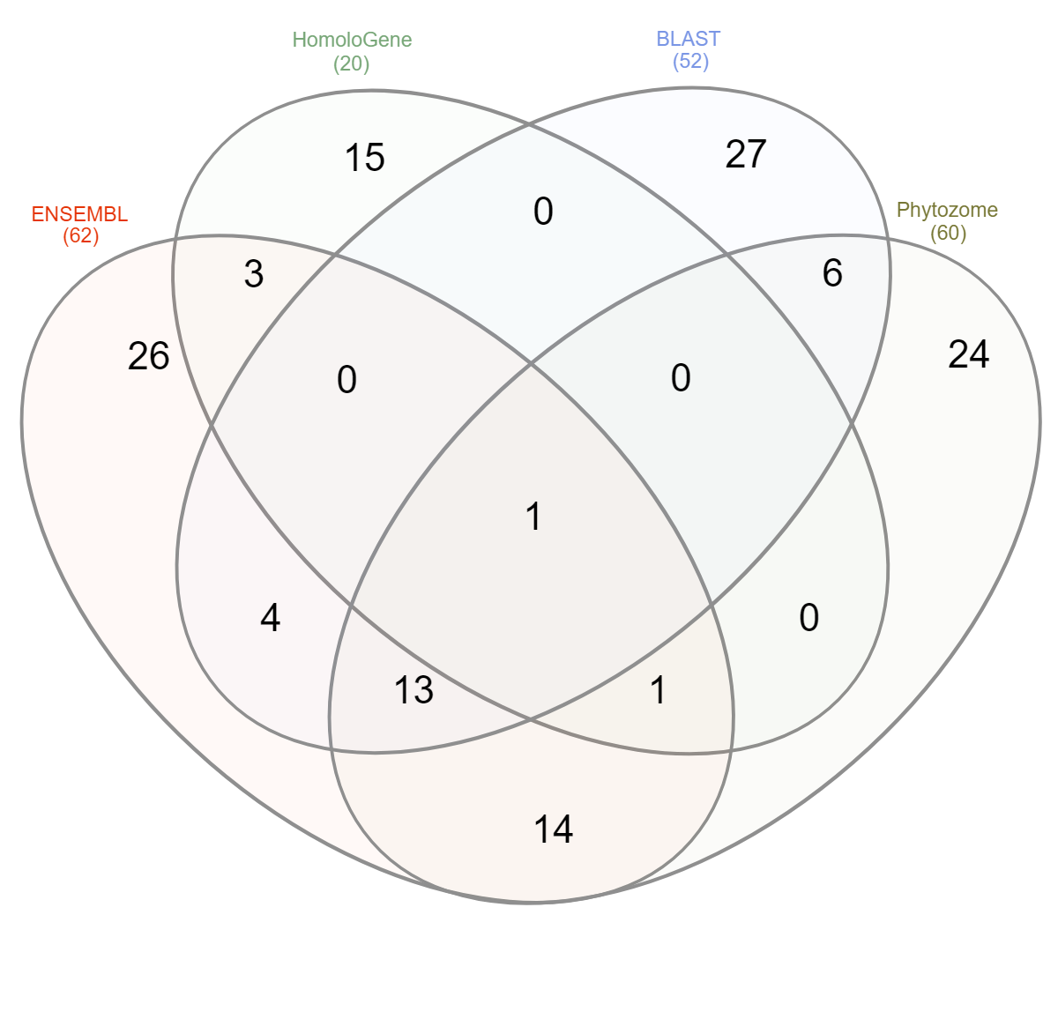
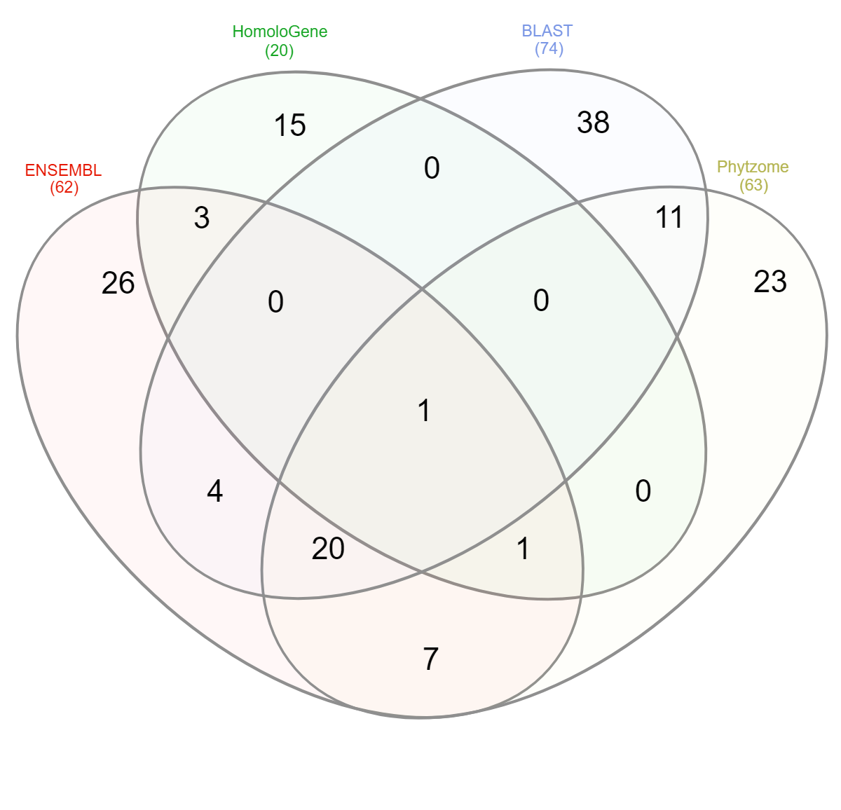
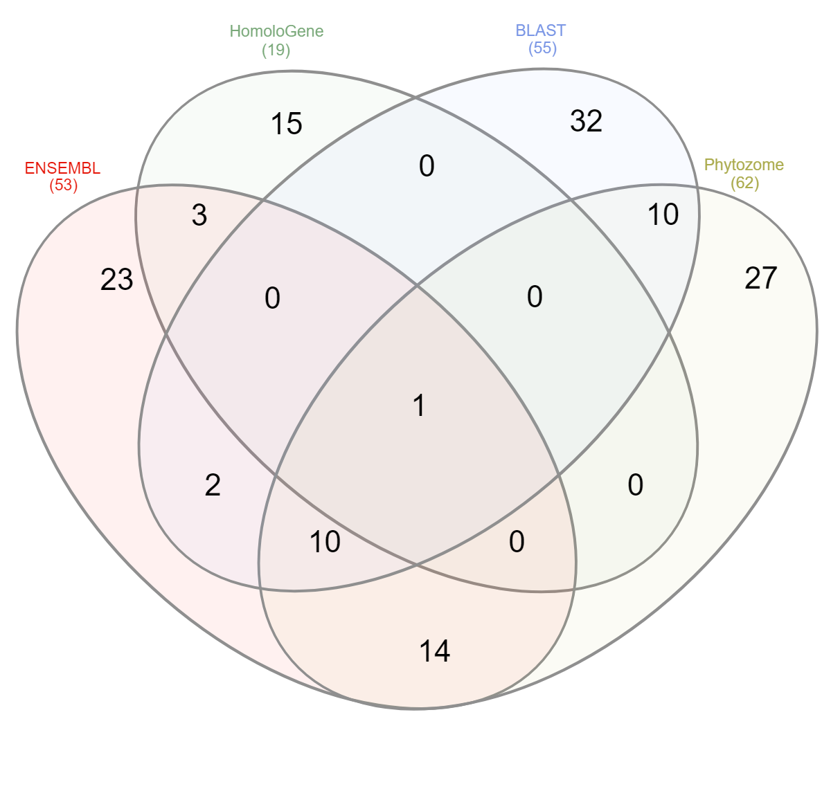
Obtaining the data: overlapping species
RAPTORB
LST8
TOR

Slide 30
Obtaining the data: overlapping species
RAPTORB
LST8
TOR

Slide 31
Obtaining the data: overlapping species
RAPTORB
LST8
TOR

Slide 32
My journey to find the best dataset of homologs
Obtaining the data
Aligning the data
Maximum likelihood phylogenetic analysis

Slide 33
My journey to find the best dataset of homologs
Obtaining the data
Aligning the data
Maximum likelihood phylogenetic analysis
Used MAFFT

Slide 34
My journey to find the best dataset of homologs
Obtaining the data
Aligning the data
Maximum likelihood phylogenetic analysis

Slide 35
Maximum likelihood phylogenetic analysis
Used RaxML-HPC
The one provided by Cipress Science Gateway webserver.
Tried with RaxML-NG in HPC-class but it was too slow
Tested 2 amino acid substitution models: BLOSUM62 and LG
Used RaxML-NG to obtain AIC/BIC

Slide 36
Maximum likelihood phylogenetic analysis

Slide 37
Maximum likelihood phylogenetic analysis
LG model give a slightly better AIC score than BLOSUM62.
NCBI (BLAST and HomoloGene) give the best AIC score

Slide 38
Maximum likelihood phylogenetic analysis
LG model give a slightly better AIC score than BLOSUM62.
NCBI (BLAST and HomoloGene) give the best AIC score
Do they give the most informative tree?

Slide 39
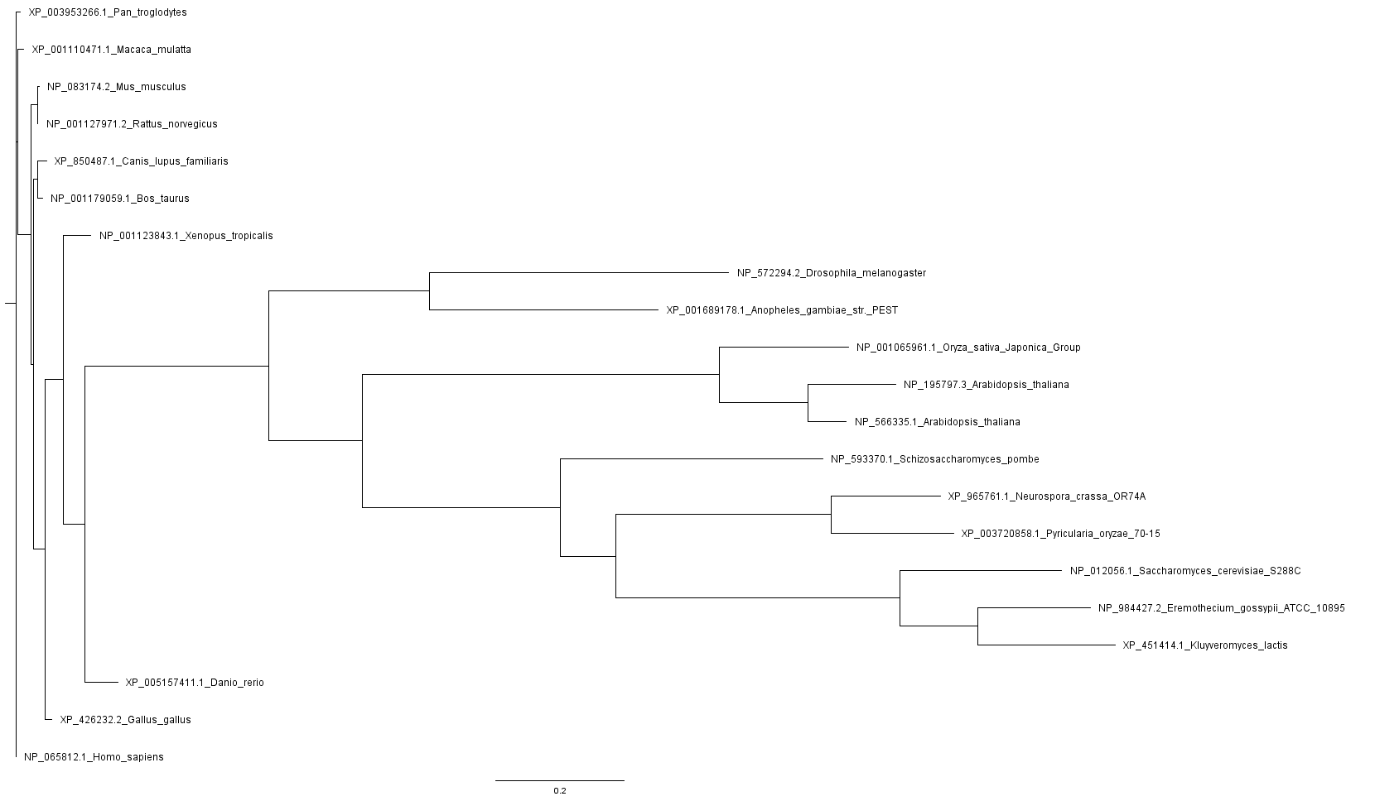
Maximum likelihood phylogenetic analysis: RAPTORB - HomoloGene
Brassicaceae

Slide 40
Maximum likelihood phylogenetic analysis: RAPTORB - HomoloGene
Poaceae
Brassicaceae

Slide 41
Maximum likelihood phylogenetic analysis: RAPTORB - HomoloGene
Poaceae
Brassicaceae

Slide 42
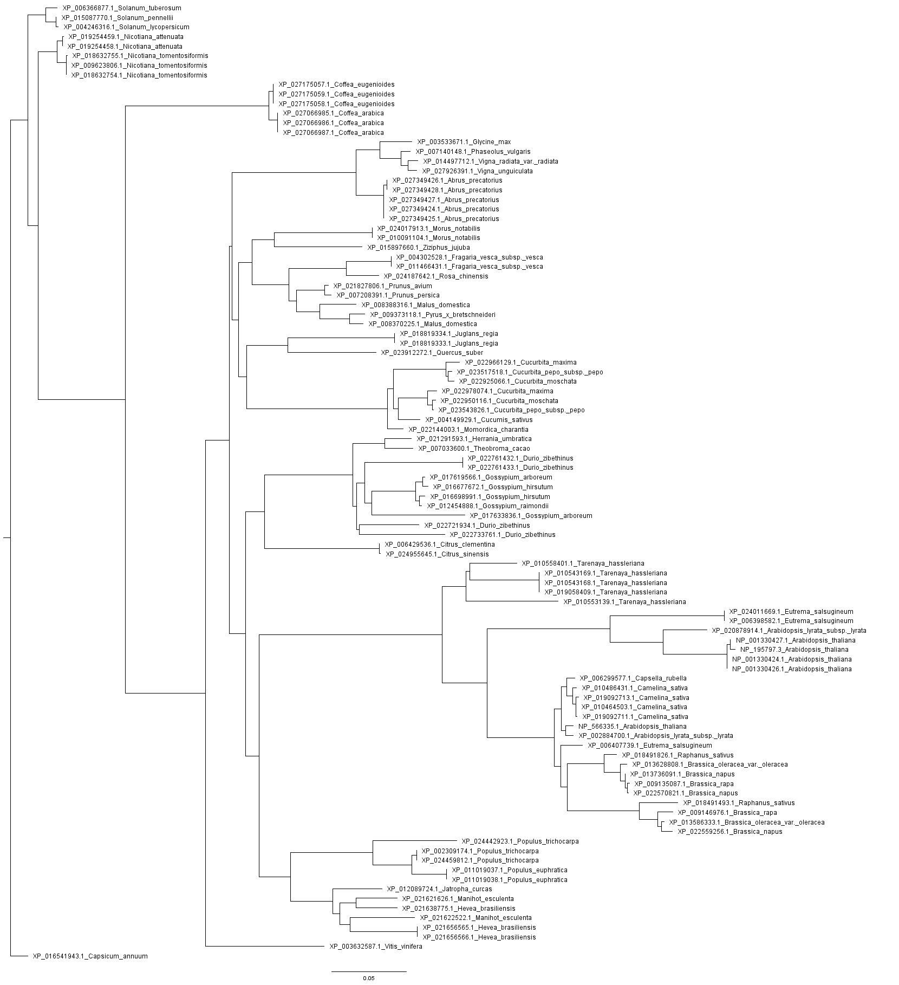
Maximum likelihood phylogenetic analysis: RAPTORB - BLAST

Slide 43
RAPTORB - BLAST
Family
Cucurbitaceae
Malvaceae
Rutaceae
Cleomaceae
Brassicaceae
Salicaceae
Euphorbiaceae

Slide 44
RAPTORB - BLAST
Family
Order
Cucurbitaceae
Cucurbitales
Malvaceae
Malvales
Rutaceae
Sapindales
Cleomaceae
Brassicales
Brassicaceae
Salicaceae
Malpighiales
Euphorbiaceae

Slide 45
Asterids
Cucurbitaceae
Cucurbitales
Malvaceae
Malvales
Rutaceae
Sapindales
Rosids
Cleomaceae
Brassicales
Brassicaceae
Salicaceae
Malpighiales
Euphorbiaceae
Family
Order
Clade

Slide 46
What about the other databases?

Slide 47
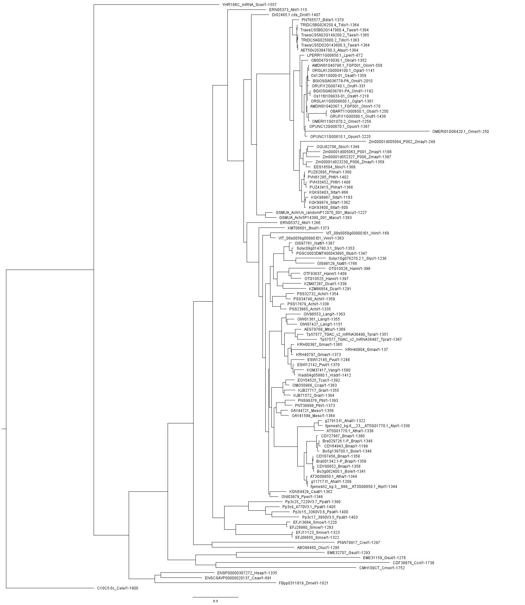
RAPTORB - ENSEMBL
Fabaceae
Malvaceae
Euphorbiaceae
Salicaceae
Brassicaceae
Cucurbitaceae
Rosaceae
Family

Slide 48
RAPTORB - ENSEMBL
Fabaceae
Fabales
Malvaceae
Malvales
Euphorbiaceae
Malpighiales
Salicaceae
Brassicaceae
Brassicales
Cucurbitaceae
Cucurbitales
Rosaceae
Rosales
Family
Order

Slide 49
Commelinids
Monocots
Asterids
Fabaceae
Fabales
Malvaceae
Malvales
Dicots
Euphorbiaceae
Malpighiales
Rosids
Salicaceae
Brassicaceae
Brassicales
Cucurbitaceae
Cucurbitales
Rosaceae
Rosales
Family
Order
Clade

Slide 50
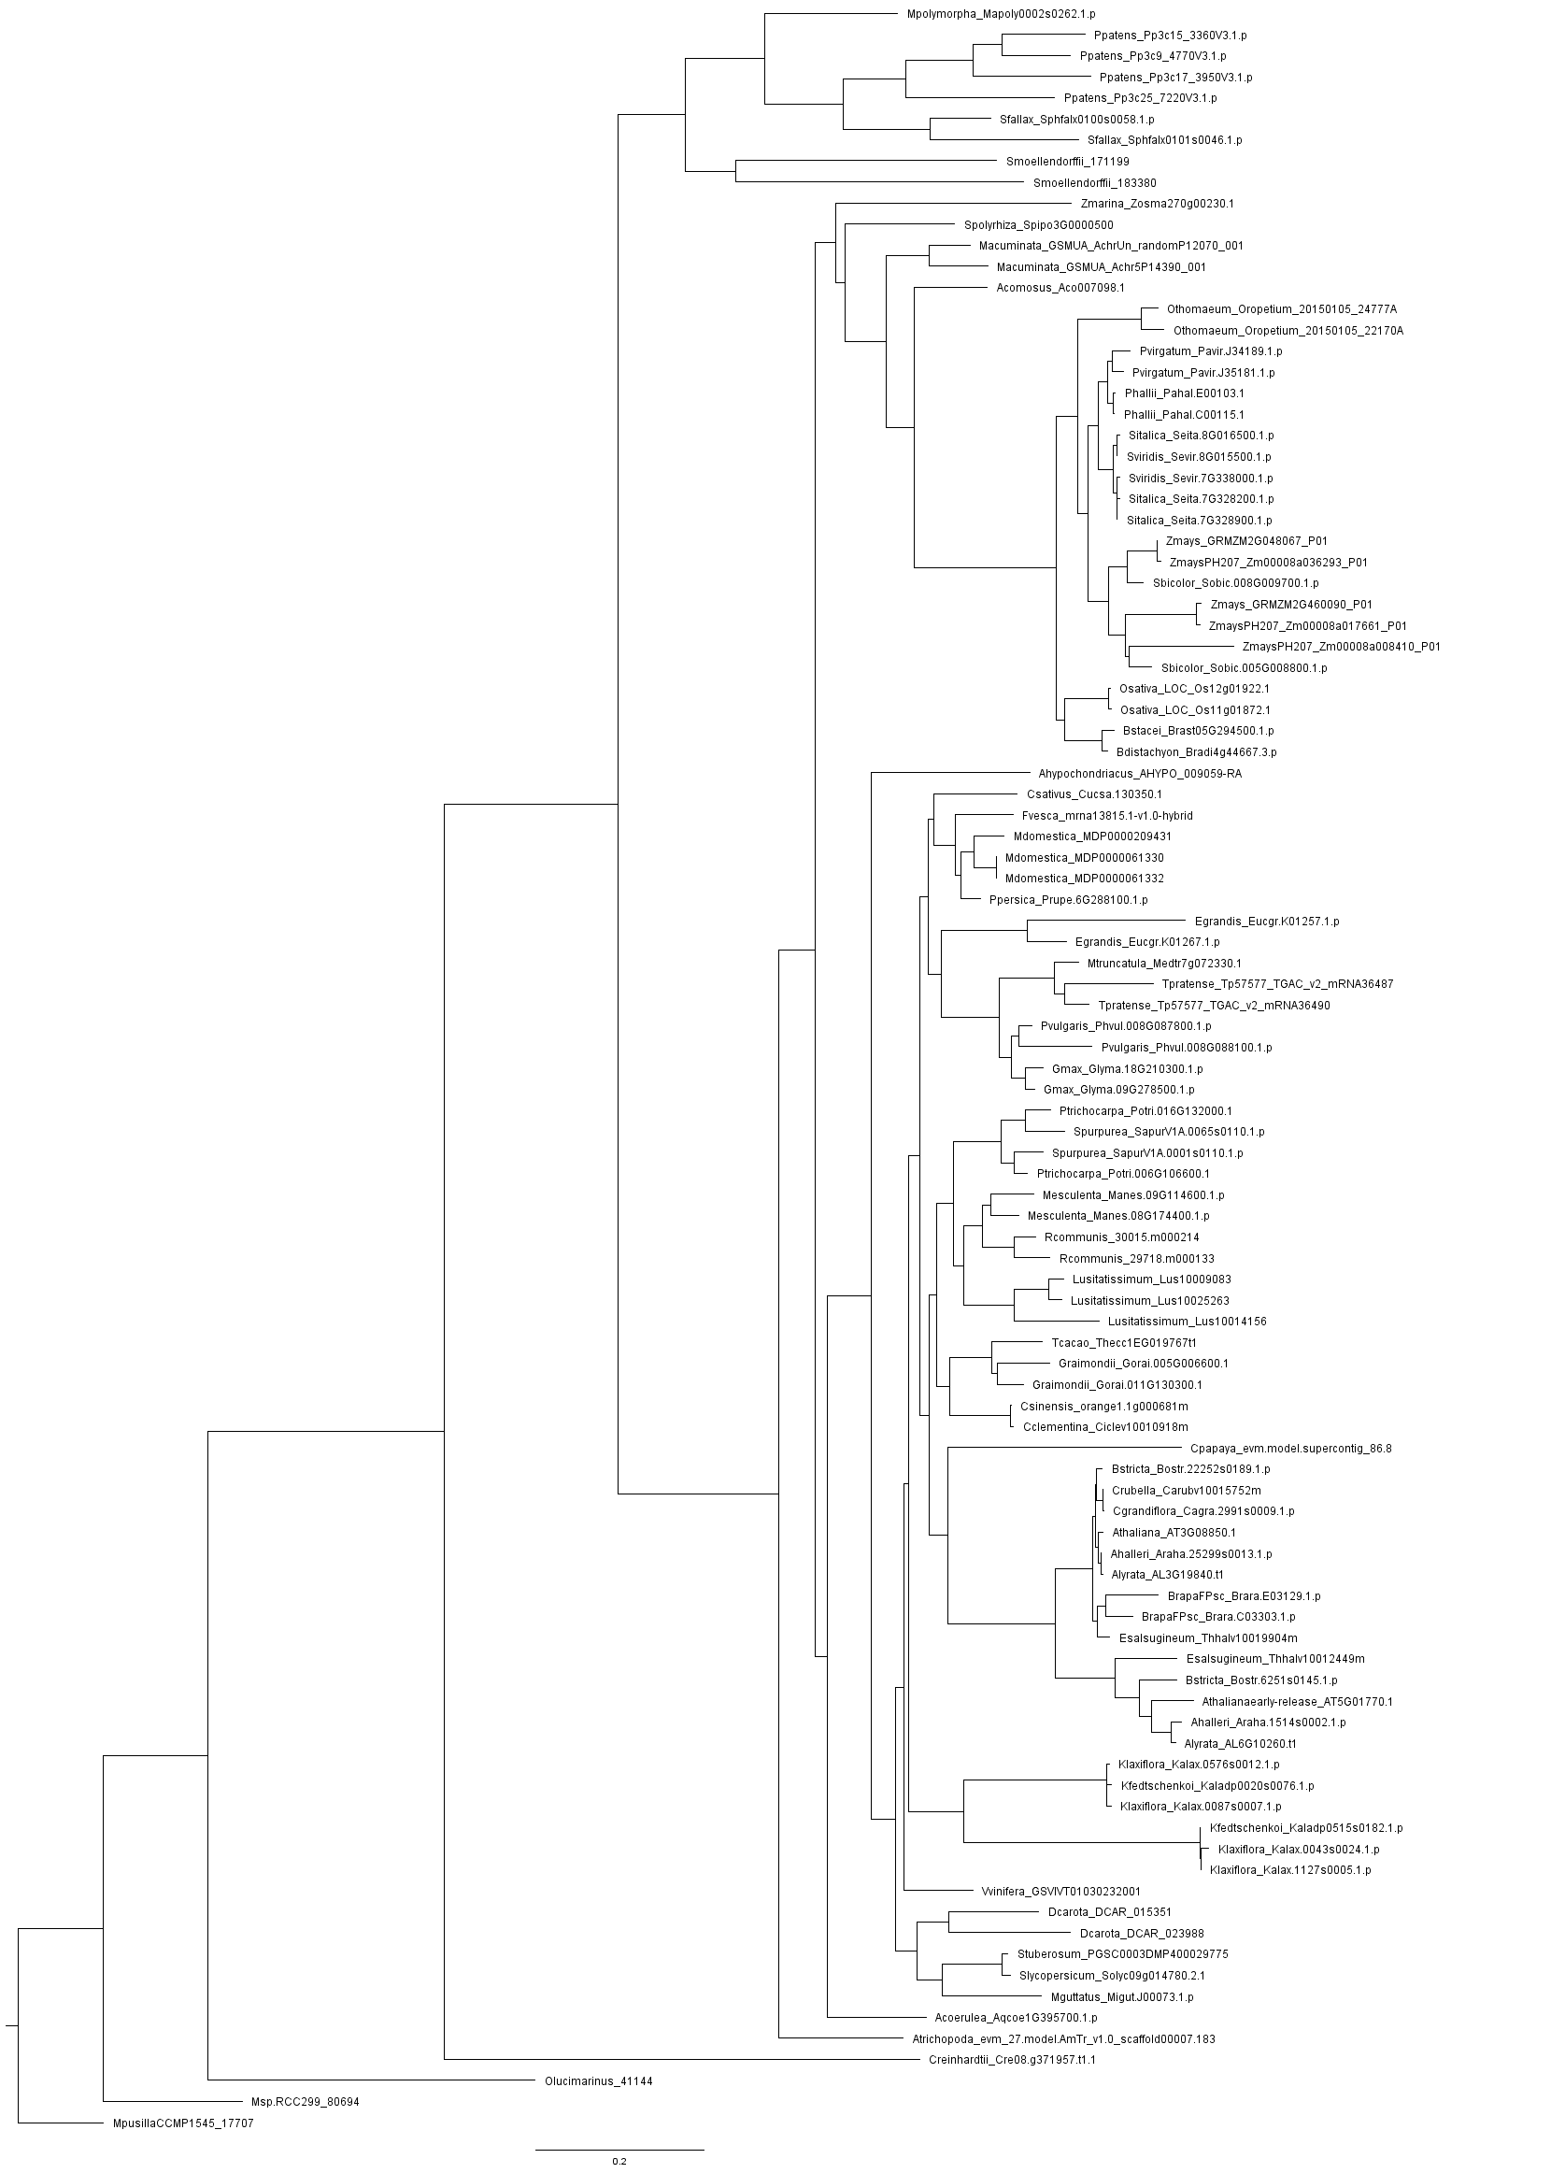
RAPTORB - Phyto
Salicaceae
Euphorbiaceae
Linaceae
Malvaceae
Rutaceae
Caricaceae
Brassicaceae
Family
Family

Slide 51
RAPTORB - Phyto
Salicaceae
Euphorbiaceae
Malpighiales
Linaceae
Malvaceae
Malvales
Rutaceae
Sapindales
Caricaceae
Brassicaceae
Brassicales
Family
Family
Order

Slide 52
RAPTORB - Phyto
Commelinids
Monocots
Salicaceae
Euphorbiaceae
Malpighiales
Linaceae
Rosids
Dicots
Malvaceae
Malvales
Rutaceae
Sapindales
Caricaceae
Brassicaceae
Brassicales
Asterids
Family
Family
Order
Clade

Slide 53
Conclusions
LG model seem to give a reconstruction with higher probability.
It was possible to reconstruct very accurate phylogenetic trees from all datasets.
There is no “wrong” dataset.
The most accurate phylogenetic reconstruction may not be the most useful.
The best accuracy/usefulness balance was obtained with Phytozome dataset.
It was possible to obtain closely related species to our query specie. This information was consistent across 3 out of 4 datasets.

Slide 54
Questions?

