Slide 1
PROJECT 1 — SOCKET PROGRAMMING
Bid Auction Protocol
BAP / 1.0
A distributed bid-auction system, sharded across TCP client-proxy-server pairs
Pomdet Foong • Kasetsart University, Computer Science

Slide 2
AGENDA
What we'll cover
01
Objective & design rationale
02
Protocol specification
Why this system, why TCP over UDP
BAP/1.0 — message families and status codes
03
System architecture
04
Data integrity
Client, Proxy, Server, Registry, and how they fit together
Mutex, audit log, snapshot, lock file
05
Wireshark verification
06
Live demo
Proof the design matches real traffic
Running the full system end to end
02

Slide 3
01 · OBJECTIVE
What this program does
A distributed bid auction system: multiple clients place monetary bids on numbered auction items over a network. At any moment, exactly one bid is recognized as the highest per item — the system either accepts a new leading bid, or rejects it.
BidRequest
{
"protocol": "BAP/1.0",
"client_name": "Alice",
"item_id": 42,
"bid_amount": 100
}
Built as a sharded architecture rather than one monolithic server, to demonstrate horizontal scaling and dynamic service discovery — not just socket programming.
BidResponse
{
"status_code": 200,
"status_phrase": "OK - Bid Accepted"
}
03

Slide 4
01 · OBJECTIVE
Application characteristics
MT
Multi-tier client-server
SH
Sharded by item range
ST
Stateless vs. stateful
Four distinct roles: Client, Proxy, Server, Registry — not peer-to-peer.
Item IDs split into disjoint ranges; each range owned end-to-end by one Proxy/Server pair.
Proxies route and validate only. Servers are the sole authority for bid state.
DY
Dynamic discovery
RR
Request-response
PS
Persistent state
Proxies register with a Registry at startup — nothing hardcoded between processes.
One request, one response, per operation — not a streaming protocol.
Every Server writes an audit log and snapshot so state survives a restart.
04

Slide 5
01 · OBJECTIVE
Transport layer: TCP, not UDP
1
2
Reliability is required
Ordering determines outcomes
A dropped bid means a client believes they bid when the server never saw it — unacceptable for a financial-style transaction.
Whether Bob's $150 is processed before Carol's $120 decides who wins. TCP preserves order on one connection; UDP does not.
3
4
Clean error semantics
Low volume, small messages
TCP's connection setup makes "unreachable" instantly distinguishable from "replied with an error" — the basis for the 503 status code.
One JSON object per bid. TCP's slightly higher overhead vs. UDP costs nothing meaningful here.
05

Slide 6
02 · PROTOCOL SPECIFICATION
Naming the protocol: BAP/1.0
Every message carries a protocol field — the same way an HTTP request line carries "HTTP/1.1" — so the protocol's identity is visible in every log line and packet capture.
NAME
VERSION
Bid Auction Protocol (BAP)
1.0 — wire identifier "BAP/1.0"
ENCODING
FRAMING
JSON, UTF-8
Newline-delimited (\n) over a TCP byte stream
STYLE
FAMILIES
Request-response, one reply per message
Bid messages · Registry messages
06

Slide 7
03 · SYSTEM ARCHITECTURE
How a bid finds its way
Registry
lookup item_id
Client
BidRequest
Proxy N
Server N
forward
Client asks the Registry which Proxy owns the item, then sends the bid directly to that Proxy. The Proxy validates the range and forwards to its paired Server — the only process that holds the actual bid state.
07

Slide 8
02 · PROTOCOL SPECIFICATION
Bid message family — fields
BidRequest
BidResponse
Field | Type | Description
protocol | string | Always "BAP/1.0"
client_name | string | Bidder's display name
item_id | int | Item being bid on (1-200)
bid_amount | float | Bid amount
Field | Type | Description
protocol | string | Always "BAP/1.0"
status_code | int | Numeric result code
status_phrase | string | Phrase paired with the code
item_id | int | (opt.) item concerned
highest_bid | float | (opt.) current highest bid
highest_bidder | string | (opt.) current highest bidder
BidRequest never decides accept/reject on its own
The Proxy only checks item-range membership. The accept/reject decision requires the current highest bid — which only the owning Server holds.
08

Slide 9
02 · PROTOCOL SPECIFICATION
Bid status codes — HTTP-style
200
409
404
503
OK - Bid Accepted
Conflict - Bid Too Low
Not Found - Out Of Range
Service Unavailable
This bid is now the highest on the item
A higher bid already exists for this item
This Proxy doesn't own the item's ID range
This Proxy's paired Server is unreachable
2xx success · 4xx client-side rejection · 5xx server-side failure — modeled deliberately on HTTP's status-code convention.
On the wire — an accepted bid response
{"protocol":"BAP/1.0","status_code":200,"status_phrase":"OK - Bid Accepted",
"item_id":42,"highest_bid":100,"highest_bidder":"Alice"}
09

Slide 10
02 · PROTOCOL SPECIFICATION
Registry message family
One message type, RegistryMessage, serves both operations — distinguished by its type field.
Field | Type | Description
type | string | "register" (sent by a Proxy) or "lookup" (sent by a Client)
proxy_id, low, high | int | (register) Proxy's unique ID and the item range it owns
proxy_host, proxy_port | string | (register) Address the Proxy listens on
item_id | int | (lookup) the item ID the Client wants to bid on
200
404
400
OK
Not Found
Bad Request
Registered, or lookup found a match
No Proxy registered for this item
Unknown message type field
10

Slide 11
02 · PROTOCOL SPECIFICATION
Two bids, one item
Item 42, owned by Proxy 1 / Server 1
1
Alice bids $100
Server 1 has no bid yet on item 42
200 OK - Bid Accepted
2
Bob bids $150
Higher than Alice's current $100
200 OK - Bid Accepted
3
Carol bids $120
Lower than Bob's current $150
409 Conflict - Bid Too Low
11

Slide 12
03 · SYSTEM ARCHITECTURE
Four roles, four responsibilities
C
R
P
S
Client
Registry
Proxy
Server
Sends bids without ever needing to know the topology — asks the Registry first.
Directory service. Proxies register their range; Clients look up who owns an item.
Stateless router. Validates the item range, forwards to its paired Server.
Stateful authority. Owns the highest-bid data for its shard, decides accept/reject.
12

Slide 13
04 · DATA INTEGRITY
TCP delivers bytes. It doesn't protect state.
TCP guarantees bytes arrive correctly and in order. It says nothing about crashes, race conditions, or duplicate processes — that's the application's job.
MX
Mutex
AL
Audit log
Serializes read-decide-write on the highest bid, preventing two concurrent bids from racing on the same item.
Every bid decision — accepted or rejected — is appended to a .txt log for a durable record.
SS
Snapshot
LK
Lock file
Current state is rewritten to disk after every accepted bid, and reloaded automatically on restart.
A PID-based lock stops two Server processes from ever owning the same shard at once.
13

Slide 14
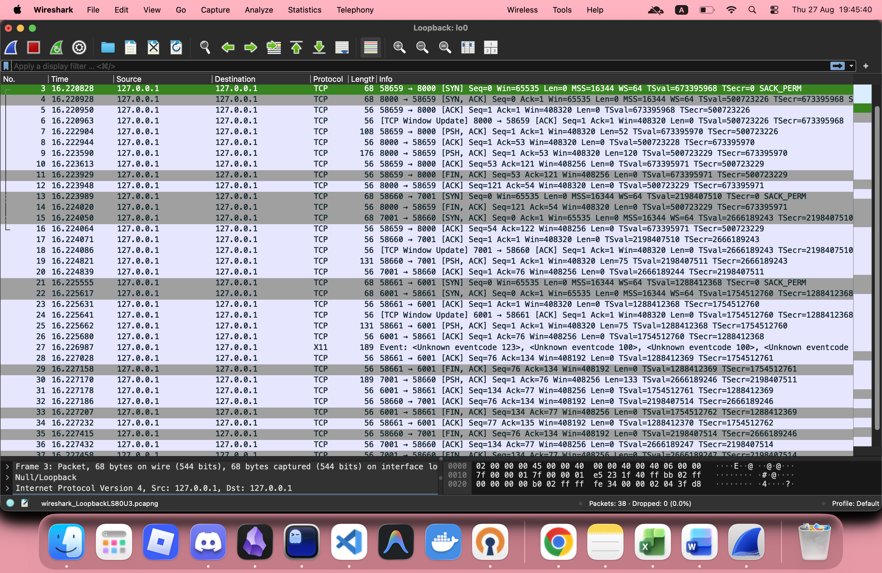
05 · WIRESHARK VERIFICATION
Proof, not just a claim
Full 3-way handshake (SYN / SYN-ACK / ACK) on every connection
3 separate TCP connections per bid: Client-Registry, Client-Proxy, Proxy-Server
Each connection is short-lived — opened, used once, closed
Payloads are plaintext JSON carrying "protocol":"BAP/1.0"
14

Slide 15
05 · WIRESHARK VERIFICATION
Where BAP/1.0 actually lives
Application
BAP/1.0 — our own JSON message design
Not WebSocket
WebSocket needs an HTTP Upgrade handshake (101 Switching Protocols) and its own binary frame format (RFC 6455) after the TCP handshake. BAP/1.0 skips both — it's raw TCP socket programming with a custom JSON protocol on top, nothing more.
Transport
TCP — 3-way handshake, ports, in-order delivery
Network
IP — destination 127.0.0.1 (same host)
Link
Loopback interface (lo) — no physical NIC involved
15

Slide 16
LOOKING AHEAD
Known limitations
Registry has no heartbeat/TTL — a crashed Proxy stays "registered" until restarted
1
Registry state itself isn't persisted — a Registry restart requires all Proxies to re-register
2
The Server lock only checks PIDs on the same machine — no cross-host guarantee
3
Audit logs are append-only and unbounded — no rotation yet
4
Snapshot writes happen on every accepted bid — fine at this scale, would need batching under very high load
5
16

Slide 17
Thank you
Live demo next — BAP/1.0 running end to end over TCP
Pomdet Foong • github.com/chrisfoong

