Slide 1


Molecular Interactions and Network Analysis From raw data to network analysis: PSICQUIC and Cytoscape
Pablo Porras Millán, IntAct

Slide 2
Session outline
Protein interactions and PPI databases introduction
IntAct as an example of a PPI database
The problem of data integration and PSICQUIC
Network representation and analysis: strategies and limitations.
Introduction to Cytoscape
Cytoscape hands-on session:
Importing and representing PPI data.
Representing external information in a network.
Topological analysis: cluster search with clusterMaker2.
GO enrichment analysis using the BiNGO app.

Slide 3
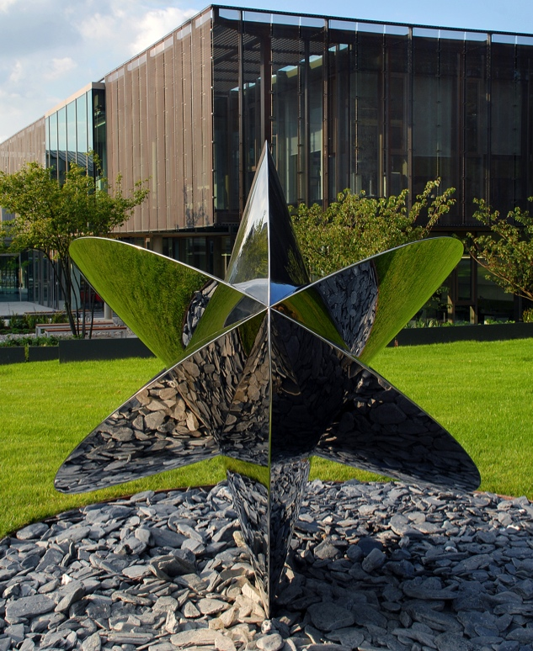
What is EMBL-EBI?
Part of the European Molecular Biology Laboratory
International, non-profit research institute
Europe’s hub for biological data services and research

Slide 4
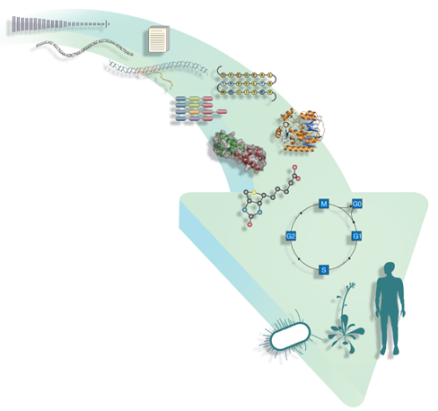
Data resources at EMBL-EBI
Literature & ontology
Europe PubMed Central
Gene Ontology
Genomes & variation
Ensembl
Ensembl Genomes
Genome-phenome archive
Metagenomics
Nucleotide sequences
European Nucleotide Archive (ENA)
Expression
Array Express
Expression Atlas
PRIDE
R-Workbench
Molecular structures
Protein Data Bank in Europe
PDBsum
ProFunc
Proteins
The Universal Protein Resource (UniProt)
InterPro
Chemical biology
ChEMBL
ChEBI
Systems
BioModels
Enzyme Portal
BioSamples
Patent sequences
Non-redundant patent sequence dbs
Patent compounds
Pathways
IntAct
Reactome
Metabolights

Slide 5
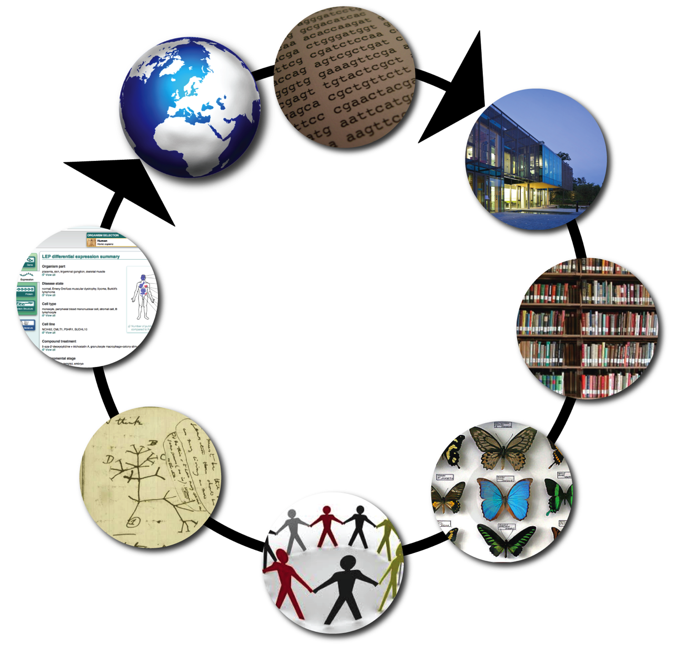
What services do we provide?
Labs around the world send us their data and we…
…provide tools to help researchers use it
A virtuous circle
Archive it
Analyse it
Classify it
Share it with other data providers

Slide 6
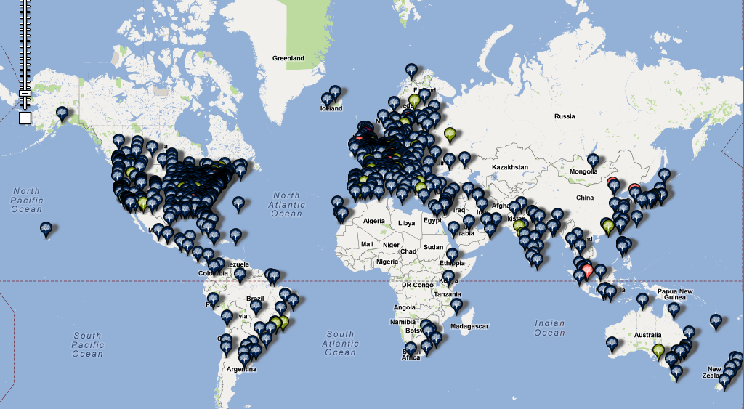
EMBL-EBI users: a snapshot

