Slide 1

The problem of data integration and an example of a solution: PSICQUIC
Sandra Orchard &
Pablo Porras Millán, IntAct
orchard@ebi.ac.uk
pporras@ebi.ac.uk

Slide 2
Molecular interaction information
Ideally
Reality
DB
DB
DB
DB
DB
I
I
I
I
I
Database
I
Interface
User
Notes:
As a biologist I would prefer to see all the information in one unique database.
Centralized databases have this mission.
The aim to collect all the information for one specific domain.
However …
Medium-size labs and organizations are capable to produce large amounts of data.
Then it becomes harder to submit data to centralized repositories.
Moreover data producers like to control and structure their own databases, developing their own GUI and access protocols.
For us, the users, it becomes harder to access the information.
For one specific domain we might find different databases, using different GUIs. We might end up downloading data in different formats complicating the integration of results. After integration we might find a problem of high redundancy in our results.

Slide 3

Molecular interaction resources
547 resources!
www.pathguide.org/

Slide 4
Utility of Bioinformatics
Scientific impact
Too little
bioinformatics
Too many databases
Too diverse interfaces
Tim Hubbard

Slide 5
Data integration
Combining data residing in different sources
… providing users with a unified view of these data.
Ideally
Reality
Compromise
DB
DB
DB
DB
DB
DB
DB
DB
DB
I
I
I
I
I
STANDARDS AND ONTOLOGIES
I
Database
I
Interface
User

Slide 6
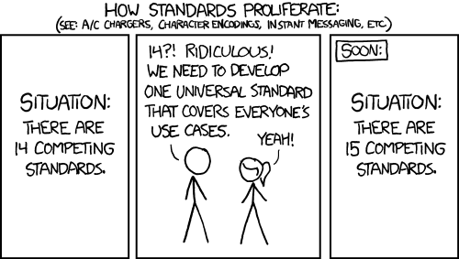
The danger with standards…
From xkcd: http://xkcd.com/927/

Slide 7
Data integration problems
Many data resources
Many to maintain
New appearing
Just 20% has a sustained future*
Not easy to find them
Different query interfaces
Variable results
Formats
Schemas
Controlled vocabularies
Minimum information guidelines
Redundancy
Inconsistency
data integration?
* Merali et al., 2005, Nature, PMID: 15973369.

Slide 8
Collaboration among data providers
More data coverage
Less redundancy
Less inconsistency
Better data management
Access, exchange, sharing, portability, interoperability, annotation, comparison, verification, representation, integration, reusability.
IntAct
PRIDE
EMBL
…
…
InnateDB
GPMDB
NCBI
DDBJ
MINT
Tranche
DIP
PeptideAtlas
Nucleotide sequences
INSDC
Molecular interactions
IMEx
Protein indentifications
ProteomeXchange

Slide 9


Standards
PSI-MI standards
Common identifiers
Controlled vocabularies
Common formats
Common schemas
Minimum information guidelines
Common query interfaces
www.psidev.info/MI
Control vocabulary
Schema
Format
Identifiers
Reporting
guideline
Data distribution
Notes:
The Molecular Interactions workgroup is concentrating on:
improving the annotation and representation of molecular interaction data wherever it is published, be this in journal articles, authors web-sites or public domain databases
improving the accessibility of molecular interaction data to the user community. By using a common standard data can be downloaded from multiple sources and easily combined using a single parser

Slide 10

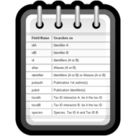




Unified query client: PSICQUIC
www.ebi.ac.uk/Tools/webservices/psicquic/view/main.xhtml
PSI-MI
MIQL
Interactions
Query
input
output
PSICQUIC
PSICQUIC
Service A
PSICQUIC
Service B
PSICQUIC
Service C
PSICQUIC
Registry

Slide 11




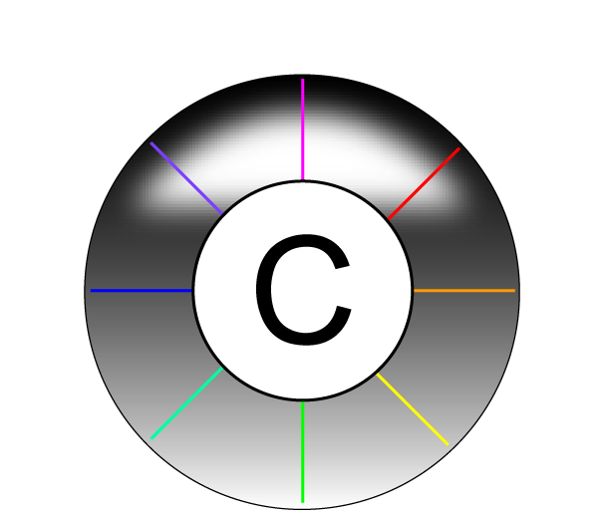





Examples of services using PSICQUIC
www.phisto.org
www.reactome.org
www.cytoscape.org
www.genemania.org
http://mentha.uniroma2.it
http://clipserve.clip.ubc.ca/topfind
http://cbdm.mdc-berlin.de/tools/hippie
www.ebi.ac.uk/Tools/webservices/psicquic/view/main.xhtml
www.bioconductor.org/packages/release/bioc/html/PSICQUIC.html

Slide 12
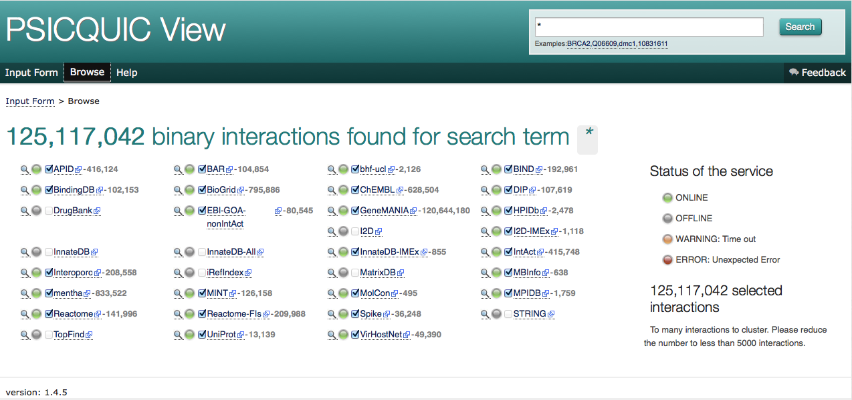
Unified query client interface: PSICQUIC view
www.ebi.ac.uk/Tools/webservices/psicquic/view/main.xhtml

Slide 13
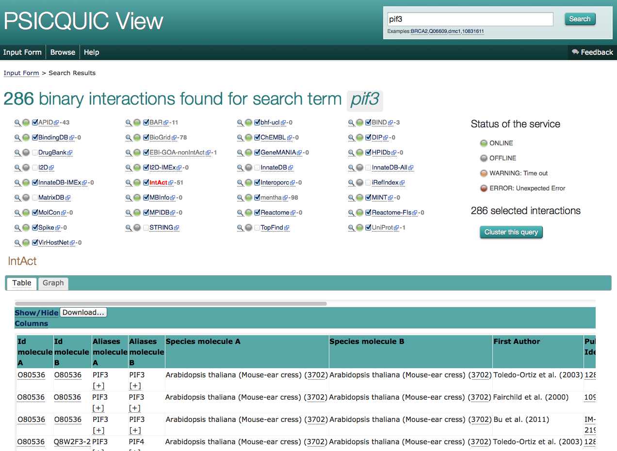
Unified query client interface: PSICQUIC view

Slide 14
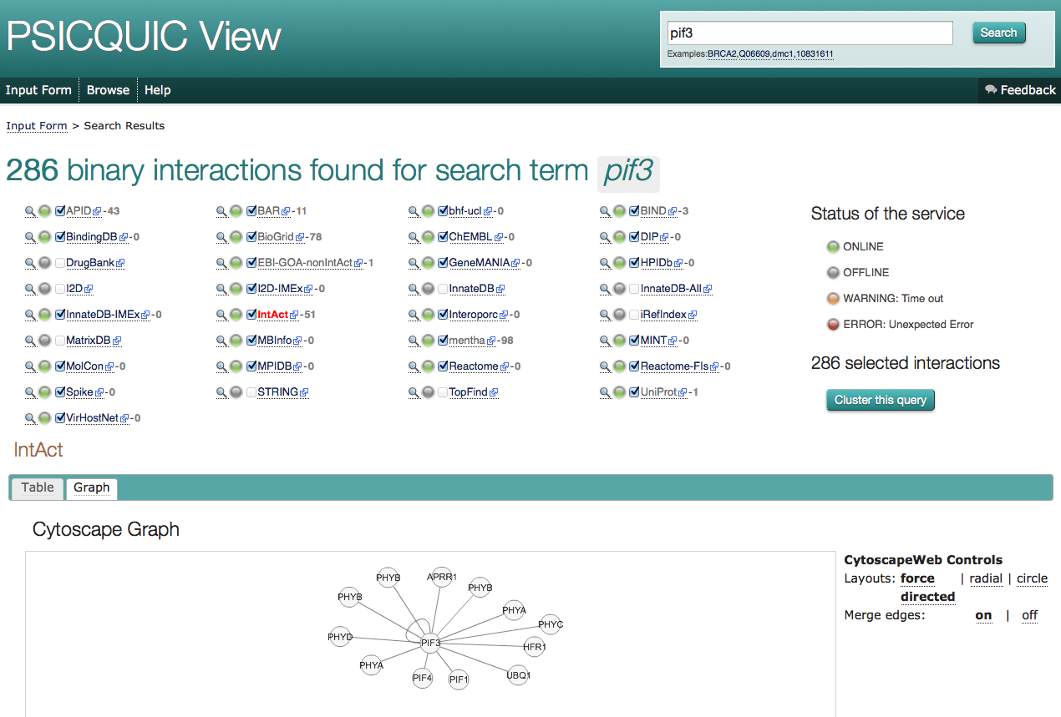
Unified query client interface: PSICQUIC view

Slide 15
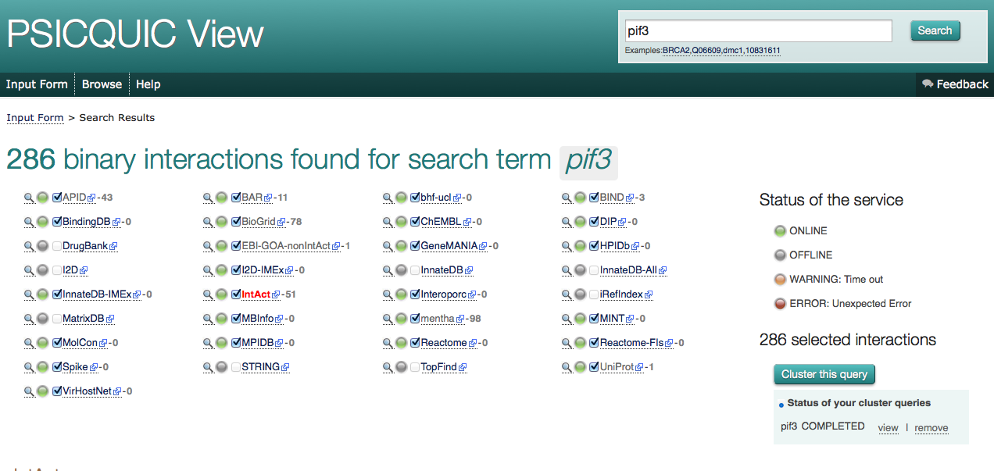
Unified query client interface: PSICQUIC view

Slide 16
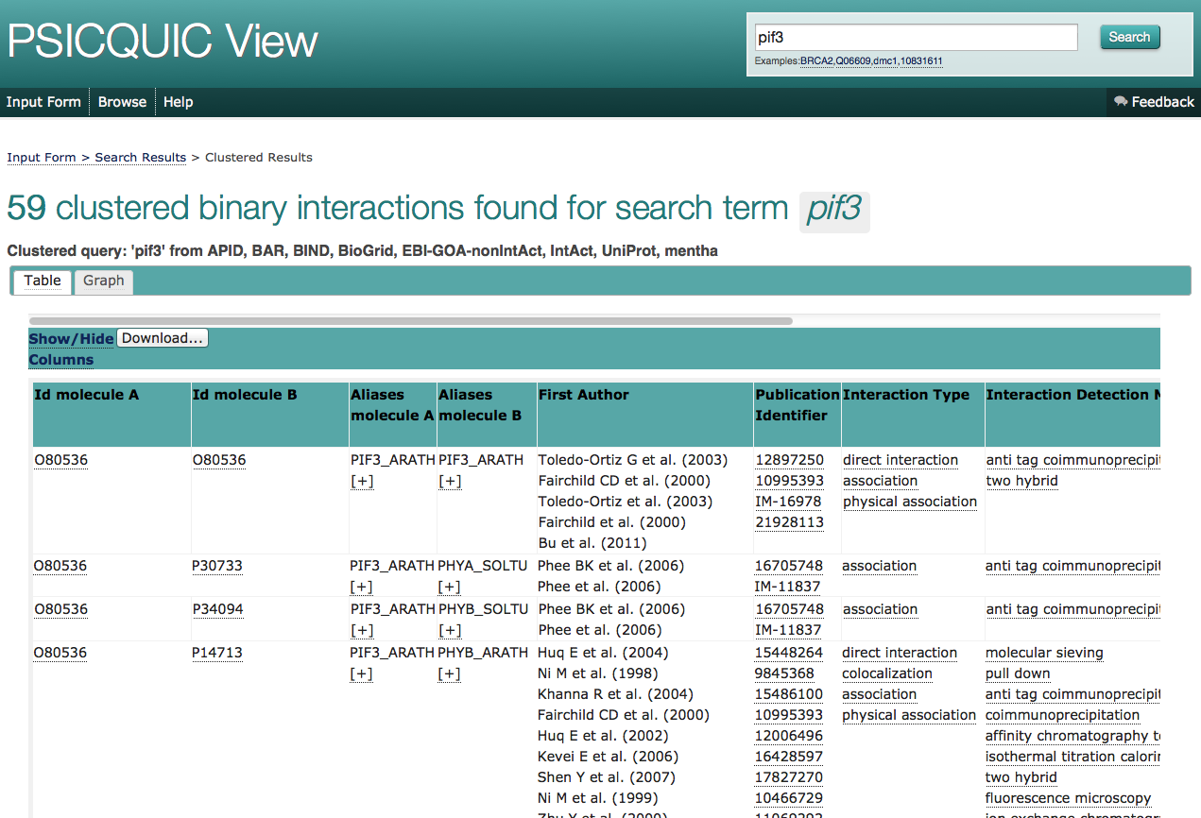
Unified query client interface: PSICQUIC view

Slide 17
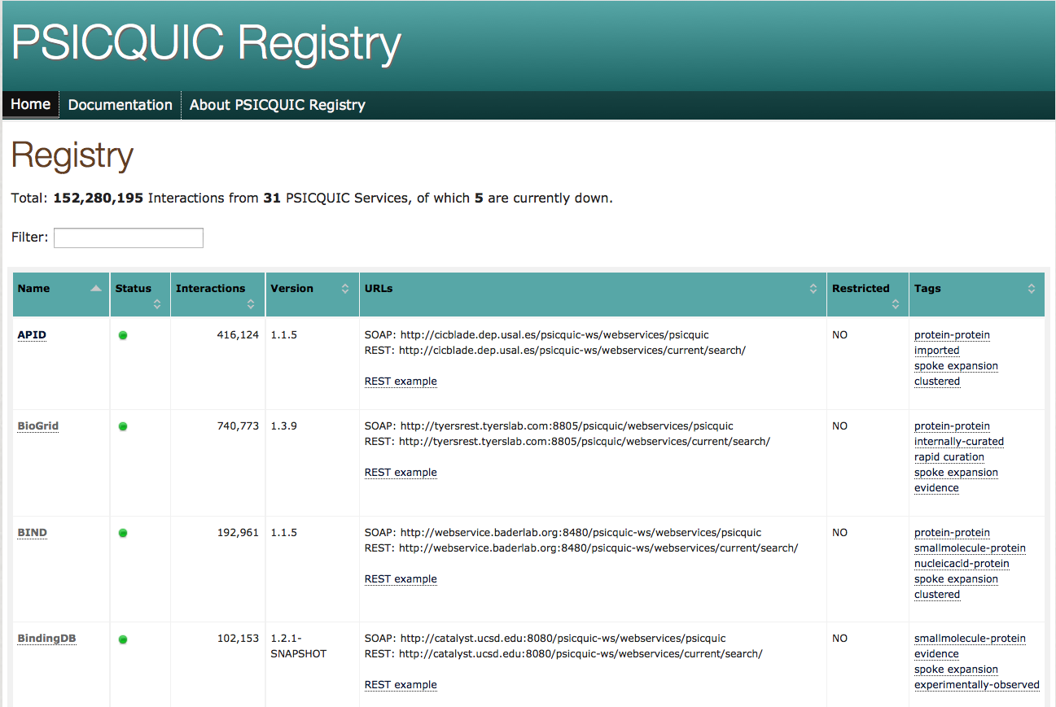
PSICQUIC registry
www.ebi.ac.uk/Tools/webservices/psicquic/registry/registry?action=STATUS

