Slide 1

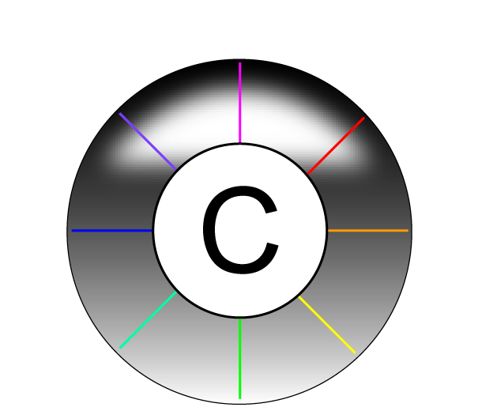
Introduction to Cytoscape

Slide 2
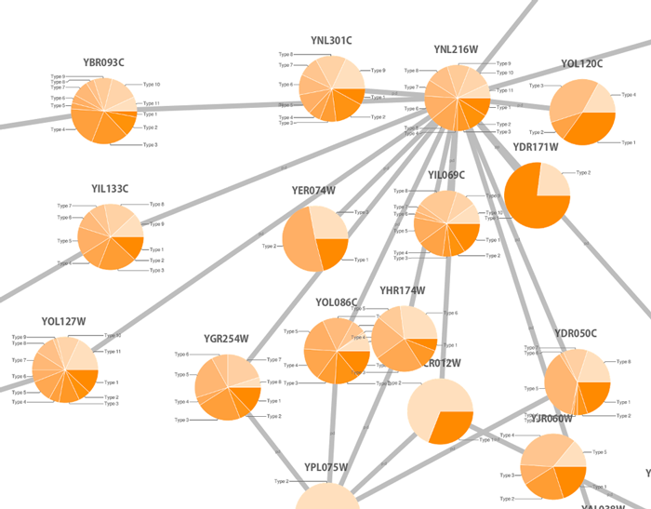
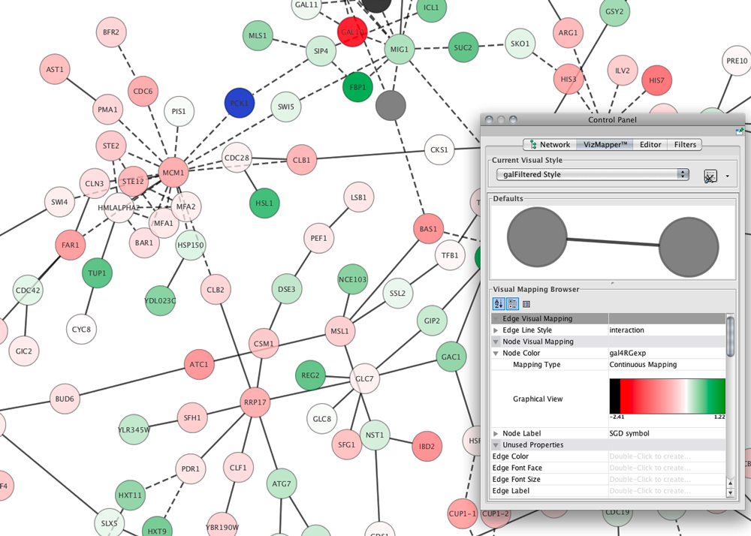
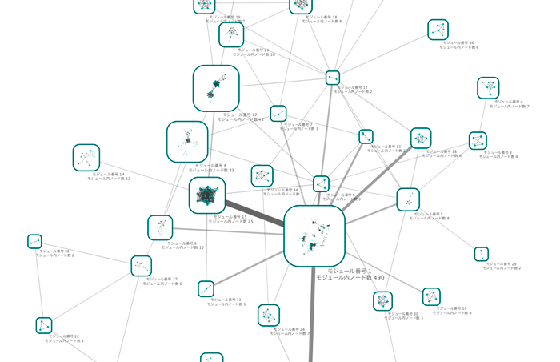
Cytoscape: open-source network representation and analysis tool
www.cytoscape.org
2.8
3.2

Slide 3

Representing PPIs: Why Cytoscape?
www.cytoscape.org
It imports molecular and genetic interaction datasets in several formats.
We will import data from IMEx-complying databases to generate a molecular interaction network using the PSICQUIC Universal Client app of Cytoscape.
It can make use of several visual features that can effectively highlight key aspects of the network.
We will use node and edge columns to represent quantitative proteomics data and interaction features.
It can integrate global datasets and functional annotations.
We will make use of resources such as the Gene Ontology to annotate the interacting partners in our network.
It has a wide variety of advanced analysis and modelling tools in the form of apps that can be easily installed and applied to different approaches.
The BiNGO and clisterMaker2 apps will be used to perform GO enrichment analysis and try to identify the functional modules underlying our network.

Slide 4
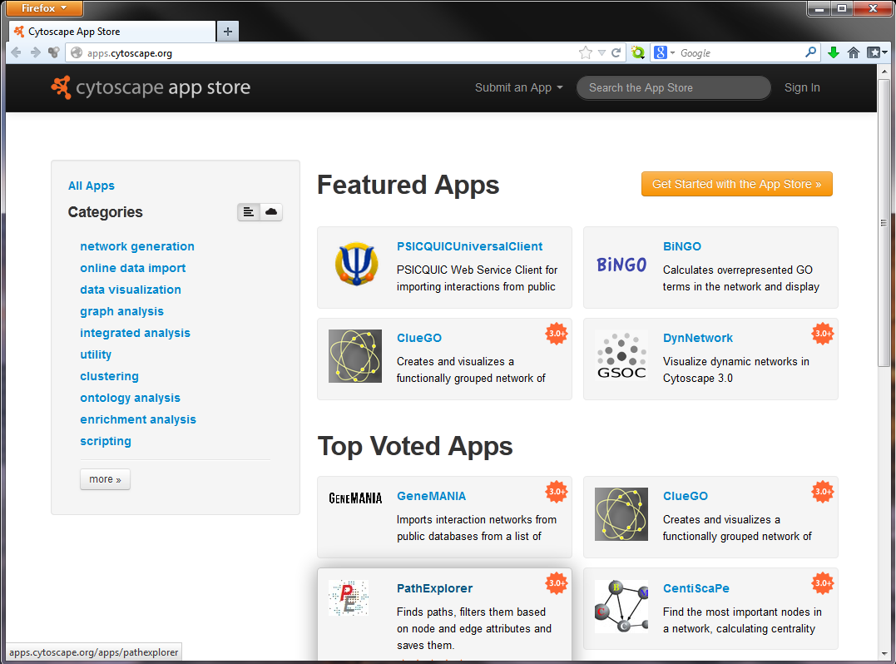
Cytoscape apps/plugins
Large variety of apps/plugins (>230)
Great flexibility, adaptable to multiple types of analysis, in various domains of knowledge: bioinformatics, social network analysis, semantic web…
Possibility to create your own.
Some deprecated or obsolete
Different functionality depending on the Cytoscape version
“A travel guide to Cytoscape plugins.”
Saito et al., 2012, Nature Methods, PMID: 23132118.

