Slide 1
Principles of Training
Train the Trainer, 2016
Part Two
Chris Taylor
Bioinformatics and Biomathematics Training Coordinator

Slide 2
"What I Hear, I Forget.
What I See, I Remember.
What I Do, I Understand."
⎯ Confucius

Slide 3
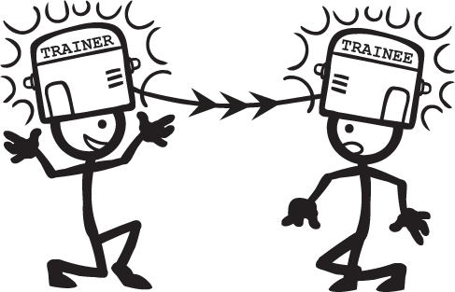
What is training?
Transferring knowledge or abilities from trainer to trainee(s)

Slide 4
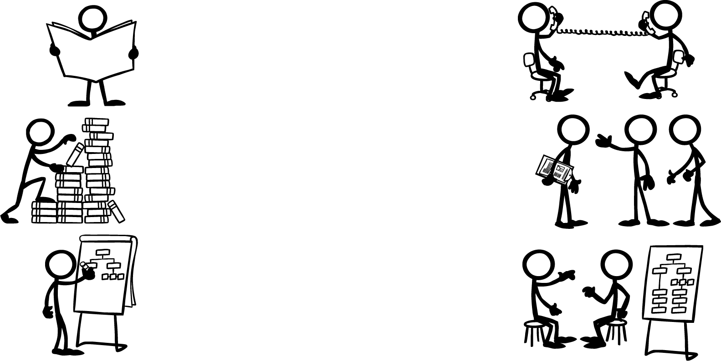

It’s a little more complicated than that…
Assess the knowledge, abilities, wants and needs of your trainees

Slide 5
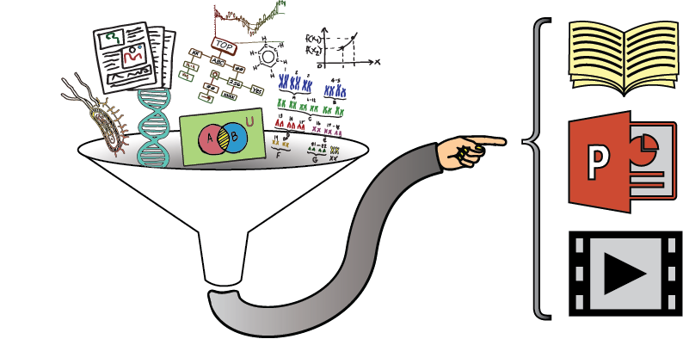
It’s a little more complicated than that…
Assess the knowledge, abilities, wants and needs of your trainees
Deconstruct subject knowledge to make a learning path

Slide 6
It’s a little more complicated than that…
Assess the knowledge, abilities, wants and needs of your trainees
Deconstruct subject knowledge to make a learning path
Generate and deliver materials and activities

Slide 7
The training triplet
Knowledge structures
The learning cycle
Learning styles
How individuals prefer to receive and explore new information
Addresses personality types and preferred sensory modalities
Our internal representation of the context and detail of a topic
Similar to the scientific method (also a learning process):
The process of absorbing and structuring new knowledge
observe → hypothesise → test → analyse [→ repeat ]
Resolving differences in representations → cognitive load
Others’ internal representations will differ (to some degree)
Good training should address several learning styles at once

