Slide 1

CSCI 6313 Blockchain – A5
Professor: Dr. Peter Bodorik
TA: Christian Gang Liu
Notes:
Hi, everyone, we are going to discuss abou the usages of remix, my name is Chirs, TA of this course.

Slide 2
Objectives
Implementation guidance of Assignment 5.

Slide 3
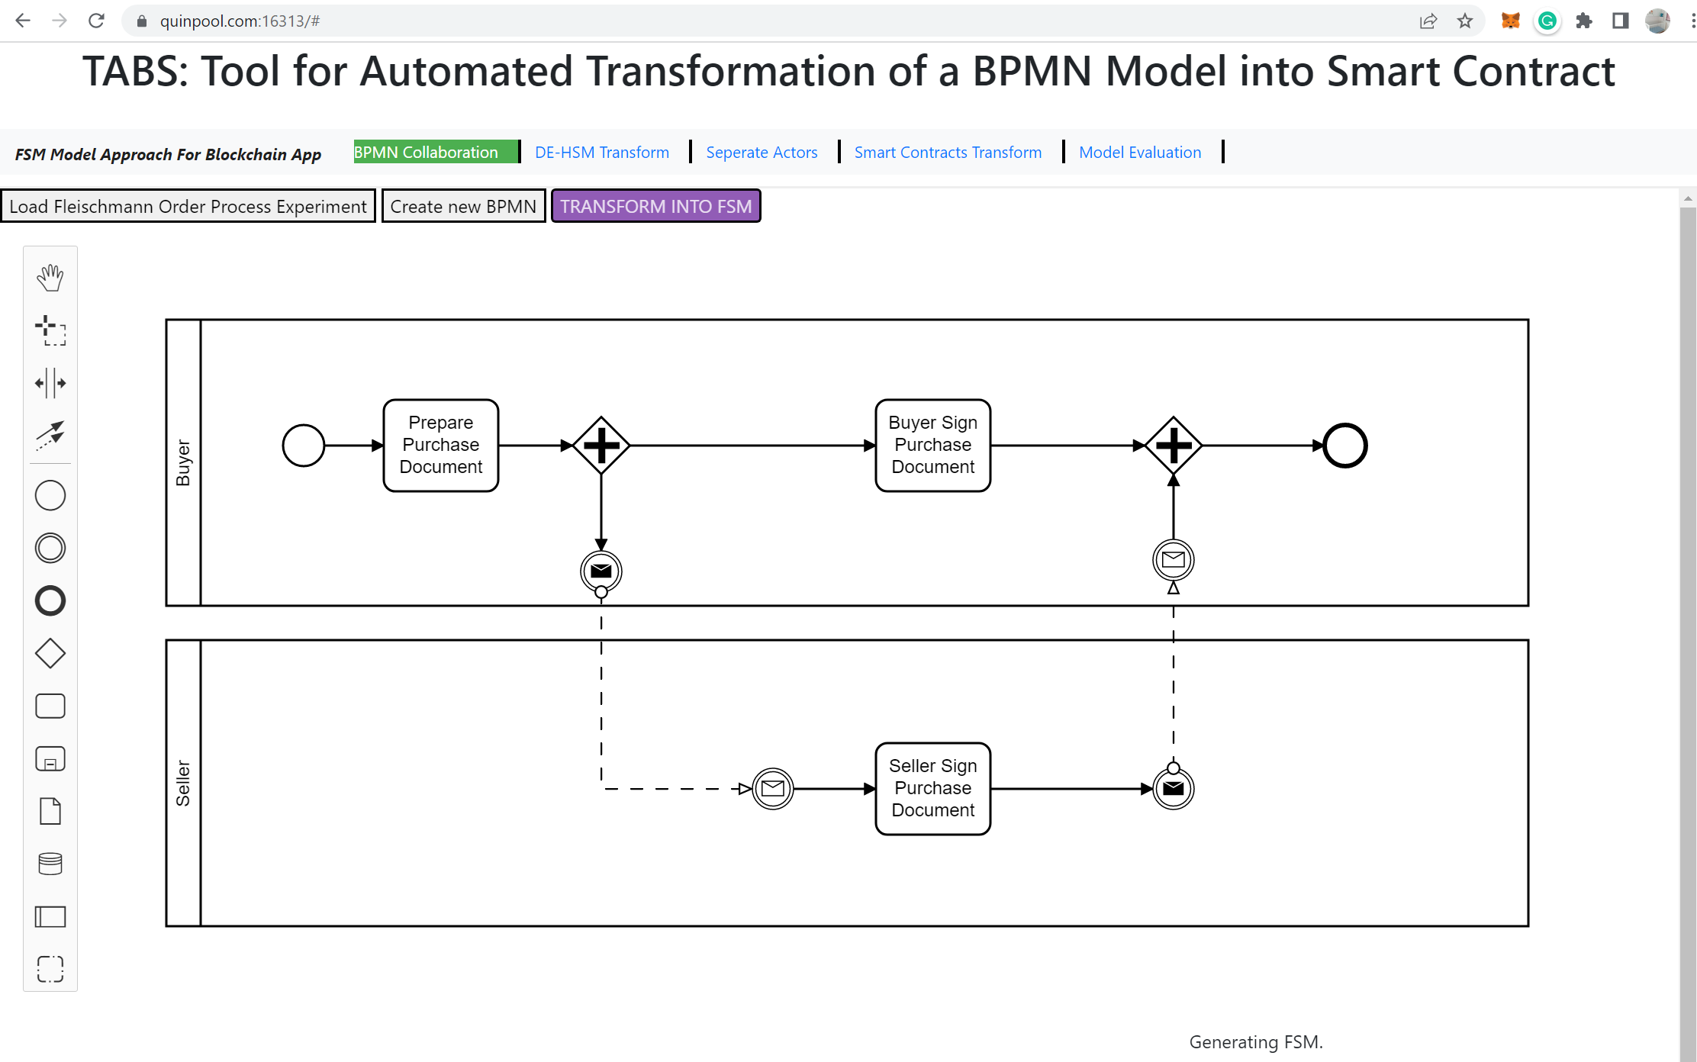
Step 1 – access tool
Use the TABS tool to create a BPMN, wherein the TABS tools is accessible at: https://quinpool.com:16313/#
Notes:
Another way to compare the various public cloud vendors is to look at how they describe themselves. Each of the leading cloud computing companies uses slightly different language to advertise its services, and comparing that language can help enterprises understand what each company perceives as its relative strengths.

Slide 4
Step 2 – generalize the smart contracts
DE-HSM Transform -> Separate Actors -> Smart Contracts Transform
Notes:
Another way to compare the various public cloud vendors is to look at how they describe themselves. Each of the leading cloud computing companies uses slightly different language to advertise its services, and comparing that language can help enterprises understand what each company perceives as its relative strengths.

Slide 5
Step 3 – edit and copy smart contracts into a Ethereum based project, e.g. A2
erc20_tokens.sol: https://github.com/chrisgangliu/6313-assignment5-skeleton/blob/main/erc20_tokens.sol
This smart contract is a ERC20 token used for our application.
actorFSM.sol: https://github.com/chrisgangliu/6313-assignment5-skeleton/blob/main/actorFSM.sol
This is the abstract smart contract that is inherited by the generated smart contract.
partial_on_chain.sol: https://github.com/chrisgangliu/6313-assignment5-skeleton/blob/main/partial_on_chain.sol
This smart contract is a coordinator that should be deployed on a public blockchain, such as rinkeby. It is used as a mainchain smart contract that invokes the methods of the other smart contracts.
S1_Buyer.sol: https://github.com/chrisgangliu/6313-assignment5-skeleton/blob/main/S1_Buyer.sol
This is the S1 buyer smart contract that should be deployed on a local/private blockchain, such as Ganache.
S3_Buyer.sol: https://github.com/chrisgangliu/6313-assignment5-skeleton/blob/main/S3_Buyer.sol
This is the S3 buyer smart contract that should be deployed on a local/private blockchain, such as Ganache.
S3_Seller.sol: https://github.com/chrisgangliu/6313-assignment5-skeleton/blob/main/S3_Seller.sol
This is the S3 seller smart contract that should be deployed on a local/private blockchain, such as Ganache.
Notes:
Another way to compare the various public cloud vendors is to look at how they describe themselves. Each of the leading cloud computing companies uses slightly different language to advertise its services, and comparing that language can help enterprises understand what each company perceives as its relative strengths.

Slide 6
Step 4 – compile and deploy
Abstract (parent smart contract): (they need to be compiled with 4 child smart contract below) (hint: copy the contents and paste them at the head of each child smart contract)
erc20_tokens.sol
actorFSM.sol
Children:
partial_on_chain.sol: Deploy on public blockchain (e.g. Rinkeby)
S1_Buyer.sol: Deploy on private/local blockchain (e.g. Ganache)
S3_Buyer.sol: Deploy on private/local blockchain (e.g. Ganache) s
S3_Seller.sol: Deploy on private/local blockchain (e.g. Ganache)

Slide 7
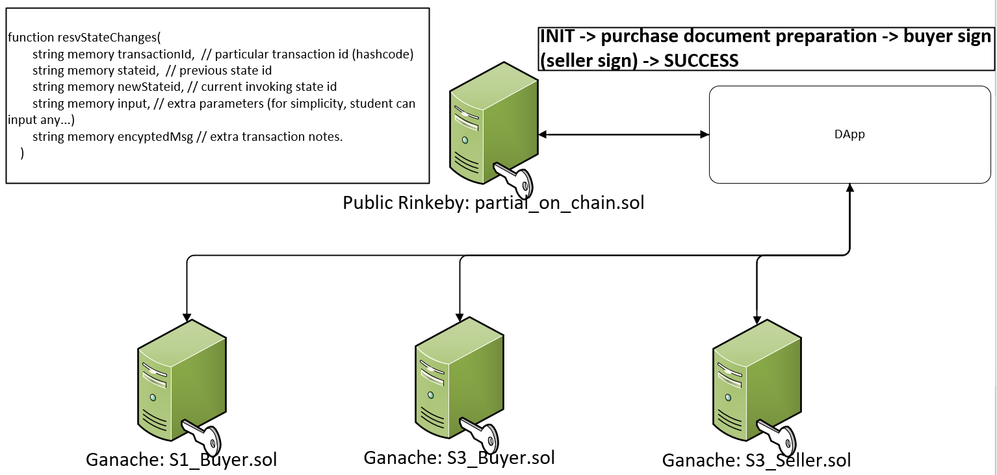
Step 5 – Application Invocation
Notes:
In the application (A2), create a container to remember deployed smart contract location (such as Blockchain endpoint (different blockchain has different endpoint), smart contract deployment address));
In the application, create a queue to store the invocation order. For instance ( INIT -> purchase document preparation -> buyer sign (seller sign) -> SUCCESS);
In the application, create a function to look up the appropriate functions defined in the smart contract for a particular invocation mapping to the one-state defined in the queue of step 2.
Define a function to invoke the following function (it was defined in each smart contract) with its parameter:
function resvStateChanges(
string memory transactionId, // particular transaction id (hashcode)
string memory stateid, // previous state id
string memory newStateid, // current invoking state id
string memory input, // extra parameters (for simplicity, student can input any...)
string memory encyptedMsg // extra transaction notes.
)
The last step is to define a sequence of invocations following the order defined in step 2.

Slide 8
References
[1] Tool: https://quinpool.com:16313/#
[2] Generated Sample Code: https://github.com/chrisgangliu/6313-assignment5-skeleton/

Slide 9


