Slide 1
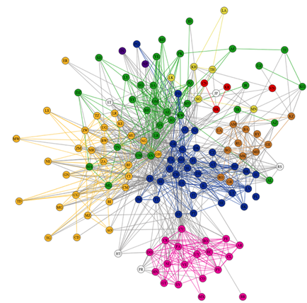


Customer Analytics with R
Open Coffee Demo December 19, 2014
Chris Garcia
cgarcia@umw.edu
chris@blueshiftanalytics.com

Slide 2
What is R?
Open source statistical computing environment
www.r-project.org
Used for lots of very interesting things
Social media and text mining
Marketing analytics
Cancer research
Drug discovery
Lots of other things too …
Tons of packages (and all peer-reviewed)
Today’s discussion: Customer Analytics
Code Repo on GitHub:
https://github.com/chrisgarcia001/R_Demos

Slide 3
Demo 1: Customer Segmentation
The Problem:
You want to group customers into different segments so you can appropriately target advertising
No more shotgun ads!
You have:
Customer data with average weekly expenditures across different categories
Solution: Latent cluster modeling
Separate customers into groups based on purchasing patterns

Slide 4
Demo 2: Churn Prediction
The Problem:
Each customer that switches to a competitor or leaves is costly
You want to identify customers likely to leave and give them some TLC to keep them
You have:
Customer demographic and service usage data from the past year, and whether each customer left
Solution: Binary response modeling
Build a predictive model using demographic and usage data
We’ll use Random Forest algorithm

