Slide 1
Identifying target States in USA for SAT participation growth
A statistical analysis of SAT/ACT standardized testing in 2017/2018

Slide 2
A Brief History of SATs and ACTs
College Board was founded in 1899 and designed the first SATs in 1929.
American College Testing (ACT) program was created in 1959.
The two standardized tests have since been widely accepted across US universities hence are direct competitors to one another
In 2010, ACTs overtook the SATs in terms of participation rate
In 2013, SATs underwent a major redesign to better suit the needs of students and colleges.

Slide 3
Exploratory Data Analysis
Data types
SAT/ACT participation rates by state
Individual and total/composite test scores by state
Trends/correlations
SAT vs ACT participation rates
Participation rates vs Mean test scores

Slide 4
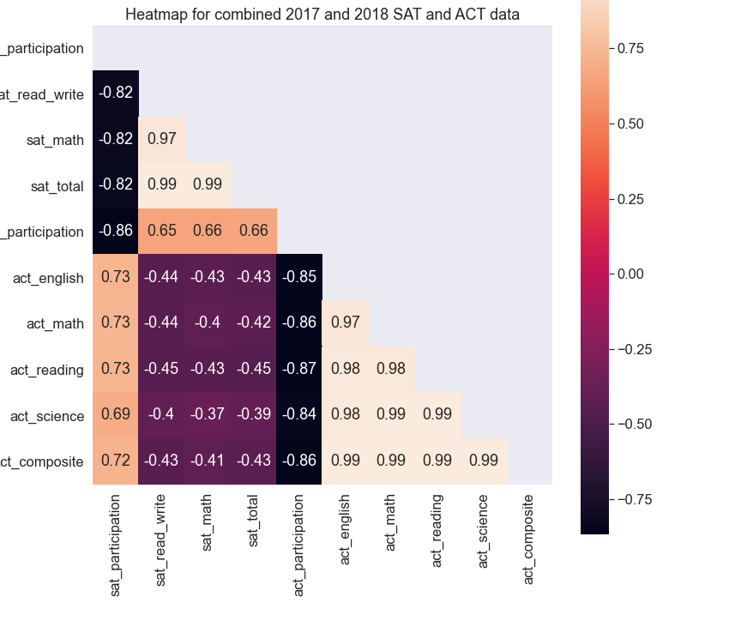
Heatmap
Strong negative correlations between participation rates for both tests. (SAT participation vs ACT participation)
Strong negative correlations between participation rate and mean test score for a given test. (E.g. SAT participation vs SAT test score)

Slide 5
States by lowest and highest mean SAT scores
States with low mean scores tend to have higher participation rates
Interesting exception is West Virginia which has a moderately low participation rate and low mean total score.
2017 SAT lowest mean scores
State | Mean Total Score | Participation Rate
District of Columbia | 950 | 100 %
Delaware | 996 | 100 %
Idaho | 1005 | 93 %
2017 SAT highest mean scores
State | Mean Total Score | Participation Rate
Minnesota | 1295 | 3%
Wisconsin | 1291 | 3%
Iowa | 1275 | 2%
2018 SAT lowest mean scores
State | Mean Total Score | Participation Rate
District of Columbia | 977 | 92%
Delaware | 998 | 100 %
West Virginia | 999 | 28%
2018 SAT highest mean scores
State | Mean Total Score | Participation Rate
Minnesota | 1298 | 4%
Wisconsin | 1294 | 3%
North Dakota | 1283 | 2%

Slide 6
Largest changes in SAT/ACT participation
State | SAT 2017 | SAT 2018 | ACT 2017 | ACT 2018
Illinois | 9% | 99% | 93% | 43%
Colorado | 11% | 100% | 100% | 30%
There were significant changes in SAT/ACT participation in Illinois and Colorado
In 2016, College Board won the bid to change the state policy for mandatory standardized testing in Illinois and Colorado.

Slide 7
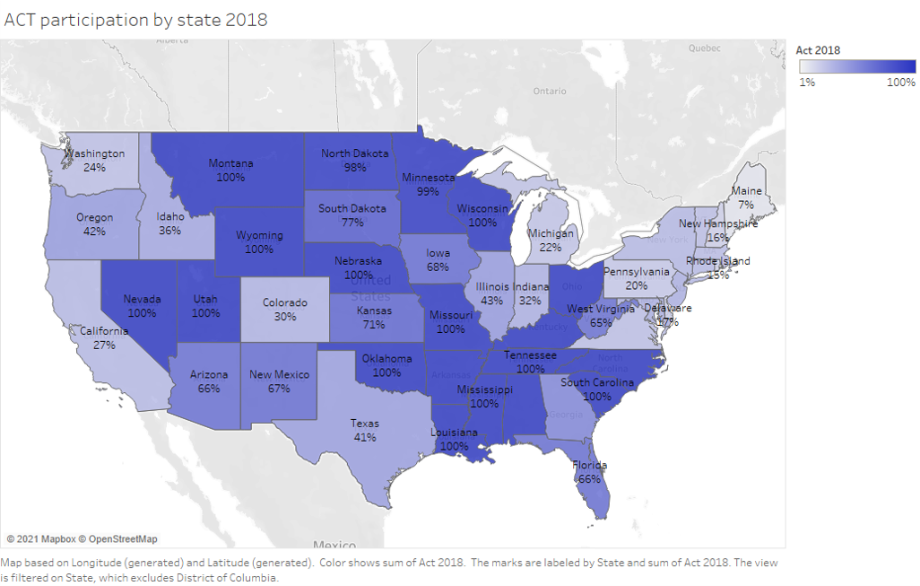
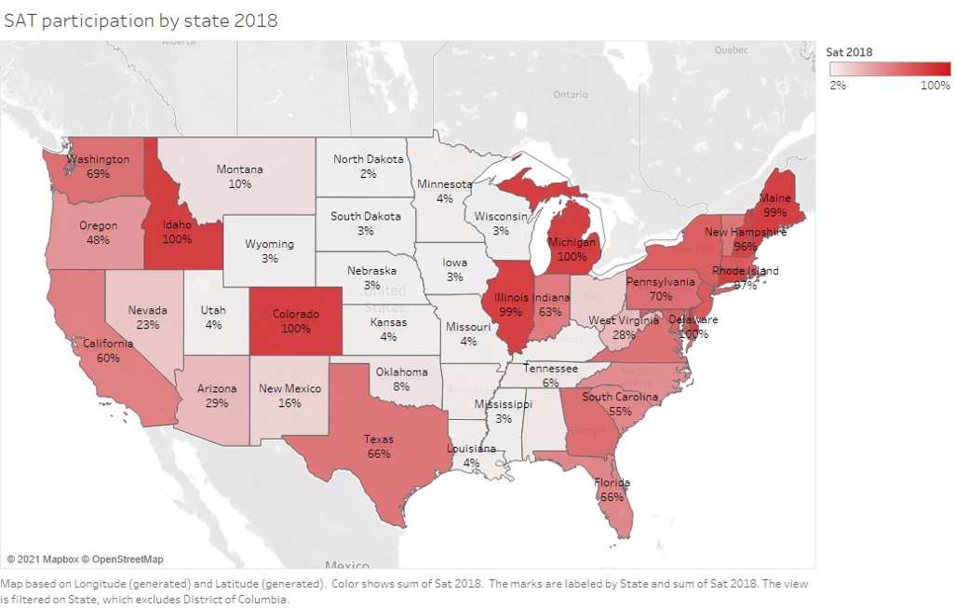

Slide 8
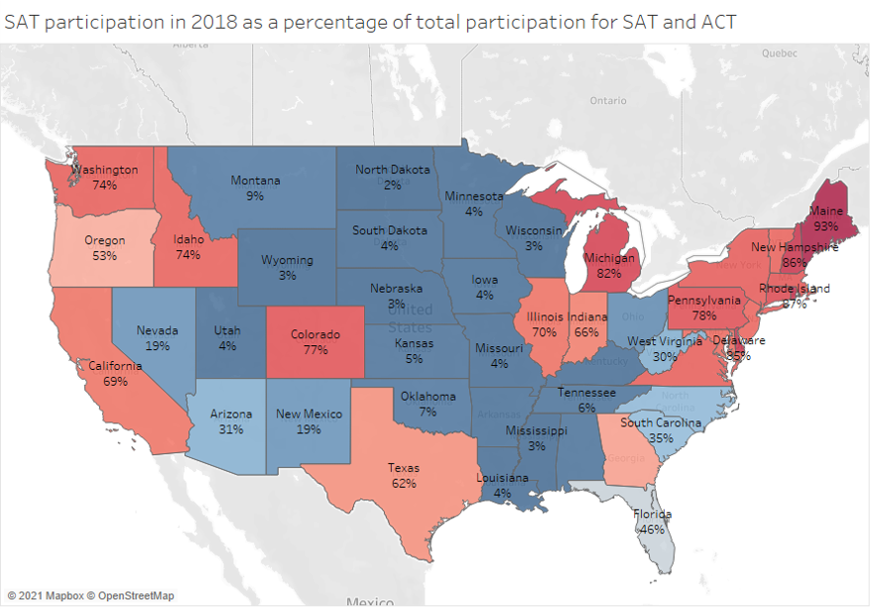
SAT participation in 2018 as a percentage of total SAT and ACT participation
More students take the ACTs than the SATs in West Virginia and South Carolina
South Carolina implements mandatory testing for ACTs, yet participation rate for SATs is > 50%
West Virginia experienced a 100% increase in SAT participation from the previous year despite ACTs being the predominant choice

Slide 9
Recommendation 1: South Carolina
South Carolina | 2017 | 2018
SAT Participation Rate | 50% | 55%
ACT Participation Rate | 100% | 100%
ACT testing is mandatory, yet > 50% of students are taking SATs
The participation rate even increased from 50% in 2017 to 55% in 2018 indicating a growing interest for SATs amongst students there.
With public support amongst students for the SATs, it may be easier to secure a bid to change the state mandates for standardized testing.

Slide 10
Recommendation 2: West Virginia
South Carolina | 2017 | 2018
SAT Participation Rate | 14% | 28%
ACT Participation Rate | 69% | 65%
ACT is the predominant choice in this state.
Yet there was a 100% increase in SAT participation from 2017 to 2018, indicating a strong interest among students there to take the SATs.
This can make for a strong case when bidding for state contracts mandating standardized testing.
Furthermore, West Virginia was amongst the bottom scoring states for the SATs in 2018. This shows that despite the increased interest, there is a need for additional student resources to better prepare them for the test.

Slide 11
Recommendation 3: Alaska
South Carolina | 2017 | 2018
SAT Participation Rate | 38% | 43%
ACT Participation Rate | 65% | 33%
Mandatory testing was dropped in 2016 resulting in a 50% decrease in ACT participation from 2017 to 2018
Yet SAT participation improved by 13% (38% to 43%), showing that students in Alaska continue to show increased interest in taking the SATs.
It would make sense to take advantage of the current trend to increase its rate of growth.

Slide 12
Conclusions
State policies which mandate participation in either SAT or ACT are the largest contributing factors to participation rates.
Lobbying to change state mandates is a good strategy to flip participation rates in favour of SATs
South Carolina was identified to have growing interest for taking the SATs between 2017 and 2018 but have a high ACT participation rate due to existing state policy
West Virginia showed a significant growth in SAT participation, yet ACTs is dominant. Mean test scores are also amongst the lowest indicating a need for additional student resources.
Alaska dropped mandatory testing for ACTs and had an increase in SAT participation. It may be a good idea to take advantage of the current growth trend

