Slide 1
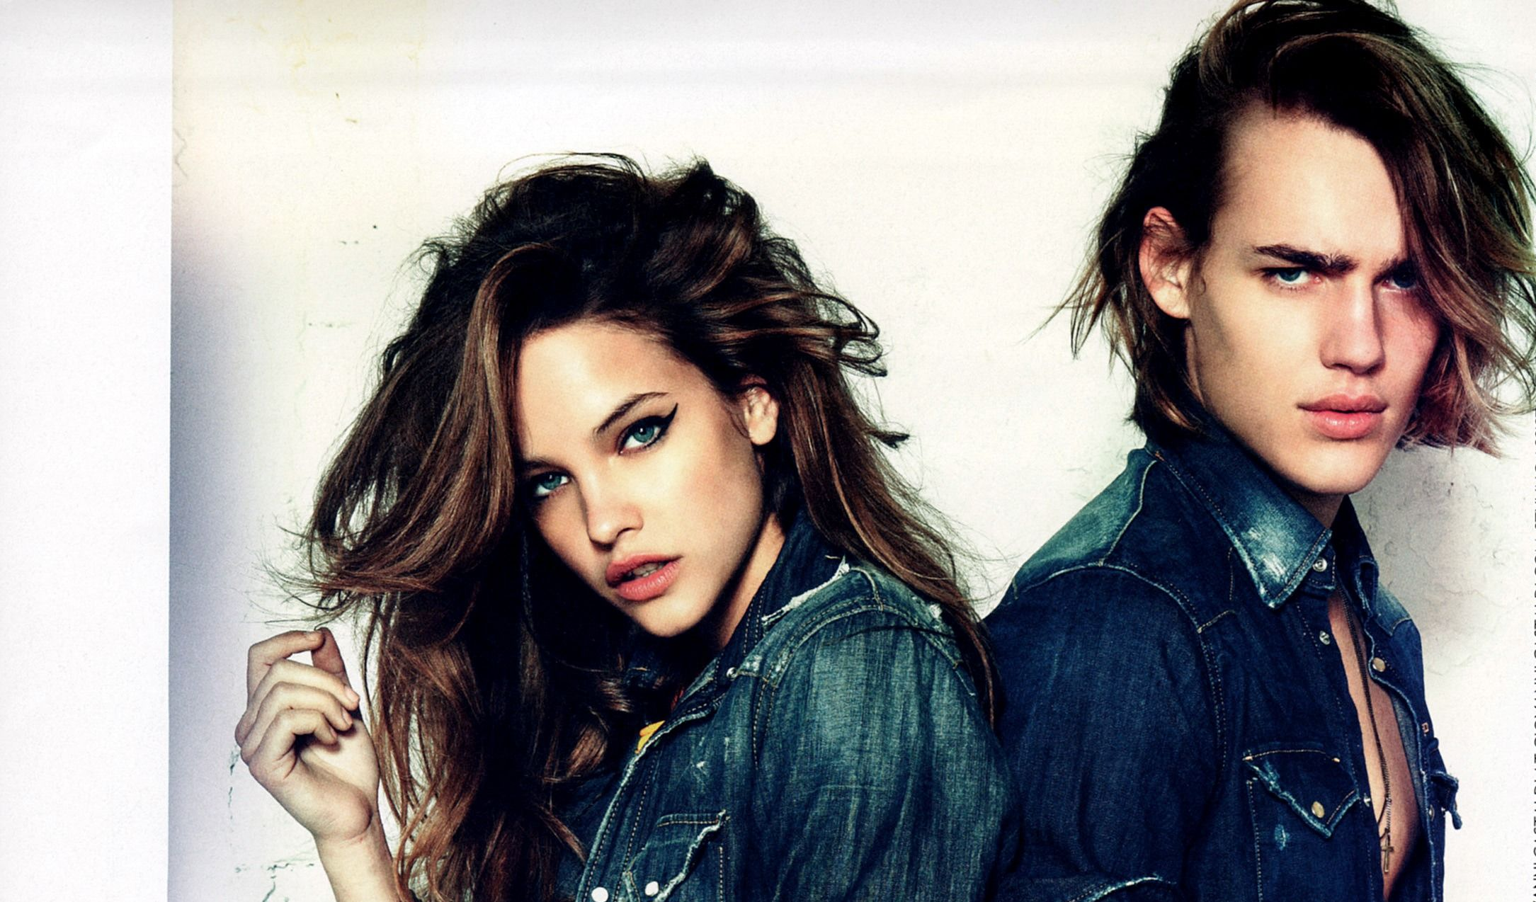
Predicting male and female hair trends from reddit posts
Building a classifier model using natural language processing

Slide 2
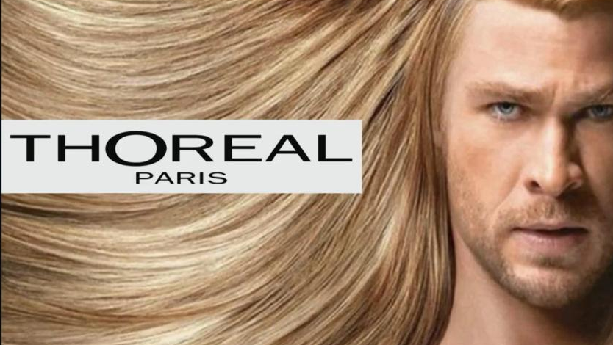
Problem Statement
Primary stakeholders: Stylescout.com
Website which provides advertising and appointment booking services for hair salons in New York City.
Wants to use Search Engine Optimization (SEO) to improve their web traffic.
Secondary stakeholders
People who visit the website site and use its services
Mostly female
Favourable class assigned as female
Objective:
Build a classifier model that can differentiate between male and female hair trends

Slide 3
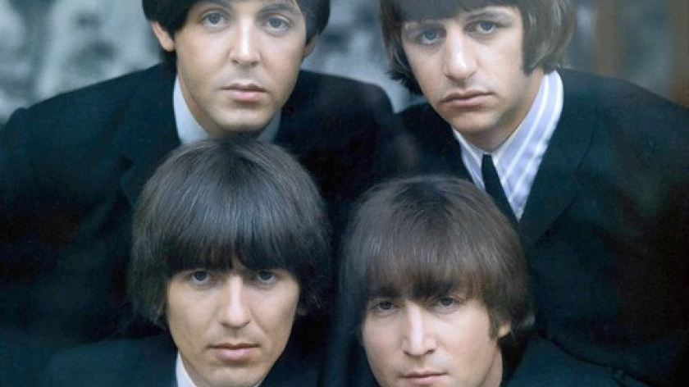
Model Construction Process
Webscraping
Dataset constructed from subreddits r/femalehairadvice and r/malehairadvice
Top 1000 posts from this year were used for each subreddit
Data Cleaning
Lemmatization and tokenization of text data
Count vs Tfidf Vectorizer
Model Comparison and Evaluation
Gridsearch cross validation
4 Models eliminated due to overfitting – K-Nearest Neighbours, Decision Tree, Bagged Decision trees, Adaptive Boost
4 Models tested – Logistic Regression, Naïve Bayes Multinomial, Random Forest, Support Vector
Model Selection
Selection criterion

Slide 4
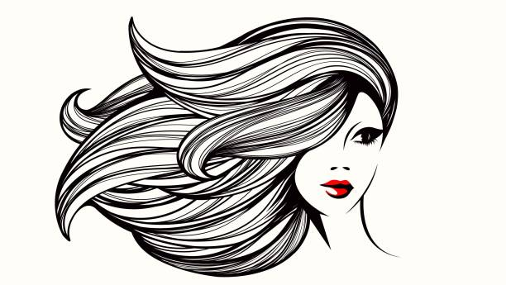
Count vs Tf-idf Vectorizer
Count Vectorizer:
Count Vectorizer – Most common features
Feature | Count | Increase in Odds
cut | 345 | + 4%
look | 312 | - 17%
think | 239 | + 15%
grow | 199 | - 32 %
long | 178 | - 24%
bang | 176 | + 458%
short | 154 | + 20%
year | 130 | - 16%
help | 118 | + 7%
good | 117 | - 14%
Tf-idf Vectorizer:
Tfi-df Vectorizer – Most Important features
Feature | Importance | Increase in Odds
bang | 46.4 | + 17670%
short | 44.4 | + 45%
suit | 34.3 | + 42%
help | 32.8 | - 14%
good | 32.3 | - 41%
thanks | 31.9 | + 79%
year | 31.7 | - 33%
guy | 30.2 | - 63%
suggestion | 29.8 | - 21%
update | 29.1 | + 363%
Features are represented as their raw count.
Only 2 features amongst the top 10 highest occurring features contribute to significant increase in odds (>|25%|)
Value reflects how important a word is in the document relative to the corpus.
8 out of 10 of the most important features contribute significant increase in odds (>|25%|)
The Tf-idf Vectorizer is more suited for use in SEO algorithms as it emphasizes meaningful words.

Slide 5
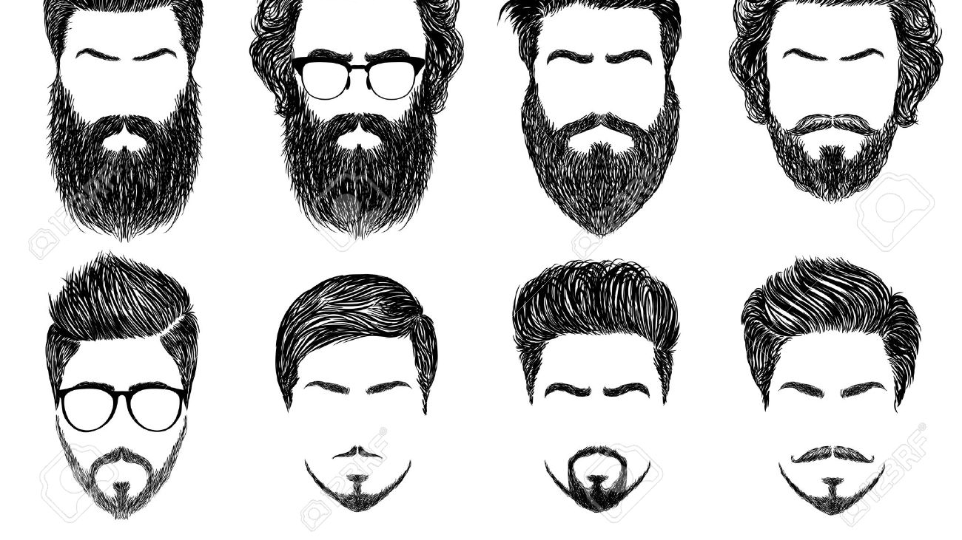
Model Selection Criteria - Overview
Accuracy
Calculated using GridsearchCV
Test model on test set from train/test split
Sensitivity
True positive rate
Optimize for sensitivity = minimize false negatives (predicting r/malehairadvice when actually female)
Robustness
Test model on more unseen data using new posts from both subreddits

Slide 6
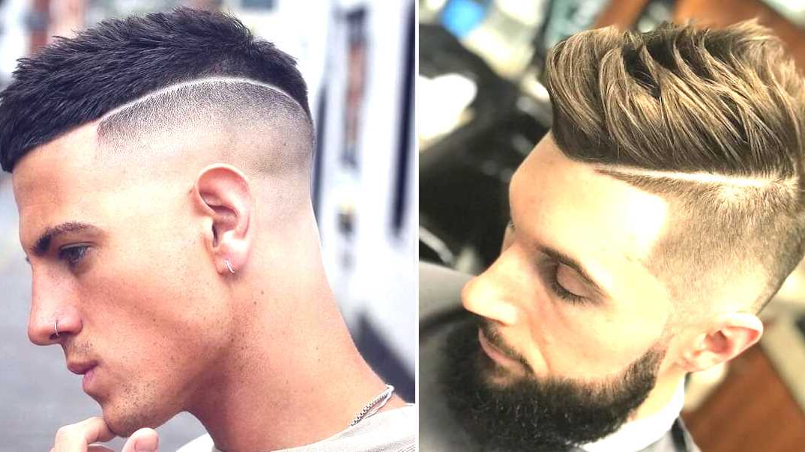
Model Comparison - Accuracy
Baseline Accuracy: 50.2%
All models beat the baseline accuracy
Significant overfitting observed when using Support Vector Classifier
Model | GridSearchCV Accuracy | Train Accuracy | Test Accuracy
Logistic Regression | 81.4% | 90.1% | 82.7%
Naïve Bayes Multinomial | 82.7% | 89.1% | 82.3%
Random Forest Classifier | 80.0% | 89.8% | 80.7%
Support Vector Classifier | 81.7% | 93.5% | 81.1%

Slide 7
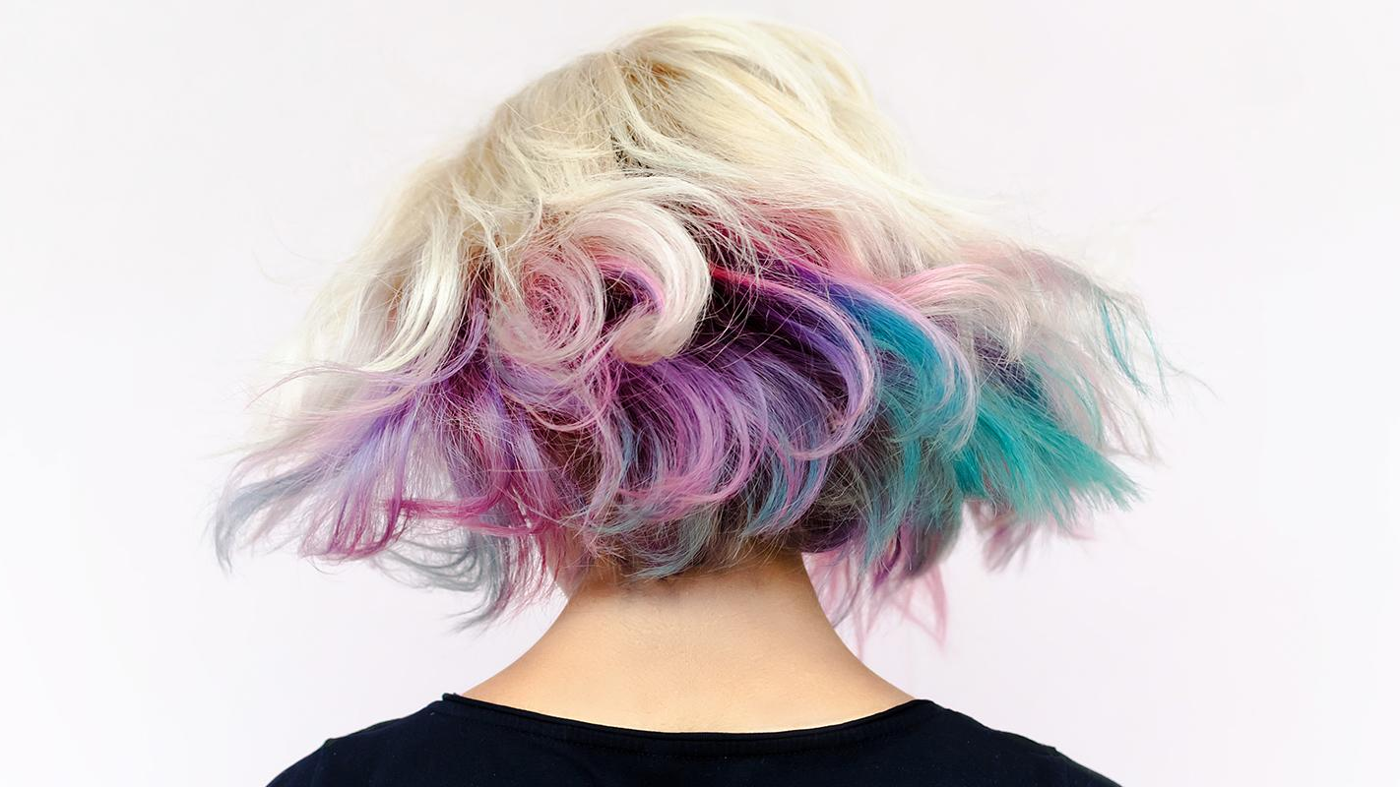
Model Comparison - Sensitivity
Optimizing model sensitivity means to maximize the true positive rate
Secondary stakeholders are mostly women so we want to ensure we predict class = 1 as best as possible.
Best 2 models are Naïve Bayes Multinomial and Logistic Regression
Model | Sensitivity
Logistic Regression | 77%
Naïve Bayes Multinomial | 80%
Random Forest Classifier | 69%
Support Vector Classifier | 71%

Slide 8
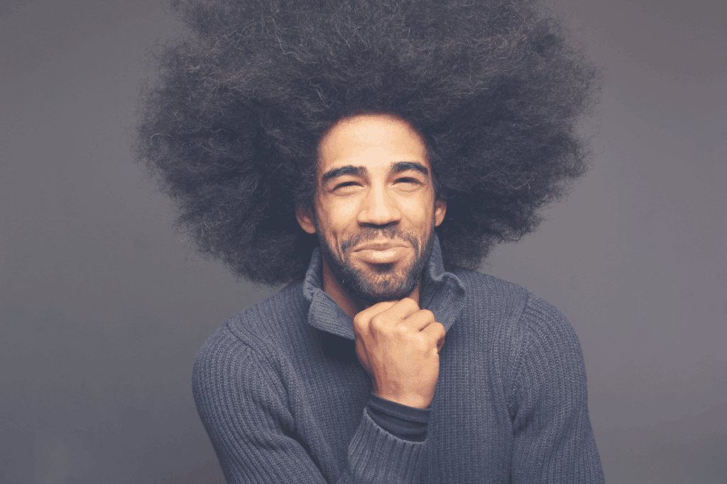
Model Comparison - Robustness
Hairstyle trends tend to change throughout time
Models were tested for robustness using test dataset and additional unseen data scraped from 500 new posts from both subreddits
Accuracy drop is calculated as the difference in accuracy from train accuracy
Models were selected based on the smallest accuracy drop
Model | Train/Test accuracy drop | Test/Unseen accuracy drop
Logistic Regression | 7.4% | 10.4%
Naïve Bayes Multinomial | 6.8% | 7.8%
Random Forest Classifier | 9.1% | 11.6%
Support Vector Classifier | 12.4% | 13.9%

Slide 9
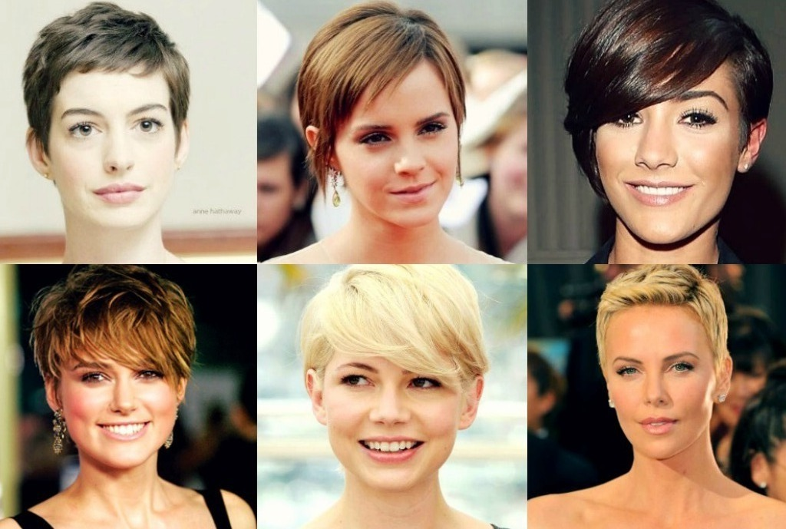
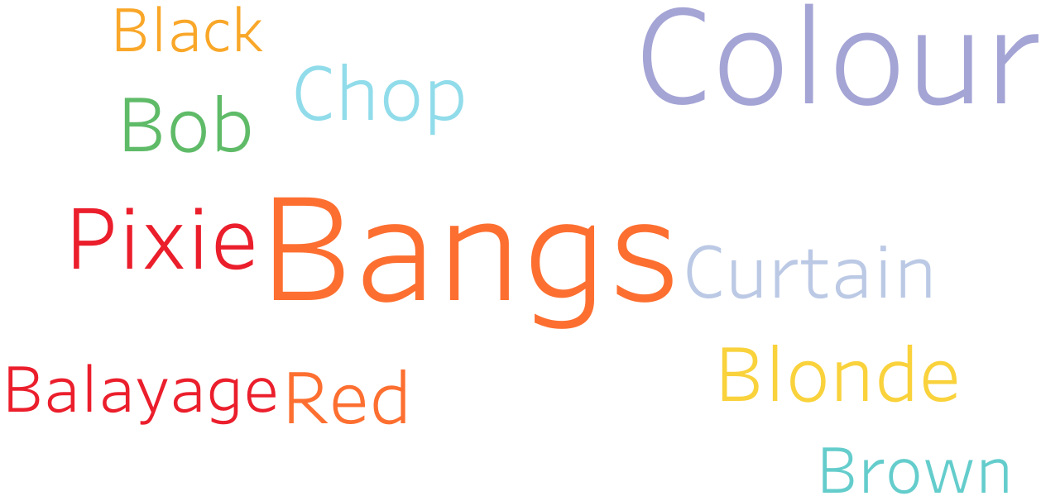
Feature exploration – r/femalehairadvice

Slide 10
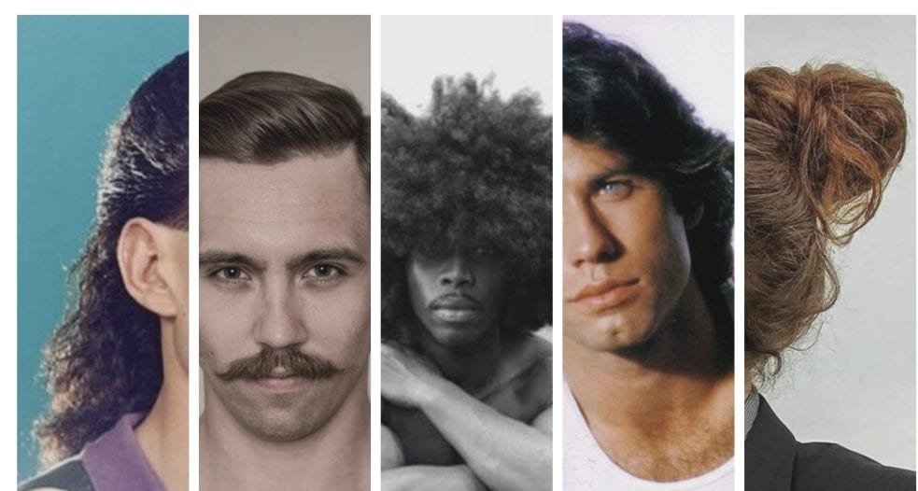
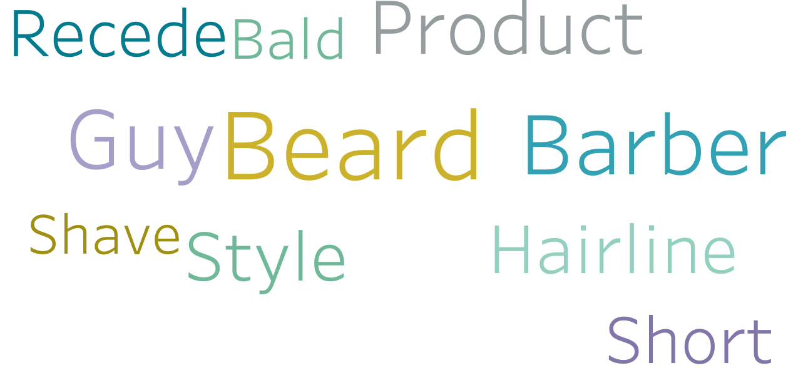
Feature exploration – r/malehairadvice

Slide 11
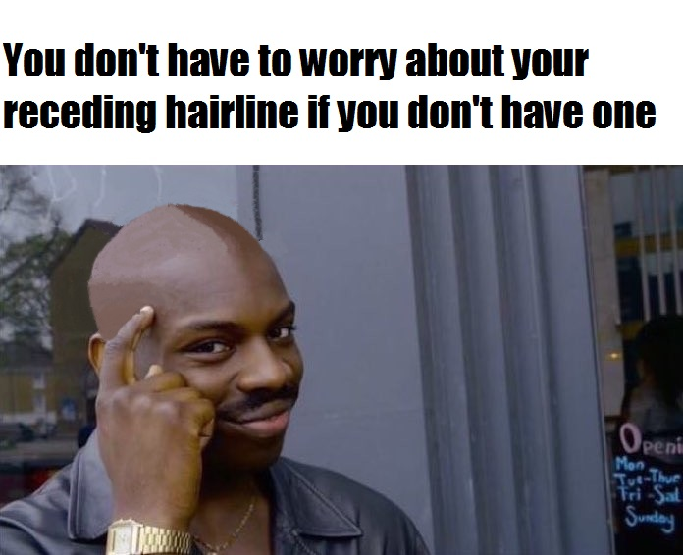
Feature exploration – female vs male vocabulary
Top features that strongly predict r/femalehairadvice are mostly words describing a variety of popular female hairstyles and hair treatments such as colouring
Top features for predicting r/malehairadvice do not contain hairstyles.
Men are concerned with receding hairlines and balding
Predictions for r/malehairadvice rely on masculine language patterns such as ‘guy’, ‘barber’

Slide 12
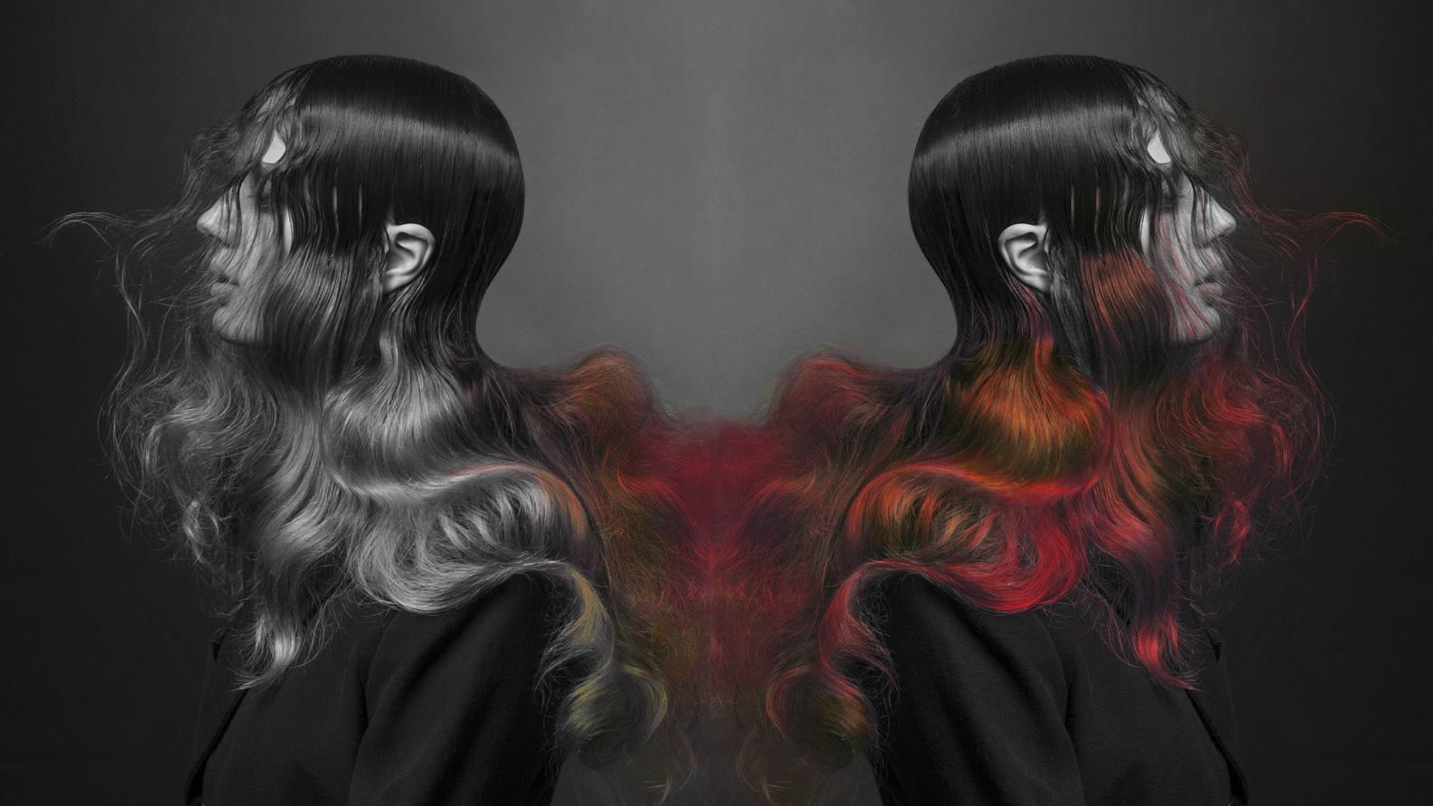
Final Recommendation
Model selected: Naïve Bayes Multinomial Classifier with Tfidf Vectorizer
Tfidf Vectorizer – Recommended for use in SEO algorithm to emphasize features of high importance in relation to the predictive task.
Naïve Bayes Multinomial Classifier performed best out of all models tested in terms of:
Accuracy – Making correct predictions
Sensitivity – Optimizing correct predictions for women (majority of secondary stakeholders)
Robustness – Good at generalizing to new data (e.g. changing hairstyle trends)

Slide 13
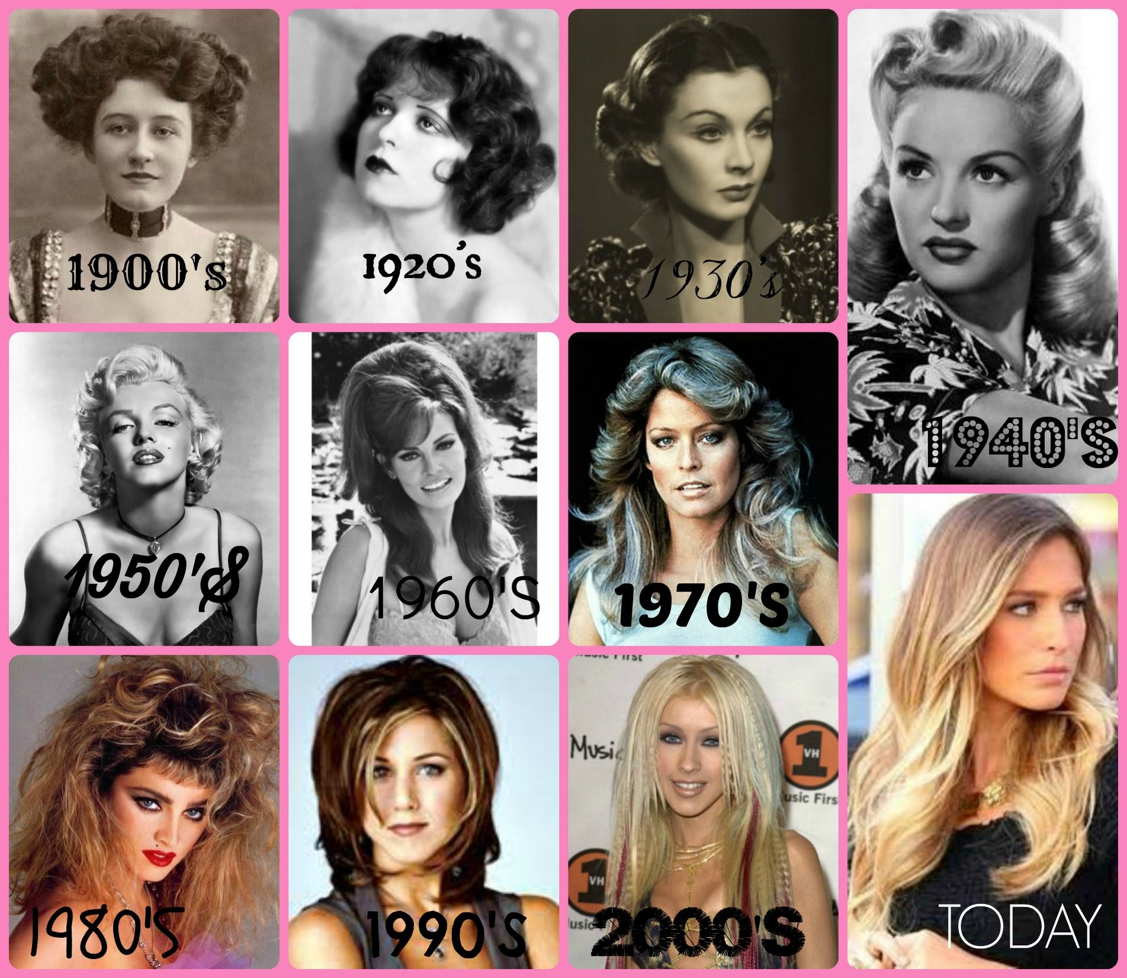
Model Limitations and Future Work
Inherent disadvantage of Naïve Bayes Model is assuming features are independent.
In reality, it is near impossible to obtain a dataset with mutually independent features.
Major limitation in the fact that hairstyle trends change thus the model might become irrelevant over time.
Can retrain model each year using the top posts by year for each subreddit
Implement deep learning algorithms for unsupervised machine learning (able to handle unlabelled data)

Slide 14
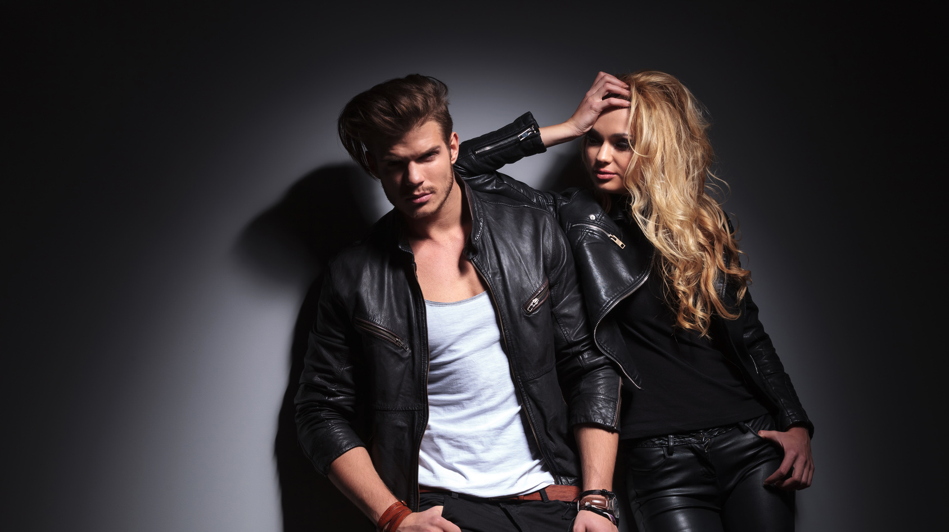
Thank you for listening!

