Slide 1

Linear regression modelling using the ames housing dataset
A data driven analysis on the best strategies for house flipping

Slide 2
Problem statement and objective
ABC network to launch a new docu-series on property flipping called “house hunters”
Targeting houses in Ames, Iowa for the first season
Objective:
Analyse Ames housing dataset for property sales in the last 4 years
Select features that most contribute to sale price
Uncover interesting house features which best increase property value
Verify model performance using test data provided on Kaggle

Slide 3
Dataset summary and cleaning
Total predictive features: 80
Number of houses: 2051
Number of features with missing values: 26
Most of which were missing components of a house such as basements, garages, fences and pools.
Outliers: 4
Houses which were sold at a low price.

Slide 4
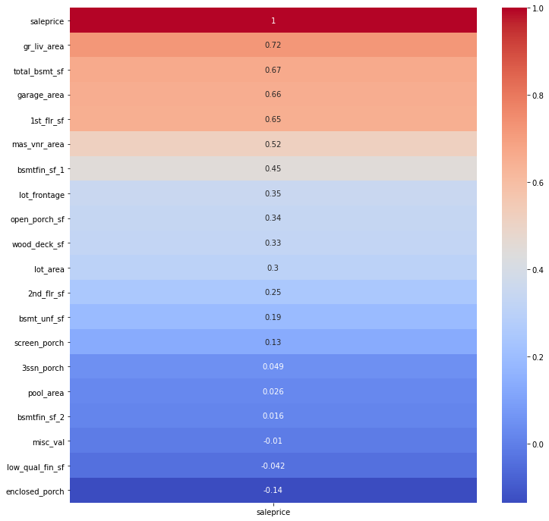
Feature Selection – Continuous features
Living area above ground (gr_liv_area)
Basement area (total_bsmt_sf)
Garage area (garage_area)
Masonry veneer area (mas_vnr_area)

Slide 5
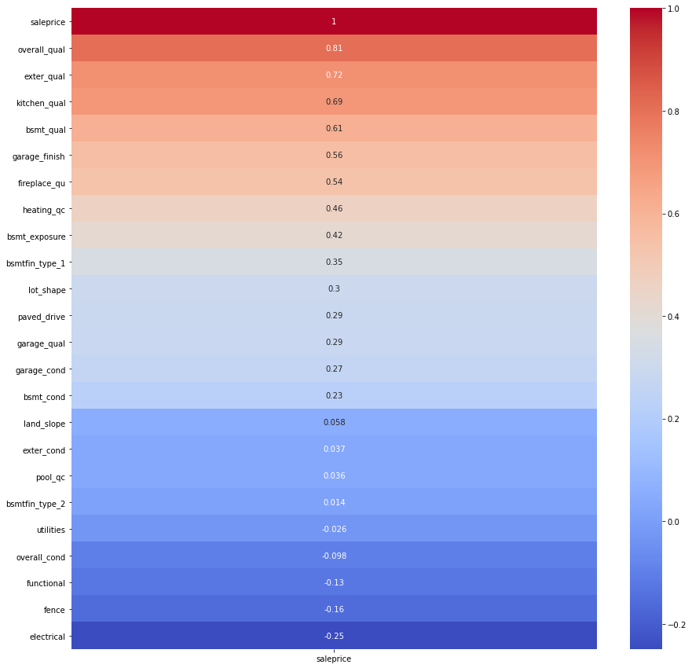
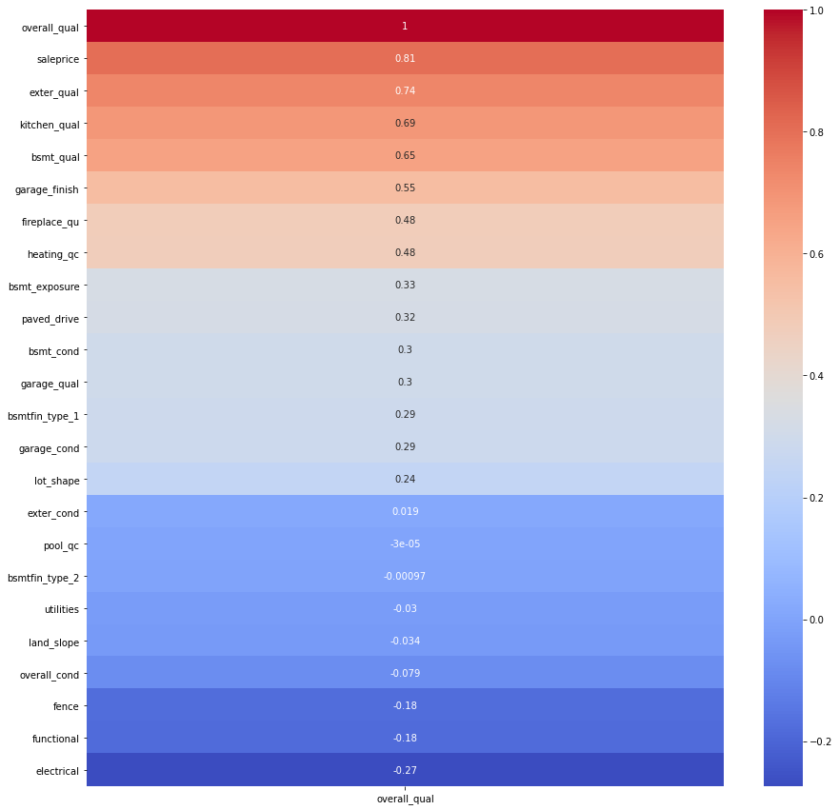
Feature Selection – ordinal features
Overall quality (overall_qual)
Fireplace quality (fireplace_qu)

Slide 6
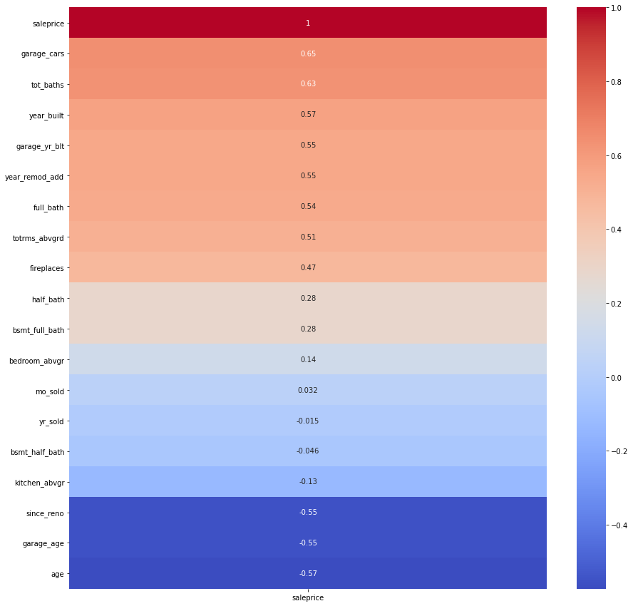
Feature engineering – discrete features
Tot_baths: total number of baths in the property
Age: age of the property since construction date
Since_reno: time since last renovation
Garage_cars: number of cars that can fit in garage (eliminated from lasso regularization)

Slide 7
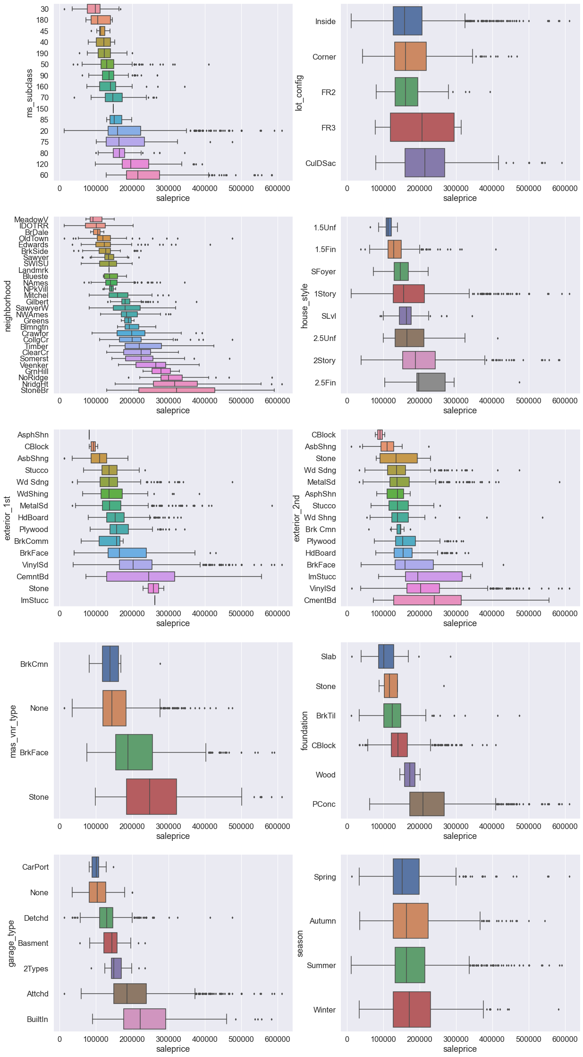
Feature engineering – nominal features
Neighborhood_l: represents upper class neighborhoods
Neighborhood_h: represents lower class neighborhoods
Garage_type_a: represents having a built-in or attached garage

Slide 8
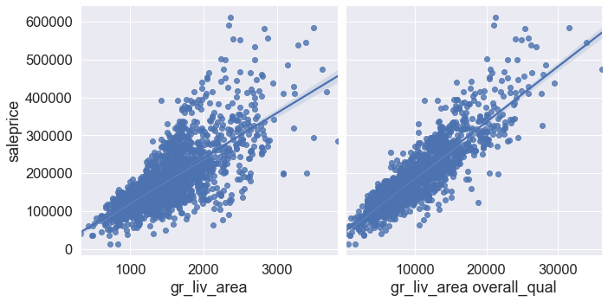
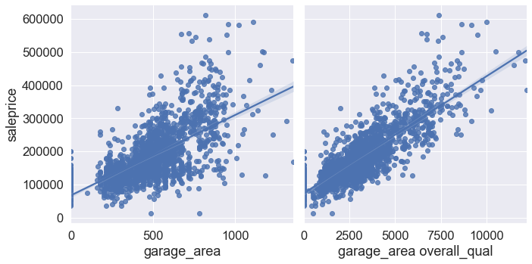
Feature engineering – polynomial features

Slide 9
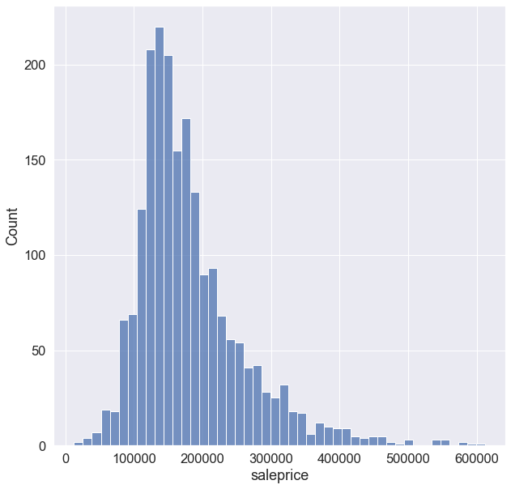
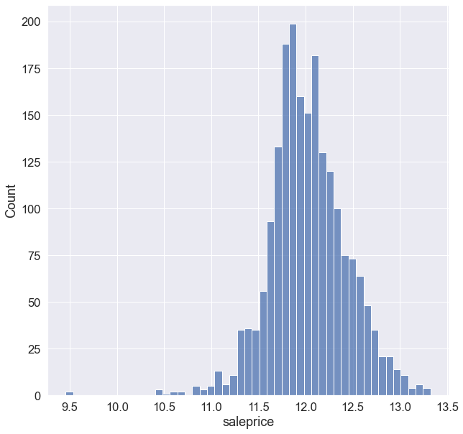
Feature engineering – target feature
Saleprice in the dataset exhibits a strong right skew
Log transformation applied to target feature to normalize distribution

Slide 10
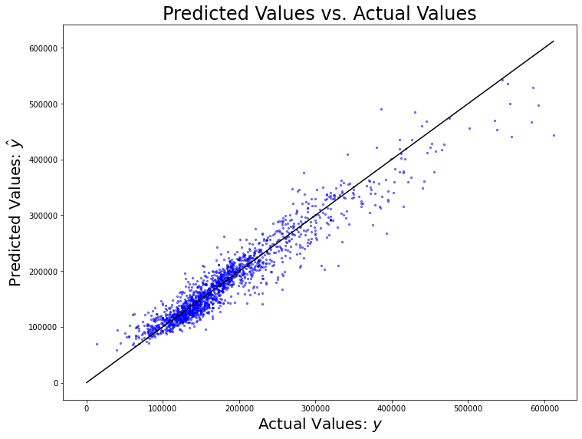
Model summary
The model includes a total of 14 features:
4 continuous
3 discrete
3 nominal
2 ordinal
2 polynomial
Ridge regularization selected after cross validation comparison
Does better at predicting lower sale prices
Overpredicting more ‘expensive’ houses
Regression Model | Linear Regression | Ridge Regularization | Lasso Regularization | ElasticNet Regularization
RMSE | 0.13756 | 0.13738 | 0.13756 | 0.13741

Slide 11
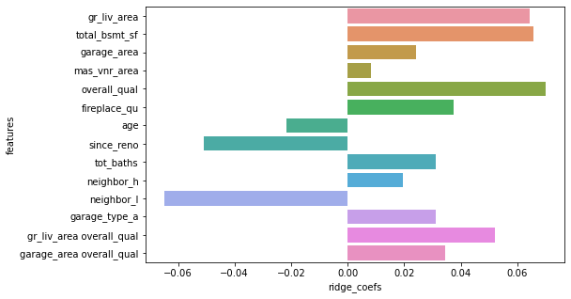
Model evaluation
Coefficients represent a % increase in saleprice for unit increase in X
Best predictors for sale price are:
Gr_liv_area
Total_bsmt_sf
Overall_qual
Neighbor_l
Since_reno
Interesting features:
Fireplace_qu
Tot_baths
Garage_type_a
Kaggle evaluation RMSE:
26,502.87

Slide 12
Conclusion and recommendations
Avoid neighbourhoods included in the neighbor_l category
Iowa DOT & Rail Road
Briardale
Meadow Village
Renovate houses by adding:
Good quality fireplace
Built-in or attached garage (spacious)
Sell house fresh after renovation

Slide 13

THANK YOU

