Slide 1

Design Specification eTimely
Matt Korte, Caleb Obi, Chris Gumieny, & Samia Chowdhury
Notes:
Matt

Slide 2
Introduction

Slide 3
Purpose
Layout, explain, and track architecture & design
define and track use cases
Guide the development team
3
Notes:
Matt
BULLET 1: this includes the software, hardware, security and communications architectures

Slide 4
Assumptions
Internet connection
No information will be stored locally with user
Firestore
Database structure
4
Notes:
Matt
BULLET 1: All user information is being stored on an external database that will require an internet connection to reach. This include login in credentials and all account information.
If we wanted to make an offline version of this application, the overall design would need to be shifted accordingly
BULLET 2: Going forward, it is assumed that Firestore, a nonrelational database structure, will be the database used for this project. If this were to change, then much of the database and some of he software architecture would need to be redesigned.

Slide 5
Constraints
React v17.0.2
Limits tools and libraries we can use
Not supported on all browsers
NodeJS v16.13.2
Firestore
Limits on data stored, reads/writes
Used for Backend Development
5
Notes:
Matt

Slide 6
Architectural Design
6

Slide 7
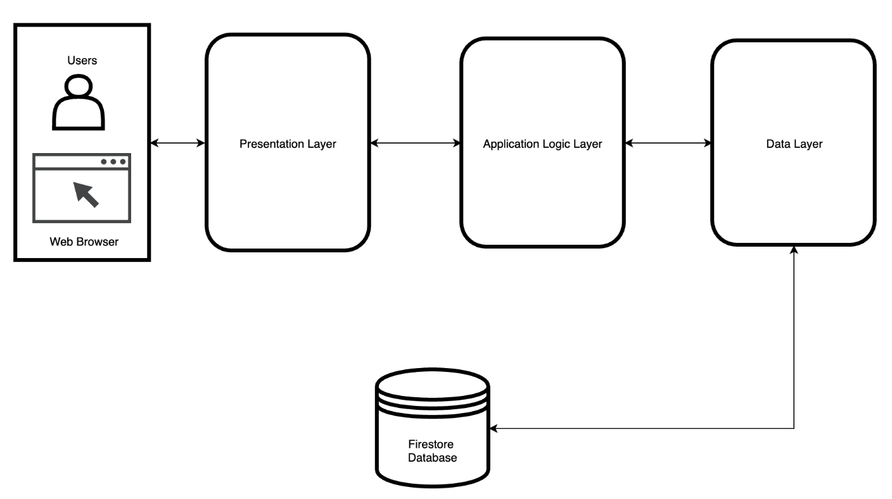
Software Architecture – Layered Architecture
7
Notes:
Caleb

Slide 8
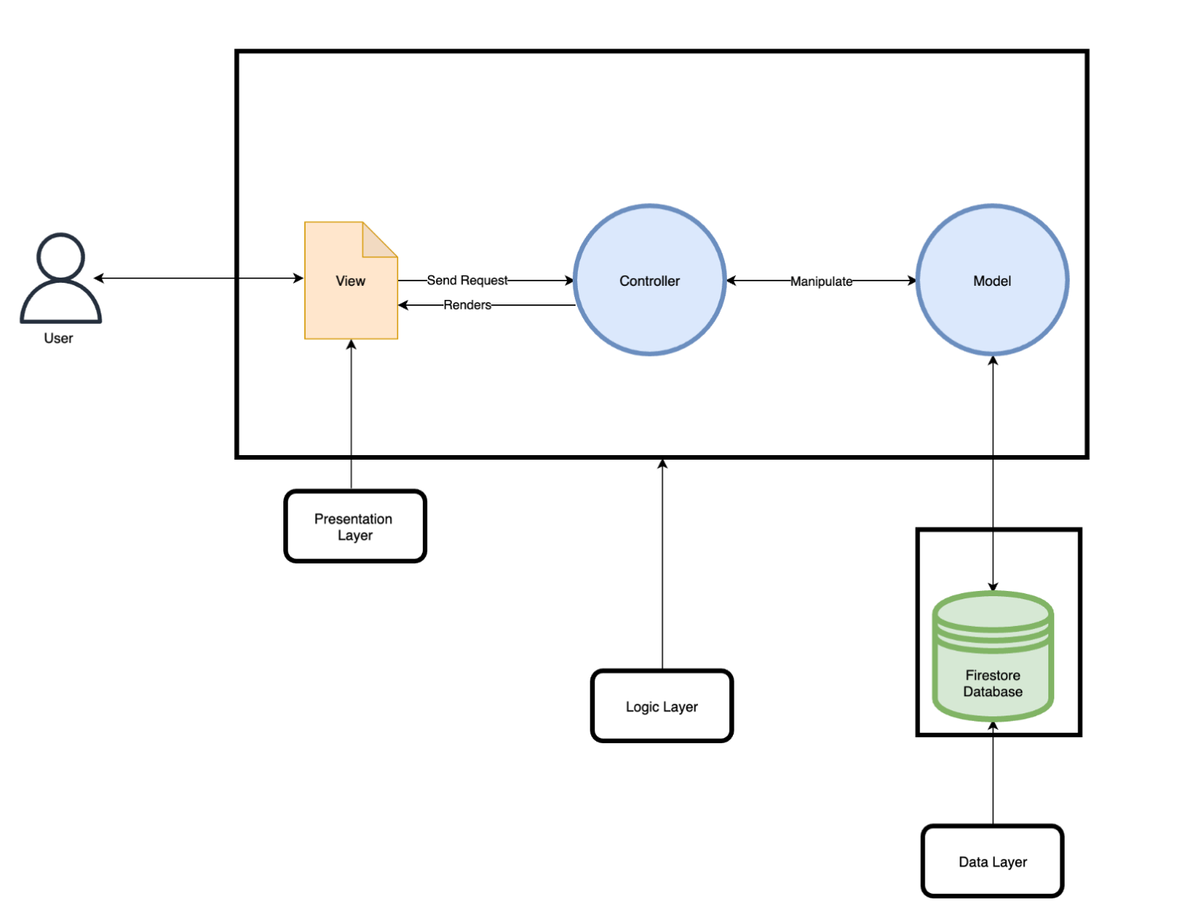
Software Architecture - MVC
8
Notes:
Caleb

Slide 9
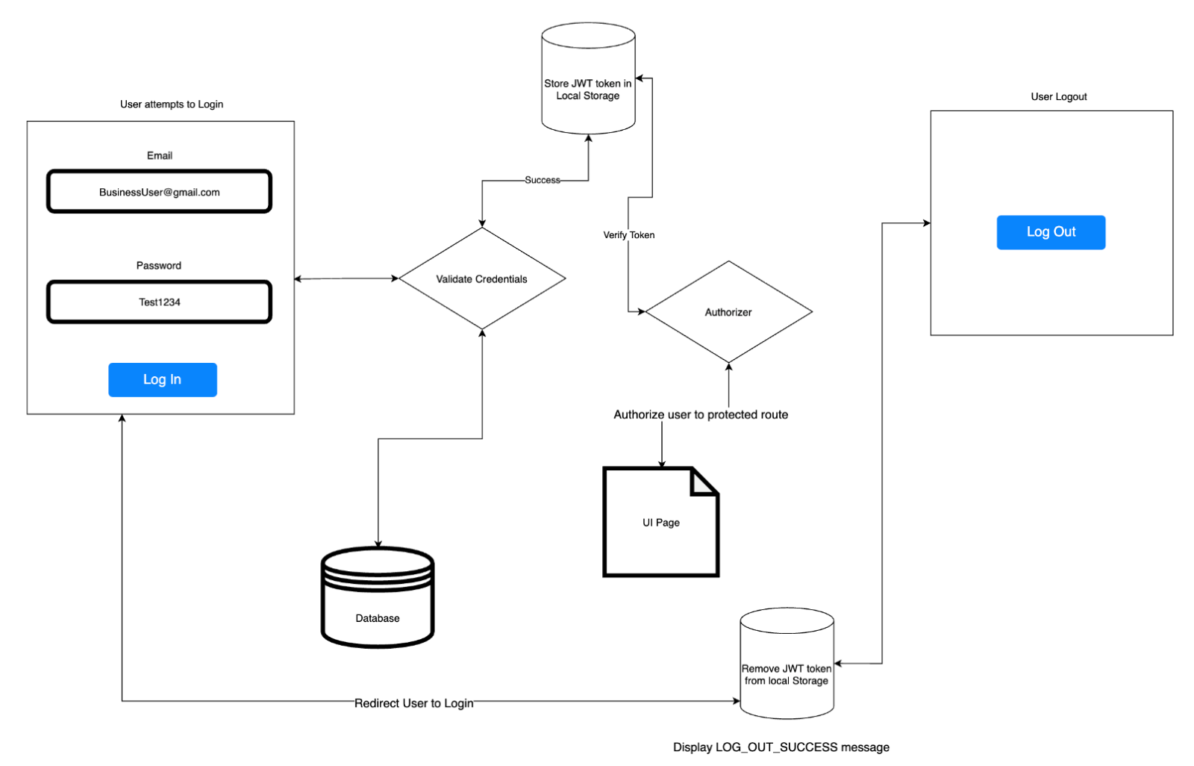
Security Architecture – Web Tokens
9
Notes:
Caleb

Slide 10
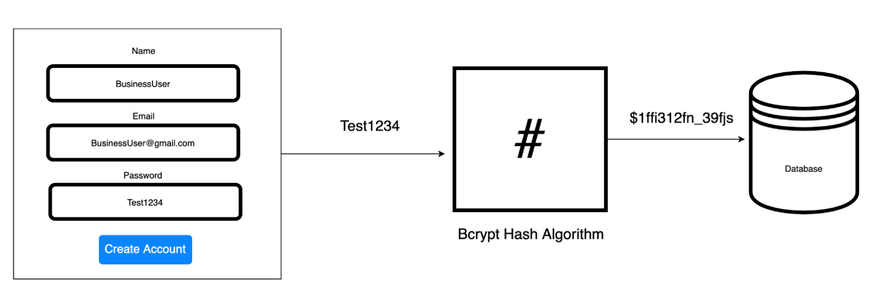
Security Architecture – Password Encryption
10
Notes:
Caleb

Slide 11
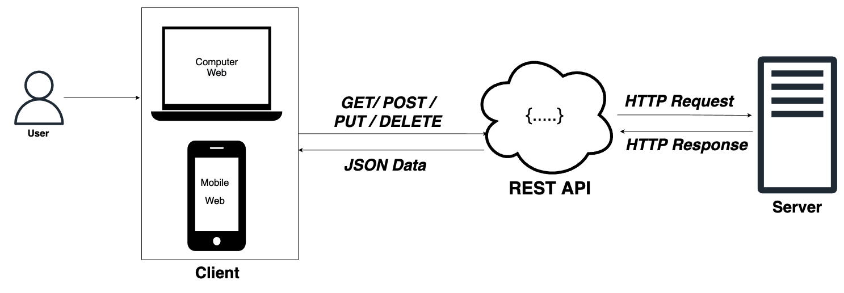
Communication Architecture
11
Notes:
Caleb

Slide 12
System Design
12

Slide 13
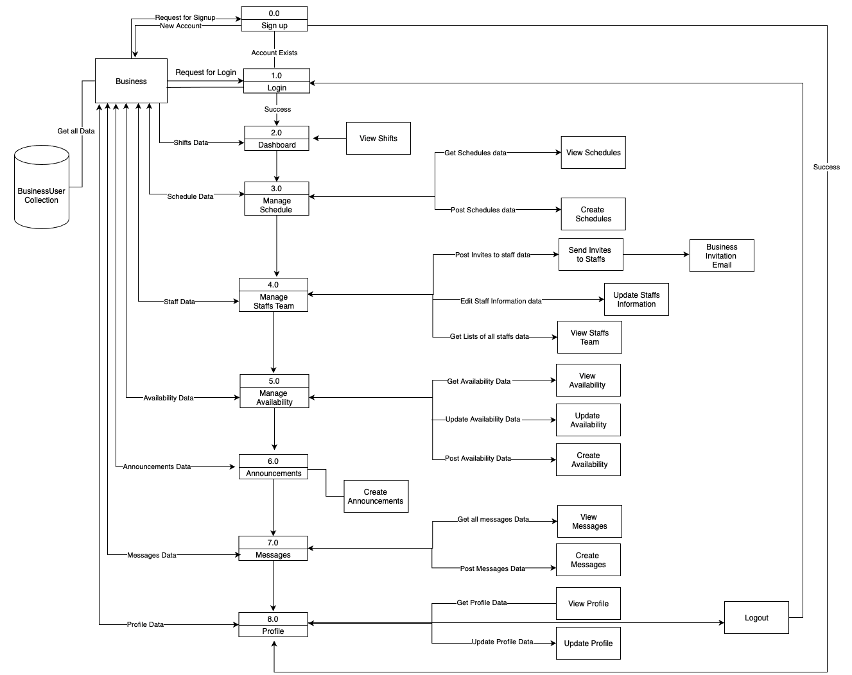
Data Flow Diagram -Business User
13

Slide 14
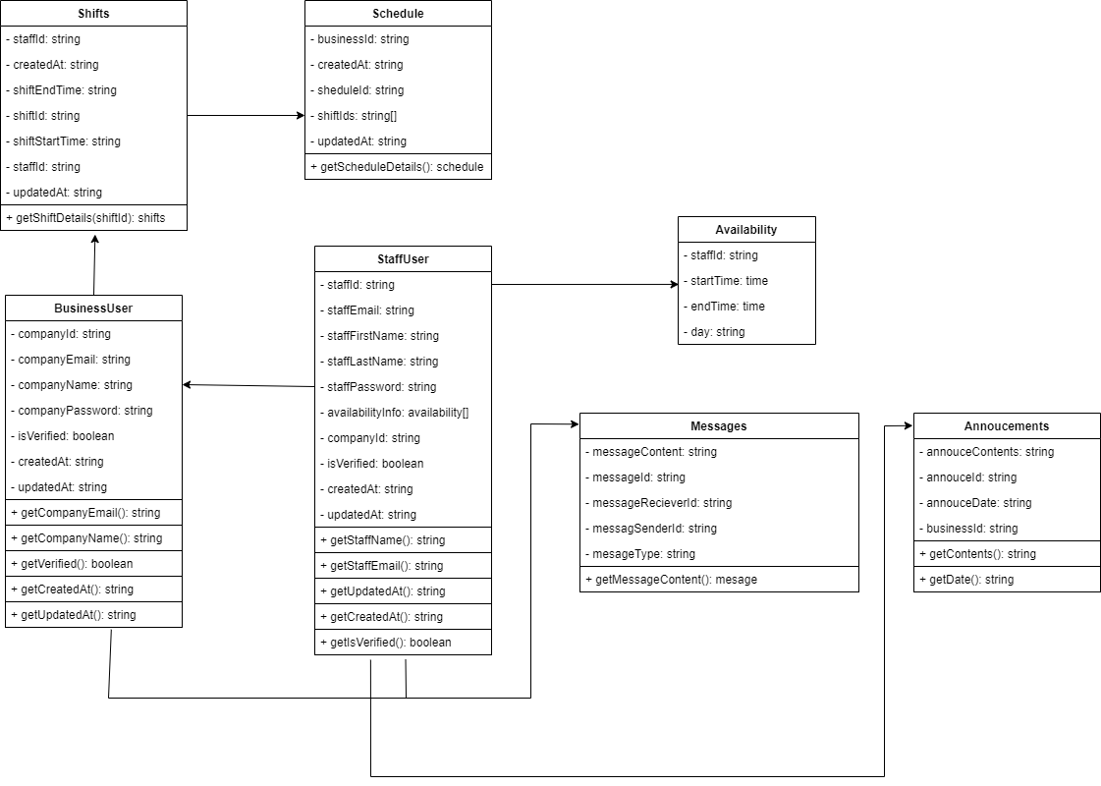
Class Diagram
14
Notes:
Matt

Slide 15
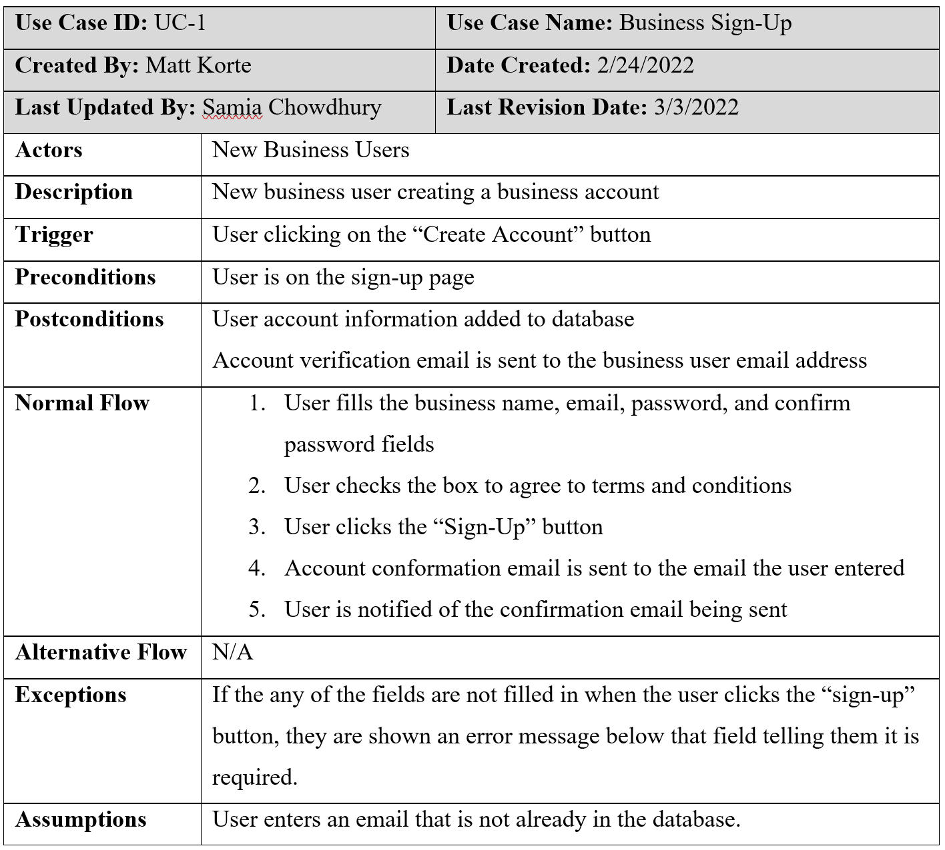
Use Cases
15

Slide 16
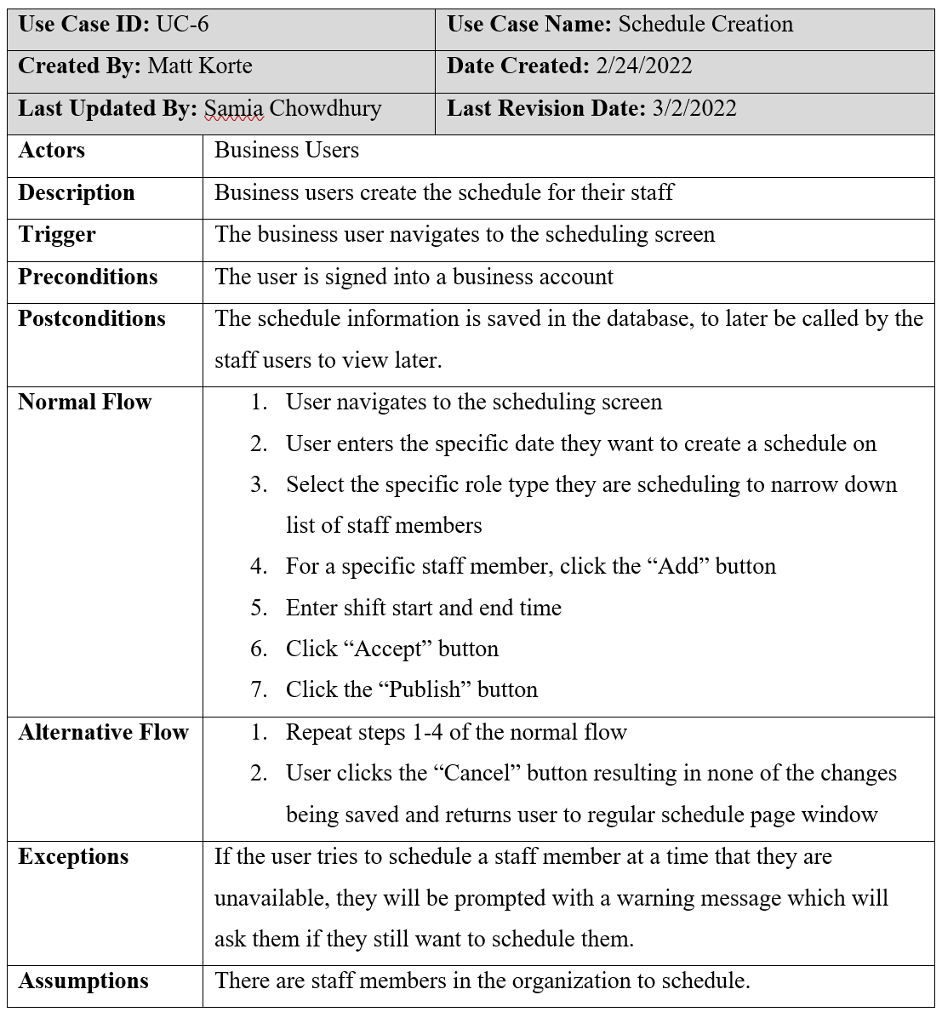
Use Cases Cont.
16

Slide 17
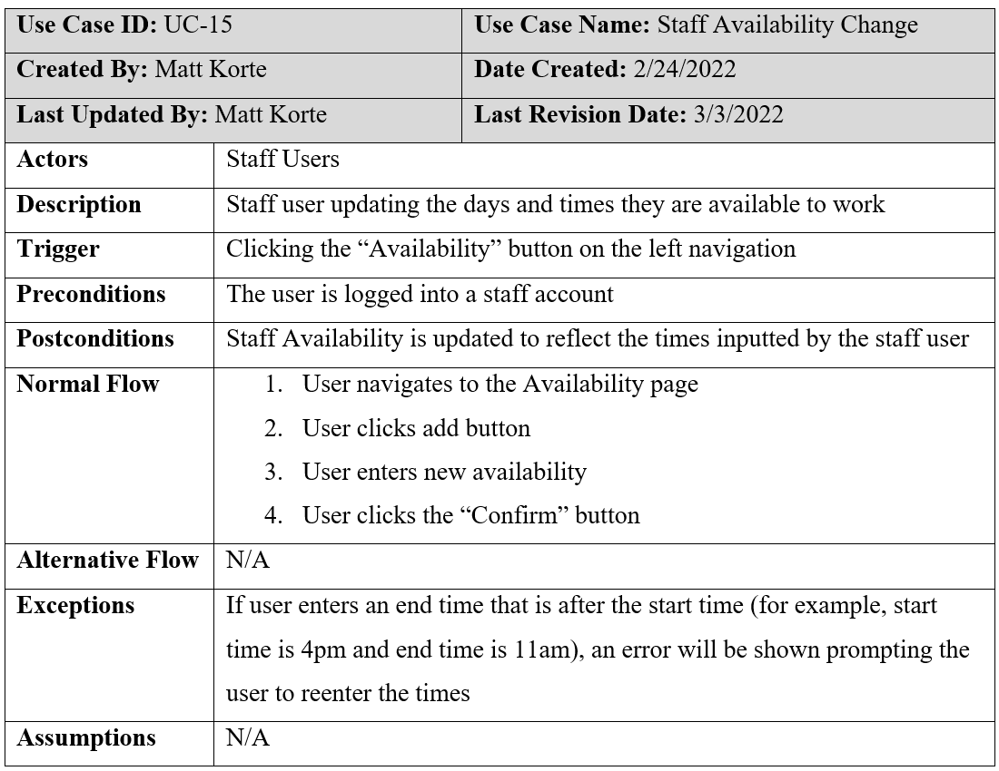
Use Cases Cont.
17

Slide 18
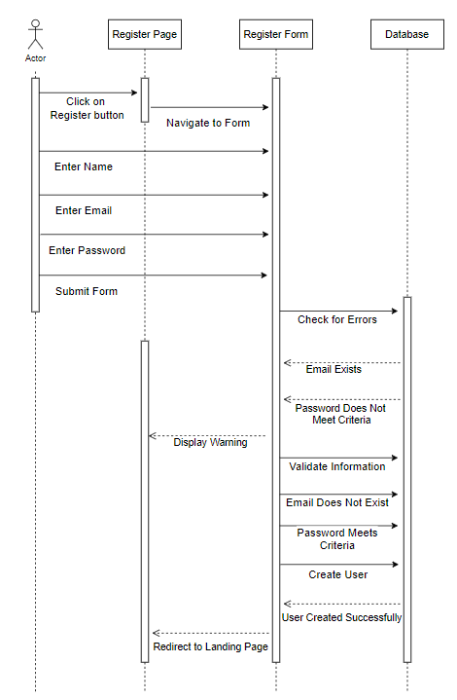
User Sign Up - Sequence Diagram
18

Slide 19
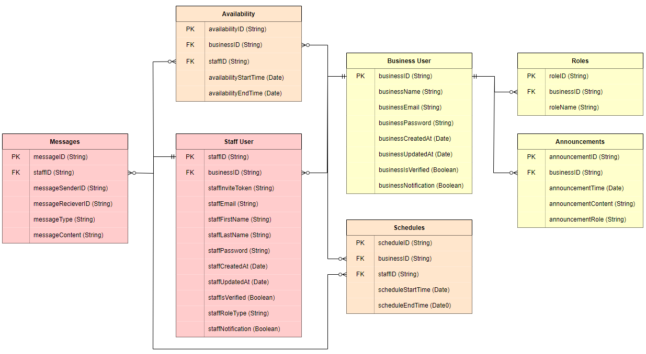
Database Design
19
Notes:
Chris

Slide 20
User Interface Design
20

Slide 21
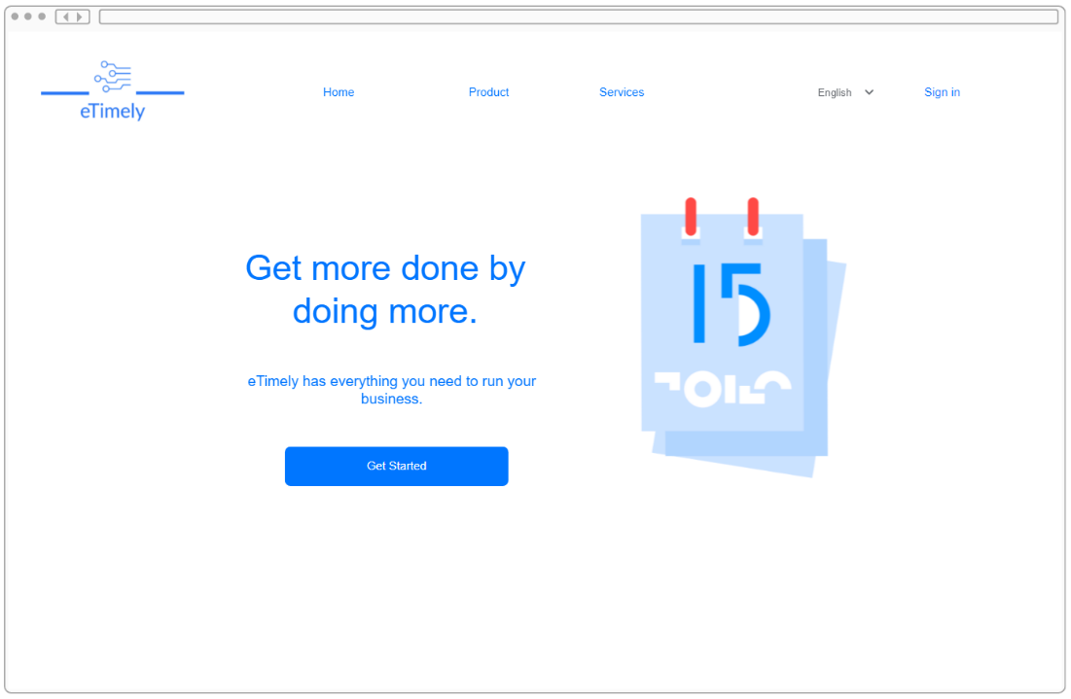
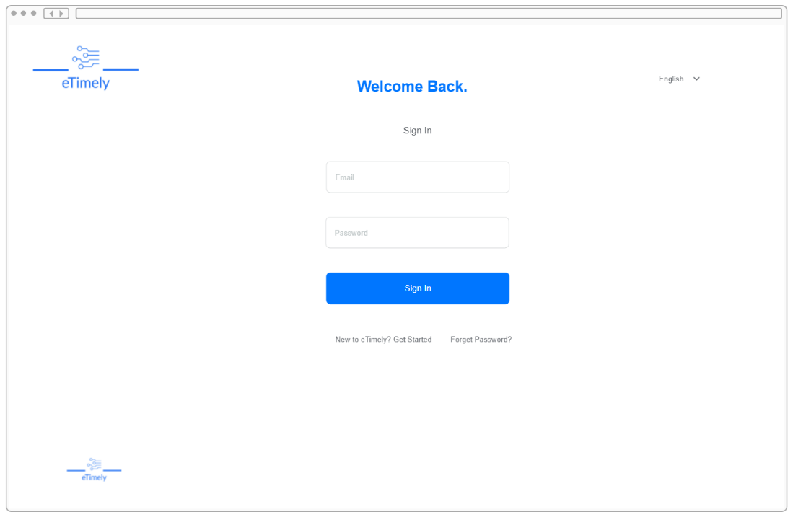
Default View
Home Page
Login Page
21

Slide 22
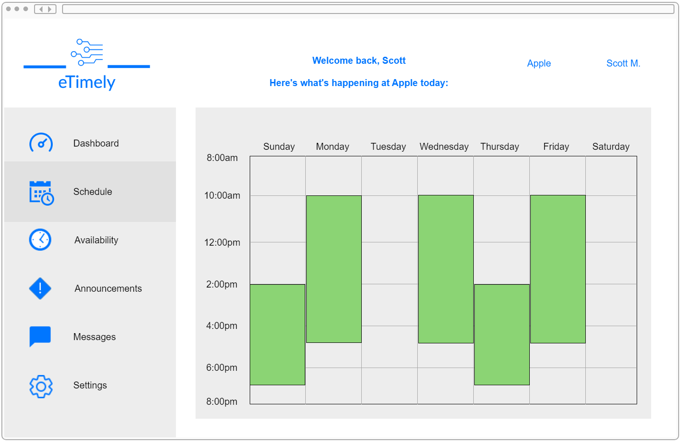
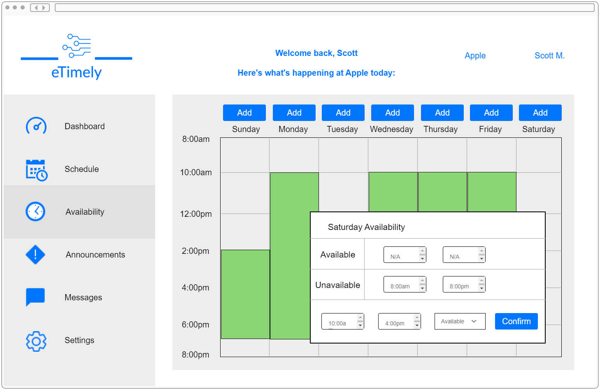
Staff View
Staff Schedule Tab
Staff Availability Window
22

Slide 23
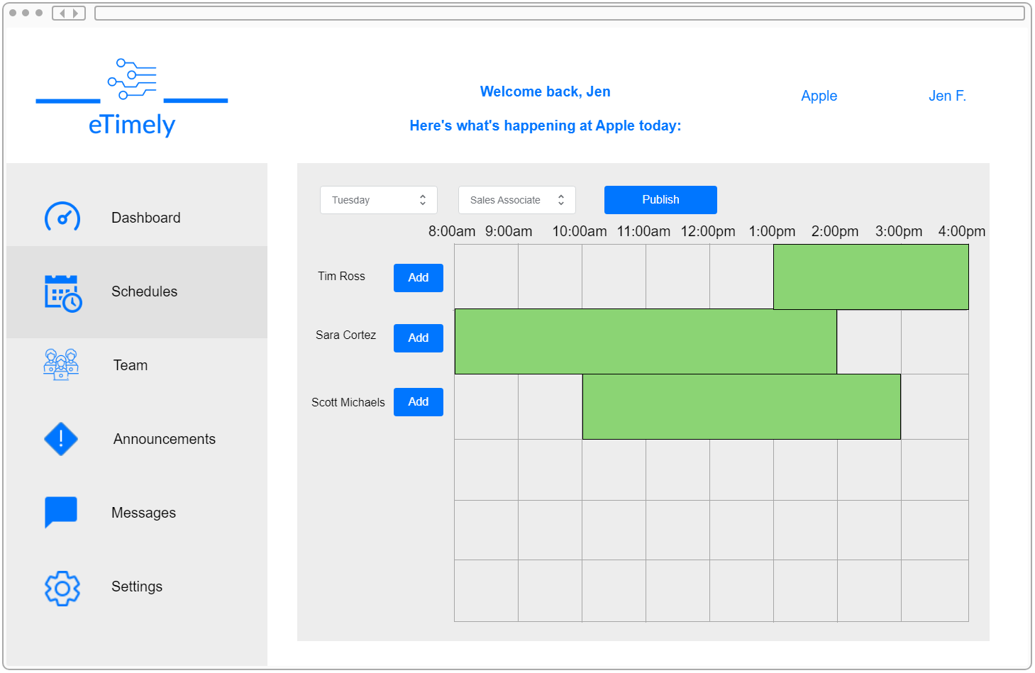
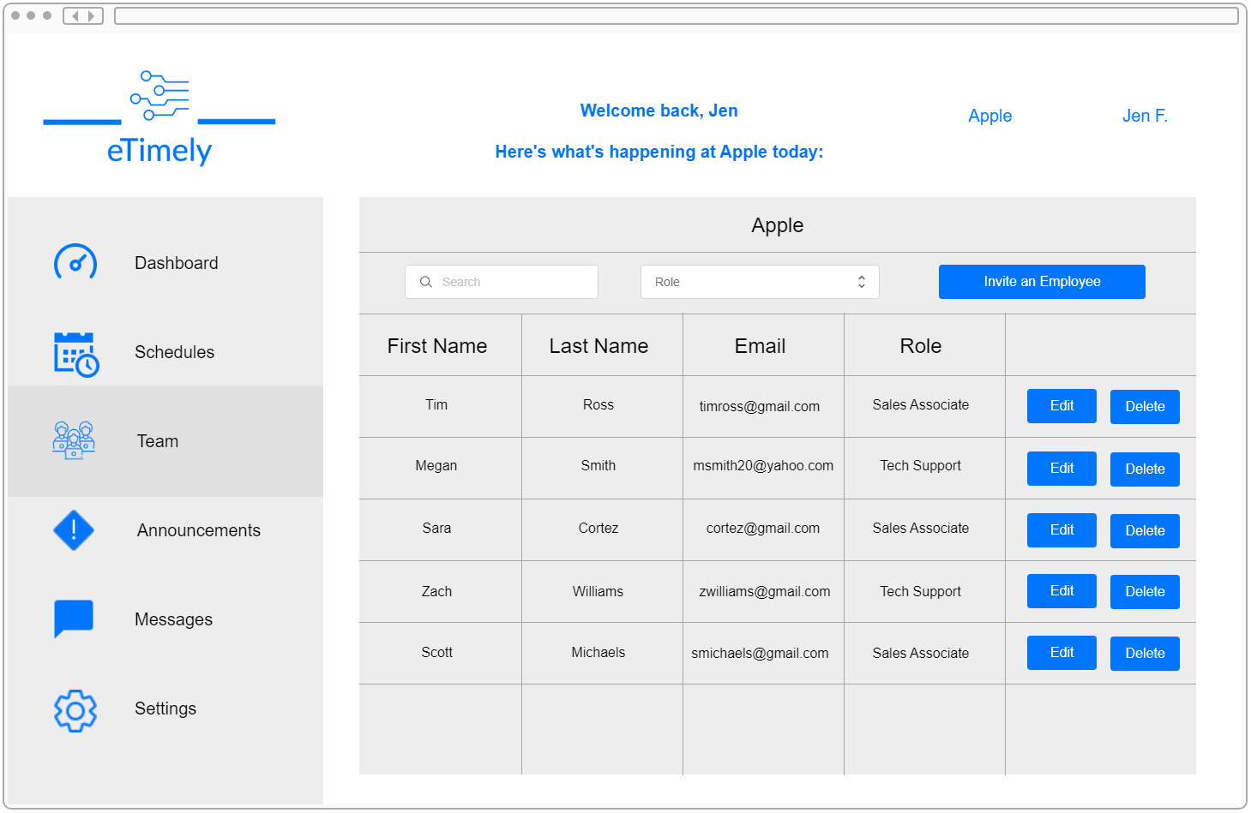
Business View
Business Schedule Tab
Business Team Tab
23

Slide 24
References
https://reactjs.org/docs/react-dom.html
https://cloud.google.com/firestore/quotas
https://jwt.io/introduction
https://mui.com/getting-started/supported-platforms/
24

Slide 25
Questions?
25

