Slide 1
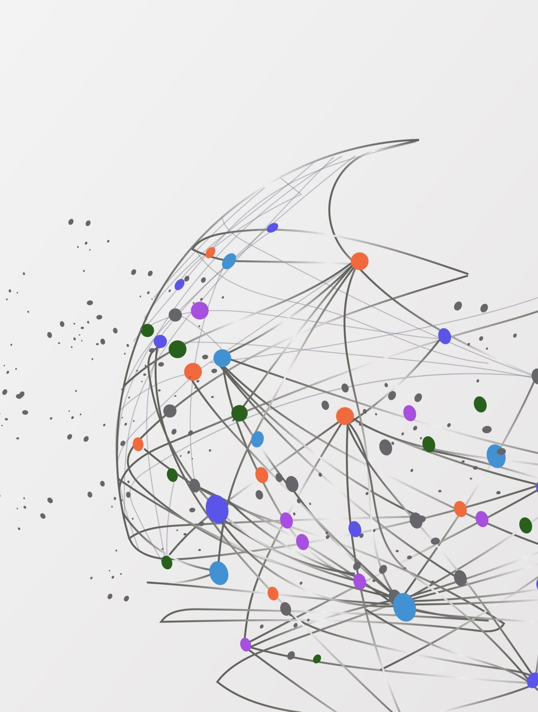
Development Plan
eTimely
eTimely
Team: Matt Korte, Caleb Obi, Chris Gumieny, & Samia Chowdhury
Graduate Teaching Assistant: Gayathri Darla
Notes:
MATT

Slide 2

Project Overview
Problem
Communication for scheduling methods are inefficient
Causes confusion which leads to missed shifts
Solution
Webapp with tools to fix these issues
Common place to communicate with entire team
Notes:
MATT
Most small businesses like restaurants and retail stores rely on verbal communication and memory when in comes to scheduling and shift planning. It is usually up to one person in management role to remember each employee’s availability, and requests off to create a schedule that works for everyone and then communicate that to the whole staff somehow, causing frequent mistakes. Employees being for shifts they cant work, management not knowing how is supposed to be at work at a given time, and what have you.
Our solution is a webapp for a business to be able create, manage, and share a schedule with their staff, in addition to adding tools to enhance communication thru the whole business.

Slide 3
Project Purpose
Alleviate the emphasis verbal communication and memory
Enhance communication between all members of the team
Prevent errors in schedule
Notes:
MATT
POINT 1
As I said before, most restaurants and retail store rely on verbal communication of availability and weekly scheduling, leaving plenty of room for mental mistakes. To alleviate this, we want to give our webapp functionality for employees to enter their own availabilities, requests off, and shift trades with coworkers to be sent to and approved by management. Having all this information gathered and saved in one place should ease the mental burden brought on by needing to remember all these things off hand.
POINT 2
Additionally, we wish to add a messaging feature that allows management and employees get into contact if the need arises, such as for shift trades or for large announcements the entire staff should now. This should allow for smoother and easier communication within a business in comparison to, say, a bulletin board or large group texts.
POINT 3
It is our belief that bringing these tools to one common place will help prevent scheduling error as well as enhance overall communication within the team.

Slide 4
Project Scope
“Business” Account Type
Ran by management
Creates and shares schedule to employees
Can post mass announcements
Approve availability, requests off and shift changes
“Staff” Account Type
Each employee creates their own
Enter availability, requests off
Post to message board
Request shift trade
Notes:
MATT
As for the scope of our project, we intend on having two separate account types, “business” and “staff”
BUSINESS ACCOUNT
The business account will be created by and accessed by the management of the business. This is where schedules will be created, employee availability will be approved, and management announcements will be sent from.
STAFF ACCOUNT
Meanwhile, each individual employee will create their own staff account that will be linked to the business. Here, employees will see their schedule for the week (or month, etc) as well as enter availability, days off, and request shift trades with coworkers. Here they will be also be able to view and post on the message board.
HAND OFF TO SAMIA

Slide 5
Project Objective
Create an easy-to-use interface which displays each landing page in a robust manner
Cut down on miscommunication regarding work schedules between the team members
Create an area for employees to put in their availability
Create an area for employees to change or offer up their shift
Notes:
SAMIA

Slide 6

Team Organization
Matthew Korte
Team Lead
Chris Gumieny
UI/Frontend Lead
Caleb Obi
Database/Backend and QA Lead
Samia Chowdhury
Documentation, Presentation, and Communication Lead
Notes:
SAMIA

Slide 7

Weekly Meetings
Team Meetings
Wednesdays 6:00pm – 9:00pm
Fridays 6:00pm – 9:00pm
GTA Meetings
Saturdays 2:00pm – 4:00pm (time and day to be confirmed)
Notes:
SAMIA

Slide 8

Problem Resolution Policies
Members must attend all meetings
Exception for one week notice with valid reason
Members must commit code changes regularly
Approximately end of each week
Members must get approval to merge
Vote to solve any conflicts
Section/team lead is tiebreaker
Three strike policy
Notes:
CHRIS

Slide 9
Project Plan
Requirements Gathering (TBD)
Prototype 1 (TBD)
Design Specification (TBD)
Prototype 2 (TBD)
Final Product (TBD)
Prototype 3 (TBD)
Testing Plan (TBD)
Notes:
CHRIS

Slide 10
Configuration Management Plan
Zoom
Regular meetings
Discord
Main method of communication
GitHub
Code repository
Jira
Sprint planning and task tracking
Notes:
CALEB

Slide 11




Technologies
Frontend
ReactJS v17.0.2
Backend
NodeJS v16.13.2
ExpressJS v4.17.2
Database
Cloud Firestore
Testing
Jest (Frontend & Backend) v27.4
Hosting & Deployment
Firebase
Figure 1
Figure 2
Figure 3
Figure 4
Notes:
CALEB

Slide 12
Image References
Figure 1
https://www.iconfinder.com/icons/1175544/firebase_google_icon
Figure 2
https://logosvector.net/wp-content/uploads/2015/09/nodejs-logo.png
Figure 3
https://mnmapplications.com/wp-content/uploads/2020/01/Firebase-Cloud-Firestore.png
Figure 4
https://d2eip9sf3oo6c2.cloudfront.net/tags/images/000/000/940/square_480/jestlogo.png

Slide 13
Thank You!
Any Questions?

