Slide 1

Software Requirements Specification
ETimely
Matt korte, Caleb obi, chris gumieny, & Samia Chowdhury

Slide 2
Introduction
Notes:
MATT

Slide 3
Definitions
Term | Definition
Availability | The specified times and days of the week an employee is willing to be scheduled.
Business | A company that has a sign up for the use of eTimely.
Employee | A singular person who works at the business who is using eTimely.
Organization | A business account and all associated staff accounts.
Staff | All employees of a business.
User | Any person using the application, generally someone using a business or staff account.

Slide 4
Purpose and scope
Purpose
Outline of what eTimely is (and is not )
Guide development team
Scope
Give businesses and their staff the tools to create schedules that work for everyone
Improve communication within organization by creating a space that can be accessed by all members
Notes:
MATT

Slide 5
Product perspective
Both Users
Dashboard
Business User
Create schedule
Make announcements
Approvals
Staff User
Enter availability
View personal schedule
Request days off
Schedule Page
Announcements
Messages
Settings
Notes:
MATT

Slide 6
User Characteristics
Business
Ownership and/or management
Staff
Wants to improve shift planning and communication
Decides to use eTimely
Uses eTimely in conjunction with business
Average employee of business
Notes:
MATT

Slide 7
Assumptions and Constraints
Assumptions
Firestore
Constraints
Time
Team size
Funding
Notes:
MATT

Slide 8
Specific requirements & User interfaces

Slide 9
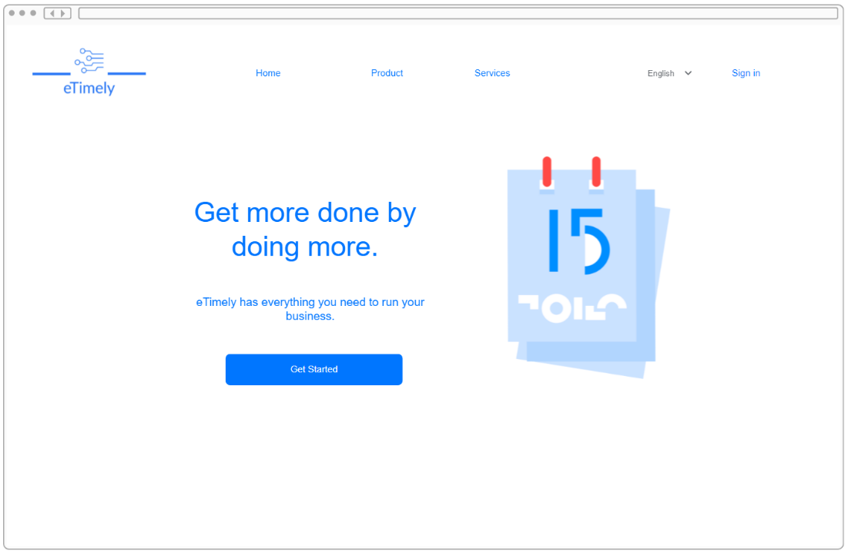
Default view
FR3.2.1: Landing Page
FR3.2.2: About Us Page
FR3.2.3: Contact Us Window
Landing Page

Slide 10
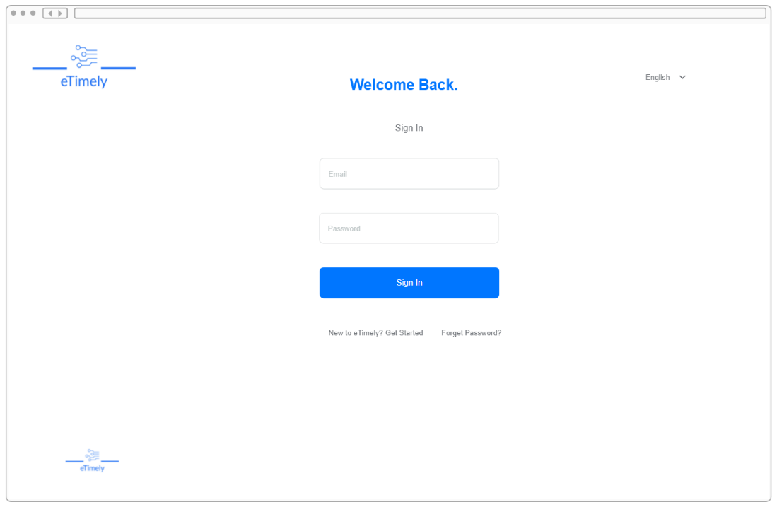
Account creation
FR3.2.4: Business User Account Registration
FR3.2.5: Staff User Account Registration
FR3.2.6: User Login
FR3.2.7: Password Reset
FR3.2.8: Email Account Confirmation Link
FR3.2.9: Credential Validation on Sign Up
FR3.2.10: Password Complexity
FR3.2.11: Business Invites for Staff
User Login

Slide 11
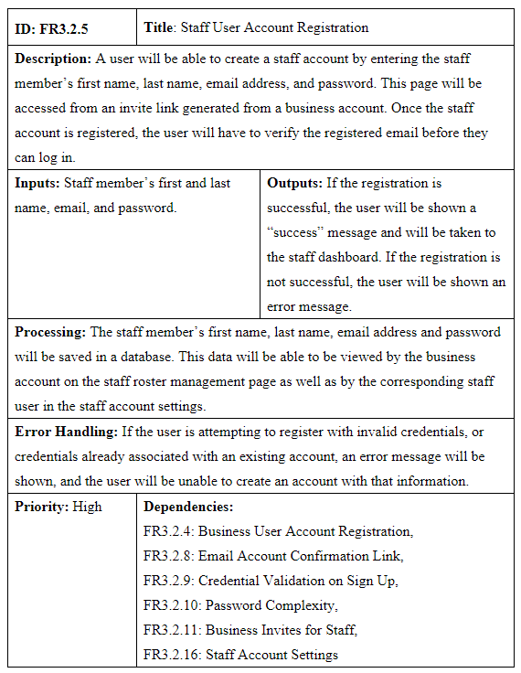
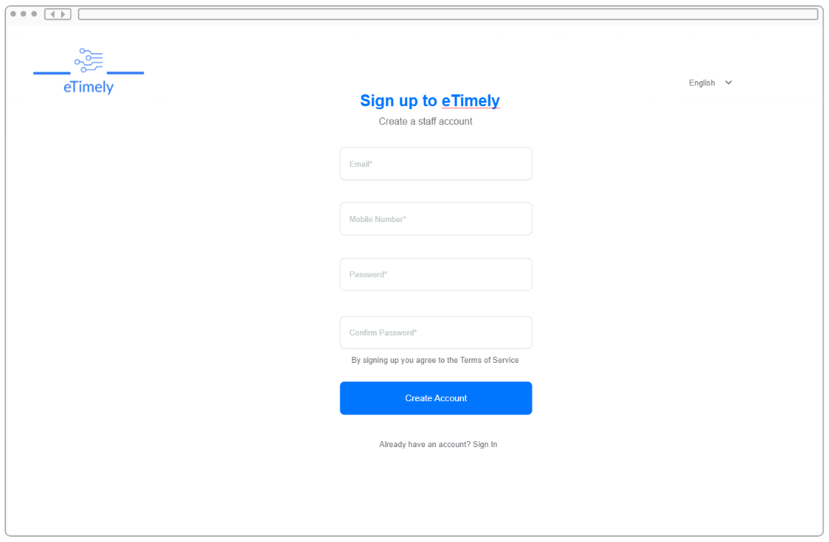
FR3.2.5: Staff user account registration
Staff Registration

Slide 12
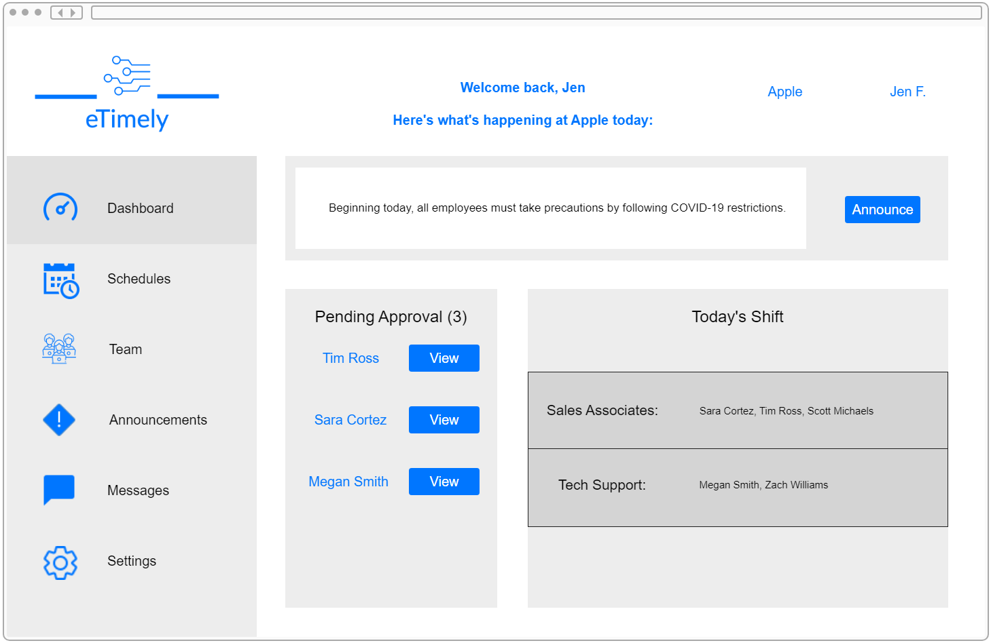
SHARED user view
FR3.2.12: Navigation Menu
FR3.2.13: Business Dashboard
FR3.2.14: Staff Dashboard
FR3.2.15: Business Account Settings
FR3.2.16: Staff Account Settings
FR3.2.18: Announcement Board
FR3.2.26: Message Board
Business Dashboard
Notes:
SAMIA

Slide 13
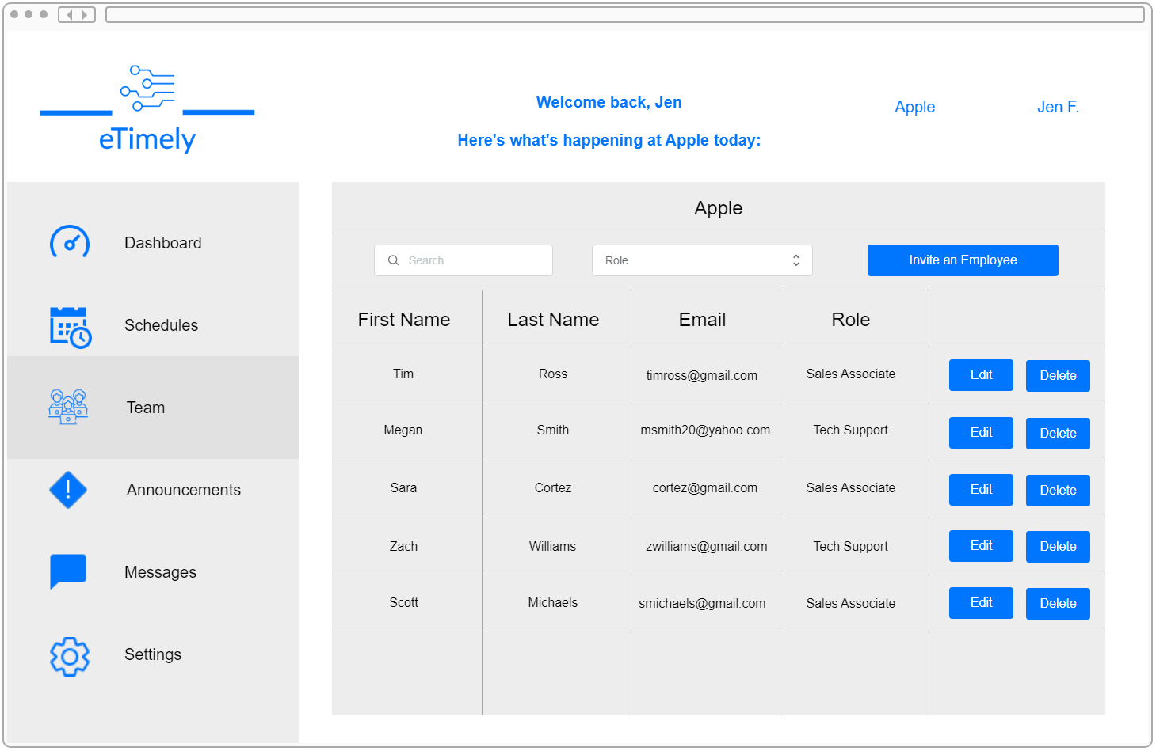
Business user view
FR3.2.17: Staff Roster Management
FR3.2.19: Role Assignment
FR3.2.20: Business Approval
FR3.2.21: Schedule Creation
FR3.2.22: Show Employee Availability
Staff Roster Management

Slide 14
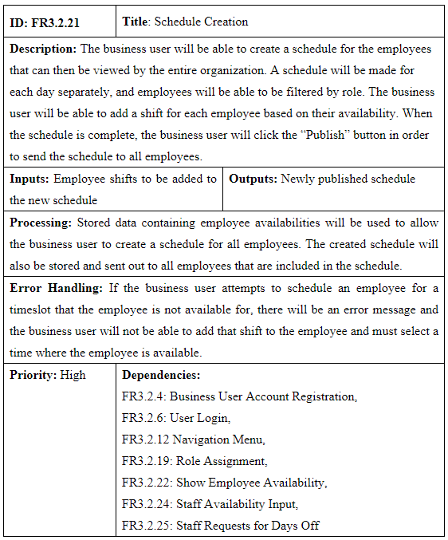
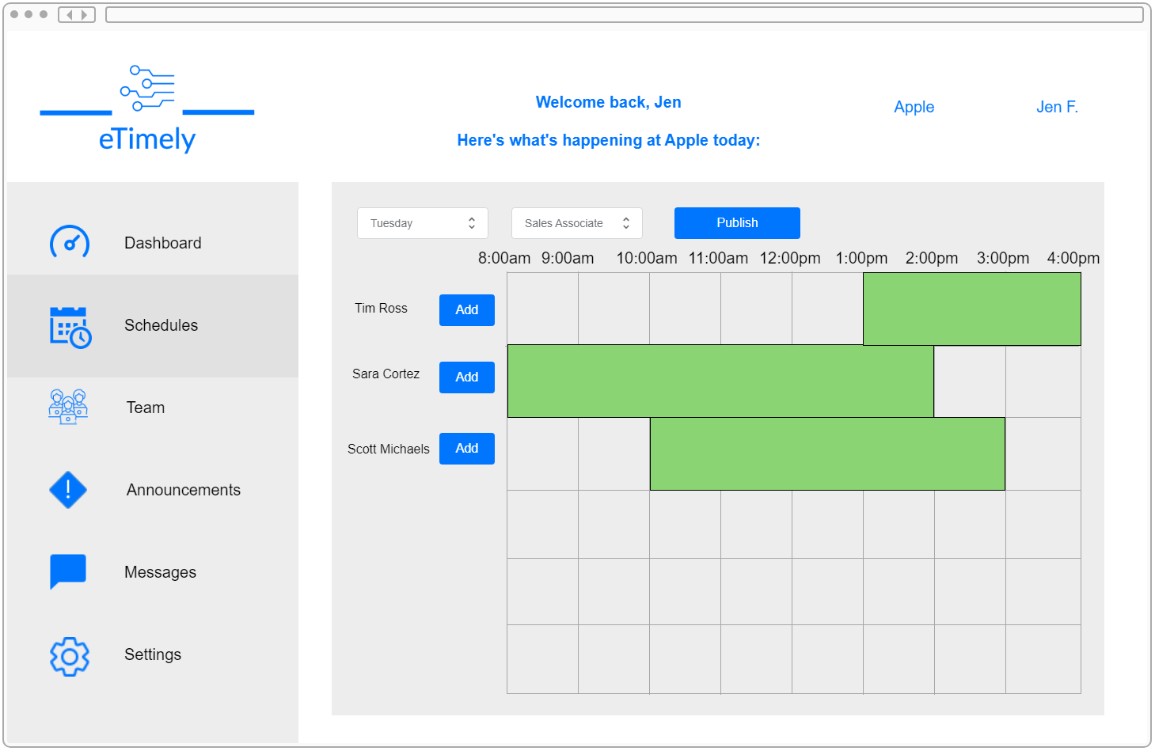
FR3.2.21:
Schedule
creation
Schedule Creation Page

Slide 15
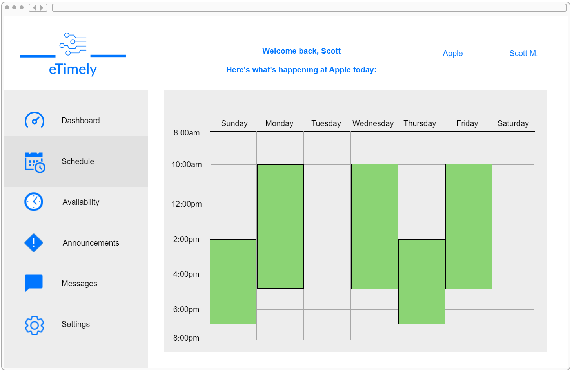
Staff user view
FR3.2.23: View Schedule
FR3.2.24: Staff Availability Input
FR3.2.25: Request Days Off
Schedule View

Slide 16
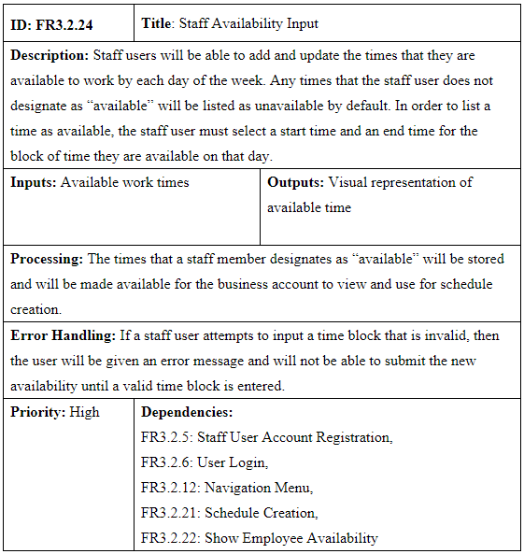
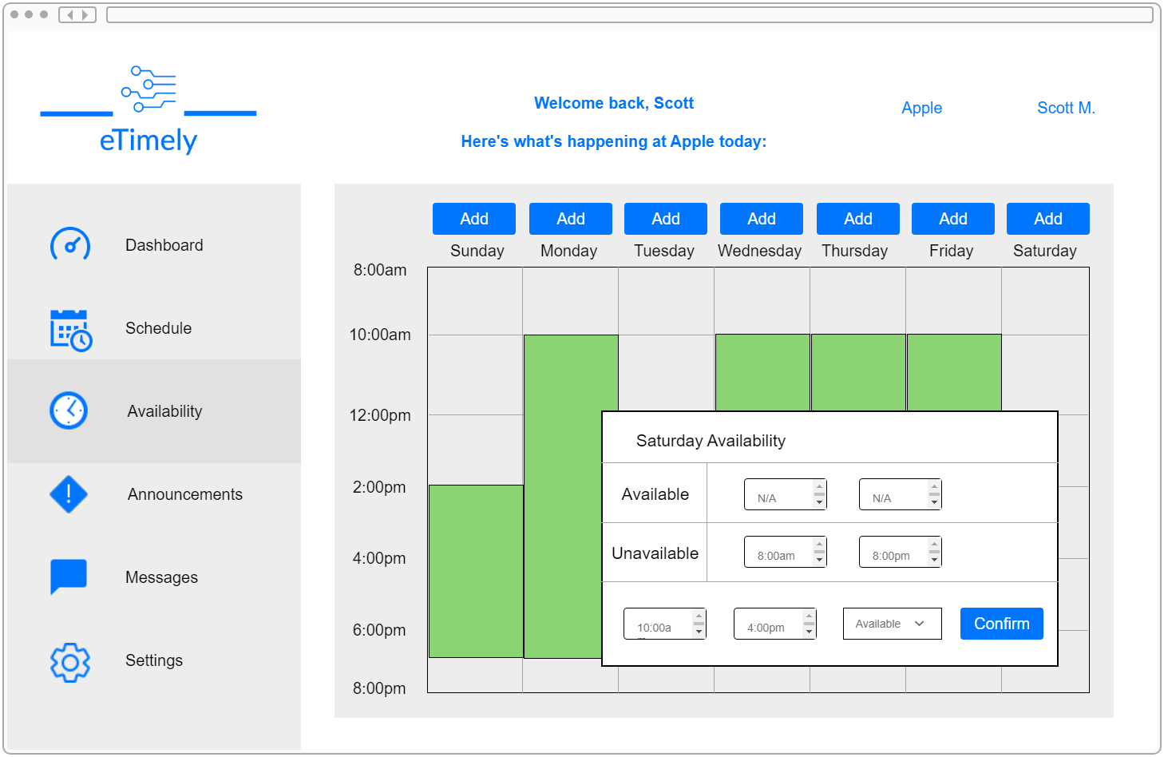
FR3.2.24: Staff availability
input
Staff Availability Input

Slide 17
External interfaces
Hardware
The eTimely web application will rely on any computer or mobile device in order to access the web application through a browser.
Software
Communication
eTimely's user interface will be built with React and JavaScript, and our server-side interactions will be built with NodeJS and ExpressJS.
For our database we will use firebase firestore to store all our application data.
The eTimely web application will use Rest API's to communicate with the backend servers.
JWT (JSON Web Tokens) will also be used to authorize and validate users in this application.

Slide 18
Non-Functional Requirements
Performance
Restful API's requests performance
Reliability
Database error handling
Availability
Website maintenance time
Website availability
Security
Encrypt passwords
Maintainability
Application Extensibility
Portability
Website Responsiveness
Notes:
CALE=B

Slide 19
Design constraints
Deployment Constraints
Rest API needs deployment
Database Constraints
Firestore can store only 1 GB of data
Firestore can handle only 50,000 read requests per day
Firestore can handle only 20,000 write requests per day
Firestore can handle only 20,000 delete requests per day
Firestore supports only 1,000,000 concurrent connections
Notes:
CALEB

Slide 20
Logical database requirements
Staff user collection
Unique staff id
Staff first name
Staff last name
Password
Schedule
Role
Availability
Business user collection
Unique business id
Company name
Company phone number
Role types
Password
Company Staff
Announcements
Schedules
Messages

Slide 21
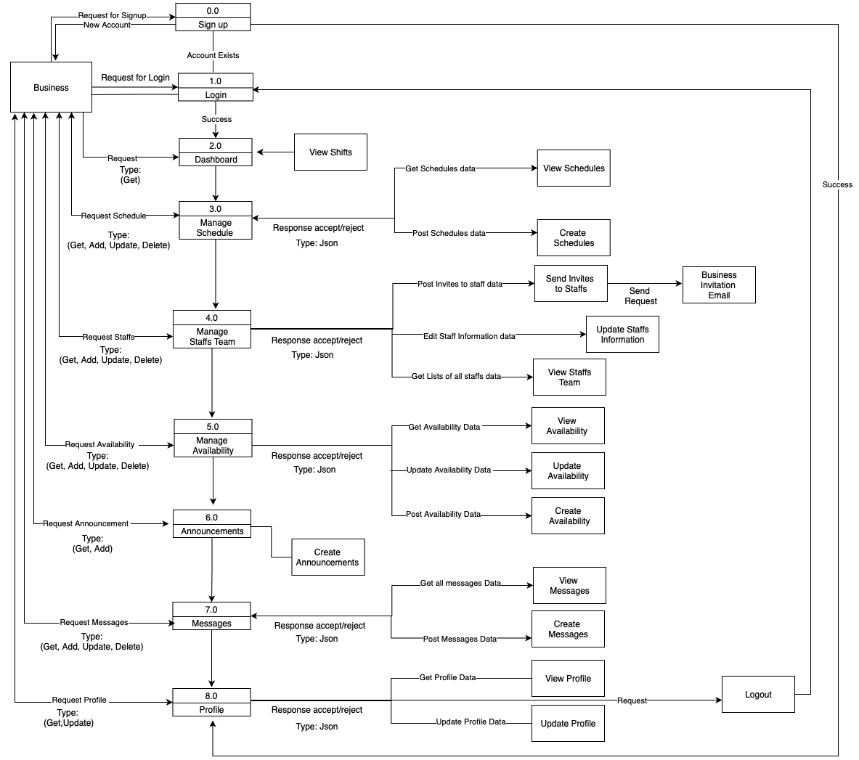
Business Data Flow Diagram
Notes:
CALEB

Slide 22
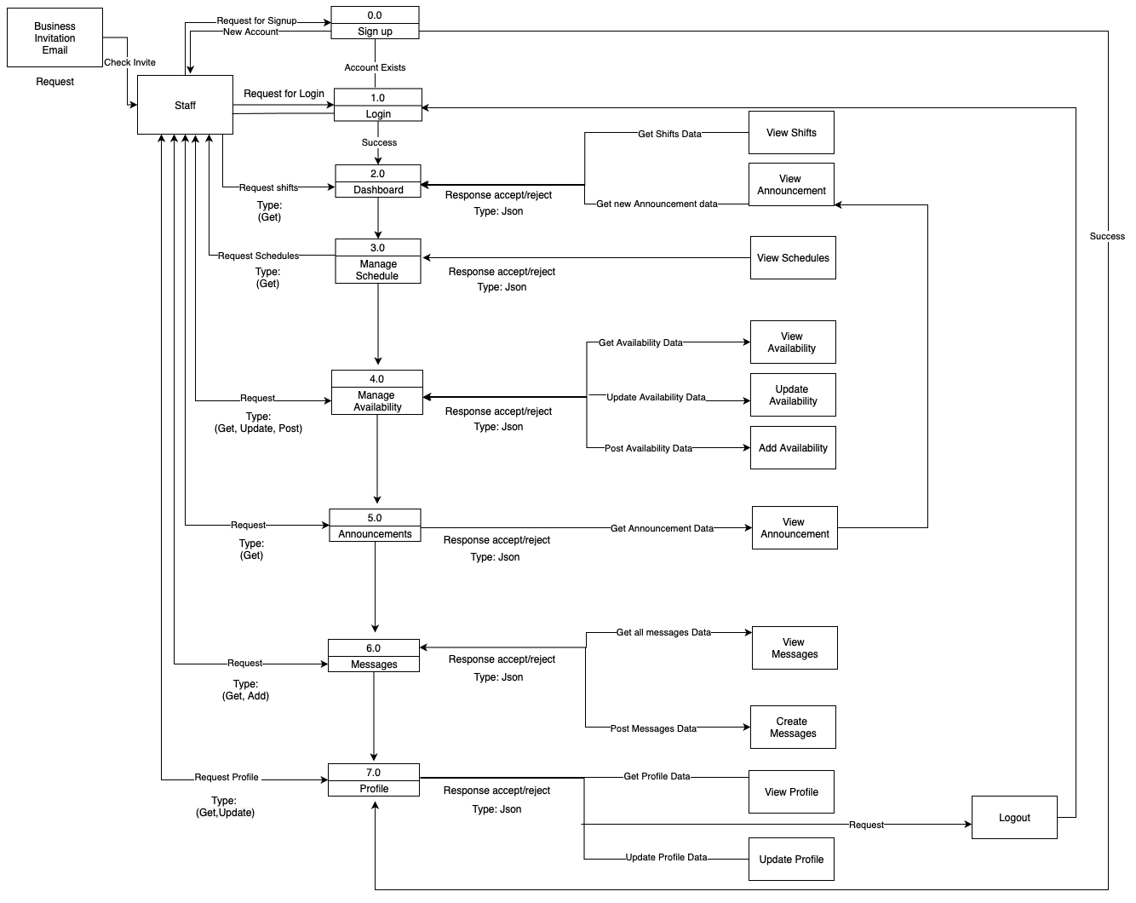
Staff Data Flow Diagram
Notes:
CALEB

Slide 23

References
[1] Google, “Firebase Build Documentation” https://firebase.google.com/docs/build
[2] Google, “Firebase Firestore Collection Structure” https://firebase.google.com/docs/firestore/manage-data/structure-data

Slide 24

QUESTIONS

