Slide 1
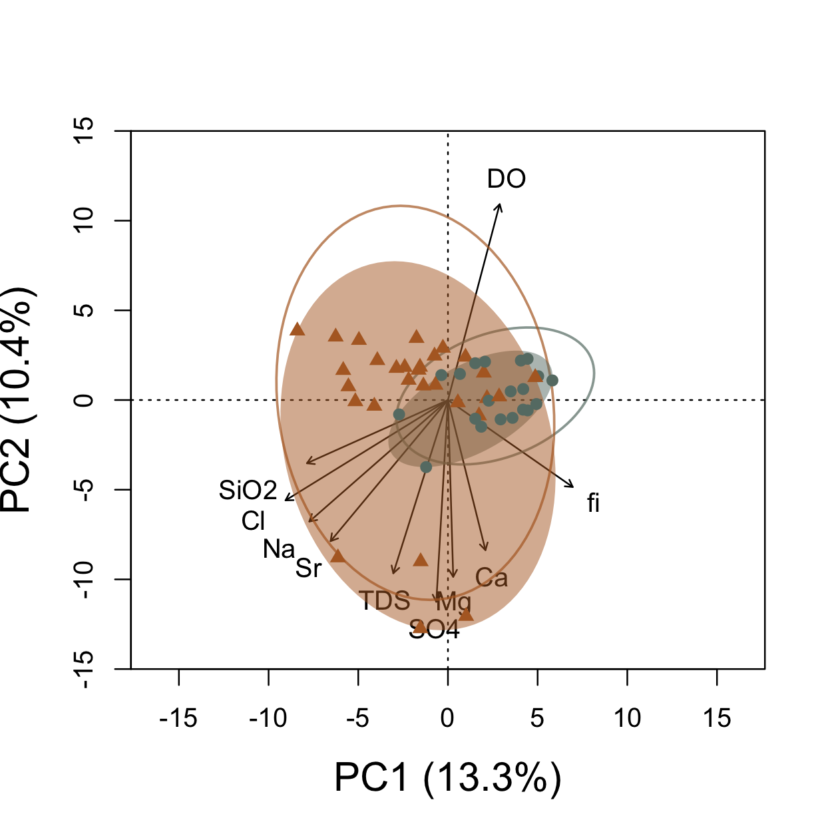
Mount Hood
Glacier National Park
Warm
springs (4)

