Slide 1
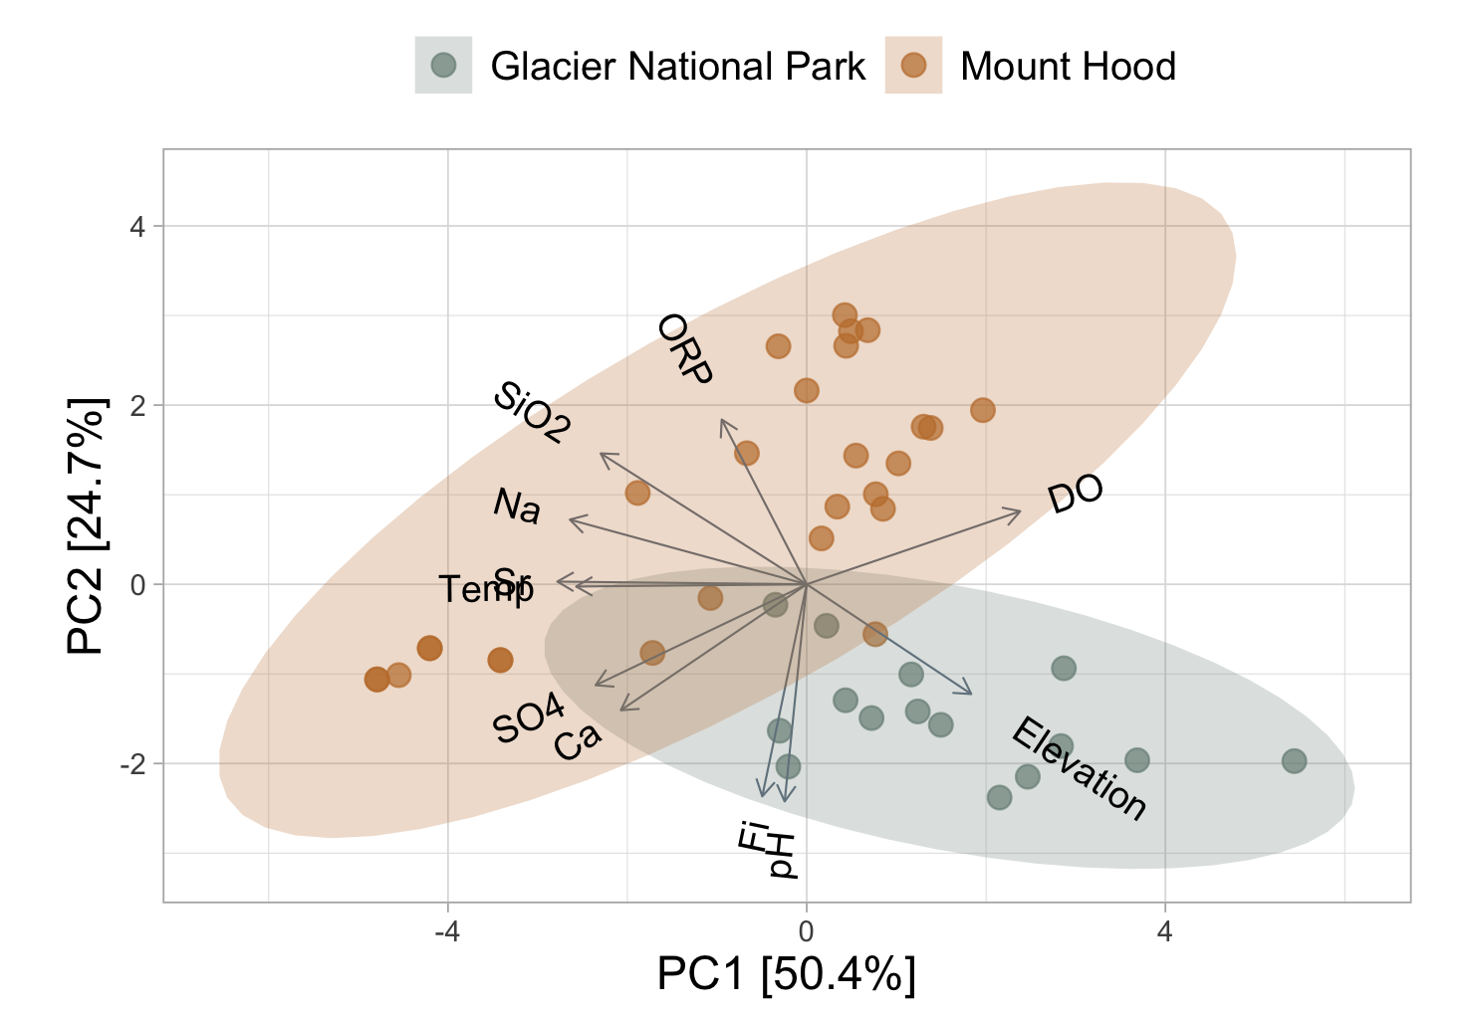
Sr, Temp
Warm Springs

