Slide 1
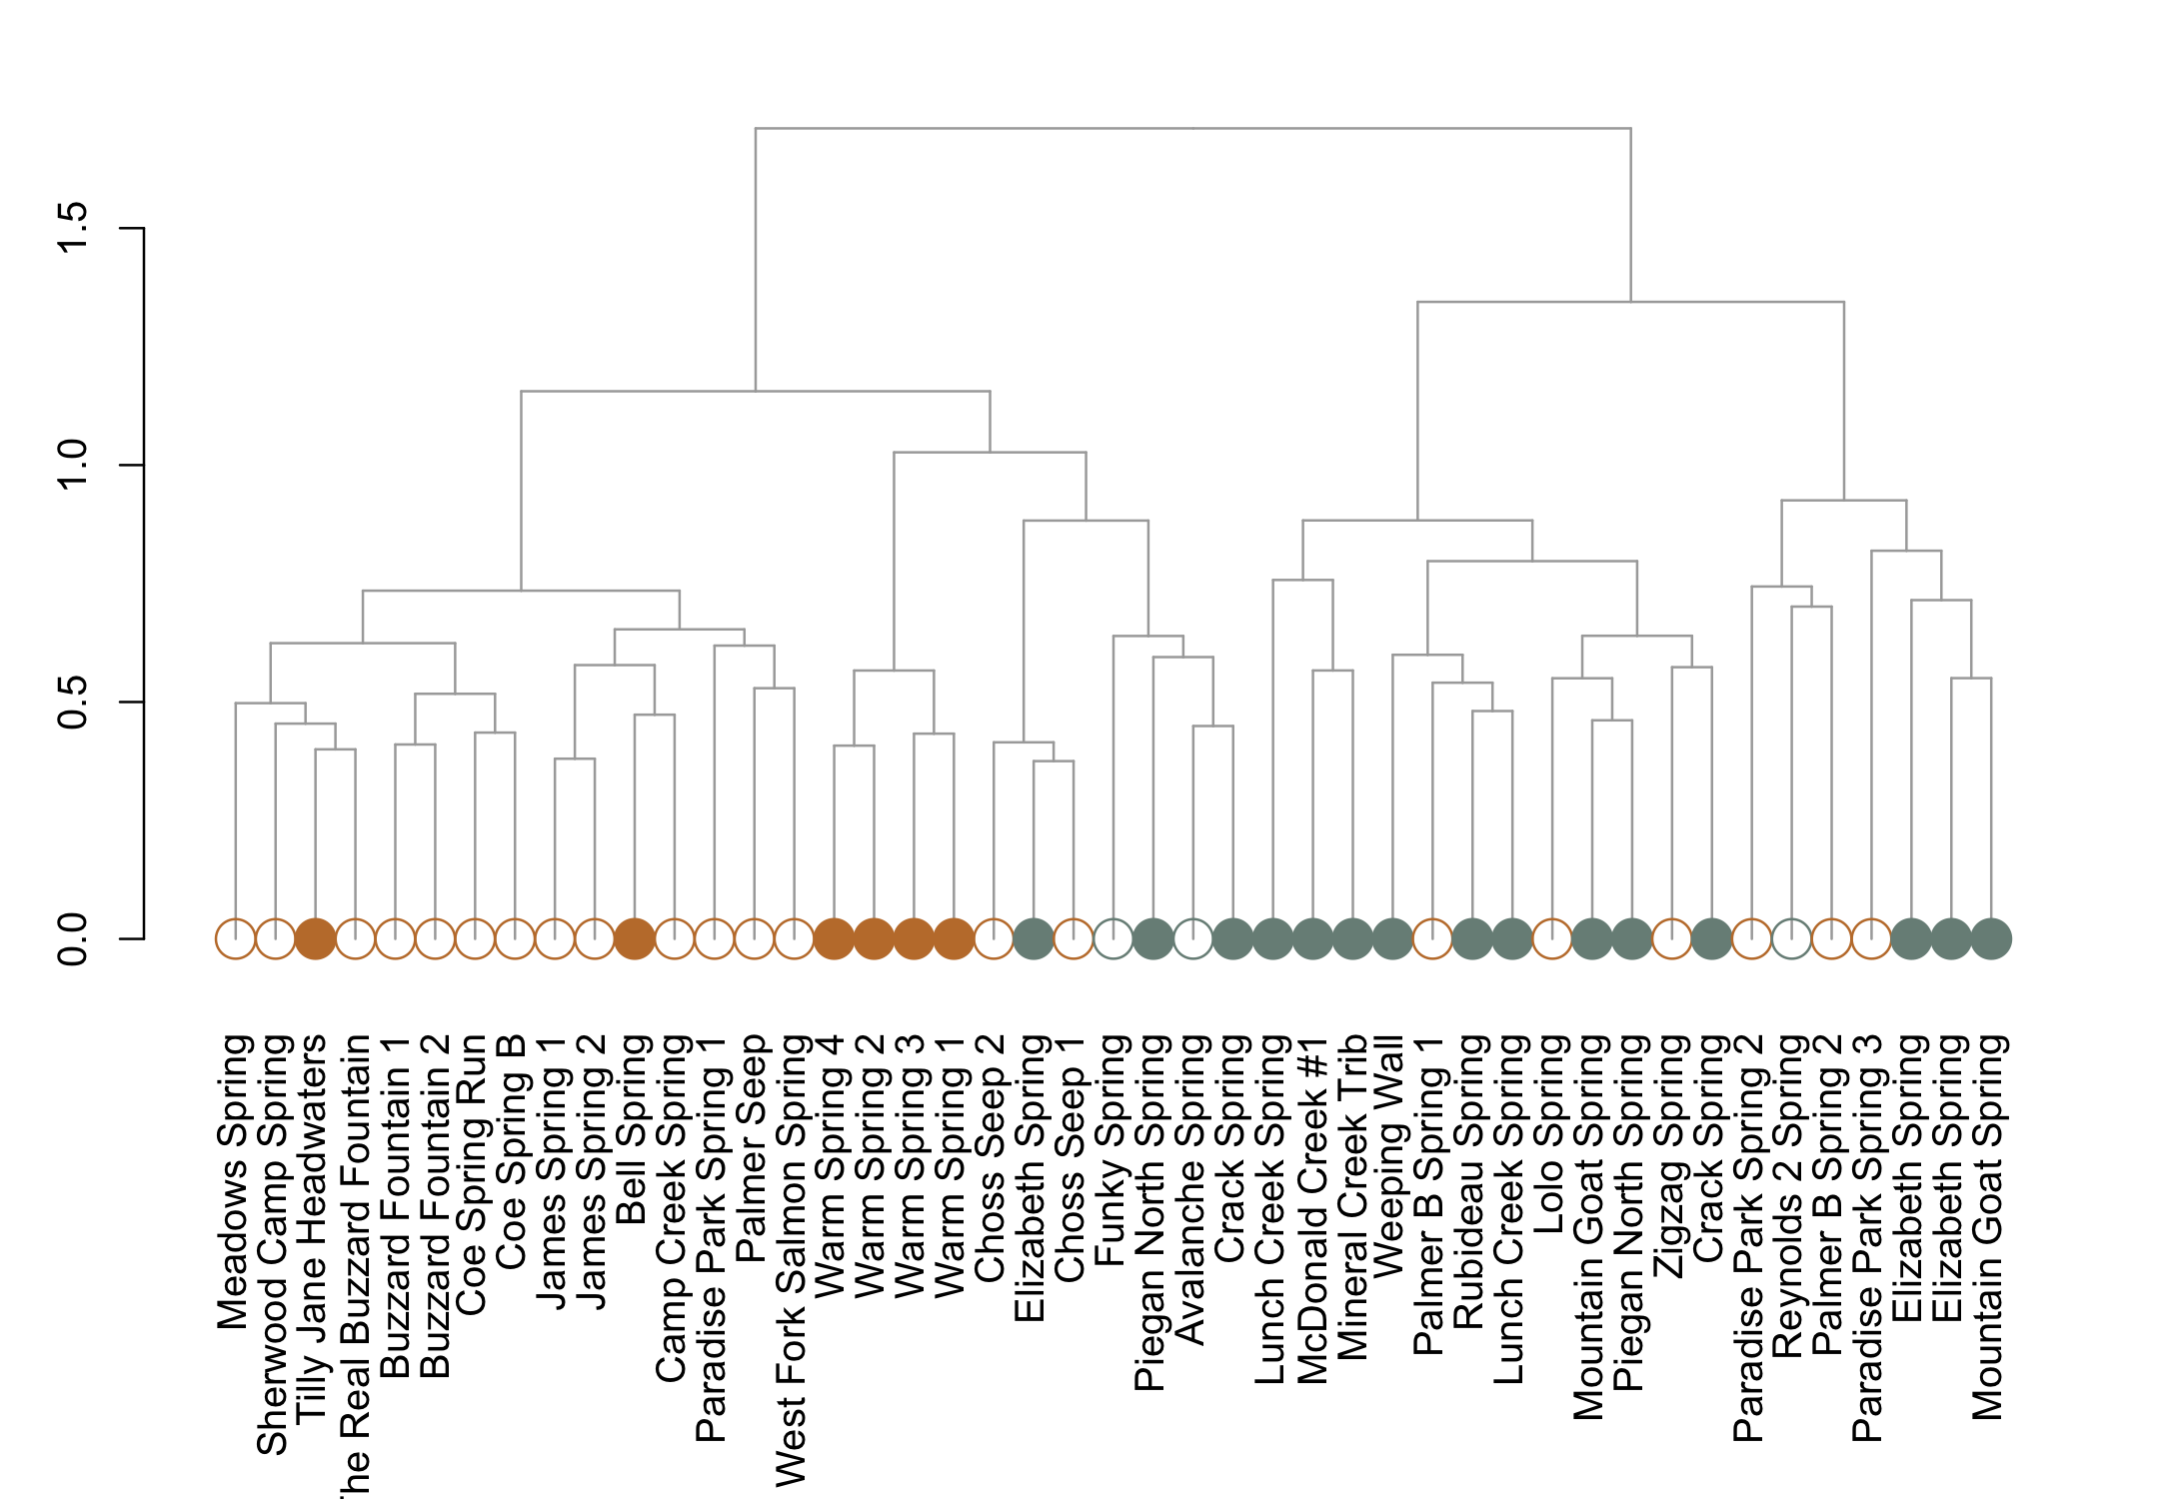
Recharge Source
Mount Hood
Glacier Meltwater
Glacier National Park
Precipitation

