Slide 1
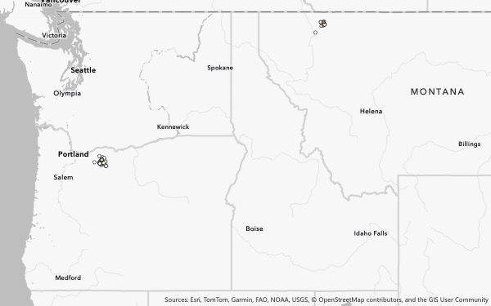
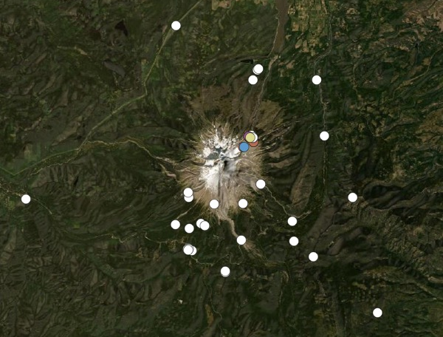
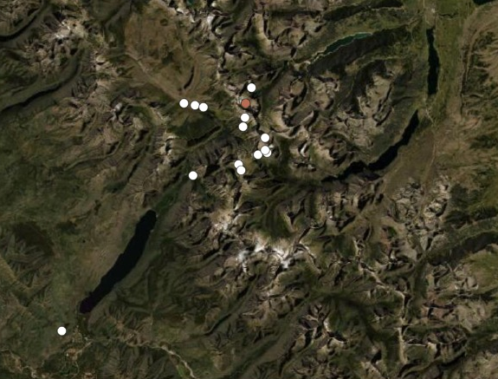
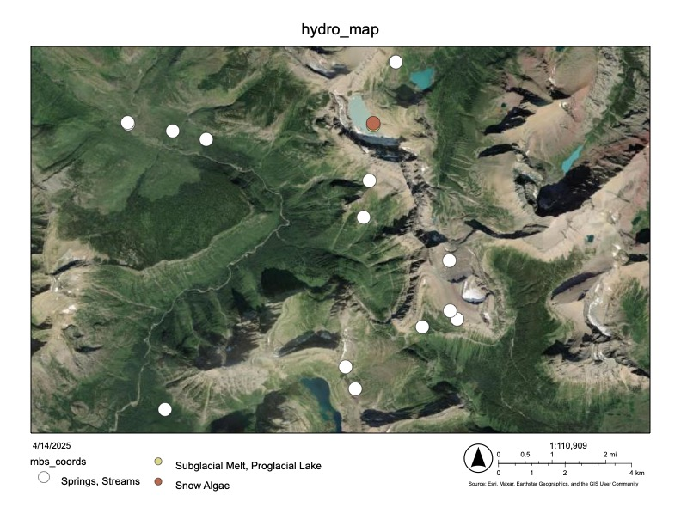
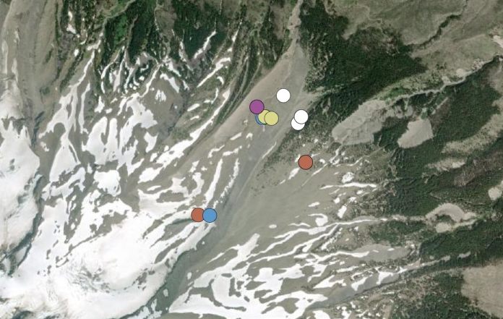
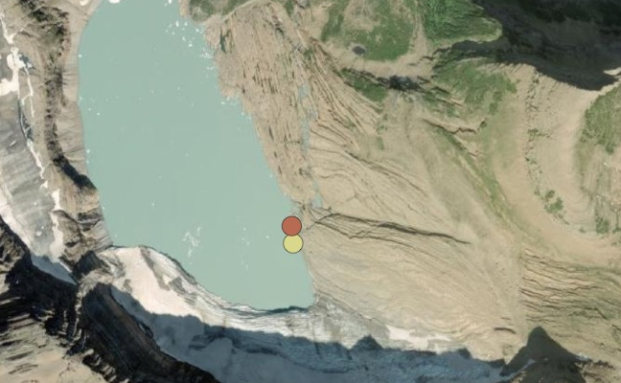
Montana
10 km
10 km
Oregon
Springs, Streams
C
Subglacial Melt, Proglacial Lake
A
Snow Algae
Snow
Glacial Ice
1 km
4 km
0.5 km
B
D
E

