Slide 1

Dallas Love Field Flight Delays
Christopher Haub
Spring ’23
SMU MSDS 6373 – Time Series

Slide 2
Flight Delays Departing from Dallas Love Field in 2018
Investigated role of weather affecting flight departure delays
Specifically, the role of temperature and humidity
Examined all flights departing Love Field from Alaska Airlines, Delta Airlines, Skywest Airlines, Virgin America and Southwest Airlines
Data was for the entire year of 2018

Slide 3
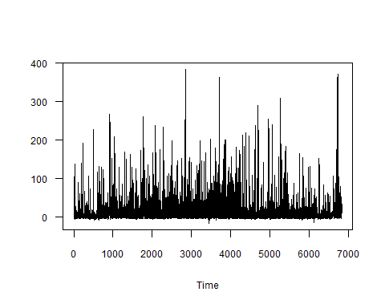
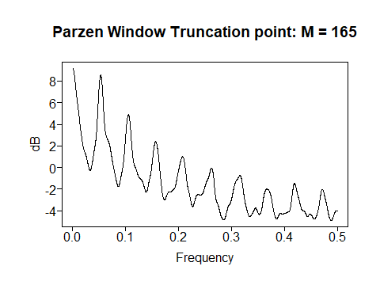
The Data
Departure Delays in Minutes
Response variable: average departure delay
Explanatory variables: average temperature, average humidity, hourly averages for both
Other variables: date, departure time

Slide 4
Applications
Uses of this analysis:
Predict flight delays ahead of time based on forecasted weather
Potential cost savings for airlines
Potential time savings for customers

Slide 5
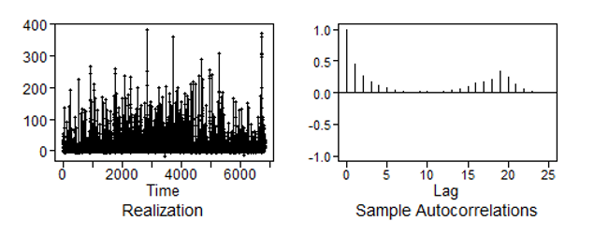
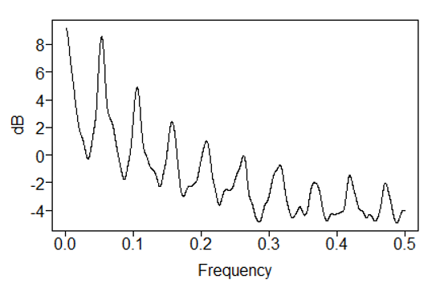
Univariate Analysis
Peak at 0, wandering
Peak at .05, 19 hours
Non-stationary data
Daily seasonality suspected, flight day on
average is 19 hours. Very few flights from midnight hour until 5 A.M. Shows up well in ACF and spectral density plots
1/19 = 0.053
Wandering behavior present with a peak in spectral density at 0.0

Slide 6
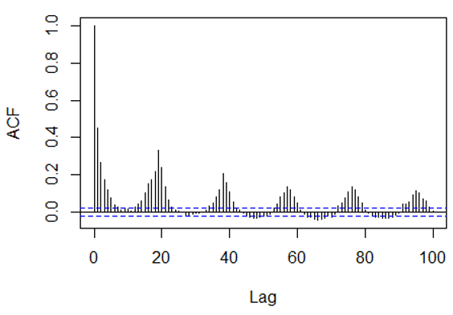
Univariate Analysis
Peaks every 19 days in ACF plot
Peaks every 19 hours

Slide 7
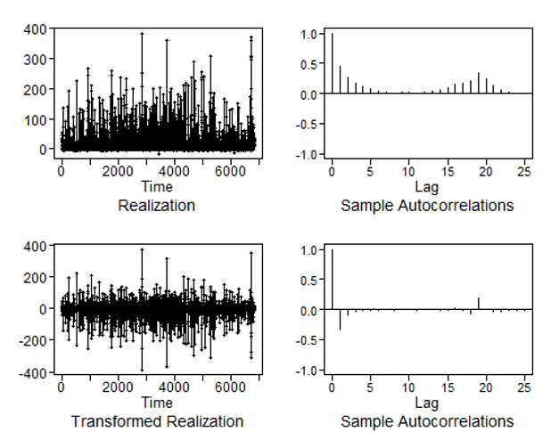
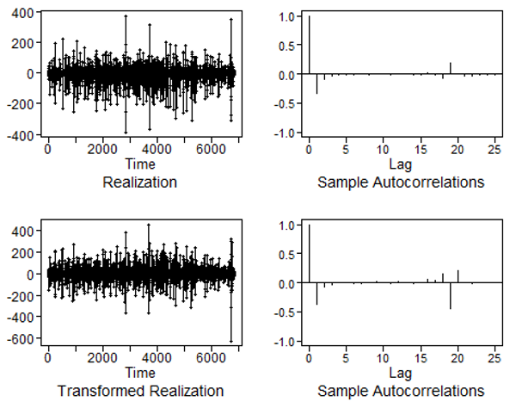
Filtering Univariate Data
Differenced Data
Resulted in data that looks to have much more of a white noise pattern
(1-B19)Xt=at
After differencing a 1 minus B to the 19th was taken out

Slide 8
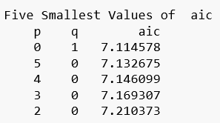
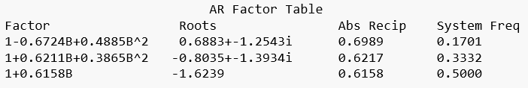
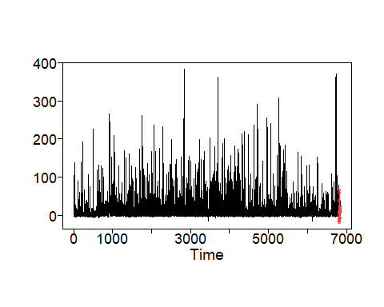
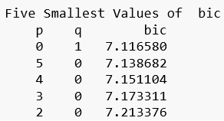
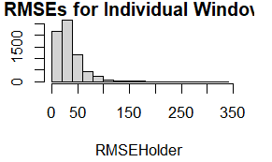
Univariate Analysis: ARMA
AR (5, 0), 19
Final AR Model:
(1 + 0.56B + 0.43B² + 0.33B³ + 0.22B⁴ + 0.12B⁵)Xt = at
AR (5, 0) ASE 208.22
Both models of AIC recommend an
ARMA (0, 1), then (5, 0)
Forecast next 19
Last 19 minutes

Slide 9
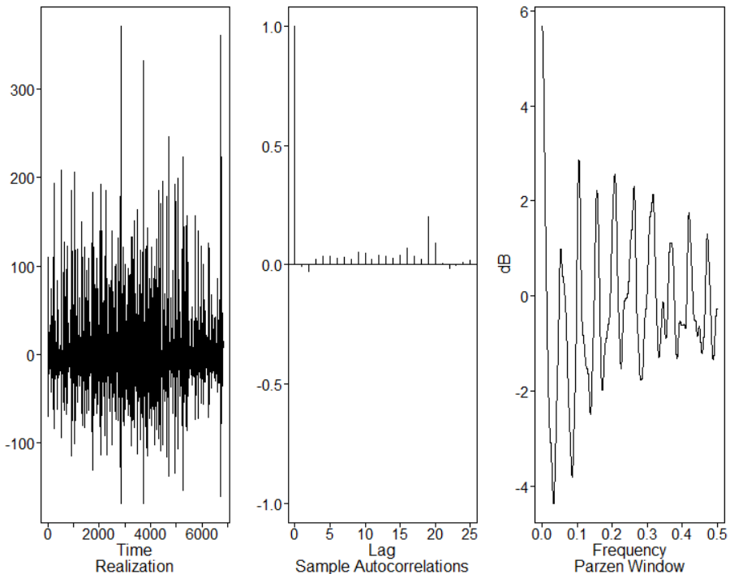
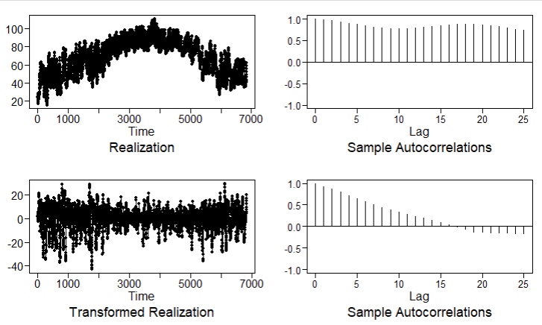
Multivariate Analysis: ARMA (2, 2)
Multivariate analysis – includes additional variables:
Average Temperature
Average Humidity
AIC = 64,198
ARMA (2, 2)

Slide 10
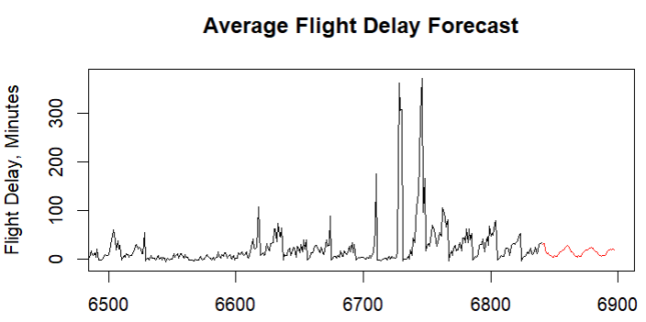
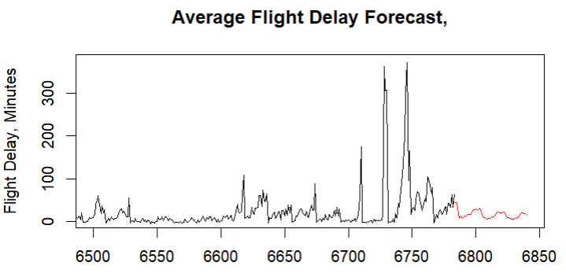
VAR Model
Predicting next 57 hours
Predicting previous 57 hours
ASE = 378
AIC = 23

Slide 11
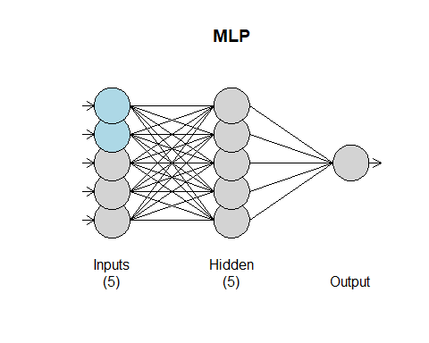
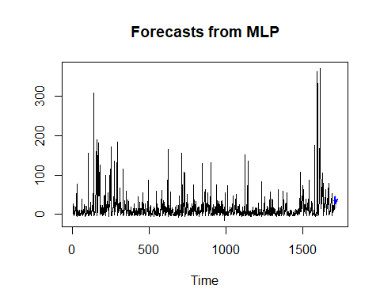
Neural Network: MLP
ASE = 478

Slide 12
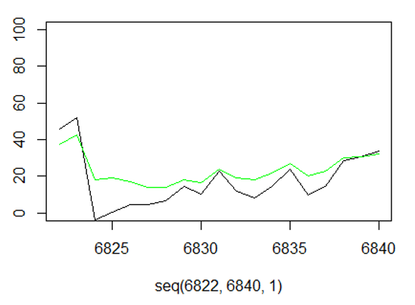
Ensemble
Combination of MA (1) + MLP Models
Had the best ASE of all models
Previous 19 Hours
ASE = 91

Slide 13
Chris Haub Time Series SMU Masters of Data Science Spring Semester 2023 chaub@smu.edu
Thank you for taking the time to review my presentation. If you have any comments or questions, feel free to reach out. I plan on taking this farther and featuring data from previous 12 months and including additional airports and more explanatory variables. FAA keeps extensive statistics on reasons for flight delays, I am planning on meeting with a couple of commercial airline pilots that fly for major carriers and learning more.

