Slide 1

Leadership Cloudcroft
Developing Community Champions
A new solution for an old problem

Slide 2
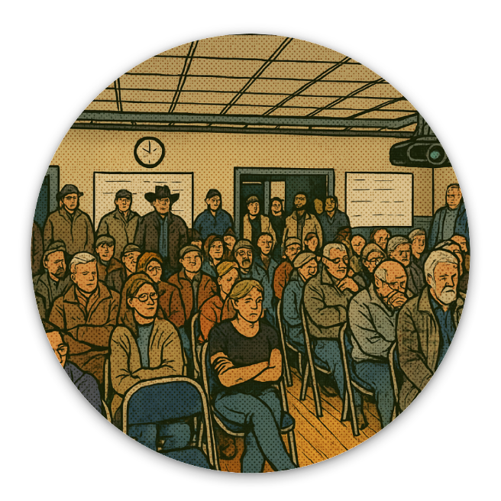
The Challenge
Dependence on Volunteers
Cloudcroft relies on volunteers for essential roles in government, schools, library, fire department, and community committees.
Lack of Formal Training
There is no formal system to identify or train these leaders, resulting in unprepared volunteers and oversights.
Volunteer Burnout
Without proper systems, we experience burnout and high turnover, affecting the efficiency of community services.
Weak Networking
There is weak networking across groups, exacerbating coordination and communication issues.
Notes:
Cloudcroft relies heavily on volunteers for essential roles in various areas such as government, school board, library, fire department, and community committees. However, there is no formal system in place to identify or train these leaders, leading to unprepared volunteers, oversights, and burnout. Additionally, there is weak networking across different groups, exacerbating these issues.

Slide 3
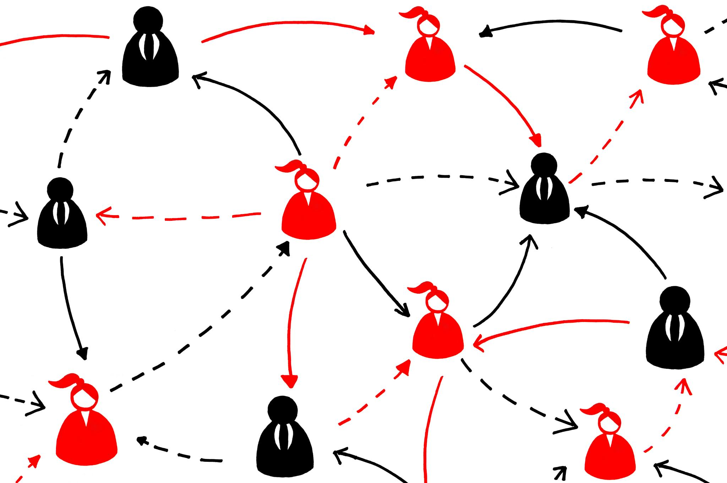
Leadership Cloudcroft Goals
Identify and Prepare Leaders
Help develop community champions to lead civic, business, and community positions.
Practical Knowledge of Local Issues
Gain practical, real-world knowledge of local issues.
Network of Engaged Members
Foster a network of informed and engaged leaders who collaborate and support each other. Fewer silos.
Encourages Active Participation
Get people off the sidelines. Empower those who want to help make Cloudcroft healthy and strong.
Notes:
The Leadership Cloudcroft Mission aims to identify and prepare leaders for volunteer, civic, business, and community roles. It seeks to equip participants with practical knowledge of local issues and foster a network of informed and engaged community members. This initiative encourages active participation and empowers individuals to make a positive impact in their communities.

Slide 4


Program Overview
Program Duration
The program spans from June to October 2025, featuring six full-day classes held monthly.
Expert Speakers
Sessions will feature presentations and insights from expert speakers sharing lessons learned.
Interactive Discussions
Classes will incorporate interactive discussions and meaningful conversations.
Site Visits and Group Projects
We will make site visits, such as a tour of the Village Water Systems, and engage in group projects to enhance practical application.
Notes:
This program runs from June to October 2025 and includes six full-day classes, one per month. The format features interactive discussions, expert speakers, site visits, and group projects. Sessions will be held at a central venue in Cloudcroft, providing an engaging and immersive learning experience for all participants.

Slide 5


Curriculum Topics
Governance
How Cloudcroft is organized as a local government. Roles and responsibilities. Lessons learned from past mistakes.
Infrastructure
Delivery and maintenance of Water, Roads, Utilities, and more
Education
What it takes to provide a first-class educational experience.
Fire Safety
Protecting people and property from fire risk. Preparation and plans.
Economic Development
How can we improve tourism, encourage new businesses, and address the workforce's needs?
Healthcare
Challenges of getting quality, timely care in the region.
Notes:
An in-depth look into key curriculum topics including Governance, Infrastructure, Fire Safety, Economic Development, Healthcare, and Education.

Slide 6

How to Apply
Raise Your Hand
Let us know you want to be part of the program. To be considered for the Leadership Cloudcroft 2025 Class, submit your application by May 28th.
Online Submission
Applications can be submitted online through the Leadership Cloudcroft 2025 Class Application portal: LeadershipCloudcroft.com
Class Participants
The Leadership Cloudcroft 2025 Class will consist of approximately 12 participants.
Notes:
To apply for the Leadership Cloudcroft 2025 Class, you need to submit your application by May 28, 2025. Applications can be submitted online through the Leadership Cloudcroft 2025 Class Application portal. The class will consist of approximately 12 participants. For any inquiries, please contact us at ideas@leadershipcloudcroft.com.

Slide 7
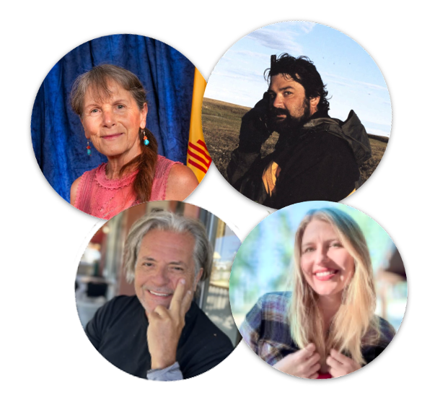

Leadership Team Overview
The Advisory Board consists of Trustee Gail McCoy, Mayor Tim King, and Chris Hearne
Hannah Dean is the Executive Director of the program.
Leadership Cloudcroft is produced by Cloudcroft Reader, the voice of the mountain.
Notes:
Our leadership team consists of experienced and dedicated individuals who guide our organization. The Advisory Board includes Trustee Gail McCoy, Mayor Tim King, and Chris Hearne. Our Executive Director, Hannah Dean, leads with vision and commitment. This presentation is produced by Cloudcroft Reader, showcasing our team's capabilities and achievements.

Slide 8

Contact Information
Visit
leadershipcloudcroft.com
for detailed information on the program and how to apply online.
Email
hello@leadershipcloudcroft.com
Notes:
For inquiries or further information, please reach out to us via email at hello@leadershipcloudcroft.com. You can also visit our website at www.leadershipcloudcroft.com for more details about our programs and activities.

