Slide 1
Project Course
SUBSCRIPTION
CHRISTIANE MARIA PEDROSA

Slide 2
Topics
About me
Technologies / TOOLS/ frameworks
coding
Scaling and querying
CHALLENGES
IMPROVEMENTS

Slide 3
About me

Slide 4
technologies / tools / FRAMEWORKS
DDD
.net core
Web api
AZURE SQL
ENTITY FRAMEWORK core / code first
AZURE SERVICE BUS
SWAGGER

Slide 5
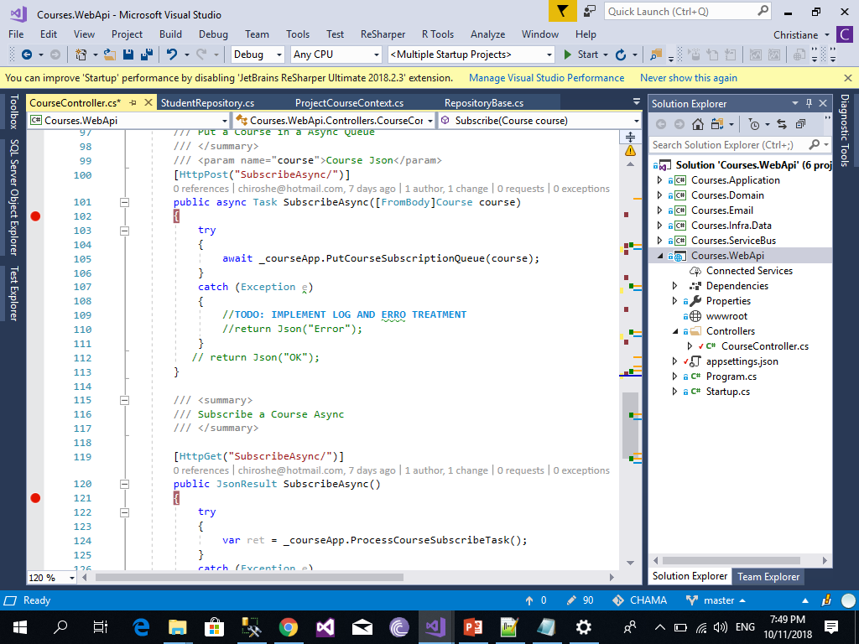
CODING

Slide 6
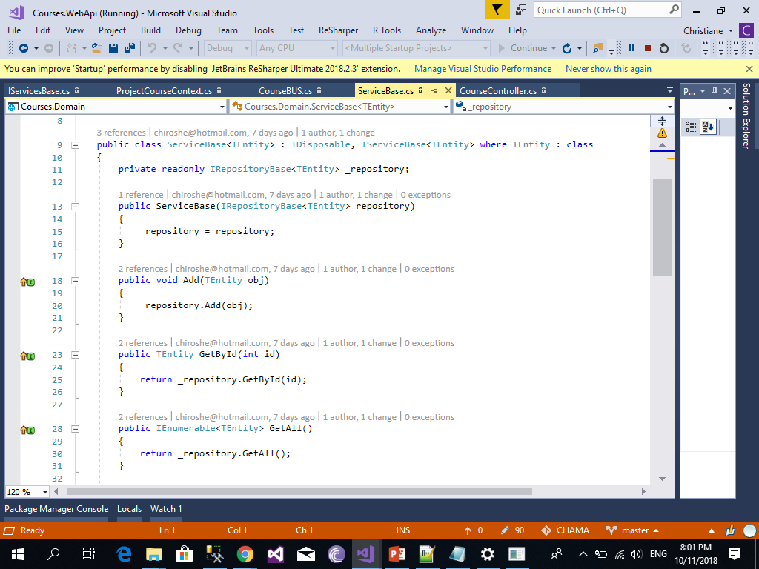
CODING

Slide 7
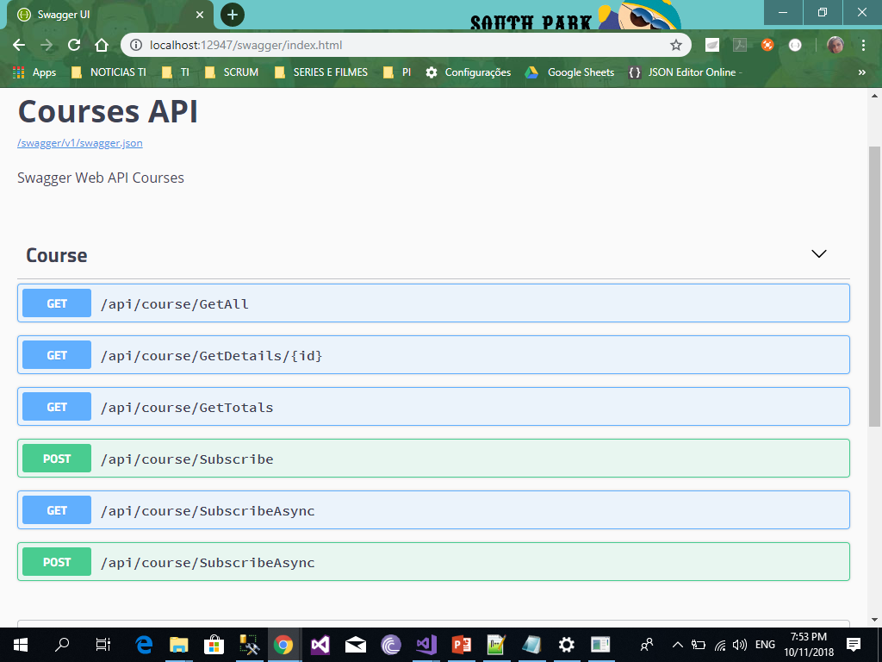
CODING

Slide 8
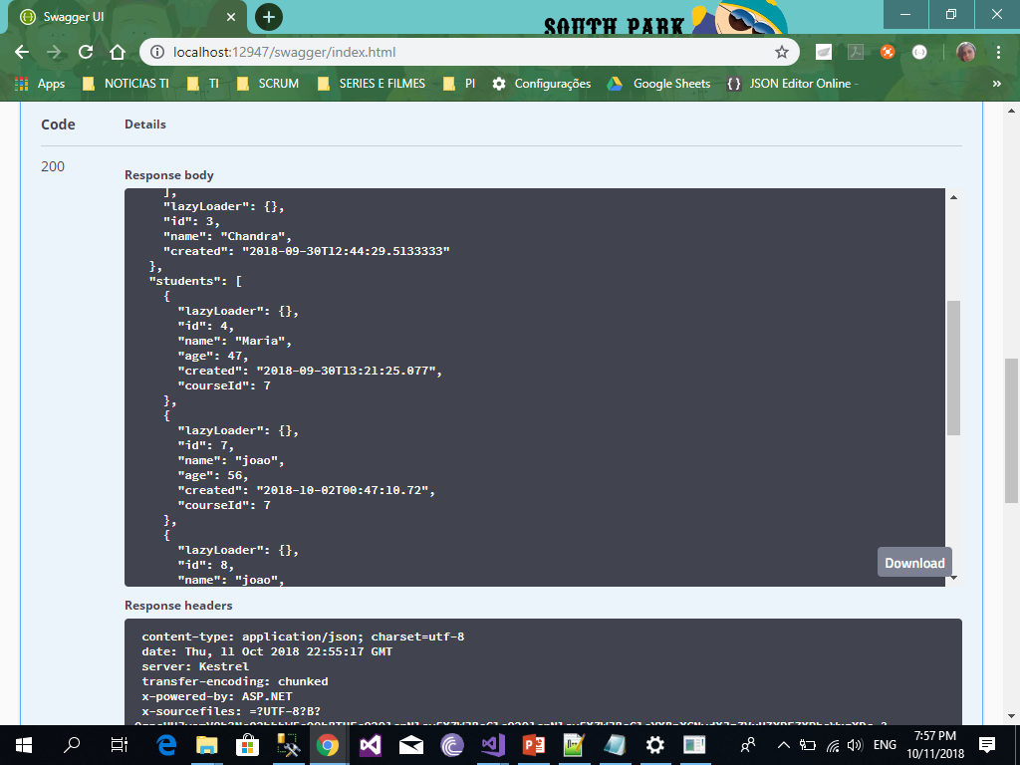
CODING

Slide 9
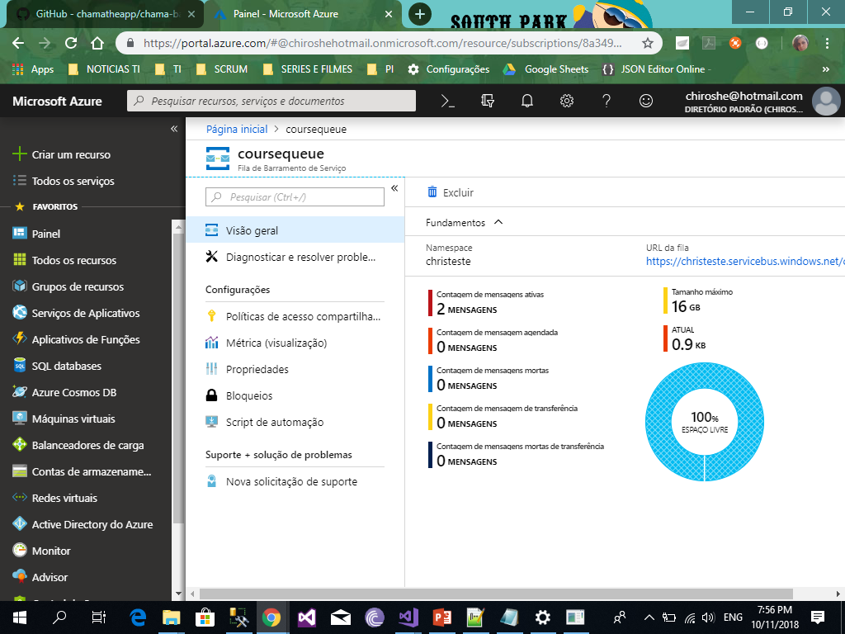
CODING

Slide 10
SCALLING / QUERYING
WEB API
SERVICE BUS

Slide 11
CHALLENGES
SERVICE BUS PERMISSIONS
SERVICE BUS DIFICULTS WITH .NET CORE VERSION

Slide 12
IMPROVEMENTS
TDD / MOQ
Error TREATMENT / LOG
DEPENDENCY INJECTION
NO SQL
FACTORY PATTERN EMAIL
SWAGGER DOCUMENTATION
EVENT GRID / AZURE FUNCTIONS

