Slide 1

Grocery Store Management
Presented by:
SATISH TALLURI
Chrishmen .ys
Vikram
sridhar

Slide 2

Introduction
The Retail and Grocery domain requires effective management of inventory, suppliers, customer orders, employees, and product categories.
Efficient data handling helps businesses track sales and revenue, monitor product availability, and analyze operations.
This project simulates a mini grocery store database with interconnected entities like products, orders, and suppliers.
It offers hands-on experience in understanding data relationships and operational workflows.
Students will use SQL to extract and transform data, gaining valuable business insights.
The goal is to improve decision-making and operational efficiency through data analysis.

Slide 3
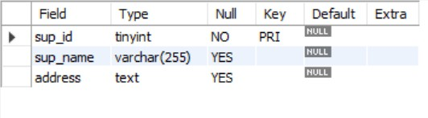

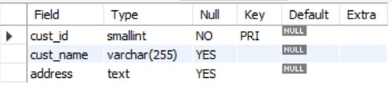

Tables
Suppliers Table
Employees Table
Customers Table
Categories Table

Slide 4
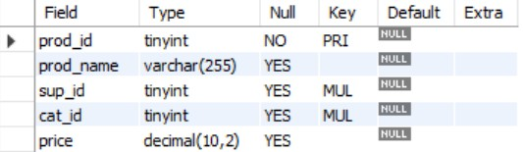

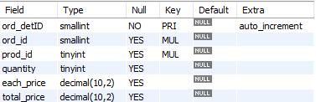
Tables
Products Table
Orders Table
Order details Table

Slide 5
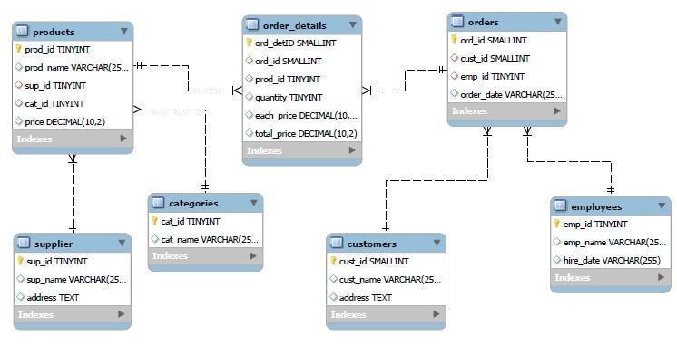
ER Diagram

Slide 6
Problem Statement
In the dynamic environment of a retail grocery store, managing and analyzing large volumes of data related to products, suppliers, customers, and orders is crucial for efficient operations and informed decision-making. This project aims to design and implement a relational database system that captures essential store activities and enables users to retrieve and analyze data through SQL. The system will support complex queries to identify key business insights such as top-performing products, high-value customers, and revenue patterns, while reinforcing practical SQL skills including joins, aggregations, subqueries, and filtering.

Slide 7


1.How many unique customers have placed orders?

Slide 8
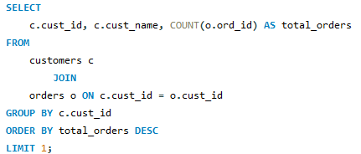

2.Which customers have placed the highest number of orders?

Slide 9
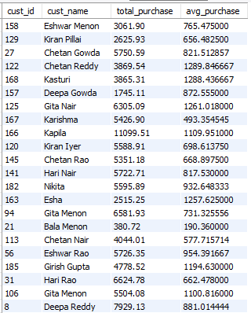
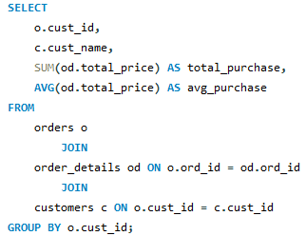
3.What is the total and average purchase value per customer?

Slide 10
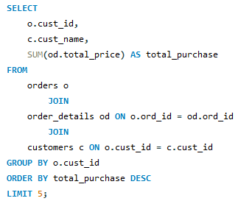
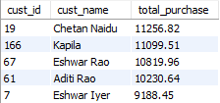
4.Who are the top 5 customers by total purchase amount?

Slide 11
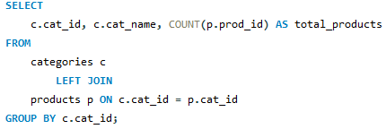
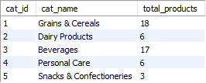
5.How many products exist in each category?

Slide 12
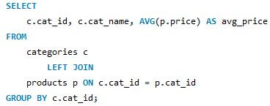
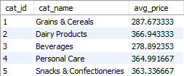
6.What is the average price of products by category?

Slide 13
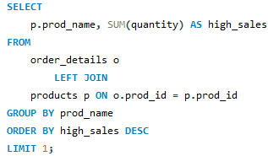

7.Which products have the highest total sales volume (by quantity)?

Slide 14
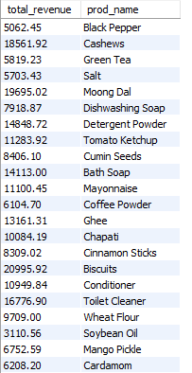
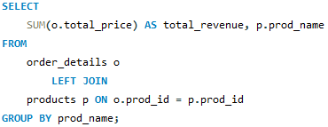
8.What is the total revenue generated by each product?

Slide 15
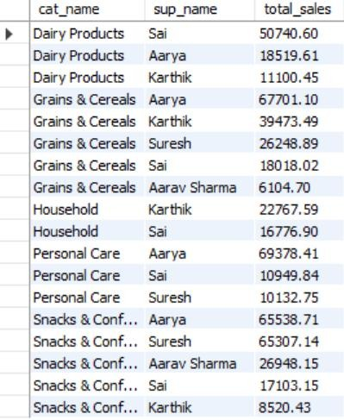
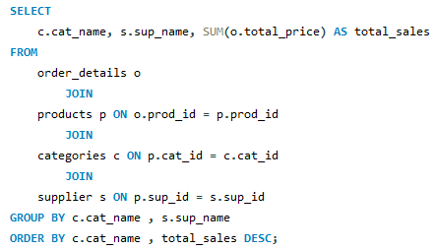
9.How do product sales vary by category and supplier?

Slide 16


10.How many orders have been placed in total?

Slide 17


11.What is the average value per order?

Slide 18
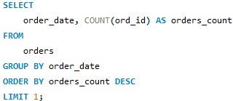

12.On which dates were the most orders placed?

Slide 19
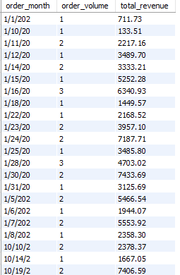
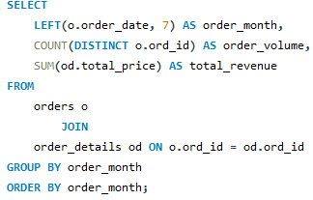
13.What are the monthly trends in order volume and revenue?

Slide 20
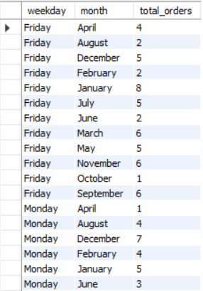
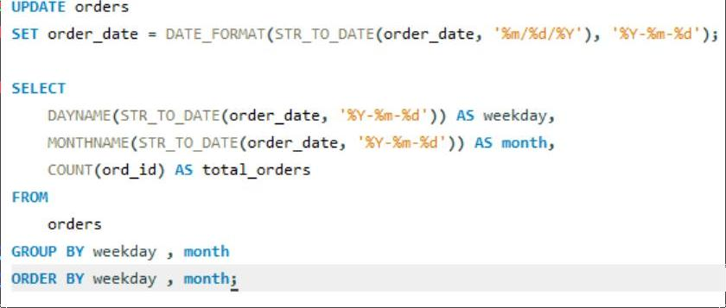
14.How do order patterns vary across weekdays and months?

Slide 21


15.How many suppliers are there in the database?

Slide 22
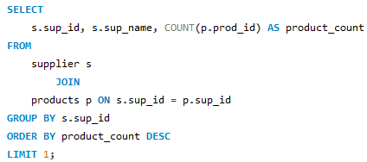

16.Which supplier provides the most products?

Slide 23
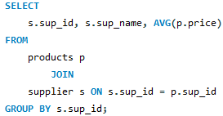
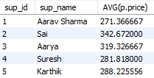
17.What is the average price of products from each supplier?

Slide 24
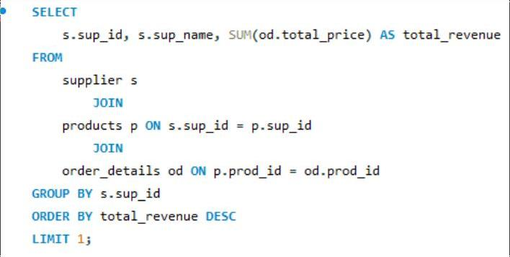

18.Which suppliers contribute the most to total product sales (by revenue)

Slide 25
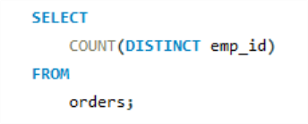

19.How many employees have processed orders?

Slide 26
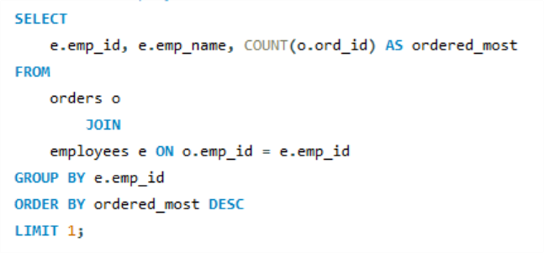

20.Which employees have handled the most orders?

Slide 27
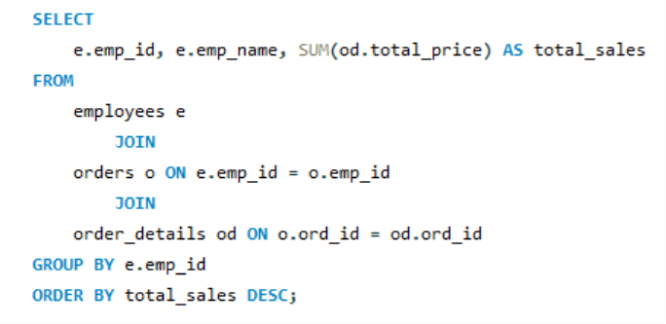
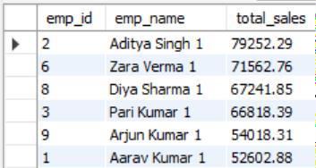
21.What is the total sales value processed by each employee?

Slide 28
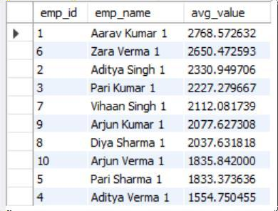
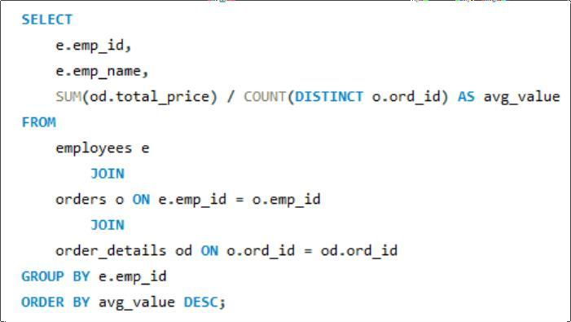
22.What is the average order value handled per employee?

Slide 29
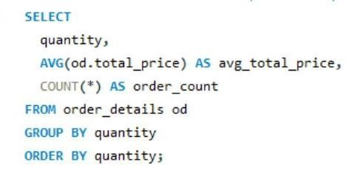
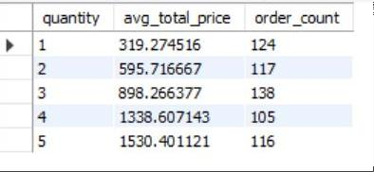
23.What is the relationship between quantity ordered and total price?

Slide 30
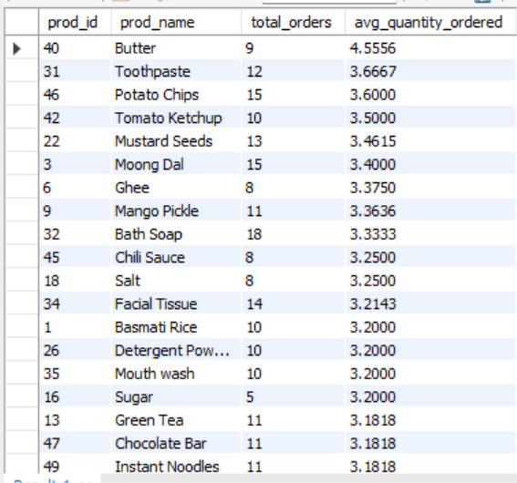
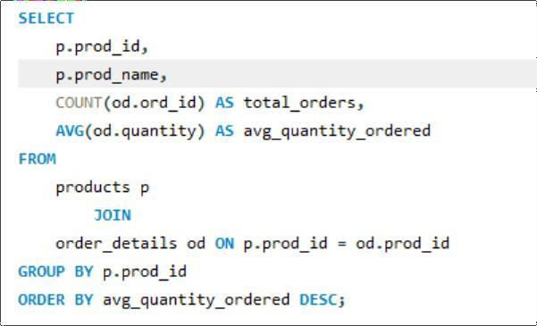
24.What is the average quantity ordered per product?

Slide 31
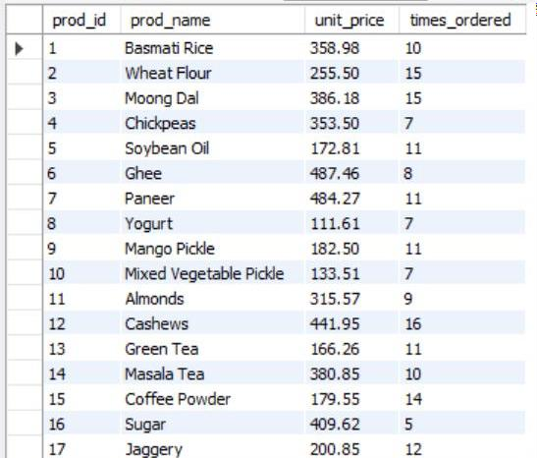
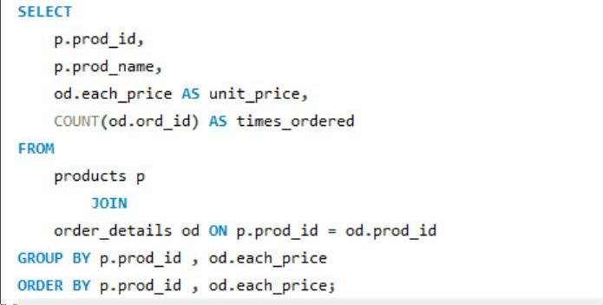
25.How does the unit price vary across products and orders?

Slide 32
conclusion
The Grocery Store Management System using SQL helps in organizing and managing grocery store operations efficiently. It reduces manual work and improves accuracy in handling product, customer, and sales data. By using SQL queries and relational database concepts, the system allows quick data retrieval, better inventory control, and effective sales management. Overall, it makes grocery store operations faster, more reliable, and easier to manage.

Slide 33

THANK YOU

