Slide 1
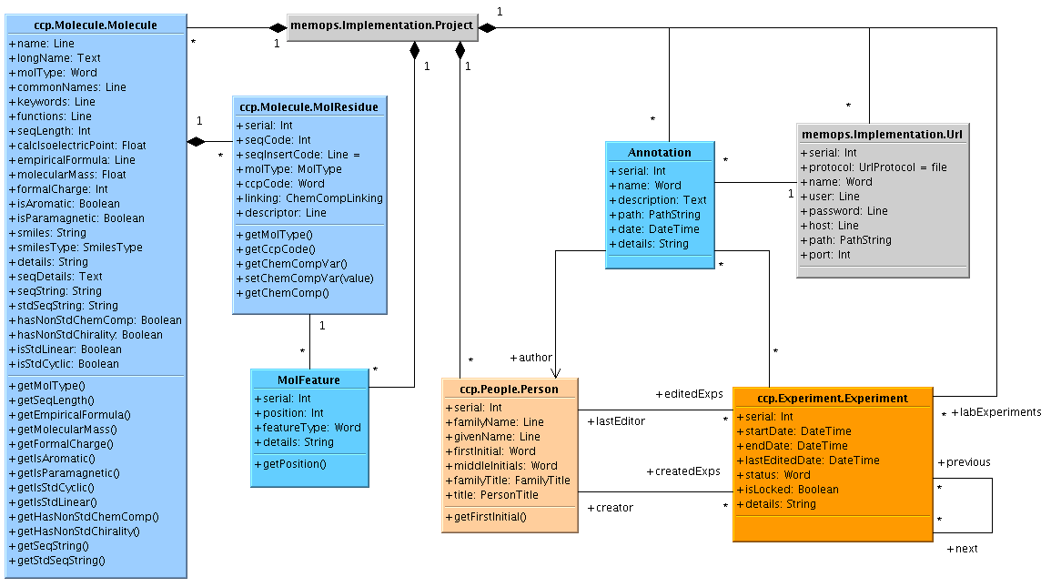
ccp.Annotation

Slide 2
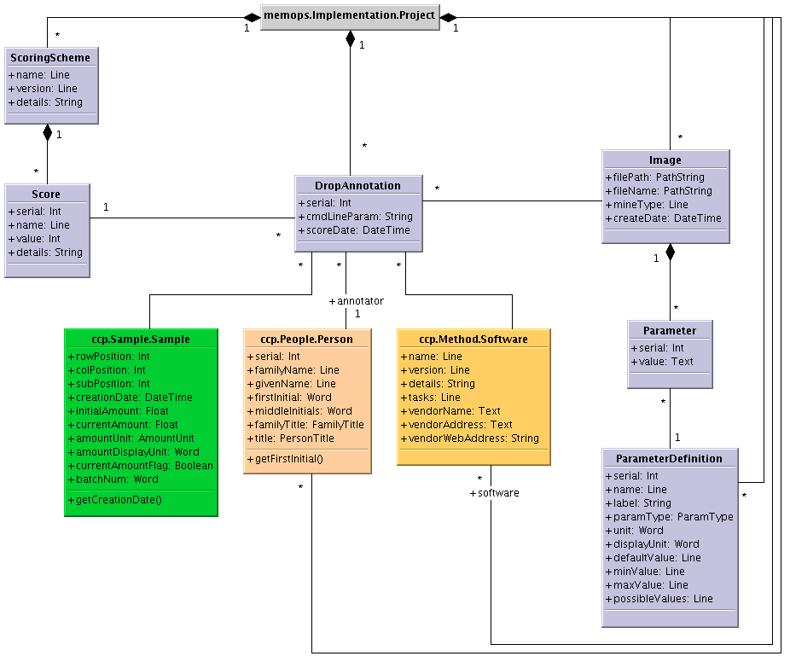
ccp.Crystallization

Slide 3
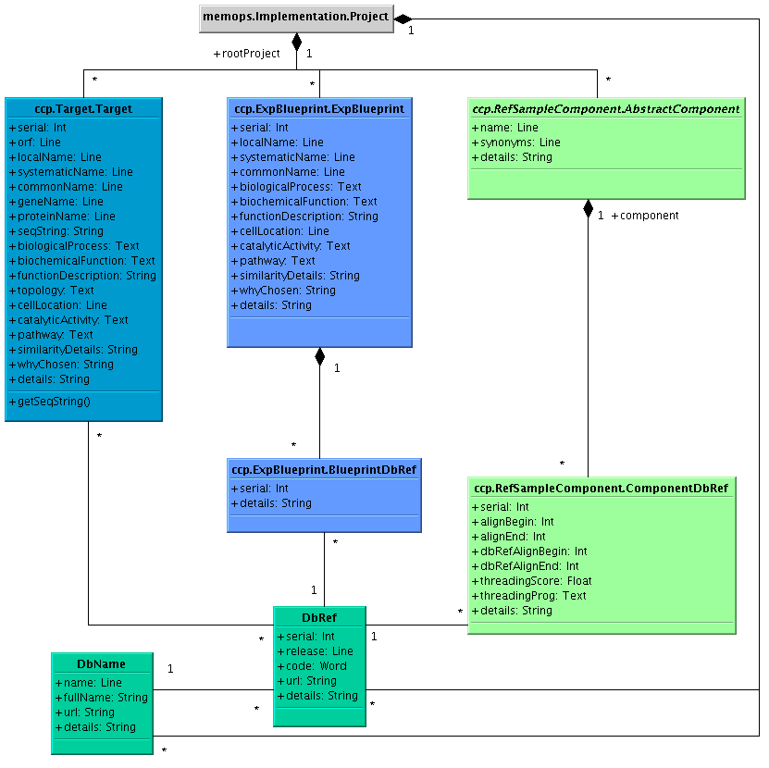
ccp.DbRef

Slide 4
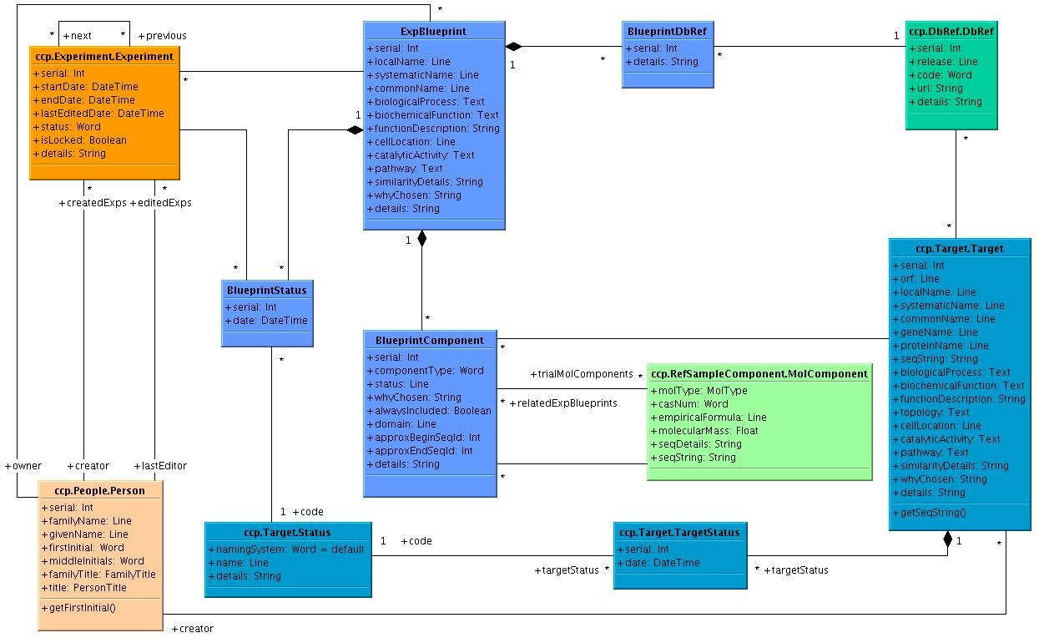
ccp.ExpBlueprint

Slide 5
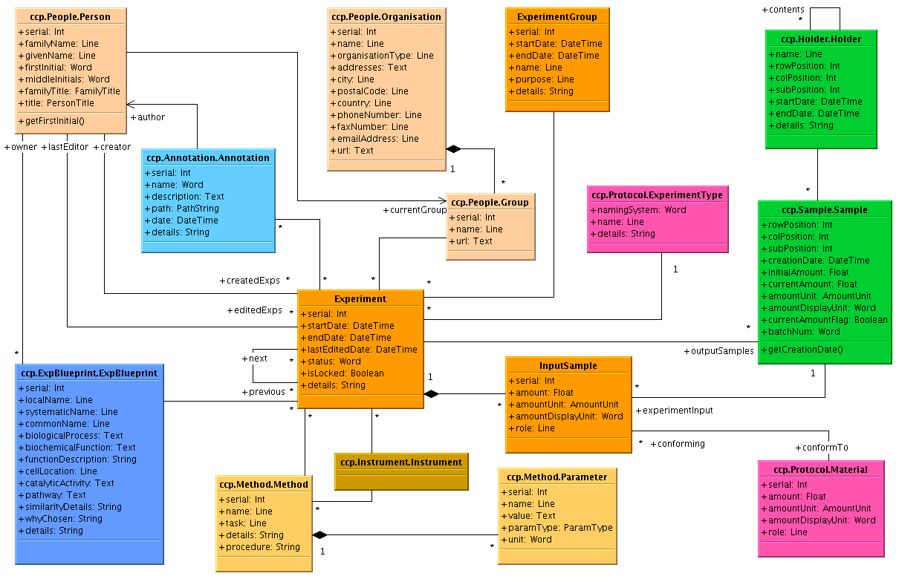
ccp.Experiment

Slide 6
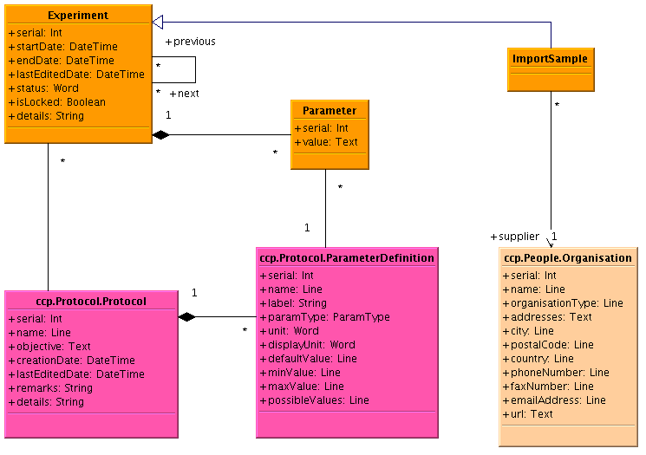
ccp.Experiment

Slide 7
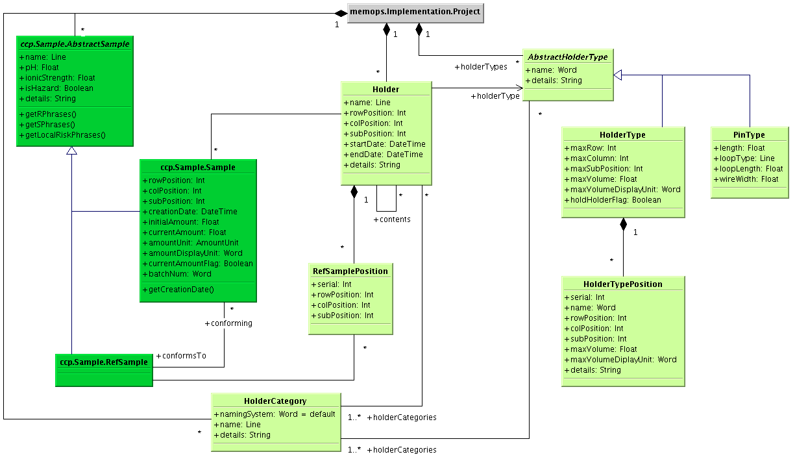
ccp.Holder

Slide 8
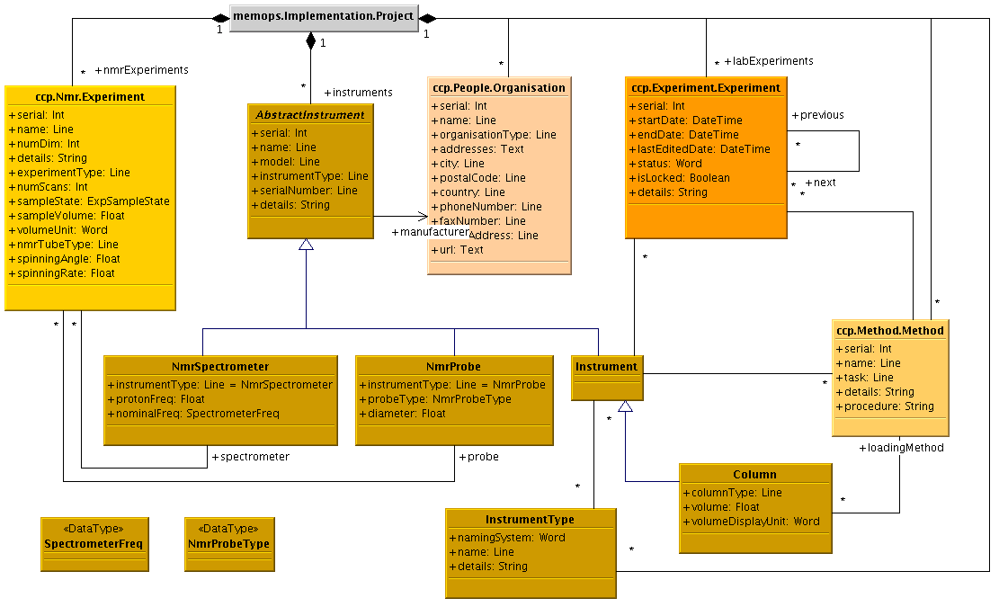
ccp.Instrument

Slide 9
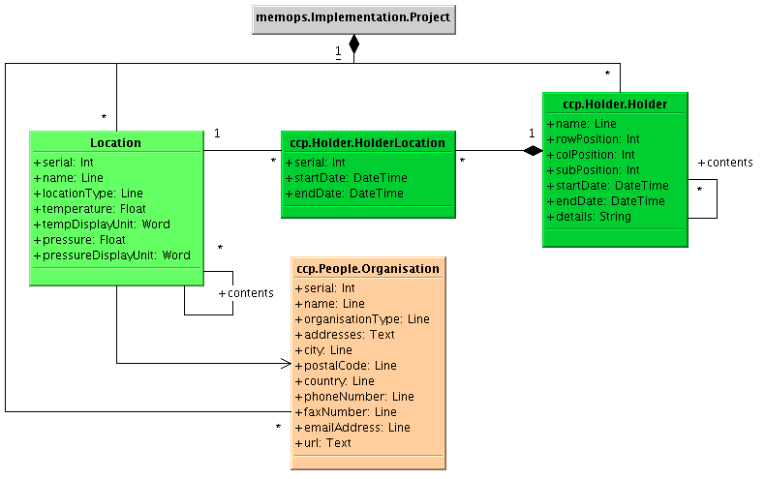
ccp.Location

Slide 10
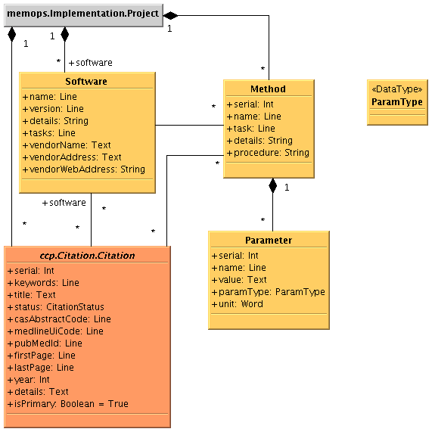
ccp.Method

Slide 11
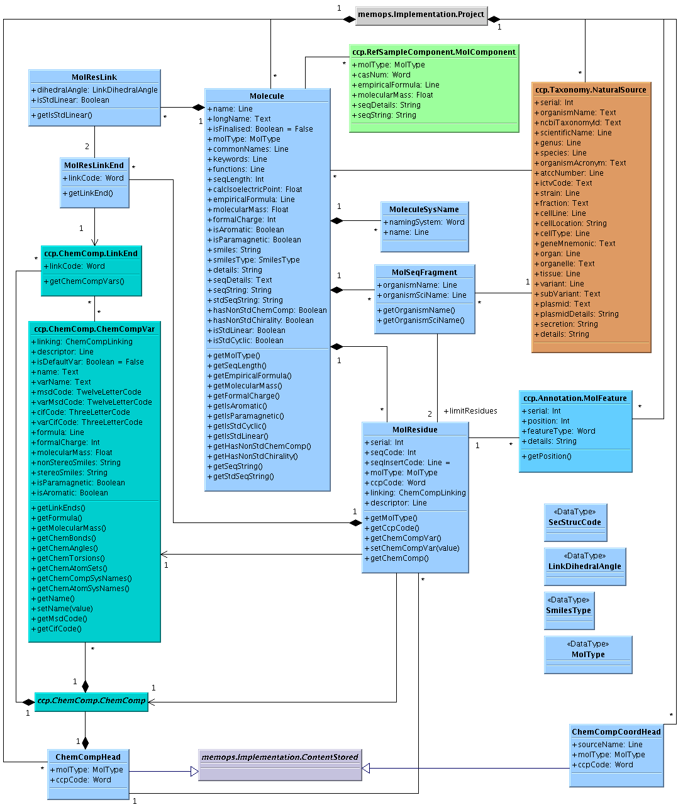
ccp.Molecule

Slide 12
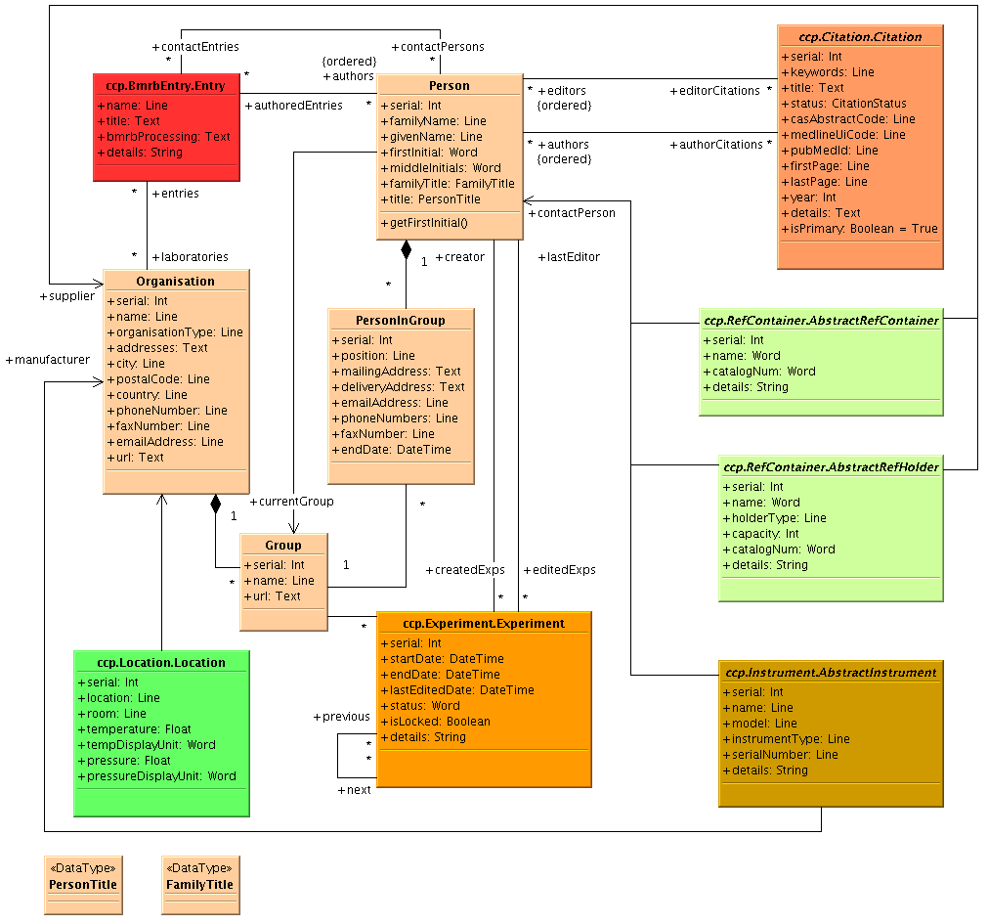
ccp.People

Slide 13
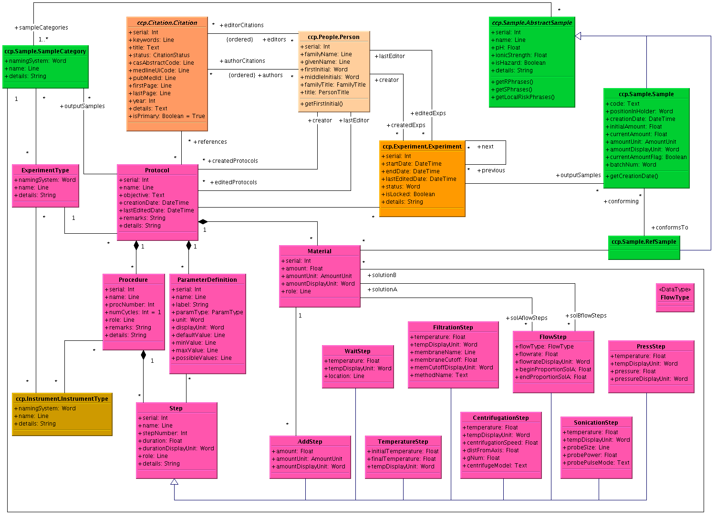
ccp.Protocol

Slide 14
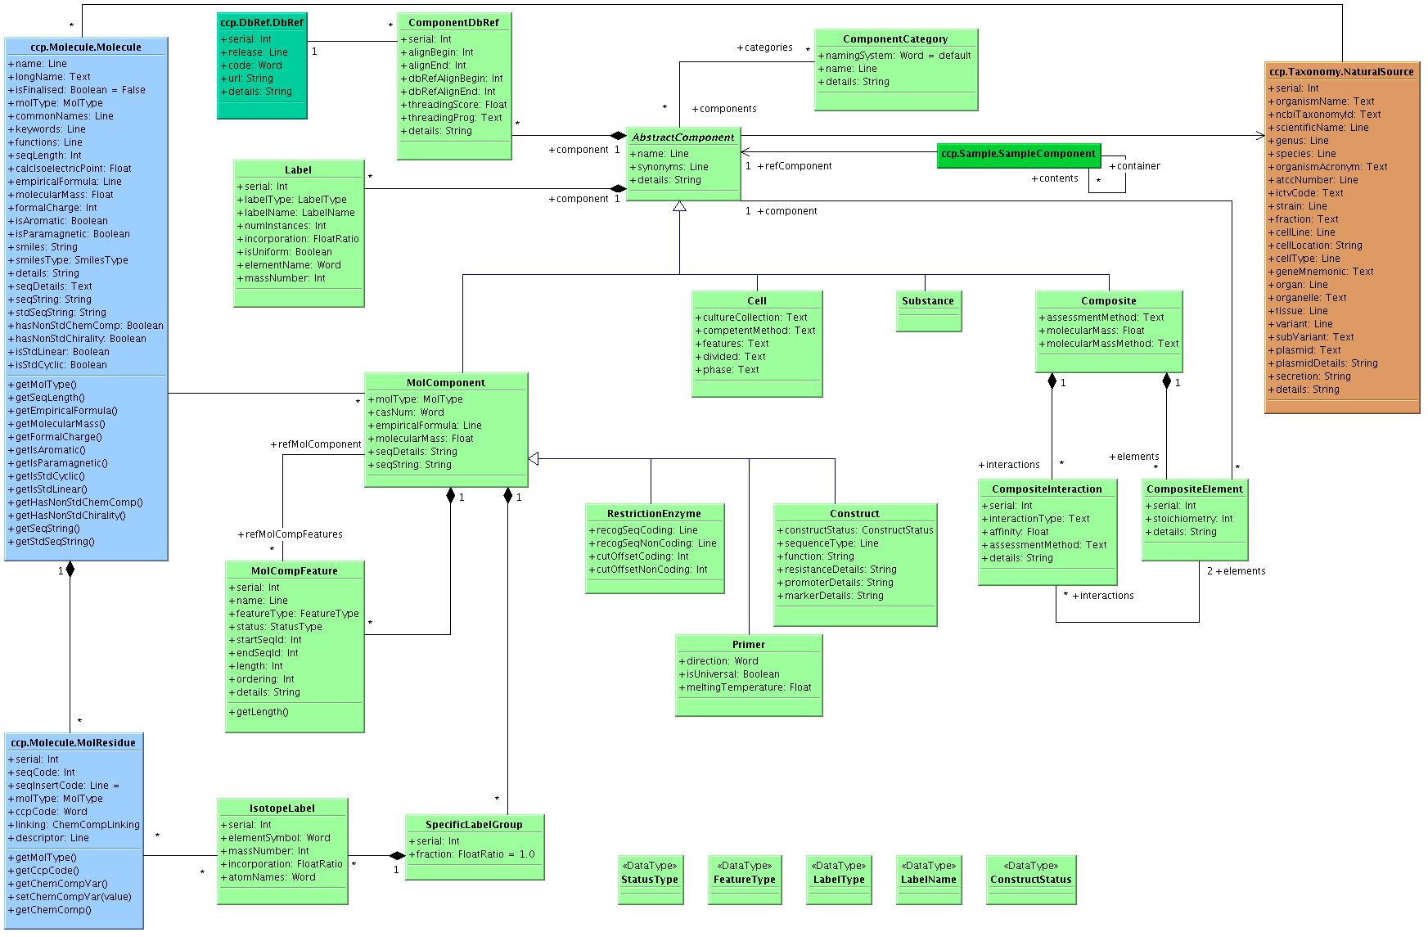
ccp.RefSampleComponent

Slide 15
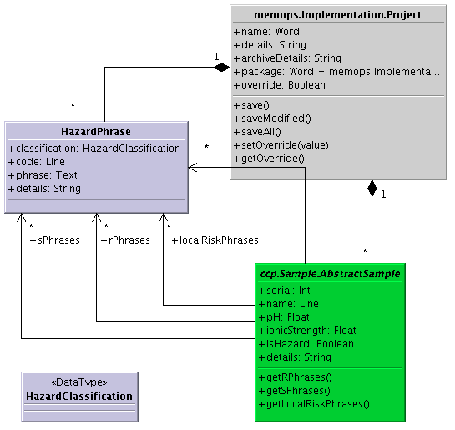
ccp.RiskAssessment

Slide 16
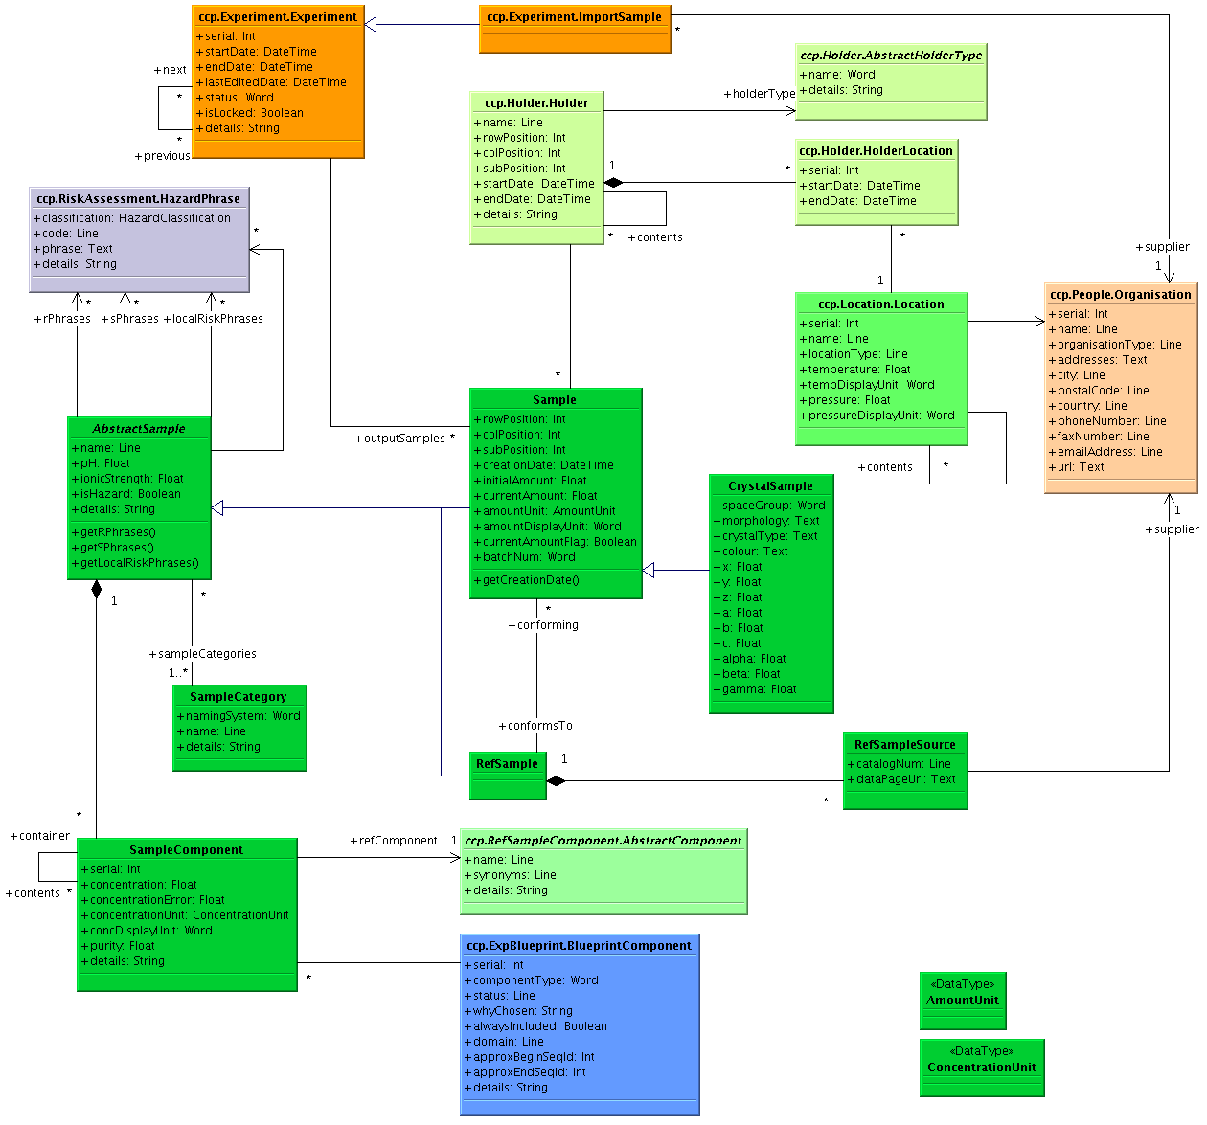
ccp.Sample

Slide 17
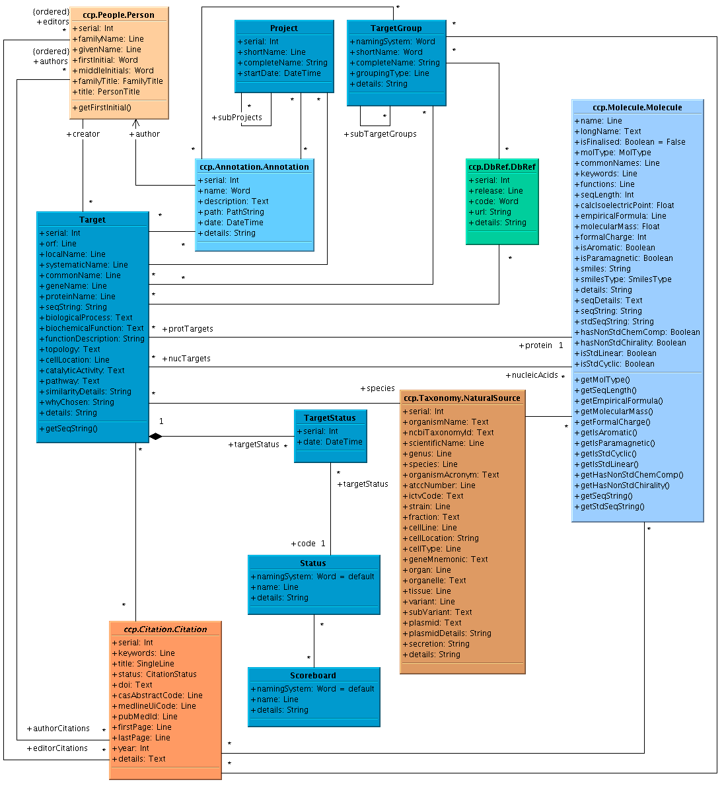
ccp.Target

Slide 18
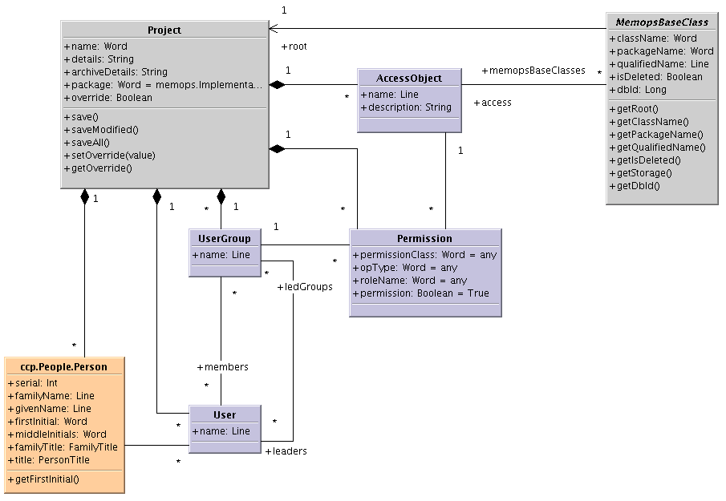
memops.AccessControl

Slide 19
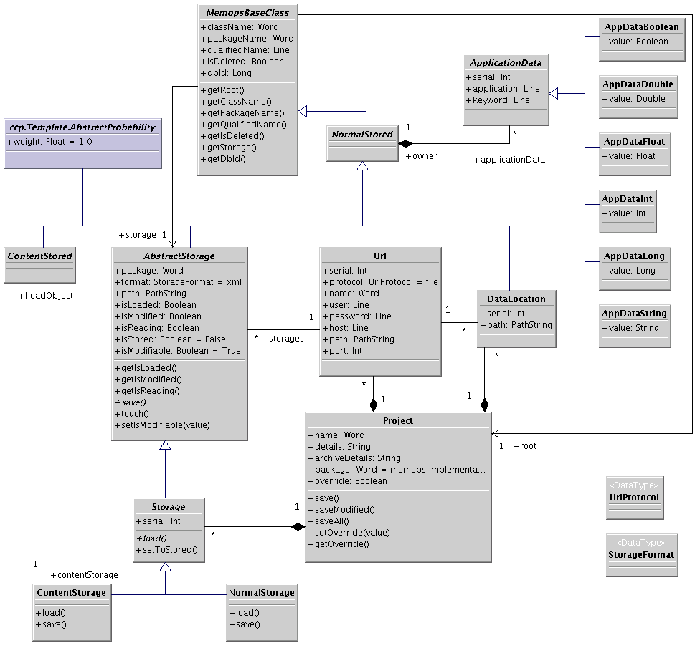
memops.Implementation

