Slide 1

PiMS MSD review
  Robert Hulme (hulme@ebi.ac.uk)‏
  Anne Pajon (pajon@ebi.ac.uk)‏
  Antonio Suarez (suarez@ebi.ac.uk)‏

Slide 2
Presentation Overview
Requirements / functionality
  At this stage in the project how can the management team be most helpful?
User experience
  How will scientists in the lab use PiMS? How does that match up with how the system currently works?
Project technologies
  A look at the different technologies and approaches used to develop the system
Performance
  What performance problems are there and how can they be resolved?
Database schema
  an investigation of the physical database layer, the problems found, and some suggested solutions

Slide 3
Caveats
PiMS system is large and complex
  We have not been able to look at the whole system
  The suggested changes in the database schema represent only part of the changes that we would suggest if we had more time to analyse the schema
  The changes we are suggesting may not improve performance or reduce the amount of data stored, because of the multi layered nature of the system it is difficult to be certain about the effects of such changes
We didn't look at everything
  The source code itself has not been read
  Methods of optimising the Hibernate layer (such as changing the loading / caching modes) were not considered
We focussed on the database layer
  Our investigations have been focussed on the physical database layer as this is the main area of expertise in the MSD group. As the project is focussed around a UML model that is object oriented in nature it may be the case that there are significant improvements that can be made by investigating the system from this perspective.

Slide 4
Requirements / functionality

Slide 5
Requirements / functionality
The current system
Is an excellent general purpose system
Such generality means almost anything can be done with / stored in the system
  The price of such generality is that the user interface and other layers are not optimised for the most common uses of the system

Slide 6
Requirements / functionality
What is needed now
More direct involvement from the scientific management team and the end users
Reduce the generality
To determine what functionality available in PiMS is not required
What features if any are missing
To ensure the nomenclature used in the system matches with what is used in the scientific community
To identify issues with the user interface

Slide 7
Requirements / functionality
The modifications identified should be:
  With respect to functionality not implementation
  Properly documented
  Regularly assessed
    The end users and management team need to be regularly using the system to provide regular feedback to the developers

Slide 8
User experience

Slide 9
User experience
Problems 1
Users are not presented with the information or tasks they individually need
Information overload - they are presented with all possible tasks and information
User interface is mainly data centric rather than user or workflow centric

Slide 10
User experience
Problems 2
Information is not appropriately filtered
  When choosing a solution for a well thousands of solutions are displayed, when in almost all cases the user will only want to choose from a small subset
  Lists of 'users' include lists of authors of any reference data added to the system
    so for example when selecting the owner of an experiment you need to scroll through hundreds of authors who are not users of the system
  Some paths in the interface result in dead ends

Slide 11
User experience
Problems 3
Impossible situations are allowed
  Plate experiment Foo well A1 can be set to contain solution from Foo well A2 at the same time that Foo well A2 is set to contain the solution from Foo well A1
Fields which could be filled in with sensible default values based on earlier steps in the workflow, which user was logged in, and other criteria are not
Complex user interfaces are used that do not take advantage of client side caching / AJAX technology, this leads to a slow poor user experience

Slide 12
User experience
Example of plate experiment
Does not reflect how users will want to set up such experiments
  Using templates of existing plate configurations or computer programs
Loads large amounts of data which is not cached locally
Every change to a well or set of wells requires the page to be reloaded
Reloading the page takes you to a different tab to the one you were originally on

Slide 13
User experience
Recommendations
Change interface to be user focussed using workflows
  Talk to end users, and document the tasks they need to complete and what the steps in each task are
  Storyboard / diagram / flow chart these processes and discuss these designs with users
  Prototype UI and get users to try to complete the tasks, time how long it takes for them to complete them, discover where they have problems

Slide 14
User experience
Recommendations
Determine what user roles exist and add role functionality
  Talk to end users, and document all the roles they have
Wherever lists are presented filter based on role / current task / position in workflow
Add dashboard
  List of outstanding tasks to do
  List of interesting experiments / information
  List of commonly used actions

Slide 15
User experience
Recommendations
Make most commonly selected options more easily selected (e.g. with solutions)‏
Use AJAX and client side caching to provide real time validation and a more responsive UI
Pre-fill fields with sensible values where appropriate based on logged in user / position in work flow / etc

Slide 16
Project technologies

Slide 17
Project technologies
UML and auto code generation
Pros
  Allows reuse of work from CCPN project
  Simplifies high level understanding of the system and it's components
  Fits naturally with the dominant techniques and skills among software developers
  Allows inexpensive changes to the DM
Cons
  Leads to less control over the physical implementation
  Less tuning / poorer performance
  The ease of understanding an overview of the system may result in a less detailed understanding of how all the parts fit together

Slide 18
Project technologies
Object orientation and OR mappers
Pros
  Simplifies high level understanding of the system and it's components
  Fits naturally with the dominant techniques and skills among software developers
  The development cost is lower because understanding and writing queries for relational databases requires a more detailed understanding of the system and of additional database concepts

Slide 19
Project technologies
Object orientation and OR mappers
Cons
  The performance of queries performed by an object relational mapper will be worse than hand written SQL statements
  There are overheads in terms of latency, memory usage, and processor time involved in converting the data stored relationally into Java objects compared to working with tabular data
  Complex updates or queries are likely to be significantly more expensive if the operation does not occur inside the database engine

Slide 20
Performance

Slide 21
Performance
Is PiMS slow?
  This was suggested in earlier meetings
  There were few specific examples of why it was slow
Why do some users consider PiMS to be slow?
  It takes the user a lot of time to complete some tasks (e.g. creating a plate experiment)‏
    User interface issue
  Importing data via a script takes a long time
    Underlying system issue

Slide 22
Performance
What actions are being performed?
The reports and queries that will be run on the system need to be considered sooner rather than later
Database schema may be optimised for writing data but not for reading
  Generality is the enemy of performance

Slide 23
Performance
Identify performance problems
To ensure the performance of the system does not become a problem
  Specify what acceptable performance is
  Create automated tests to ensure the system meets those specifications
These concerns need to be:
  Recorded – so we know what the problem areas are
  Classified – Is it a user interface issue, or is it a problem with the underlying system?
  Acceptable solutions specified – what are the acceptable delays / throughputs
  Testable – once specified automated tests need to be created to ensure the system meets the specifications
One example was given: “The system needs to be able to store x well photographs every y period of time”. What are the other requirements? What are their performance constraints?

Slide 24
Performance
How can performance be improved?
The PiMS system is multi layered
Changes at one layer may not have easily predictable consequences
  For example Hibernate may generate queries quite different from those a human would
Benchmarking of the entire action for the test case is required
  Benchmarking the time spent in each layer will be useful for tuning
  Profiling tools such as JProfiler can show how much time is spent in each Java function
  Hibernate can be configured to log which queries are being performed and how long they take to complete

Slide 25
Performance
Techniques for improving DB performance
Basic techniques
  Reduce number of joins
  Reduce the amount of data stored / the number of rows
  Denormalise data
  Use indexes
  Regularly update statistics (would need an automated script as PiMS does not assume a DBA)‏
Advanced techniques
  Table partitioning (is supported in PostgreSQL)‏
  Query optimiser hinting

Slide 26
Performance
Techniques for improving DB performance
Consider different database engine for users with higher requirements
  Some users may have requirements that cannot be fulfilled by PostgreSQL
  Hibernate supports other database engines: Oracle, MySQL, Firebird, etc...
  Use of other databases would require more time to ensure full compatibility with PiMS and tuning specific to that database engine

Slide 27
Performance
Recommendations
Classify, specify, and document the performance requirements of the system
Create automated tests to ensure the system meets these requirements
Consider the database schema changes made earlier in the presentation
Consider de-normalisation of some of the data (e.g. chemical data)‏
Tune / optimise the PostgreSQL tables
Investigate providing support for Oracle for users with high requirements

Slide 28
Database schema

Slide 29
Project Architecture
Java API
Applications
Hibernate
mapping
files
UML model
Relational DB
SQL
script
The database layer exists. It is part of the project. We need to take care of it.

Slide 30
A good system needs
A good physical DB implementation
  transactions, answer's time, disc space, memory config, type index, type organization and size of files, ...
Depends on each installation
  hardware, applications, amount of data, ...
PiMS can give guidelines and show real examples
Uses RDBMS mechanisms like
  Multi transaction and concurrency, blocking and recovery, backups, security, auditory tracks, deadlocks, partitions, data dictionary, analyse commands, etc.

Slide 31
Our work
Database centric
Change the logical model (propositions)‏
Make diagnosis and give some recommendations
Team result
Not thinking
  To make a full cover of the model
  Cost of changes or strategies to implement them
  Effects in others layers (impedance)‏
  Previous reports
  Rules of generations

Slide 32
Why database?
Global data access
Avoid redundancy
Avoid inconsistency
Share information
Maintain integrity
Persistence
Independence (data versus application)‏
Control of access and update on data

Slide 33
Why database model?
Give an abstraction level
Describe the DB structure easy to implemented and easy to understand for the user
Show what data will be handled by the system
Iterative mechanism
Independent of the platform

Slide 34
Quality criteria
Clear and simple (as much as possible)‏
  store only necessary information
Completed and specific (as much as possible)‏
Reliability and robust
Portable
Modifiable
Efficient and effective

Slide 35
Quality criteria
Check m-n relation (are they really necessary?)‏
Check circles (are they really a good solution?)‏
Check recursive relations
Check multi-service entities
Check 1-1relations
Check multi-functional entities
Try to reduce nulls values
Try to reduce the redundancy
Check for constraints (always we forget them)‏
Check primary keys
Check natural keys
Check for referential integrity - FK (non) mandatory
Check for domains
Check for default values
Check normal forms (1NF & 2NF)‏
Check for metadata (documentation about the model)‏
Check for good (needed) denormalization

Slide 36
What else need to be checked?
The growing of data
Preparation for typical usage
Indexes
Security schema
Statistics
Auditory tracks

Slide 37
Methodology
We are following the model looking for suspicious structures and looking at the data
Trying to improve the model WHEN IT is necessary
There are suggestions to be approved by “users” (scientists) and by the technical team of the project

Slide 38
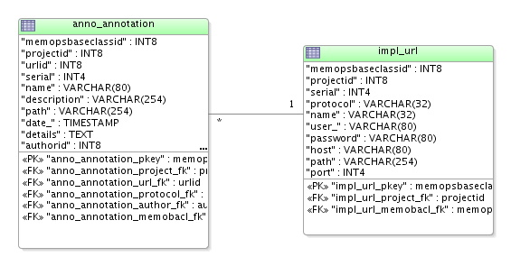
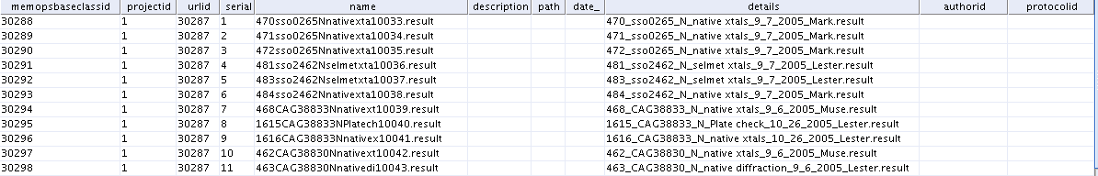
Selecting data - Annotations
empty columns
badly populated
no precise meaning of the columns

Slide 39
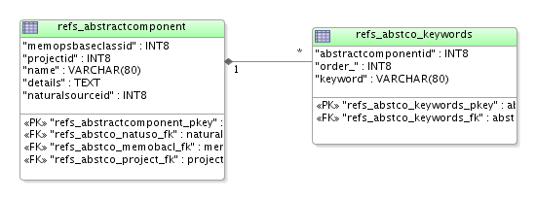
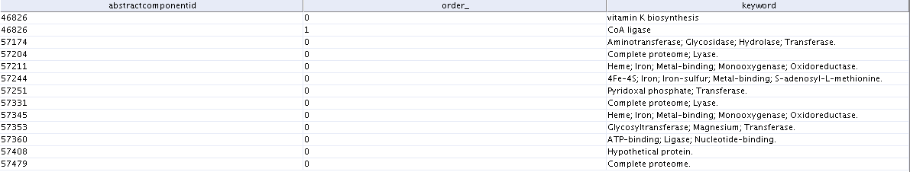
Keywords
Not in first normal form (1NF)‏
A table must be guaranteed not to have any duplicate records
There must be no repeating groups

Slide 40
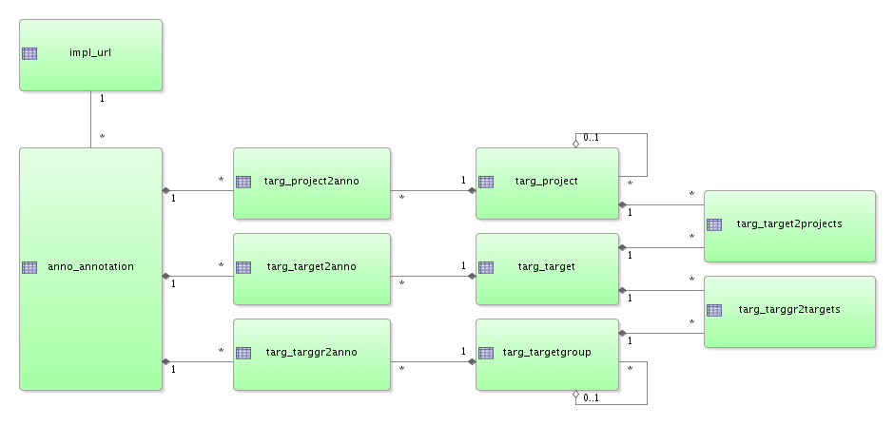
Annotation
Ambitious
  many m-n relationships
  the same “service” at different level of the hierarchy
  Infinite possibilities for grouping
  Need reduce the scope

Slide 41
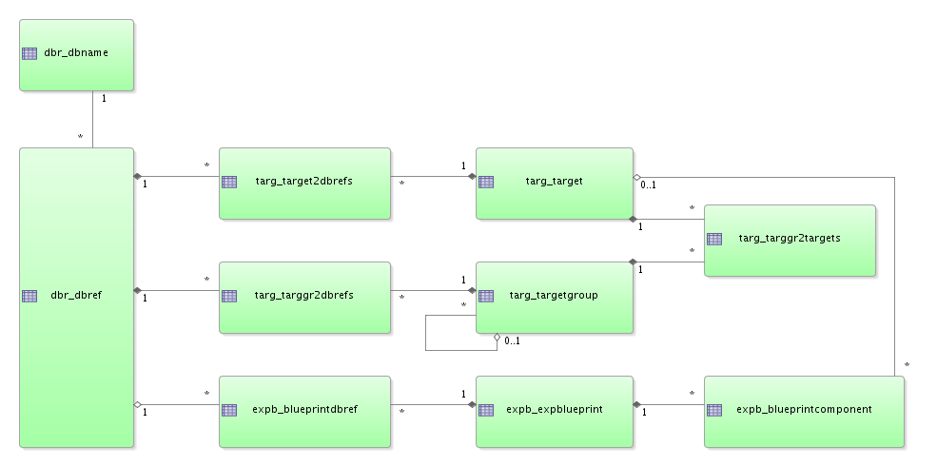
Database reference: same plus circles

Slide 42
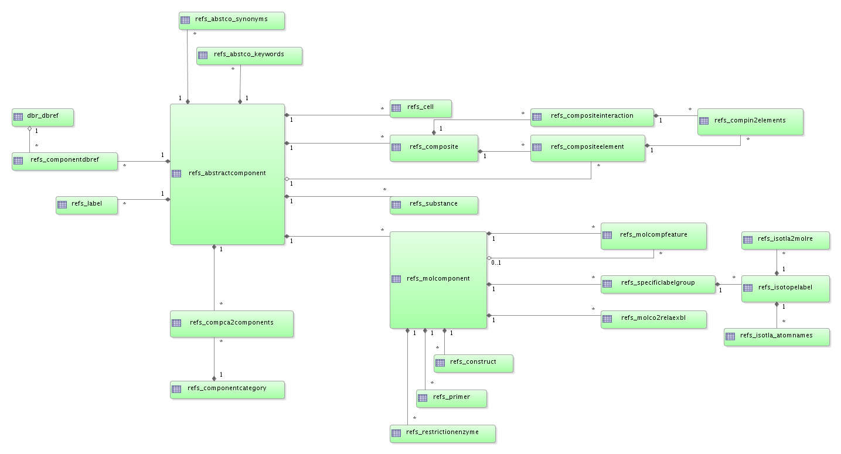
Bow ties with data

Slide 43
Database schema
detailed analysis

Slide 44
Our work
142 tables (233)‏
DM review
  Target
  ExpBlueprint
  RefSampleComponent
ccp.Annotation
ccp.Citation
ccp.Crystallization
ccp.DbRef
ccp.ExpBlueprint
ccp.Experiment
ccp.Holder
ccp.Instrument
ccp.Location
ccp.Method
ccp.People
ccp.Protocol
ccp.RefSampleComponent
ccp.RiskAssessment
ccp.Sample
ccp.Target
ccp.Taxonomy
memops.AccessControl
memops.Implementation

Slide 45
Detailed comments on Target
Annotation: not use of url and filename put in name and not in path
  remove link to Url from Annotation
Project: two projects coexist Implementation.Project and Target.Project
  need only one as the head, merge the two
Annotation: too many-to-many relationships at different levels - need to reduce the scope of what really need annotation. Similar problem found for Citation, Taxonomy,...
  Annotation at the level of Target should be enough, no need to have it at the level of Project and TargetGroup. Should be changed to a one-to-many relationship from Target to Annotation.
DbRef: many-to-many link is not in used and make the model with too many functionalities that are not in used.
  Should be changed to a one-to-many relationship from Target to DbRef
TargetGroup: more a classification than a grouping
  Rename the class to make it more obvious that you can have many different classifications. Keep the tree (with link onto itself) but add into the documentation that target should be assigned to the last leave of the tree.
Scoreboard/Status: it is three tables that do nothing.
  Scoreboard and Status should be merge.

Slide 46
Detailed comments on ExpBlueprint
Target/NaturalSource: There is already a link between MolComponent and NaturalSource, do we really need the redundancy at the level of Target? Avoid redundancy information and circle relationship, except if there is a need to know the taxonomy of the target all the time.
  remove link between Target & NaturaSource
Molecule. Don't need to try to model the entire world, no need for Molecule
  remove link between MolComponent and Molecule and remove Molecule from the model
Loop formed by Target / MolComponent / BlueprintComponent and ExpBlueprint.
  sub-sequences stored in BlueprintComponent not directly related to their main sequence
  no constraint to force the update of the many-to-many relationship between Target and MolComponent when sub-sequences created
Do we really need to be able to have little molecule within an ExpBlueprint that is not related to a Target?
  split BlueprintComponent into two: BlueprintComponent link to Target and ExtraBlueprintComponent link to MolComponent
  change the link between BlueprintComponent and MolComponent to BlueprintComponent and target2nuclac and create a constraint on the FKs in BlueprintComponent that it should be targetid not null or target2nuclacid not null

Slide 47
Detailed comments on ExpBlueprint
Status / Target / Milestone / Experiment / ExpBlueprint necessity to have Status only attached to ExpBlueprint (Kim)‏
  Delete relationship between Milestone and Target
  Make mandatory the relation between Experiment and ExpBlueprint

Slide 48
Detailed comments on RefSampleComponent
remove empty tables like RestrictionEnzyme, Construct, Primer and add type in MolComponent that must be specific, with constraint and mandatory
remove empty tables like SpecificLabelGroup and IsotopLabel
generalise MolCompFeature to handle in one table SpecificLabelGroup, RestrictionEnzyme, Primer and Construct like remarks, notes, features or characteristics.
ComponentCategory. Constraint needed to avoid duplicate name with different namingSystem
  issue raised by having namingSystem inside the category that adds an extra level of classification in the same table.
  reference data need to be reduced and maintain by one person in each site to impose the quality of data.
  2 possibles solutions:
    (1) curate reference data because you allow data entry with new reference data or
    (2) stop the process if you don't have the reference data and wait until the admin person create the ref data
  need to identify the reference data tables and define the process to decide what to do in case the data is not already there.

Slide 49
Detailed comments on RefSampleComponent
merge AbstractComponent with MolComponent and connect ComponentCategory to MolComponent
Can we just link MolComponent to NaturalSource and remove it from Target?
AbstractComponent.synonyms should be mandatory
  remove white spaces at the beginning and end of name and synonyms
  need clean up into the synonyms: some have comma, some have white spaces
  how to maintain and synchronise them? If a component name is A with synonym Z, what's happen if I create a component with name Z?
    If there is no specific use of synonyms, then just use keywords and qualified keywords in an extra table RelatedInfo with a type {keyword, synonym, ...}. But if the system automatically recognise synonyms when you enter a new MolComponent, then you need to keep synonyms.
AbstractComponent.keywords
  need clean up: keywords are separated by ;. It needs to be relational.
Person. Need to have two tables: Author and User.

Slide 50
Detailed comments on RefSampleComponent
namingSystem attribute. Would be nice to remove namingSystem in ComponentCategory
DbRef. Need to choose where to link DbRef with
  (A) Target,
  (B) ExpBlueprint,
  (C) MolComponent or
  (D) any combination of two but not three
remove recursive cycle on SampleComponent
Vocabulary problem. Replace Sample by Mixture? Would that solve the problem between Sample and Solution?

Slide 51
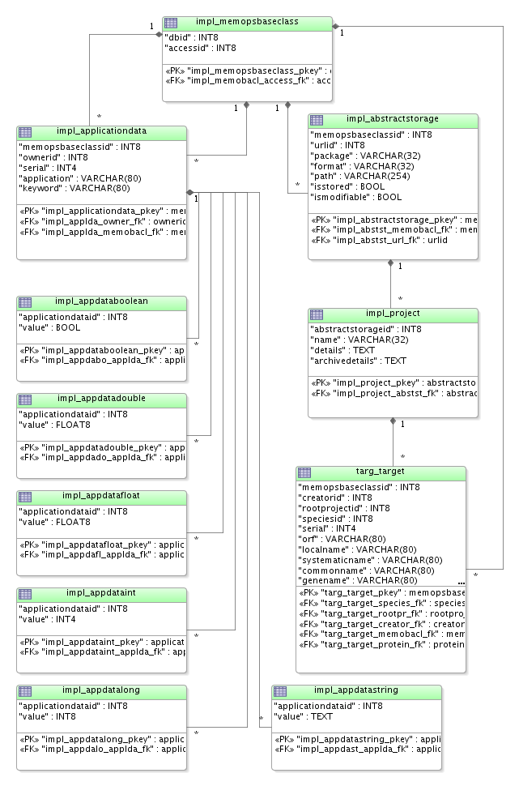
MemopsBaseClass
2 hierarchies
  Inheritance
    impl_memopsbaseclass
  XML compatibility
    impl_project

Slide 52
ApplicationData
Is it needed?
Multiple tables per type

Slide 53
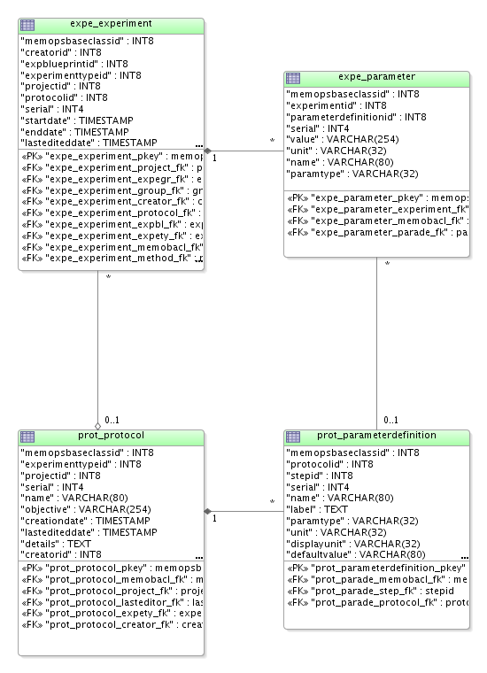
Parameter / ParameterDefinition
Cycle problem
  in general create problem or produce inconsistency
  difficult to search data
All data stored as String
  Solution can be to have 3 columns in Parameter for number, varchar and date
    Assignment to the column should be control with ParameterDefinition

Slide 54
Plate Template
Extend Protocol to handle template for multiple experiments in plate
Explore other ways to store screens than into Holder / Sample existing mechanism
Need interaction between users, UI and DM developers to define the requirements and find solution adapted to the problem

Slide 55
Conclusion

Slide 56
List of issues found (1)‏
Model is over constrained
  need simplification
Tables are not populated based on the original idea of the model
  symptom of over flexibility and over ambitious
  should be only one place and only one possibility to store data
  avoid redundancy as much as possible

Slide 57
List of issues found (2)‏
Two solutions:
  (1) Reduce the number of tables and columns to have only one way to store data
  (2) Have a good documentation on how to use the model with example and procedure to create things
All tables and columns must have description on how to use them and some associated examples
  focused on the programmer
  understand how to use and populate them

Slide 58
List of issues found (3)‏
ObjectMetaData table for documentation
  with columns objectName, objectType {FK, Table, Column, PK, UK, ...}, Description, Constraint {mandatory, null, ...}
Data quality. Rule needed for white space in name attribute
  name starts with white space, specially in the case of a unique key

Slide 59
Diagnosis
It is an ambitious and very general model
It is full of nice intentions
It is a good academic job
It needs to be tuned and improved URGENTLY
  Imprecision in concepts (language)‏
  No clear understanding for the programmers
  Over related and complex
  Redundancy
  Integrity - No mandatory FK
  Need of metadata
  Heavy entities (person, experiment)‏
  Bow ties, circles

Slide 60
To keep in mind
Once DB is implemented : monitoring is necessary
The tuning is a continuous job
A system and a DB are not static
Have to change according with needs (and users)‏
Does not exist a general rule to apply at 100%
Each case has to be studied and solved in the best way
A good model can help to improve the performance but it is not the only one factor

Slide 61
What's next
Next packages to explore
  Sample, Holder, Experiment, Protocol, People & AccessControl
Create SQL table diagrams
  Oracle JDeveloper
  Current version and simplified version
  Target, ExpBlueprint, RefSampleComponent, Sample, Holder, Experiment, Protocol, People and AccessControl
Look at model for screens and plate experiments
Look at model for complexes based on Spine2 DTD

Slide 62
Issues to be resolved
SQL Database
XML Hibernate mapping
Java API
UML model
“new” development branch
SQL schema improvements
current development branch
support work for current UI
SQL schema changes
DM changes
new jar
UML model changes
UML model changes
DB upgrader
one development branch

