Slide 1
PySpark

Slide 2
Spark
Engine for analyzing large-scale data sets
Generally faster than MapReduce
Native high-level APIs in Scala, Java, Python, and R
Has the original batch component, and a newer streaming component
Can run within Hadoop or not. It’s standalone.
Open source Apache project
Supported by multiple commercial vendors

Slide 3
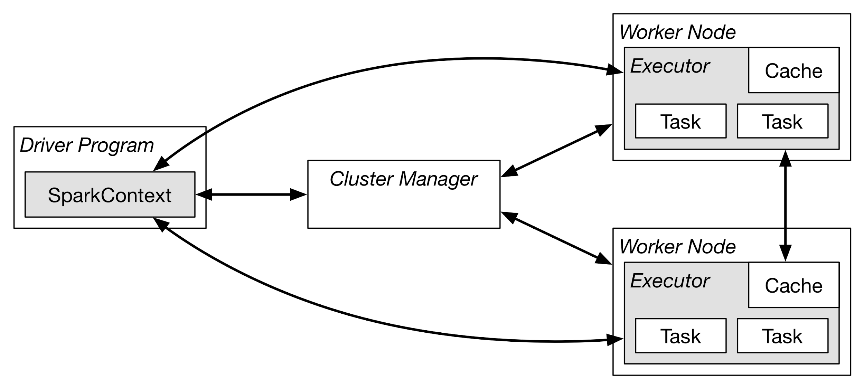
Spark Components
Notes:
All programs run as a JVM
Master connects to a cluster manager for allocate resources available across applications
Acquires executors on cluster nodes - process run compute tasks, cache data
Sends app code to the executors
Sends tasks for the executors to run

Slide 4
SparkContext
The SparkContext object tells spark how to access a cluster
It is required for every Spark program
To build a SparkContext you need to build a SparkConf that contains information about your application
Only one SparkContext may be active per JVM
stop() must be called on the active SparkContext before creating a new one
In the Python or Scala shell this is the sc variable, which is created automatically

Slide 5
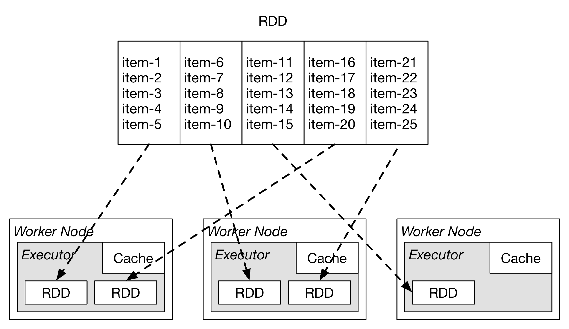
Resilient Distributed Datasets (RRDs)
Spark’s primary abstraction is a distributed collection of items called a Resilient Distributed Dataset (RDD):
Immutable
Enable parallel operations on collections
Repairable

Slide 6
PySpark
PySpark is the native Python API for working with Spark
Supported as part of the main Spark project
It works by wrapping a native Python application outside of the JVM then communicates with the JVM
introduces some problems, but gives a native feel

Slide 7
SparkSQL
A SQL engine inside of Spark that operates on DataFrames
Called by sending SQL queries as strings from any of the native APIs
Lets you corss between Spark, local Python, and SQL quite seamlessly

Slide 8
Exercise: Getting set up in Databricks
https://databricks.com/try-databricks
Click on “Start Today” under Community edition
Enter info, click “Sign up”
Agree to terms
Check email for verification
Log in to Databricks
Click Cluster and add a new cluster
Give it a name, choose AWS zone, leave others default

Slide 9
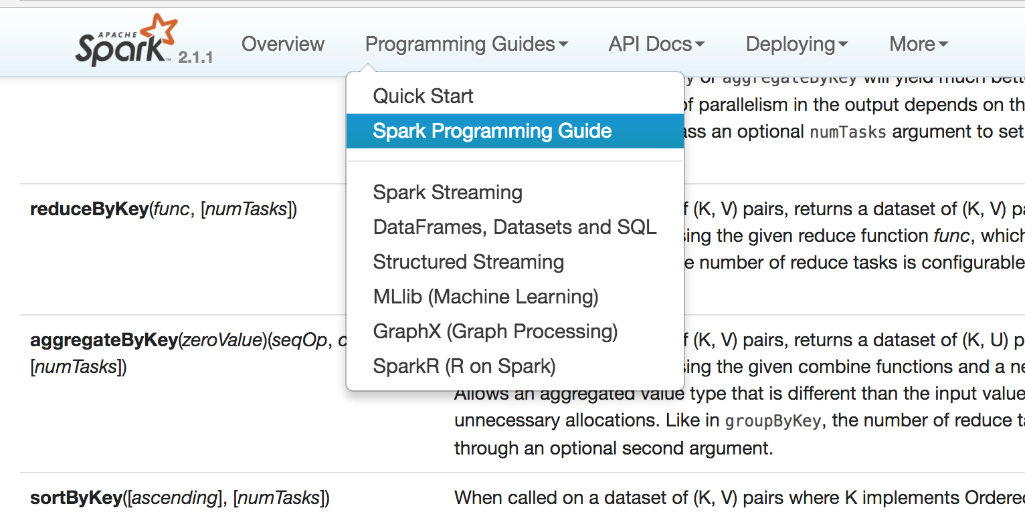
RDD Documentation
Spark’s documentation is fairly good
Most of the examples pulled here are derived from this documentation
https://spark.apache.org/docs/latest/programming-guide.html
https://spark.apache.org/docs/latest/api/python/pyspark.html#pyspark.RDD

Slide 10
Initializing Spark Context
Start by telling your application where your Spark cluster is
Need to tell it what the name of your application is (for tracking)
Zeppelin creates the SparkContext for you
from pyspark import SparkContext, SparkConf
conf = SparkConf().setAppName(appName).setMaster(master)
# appname = name of thing, master = YARN cluster URL
sc = SparkContext(conf=conf)

Slide 11
Running a job in YARN
Client mode vs. cluster mode
./bin/spark-submit \ --class <main-class> --master <master-url> \ --deploy-mode <deploy-mode> \ --conf <key>=<value> \ ... # other options <application-jar> \ [application-arguments]
spark-submit --master yarn-client --executor-memory 6g --num-executors 4 --executor-cores 6 load_10k.py /data/10-K/*/201* tenk

Slide 12
Creating an RDD
Different major ways to create an RDD:
“parallelize” takes an object in local memory and distributes it
From the Spark Context API to load data sets externally
Create RDDs from other RDDs as transformations

Slide 13
Creating an RDD with Parallelize
data = [1, 2, 3, 4, 5, …]
distData = sc.parallelize(data, 10)

Slide 14
Creating an RDD from local files
distData = sc.textFile(“/data/2017/*/*/*.txt")

Slide 15
Creating an RDD from HDFS
distData = sc.textFile(“hdfs://data/2017/*/*/*.txt”, 200)
Can pass in a second parameter, for the minimum number of splits
Otherwise, defaults to block size or number of files

Slide 16
Creating an RDD from s3
myRDD = sc.textFile("s3a://%s:%s@%s/forms/dd/*/*" %
(ACCESS_KEY, ENCODED_SECRET_KEY, AWS_BUCKET_NAME))

Slide 17
Creating an RDD from InputFormat
Hadoop InputFormat can be wrapped in Spark
$ SPARK_CLASSPATH=/path/to/elasticsearch-hadoop.jar ./bin/pyspark
>>> conf = {"es.resource" : "index/type"} # assume Elasticsearch is running on localhost defaults
>>> rdd = sc.newAPIHadoopRDD("org.elasticsearch.hadoop.mr.EsInputFormat", "org.apache.hadoop.io.NullWritable", "org.elasticsearch.hadoop.mr.LinkedMapWritable", conf=conf)
>>> rdd.first() # the result is a MapWritable that is converted to a Python dict
(u'Elasticsearch ID', {u'field1': True, u'field2': u'Some Text', u'field3': 12345})

Slide 18
SparkContext.wholeTextFiles
wholeTextFiles is an alternative to textFile
Instead of loading data row-by-row into cells, it loads the entire file into one large cell.
Useful if you need to process a document wholistically.

Slide 19
Saving data
Bunch of functions called .saveAs*
Spark will convert each item to a string with str(), separate with newlines
Can take HDFS, S3 as output paths
Can take a local file system path, but think about where you are!
Takes a path to a directory. Each partition will write a file.
distData = sc.saveAsTextFile(“hdfs://data/out/")

Slide 20
What now?
We have the RDD, now we can do:
Transformations: create a new data set (RDD) based on a modification to an old data set
Actions: does something and returns something to the client, not an RDD
Transformations are Lazy: they aren’t done literally when you write the code. There is query planning underneath.

Slide 21
map
Map takes a function as a parameter
Applies that function to every element in the RDD
Gives you back and RDD with the results
data= sc.textFile(”hdfs://data/books/*.txt")
yelling = lines.map(lambda s: s.upper())
some_yelling = lines.map(lambda s: s.upper() if len(s) % 2 == 0 else s.lower())

Slide 22
foreach
Identical to map except that it doesn’t collect results or return anything
Useful for doing something with “side effects” a bit more efficiently than map
data= sc.textFile(”hdfs://data/books/*.txt")
lines.foreach(lambda s: write_to_db(‘postgres’, s.lower()))

Slide 23
Python’s Lambda
In [1]: def apply_twice(myf, value):
...: return myf(myf(value))
...:
In [2]: apply_twice(lambda x : x + 1, 9)
Out[2]: 11
In [3]: apply_twice(lambda x : x * 2, 9)
Out[3]: 36
Lambda is shorthand for buildings one-line functions
Used a lot to pass in a quick function as a parameter
Functionally equivalent to defining a function with def
In [4]: def double(x):
...: return x * 2
...:
In [5]: apply_twice(double, 9)
Out[5]: 36

Slide 24
collect
Pulls data from the RDD and pulls it into Python’s local memory
Each cell turns into an element in a list
Good as a last step to return some results to an application or something like that
Be careful on how much data you are bringing back!
mylocalpythondata = myrdd.collect()

Slide 25
count
Simply count how many rows are in the data
Returns back the number in Python (i.e., an action not a transformation)
sc.parallelize([2, 3, 4]).count()

Slide 26
filter
Takes a function that returns True or False
If the result of the function is True, it keeps it, otherwise it drops it
lines = sc.textFile(" hdfs://data/books/*.txt")
bigfoot = lines.filter(lambda s: ’big foot’ in s.lower())

Slide 27
take
Gives you N arbitrary elements from the RDD
Arbitrarily picks a partition and pulls data until N is reached
They are likely to be in contiguous order
Useful for seeing if data was loaded and what might be in the RDD
>>> sc.parallelize([2, 3, 4, 5, 6]).take(2)
[2, 3]

Slide 28
reduce
Reduce takes a two-parameter function as a parameter
Applies this function to the first two elements, then the result of that with the third element, then the result of that with the fourth element, …
Returns the result to the client (action)
lines = sc.textFile(" hdfs://data/books/*.txt")
wc = lines.map(lambda s: len(s.split())).reduce(lambda a, b: a + b)

Slide 29
min and max
These functions return the minimum value and maximum value in the RDD
It’ll by default use whatever object’s < operator
You can specify a custom key
>>> rdd = sc.parallelize([1.0, 5.0, 43.0, 10.0])
>>> rdd.max()
43.0
>>> rdd.max(key=str)
5.0

Slide 30
mean
Computes the average of the RDD and returns that back
>>> sc.parallelize([1, 2, 3]).mean()
2.0

Slide 31
stdev
Computes the standard deviation of the RDD and returns that back
>>> sc.parallelize([1, 2, 3]).stdev()
0.816

Slide 32
flatMap
Like map, but the function returns a list of things not just one thing
It takes each thing in the list and “flattens” it into one cell each
Note that lists can have zero elements
data= sc.textFile(”hdfs://data/books/*.txt")
words= lines.map(lambda s: s.split())

Slide 33
sample
sample(withReplacement, fraction, seed)
Pull out a random sample of a data set
Returns that as a new RDD
myrdd.sample(False, .05)

Slide 34
takeSample
takeSample(withReplacement, num, seed=None)¶
Pull out a random sample of a data set, except gives you an exact number of elements
Pulls it into local memory, not into a new RDD
myrdd.takeSample(False, 1000)

Slide 35
top
top(num, key=None)
Retrieves the top N items from the RDD
Pulls it into local memory, not into a new RDD
By default it’ll use <
You can pass it a key to determine how it should calculate “top”
myrdd.top(10)

Slide 36
union
Combines two RDDs into one new RDD
Very efficient because it doesn’t actually do anything mechanically
Note: Spark is happy to have heterogeneous RDDs, be careful of types
newrdd = rdddocs1.union(rdddocs2)

Slide 37
intersect
Pass an RDD a second RDD
Gives a new RDD with just the elements that are shared in common
newrdd = rdddocs1.intersect(rdddocs2)

Slide 38
coalesce
Repartitions an RDD into a new, lower number of partitions
Efficient because it just combines some partitions into one without doing a shuffle
myrdd.coalesce(20)

Slide 39
repartition
Same as coalesce, but does a shuffle to redistribute the data
Use this if you are worried about skew or if you are going up in number of partitions
myrdd.repartition(20)

Slide 40
distinct
Runs over the RDD and removes all duplicates
Duplicates are defined as ”==“ returning true
Distinct gives the opportunity to repartition as well
sc.parallelize([1, 1, 2, 3]).distinct(2)
sc.parallelize([1, 1, 2, 3]).distinct()

Slide 41
histogram
Counts how many items are in between bucket boundaries you provide.
rdd = sc.parallelize(range(51))
rdd.histogram([0, 5, 25, 50])
([0, 5, 25, 50], [5, 20, 26])

Slide 42
sortBy
sortBy(keyfunc, ascending=True, numPartitions=None)
Takes in a function that returns some sort of comparable object
Sorts the data set by that
Very expensive over large data sets!
Can sort ascending or descending
Gives you the opportunity to change the number of partitions
>>> tmp = [('a', 1), ('b', 2), ('1', 3), ('d', 4), ('2', 5)]
>>> sc.parallelize(tmp).sortBy(lambda x: x[0]).collect()
[('1', 3), ('2', 5), ('a', 1), ('b', 2), ('d', 4)]
>>> sc.parallelize(tmp).sortBy(lambda x: x[1]).collect()
[('a', 1), ('b', 2), ('1', 3), ('d', 4), ('2', 5)]

Slide 43
groupBy
Takes in a function that extracts the “group”
Spark creates a new RDD with pairs: first element is the group, second is a list of all those with that group
The “byKey” operations will usually want to be used over this
lines = sc.textFile(" hdfs://data/arrests/*.csv")
bydepartment= lines.filter(lambda s: s.split(’,’)[3])

Slide 44
Key-based RDDs
If you structure your RDD as “pair RDDs”, it opens up a bunch of efficient transformations
A pair RDD is a collection of key-value pairs in 2-item tuples. [(‘cat’, 4), (‘dog’, 3), (‘cat’, 9), (‘dog’, [3,4,5])]
key-based RDDs can easily be made from map
kvrdd = myrdd.map(lambda line: (line.split()[3], line))

Slide 45
groupByKey & mapValues
groups together the items in the RDD by their key, the left item in the tuple
Returns a new pair RDD with the key on the left and a iterable sequence of values on the right
mapValues is the same as ”map”, but applies the function only to the values of the pair RDD
>>> rdd = sc.parallelize([("a", 1), ("b", 1), ("a", 1)])
>>> sorted(rdd.groupByKey().mapValues(len).collect())
[('a', 2), ('b', 1)]
>>> sorted(rdd.groupByKey().mapValues(list).collect())
[('a', [1, 1]), ('b', [1])]

Slide 46
reduceByKey
Similar to groupByKey and mapValues, but shortcuts a bit
It first does a group by, then applies a function to the values
text_file.flatMap(lambda line: line.split()) .map(lambda word: (word, 1)) .reduceByKey(lambda a, b: a+b)

Slide 47
countByKey & countByValue
Counts the number of keys we see or values we see
Returns a pair RDD where the key is the key or value, and the value is the number of times it was seen
>>> rdd = sc.parallelize([("a", 1), ("b", 1), ("a", 1)])
>>> sorted(rdd.countByKey().items())
[('a', 2), ('b', 1)]
>>> sorted(sc.parallelize([1, 2, 1, 2, 2], 2).countByValue().items())
[(1, 2), (2, 3)]

Slide 48
join
Takes two Pair RDDs and does a “sql inner join”
Creates a new Pair RDD with the key is the foreign key, then the value is a 2-item tuple with the values from each data set
>>> x = sc.parallelize([("a", 1), ("b", 4)])
>>> y = sc.parallelize([("a", 2), ("a", 3)])
>>> sorted(x.join(y).collect())
[('a', (1, 2)), ('a', (1, 3))]
Also, see leftOuterJoin, rightOuterJoin, fullOuterJoin for different types of joins

Slide 49
cogroup
Similar to joins, but it doesn’t do the logic of the join and leaves them in lists
Creates a new pair RDD where the key is the original key, then the value is a 2-tuple with two lists in it, each list corresponding to the values of the original RDDs

Slide 50
cache
Persist the RDD in memory
Useful if you are going to use the RDD again, or if you wanted to force lazy evaluation to do something
myrdd.cache()

Slide 51
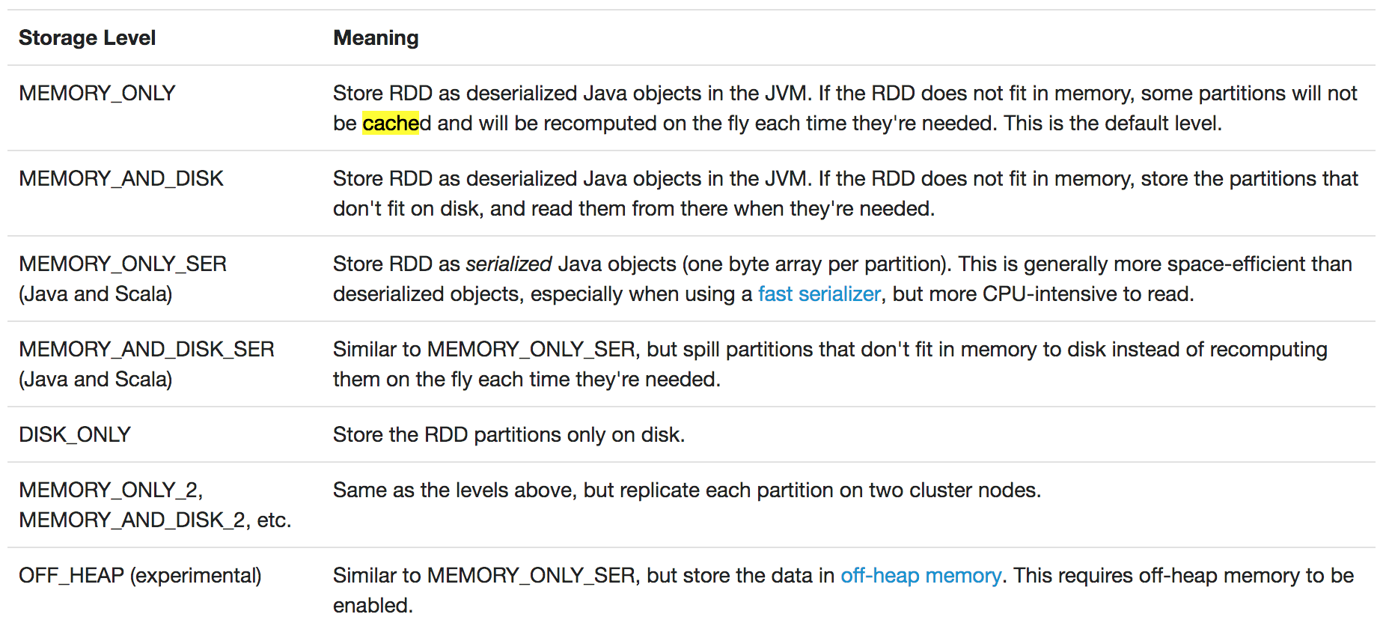
persist
Similar to cache, but has more options. Particularly for spilling to disk.
Might be useful for long-running queries that might have nodes die

Slide 52
Broadcast Variables
Create read-only variables that are shared across the job
In most cases are shared once per node
Whole thing needs to be able to be stored in memory
Useful for sharing reference data or configuration parameters
>>> broadcastVar = sc.broadcast([1, 2, 3])
<pyspark.broadcast.Broadcast object at 0x102789f10>
>>> broadcastVar.value
[1, 2, 3]

Slide 53
Accumulators
Similar to broadcast variables in that they are shared
However, accumulators are only counters
You can increment them wherever in your code
The result can be extracted or viewed in the management UI
Good for keeping track of things on the side, like number of errors
>>> accum = sc.accumulator(0)
>>> accum
Accumulator<id=0, value=0>
>>> sc.parallelize([1, 2, 3, 4]).foreach(lambda x: accum.add(x))
>>> accum.value
10

Slide 54
Spark SQL

Slide 55
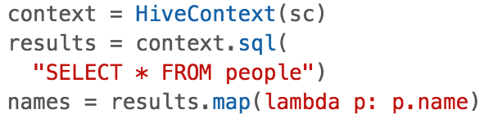
Spark SQL Overview
An easy way to use SQL/HiveQL syntax
Backed by Spark’s RDDs and execution engine
Lets you mix SQL and the native Spark API in Java, Scala, or Python
Provides a table abstraction called a DataFrame that is built for SQL processing
Documentation: http://spark.apache.org/docs/latest/sql-programming-guide.html (most examples are pulled from here)

Slide 56
Why Spark SQL?
Helps you solve some of the easier structured problems quickly
Mixing SQL and native API doesn’t force you to use one or the other
Can replace existing SQL workloads and hopefully be faster
Spark’s engine is well suited for interactive ad-hoc analysis, which other systems (such as MapReduce) struggle with
Integrate with BI tools that talk SQL through JDBC (more on this later)

Slide 57
Why not Spark SQL?
Some similar arguments to Spark vs. MapReduce where Spark may fall short:
Longer running queries
Very large scale … might want to use Hive
Data should probably be structured or SQL is going to get convoluted
SQL was built for nicely structured data, might not be very elegant for nested or denormalized data
Join performance can be troublesome on larger data sets but there are many shuffle options … might want to use the native APIs to structure the data first or just skip Spark SQL

Slide 58
DataFrames
Step 1. Get data into DataFrame
Step 2. Do SQL!

Slide 59
DataFrame Overview
The underlying structure that you run Spark SQL over
Just a list of named columns (i.e., a table)
Can be constructed from a number of data sources (text files, Hive, Parquet files, existing RDDs, etc.)
The API is available in Java, Scala, Python, and R

Slide 60
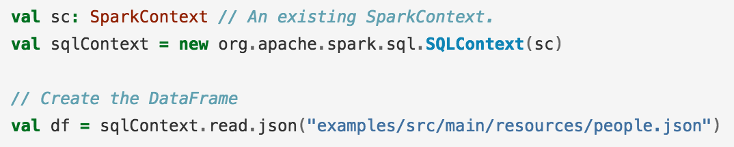
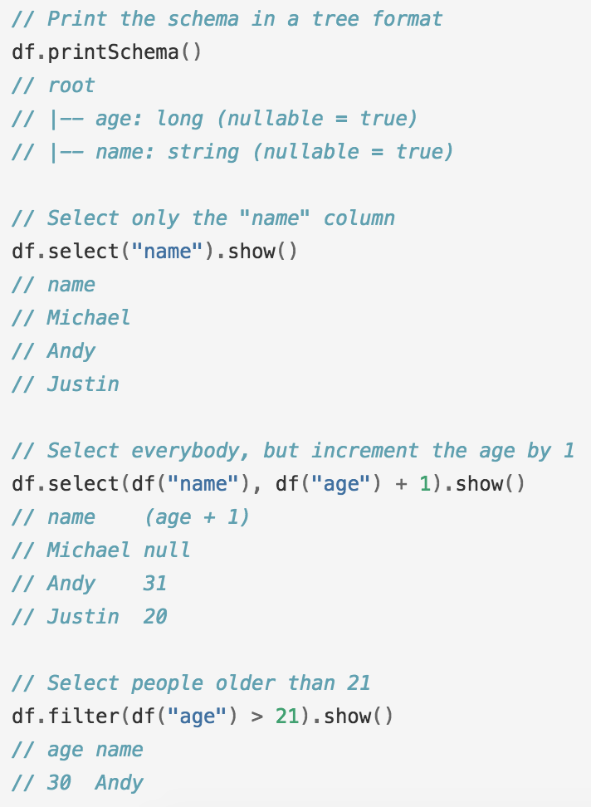
DataFrame non-SQL API
DataFrames support a number of operations outside of SQL in addition to normal RDD operations
These should be reminiscent of R or Python/pandas data frames
DataFrames are useful in their own right but provide the foundation of SQL on Spark There are dozens of methods, check them out here: http://spark.apache.org/docs/latest/api/scala/index.html#org.apache.spark.sql.DataFrame

Slide 61
Starting with a SparkSession
Instead of SparkContext, you’ll work with SparkSession
from pyspark.sql import SparkSession
spark = SparkSession.builder.appName("Python Spark SQL basic example").config("spark.some.config.option", "some-value").getOrCreate()

Slide 62
Getting data into a DF
Loading data into a DF is usually done through the “read” section of the SparkSession
# spark is an existing SparkSession
df = spark.read.json("examples/src/main/resources/people.json")
# Displays the content of the DataFrame to stdout
df.show()
# +----+-------+
# | age| name|
# +----+-------+
# |null|Michael|
# | 30| Andy|
# | 19| Justin|
# +----+-------+

Slide 63
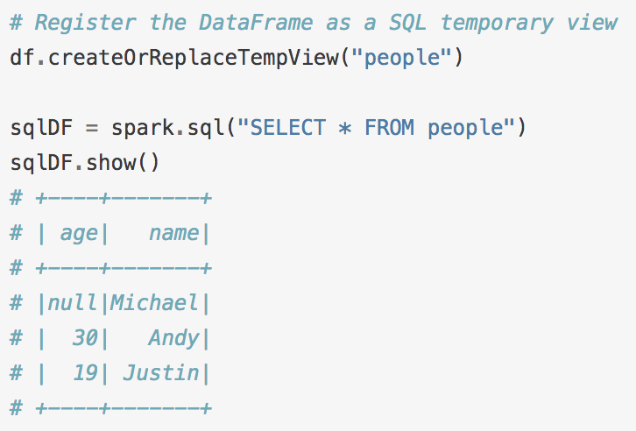
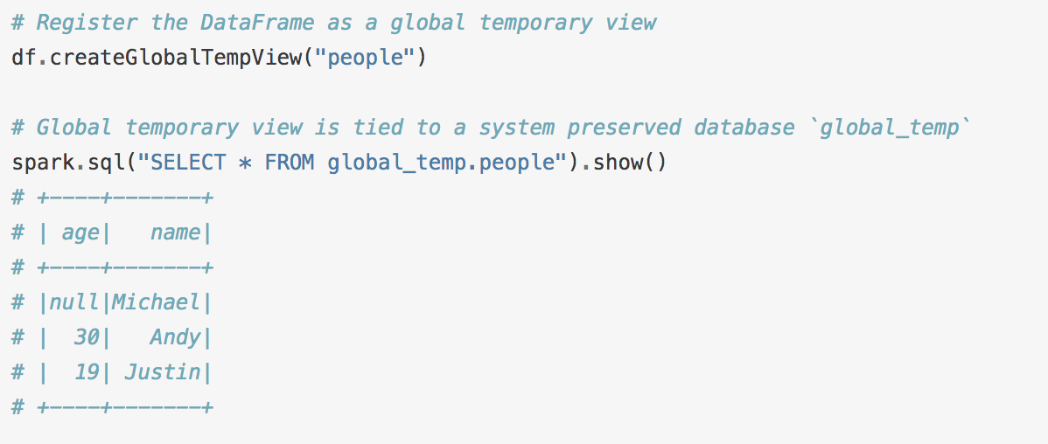
Registering a DF as a table
Before working with a DataFrame in SQL, you have to register it as a temp table
Can also register it globally, so that it persists across sessions

Slide 64
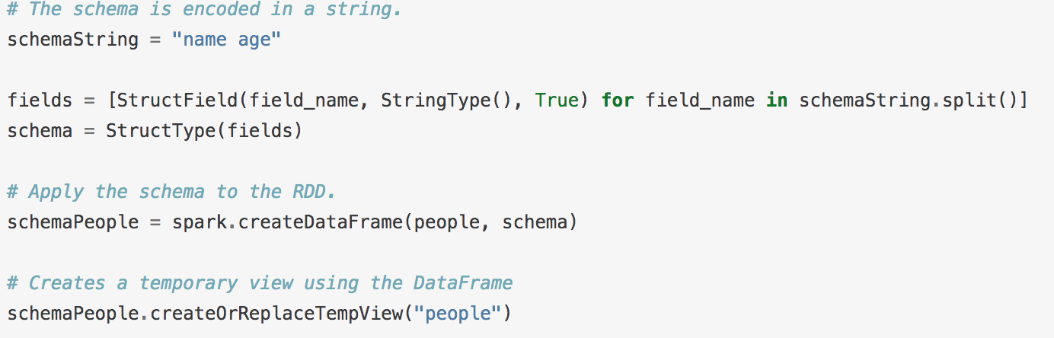
Creating an DF from an RDD
To create a DF from an RDD, you give it the RDD and some column labels
The schema is a “StructType” with a list of “StructField”. Each has a name and what type it is.

