Slide 1
Intro to Console / Terminal
Chris Human ©2023

Slide 2
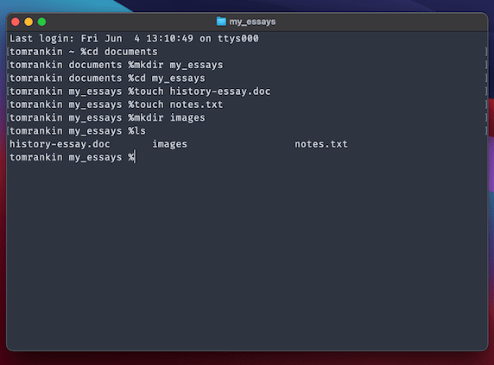
Intro to Console / Terminal

Slide 3
Demo

Slide 4
Your turn!
Activity: Get Situated Suggested Time: 1 min.
Assignment:
Make a folder in your root directory named “projects”
Put all of the code that you write inside of this folder
Best practices:
Always use lowercase for folder and file names
Never put spaces in your folder and file names
Uses dashes (-) or underscores (_) as separators

Slide 5
Your turn!
Activity: Console Commands
Suggested Time: 10 min.
Assignment:
From the console / terminal and using only the command line, create:
A new folder with the name of “first_day_stuff”
A new HTML file with the name of “first_day.html”
Open the folder containing the new HTML file
Bonus:
Create multiple directories/folders with the names “one_folder” and “second_folder” in one command
Create multiple files with the names “one.html” and “two.html” in one command in the “first_day_stuff” directory

Slide 6
Your turn!
Activity: Console Commands (pt 2)
Suggested Time: 10 min.
Assignment:
From the console / terminal and using only the command line, do the following:
Create a new folder with the name of “self_destructing_folder”
Create a new text file with the name of “secret_message.txt”
Copy “secret_message.txt” to the inside of “self_destructing_folder”
Delete the original “secret_message.txt” file
Delete the “self_destructing_folder”

