Slide 1
More JS
Chris Human ©2023

Slide 2
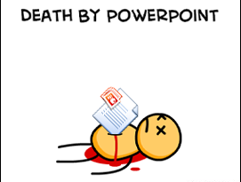
Not the Way to Learn to Code

Slide 3

True Way to Learn to Code

Slide 4
Organization

Slide 5
Demo

Slide 6
Your Turn!
Activity: Organize RPS
Suggested Time: 5 min.
Assignment:
Using your completed "rock, paper, scissors" game, organize your javascript into its own file - separate from your HTML.

Slide 7
DOM Manipulation

Slide 8
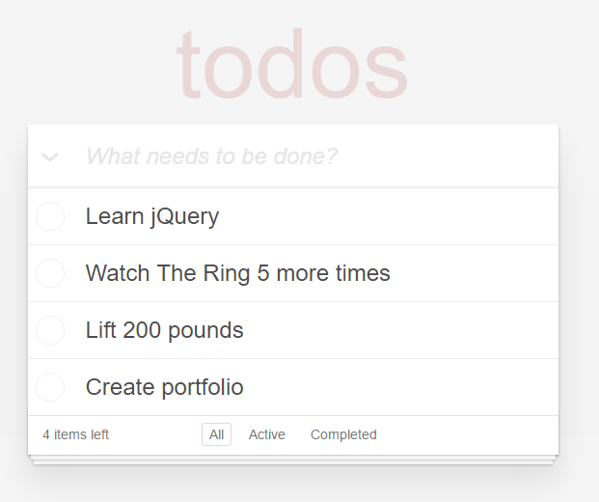
Understanding the “DOM”
Every HTML page begins as static content
However, with JS, we have the power to change the content in real-time
This allows sites to be interactive, engaging, and powerful

Slide 9
Demo

Slide 10
Your Turn!
Activity: JS Drinks
Suggested Time: 20 min.
Assignment:
Using the html file as a starting point:
Link the external js file to the html file.
Add the missing code such that your JavaScript generates HTML content that displays all of the drink options.
Note:
You will need a for-loop. Inside your for-loop you will need to use each of the following methods: `createElement`, `.textContent`, and `.appendChild`.
Bonus:
Convert the array of strings to an array of objects. Each object should have a `name` property and a `price` property. The `name` property should be the name of the drink and the `price` property should be the price of the drink.

Slide 11
Click Handling

Slide 12
Demo

Slide 13
Your Turn!
Activity: Sandwich Click
Suggested Time: 20 min.
Assignment:
Add the missing js code (and file) such that clicking any of the sandwiches causes…
An alert message to pop-up saying something snarky about the sandwich type.
A second alert message that displays to the user the number of that specific sandwich they’ve eaten.
Note:
You will need counter variables.
Bonus:
Add an image to an `image-div` on the click event.

Slide 14
Your Turn!
Activity: Random Number Generator
Suggested Time: 15 min.
Assignment:
Add in the missing code (and file) such that clicking the big blue button triggers a random number (between 1 and 1000) to be selected and prominently displayed in the random-number div.

Slide 15
Your Turn!
Activity: Lottery Generator
Suggested Time: 15 min.
Assignment:
Using the code from the previous random number generator as a starting point, create a lottery generator.
In our case, the lottery number should pick a random 9 digit number (and always 9 digits). As an example: 886563264.
Display this number in the random-number div.
Then when a user clicks again, have the code create a new row with the latest number at the top.

Slide 16
Your Turn!
Activity: Number Guesser
Suggested Time: 15 min.
Assignment:
Using the given html file as a starting point, add in the missing code (and file) such that:
The computer randomly selects a number between 1 and 4.
The user then clicks on one of the four buttons.
If the user guesses correctly, display a message to the user that they guessed correctly in the "result card".
If the user guesses incorrectly, display a message to the user that they guessed incorrectly in the "result card".
Bonus:
After you get the game working, look at the code and see how you can make it more efficient and DRY.

Slide 17
Your Turn!
Activity: Fridge Magnets
Suggested Time: 30 min.
Assignment:
Using the given files as a starting point, add in the missing code such that:
Dynamically generates buttons for each of the letters on the screen.
Clicking any of the buttons leads the letter to be displayed on the fridge.
Clicking the clear button erases all of the letters from the fridge.
Note:
The given CSS does NOT need to be modified.

