Slide 1
Intro to Coding
and the Modern Web
Chris Human ©2023

Slide 2
Recommended Setup
A quiet area to focus
A comfortable workspace
A second monitor (highly encouraged)
Headphones/headset

Slide 3
Mindset, Motivation, & Expectation

Slide 4
Your why…
Why do you want to do this?
To be able to “create”
To pursue a “dream”
To gain “financial stability/freedom”
To “challenge” yourself
To be a “role model”
To escape a “stagnant job”

Slide 5
Remember…
Nothing good comes easy!

Slide 6
Nothing good comes easy…
You will face 3 HUGE obstacles!

Slide 7
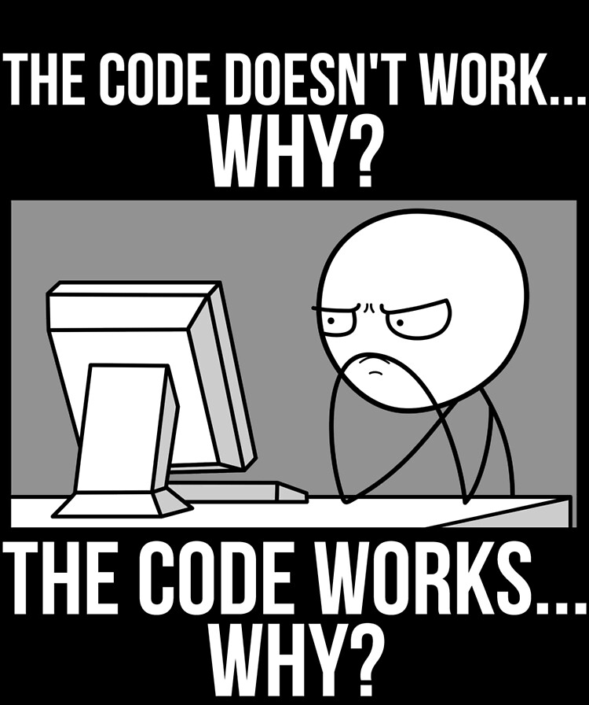


Notes:
The great confusion
The great doubt/distraction
The great distance

Slide 8
Nothing good comes easy…
Learning to code requires 2 things:
Persistence in the face of something that feels hard and confusing
Maintaining the self-confidence to believe you CAN DO THIS!

Slide 9
Learning is “Frustrating”
“You can’t tell whether you’re learning something when you’re learning it—in fact, learning feels a lot more like frustration.”
“What I’ve learned is that during this period of frustration is actually when people improve the most, and their improvements are usually obvious to an outsider. If you feel frustrated while trying to understand new concepts, try to remember that it might not feel like it, but you’re probably rapidly expanding your knowledge.”
Jeff Dickey, Author of Write Modern Web Apps with the MEAN Stack: Mongo, Express, AngularJS, and Node.JS

Slide 10
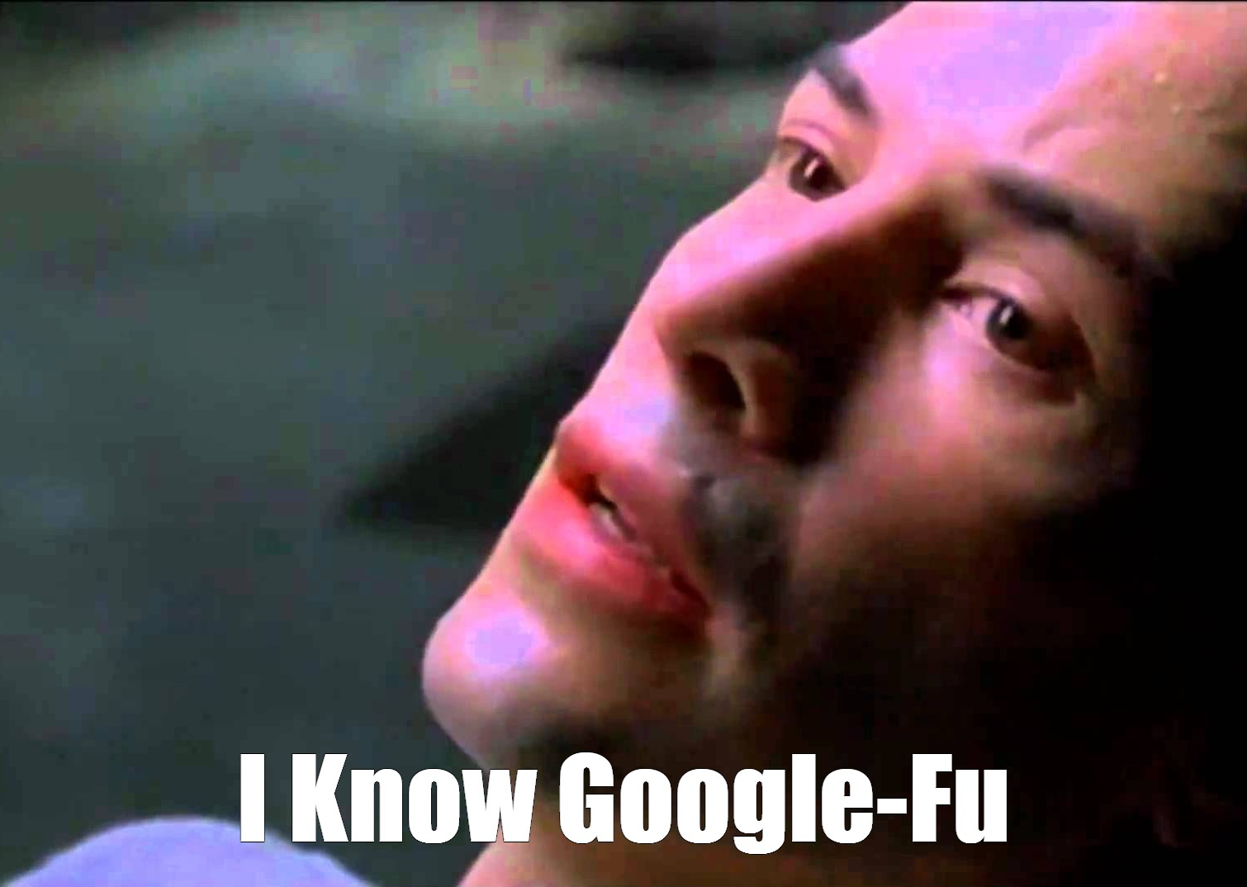

Resources…

Slide 11
On the Modern Web

Slide 12
Full-Stack Development?
In modern web applications, there’s a constant back-and-forth communication between two key components: the visuals displayed on the user’s browser (frontend) and the data and logic stored on the server (backend).
Full-Stack Development is the concept of building every aspect of the web app – from the visuals and interactions, to the data transfer and processing.

Slide 13
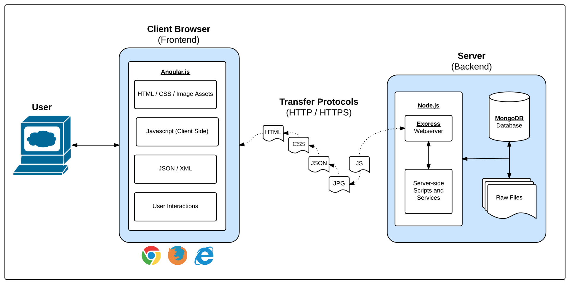

Full-Stack Development?

Slide 14
Full-Stack Development
The Browser
HTML
CSS
JavaScript
Bootstrap
SEO
React.js
Server Side
Node.js
Express.js
Templating Engines
Tests
MVC
User Authentication
Sessions
API Interaction
APIs
JSON
AJAX
Real Time Cloud
DevTools
Heroku
Git
GitHub
Databases
MySQL
MongoDB
Firebase
CS Fundamentals
Algorithms
Design Patterns
Containers
Docker
Kubernetes

