Slide 1
CSS Positioning
Chris Human ©2023

Slide 2
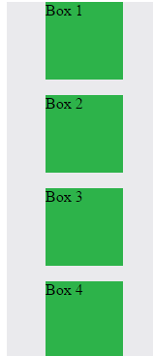
Position: Static (Default)
Four boxes placed statically (default)

Slide 3
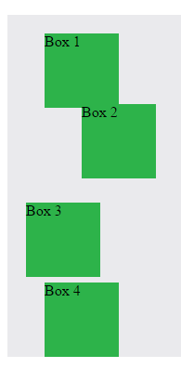
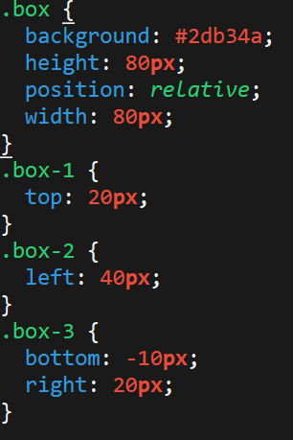
Position: Relative
Switching the boxes to relative will nudge the boxes in relation to their “original” location.

Slide 4
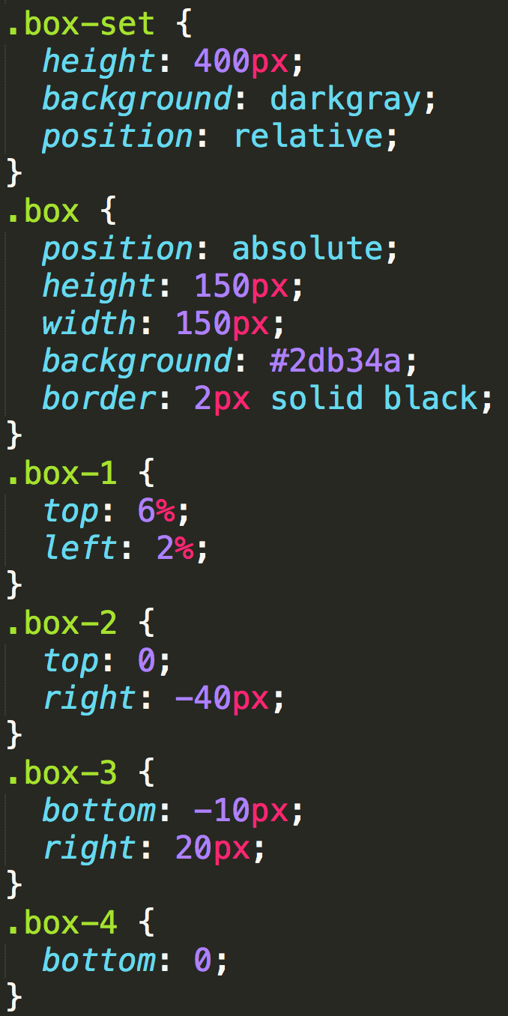
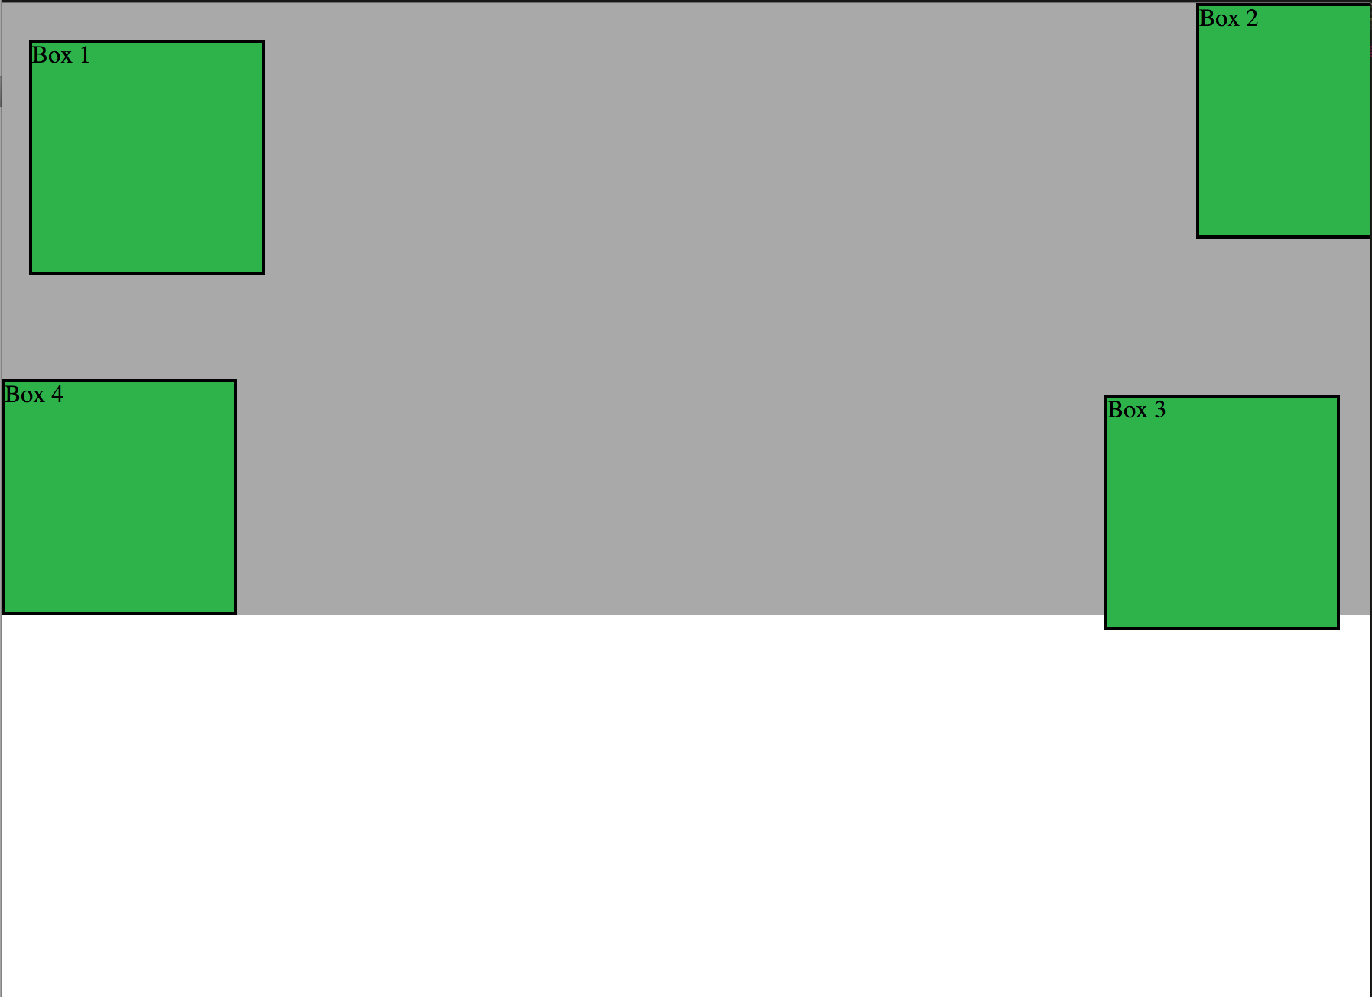
Position: Absolute
Positioned relative to nearest positioned ancestor

Slide 5
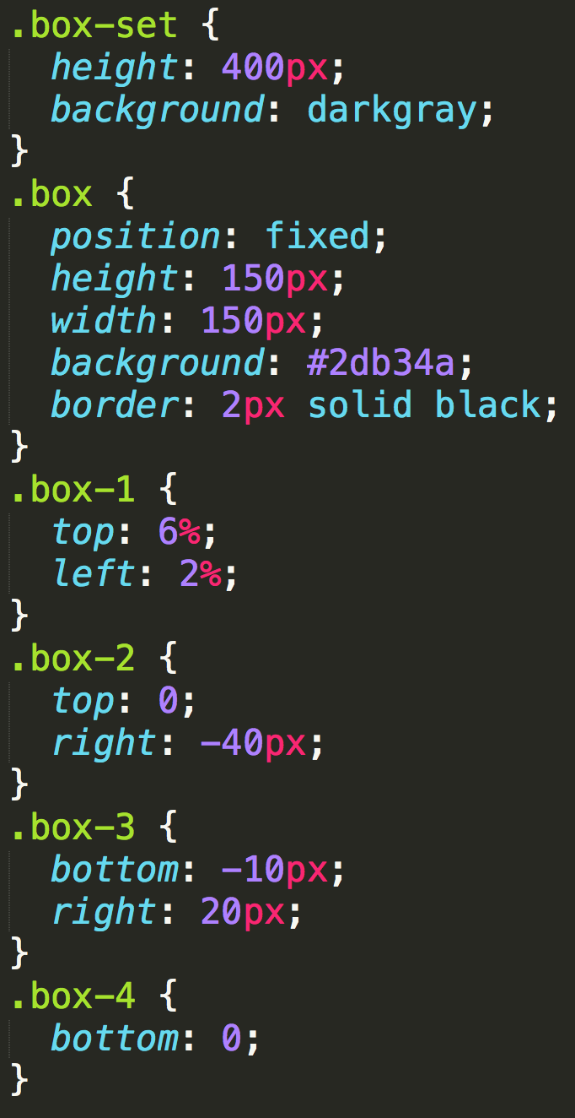
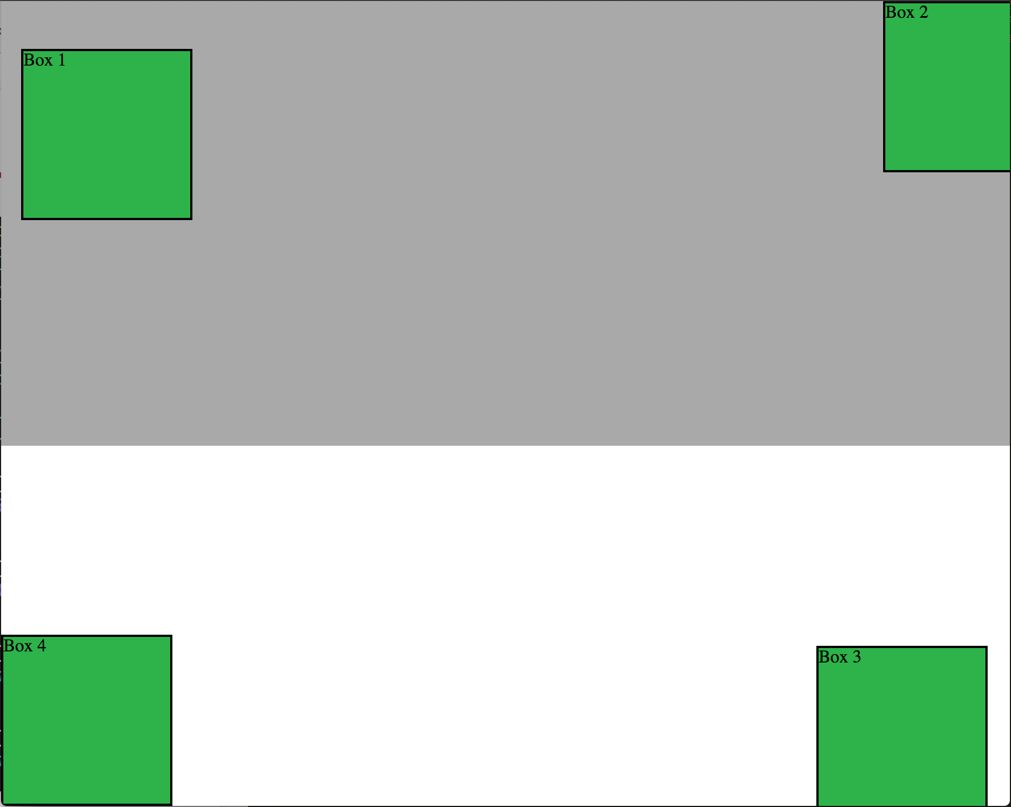
Position: Fixed
Position with exact coordinates to the browser window

Slide 6
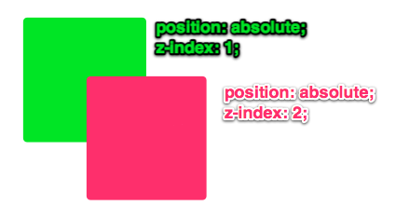
Layering with Z-Index
Z-Index allows you to layer elements on top of each other when they’re positioned.

Slide 7
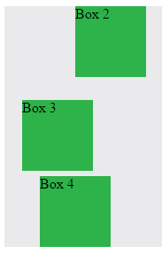
Hiding Things
“Display: none” allows us to hide elements from view.
This will become useful in later sections, when we’ll be hiding and revealing specific HTML elements of our choice.

Slide 8
Demo

Slide 9
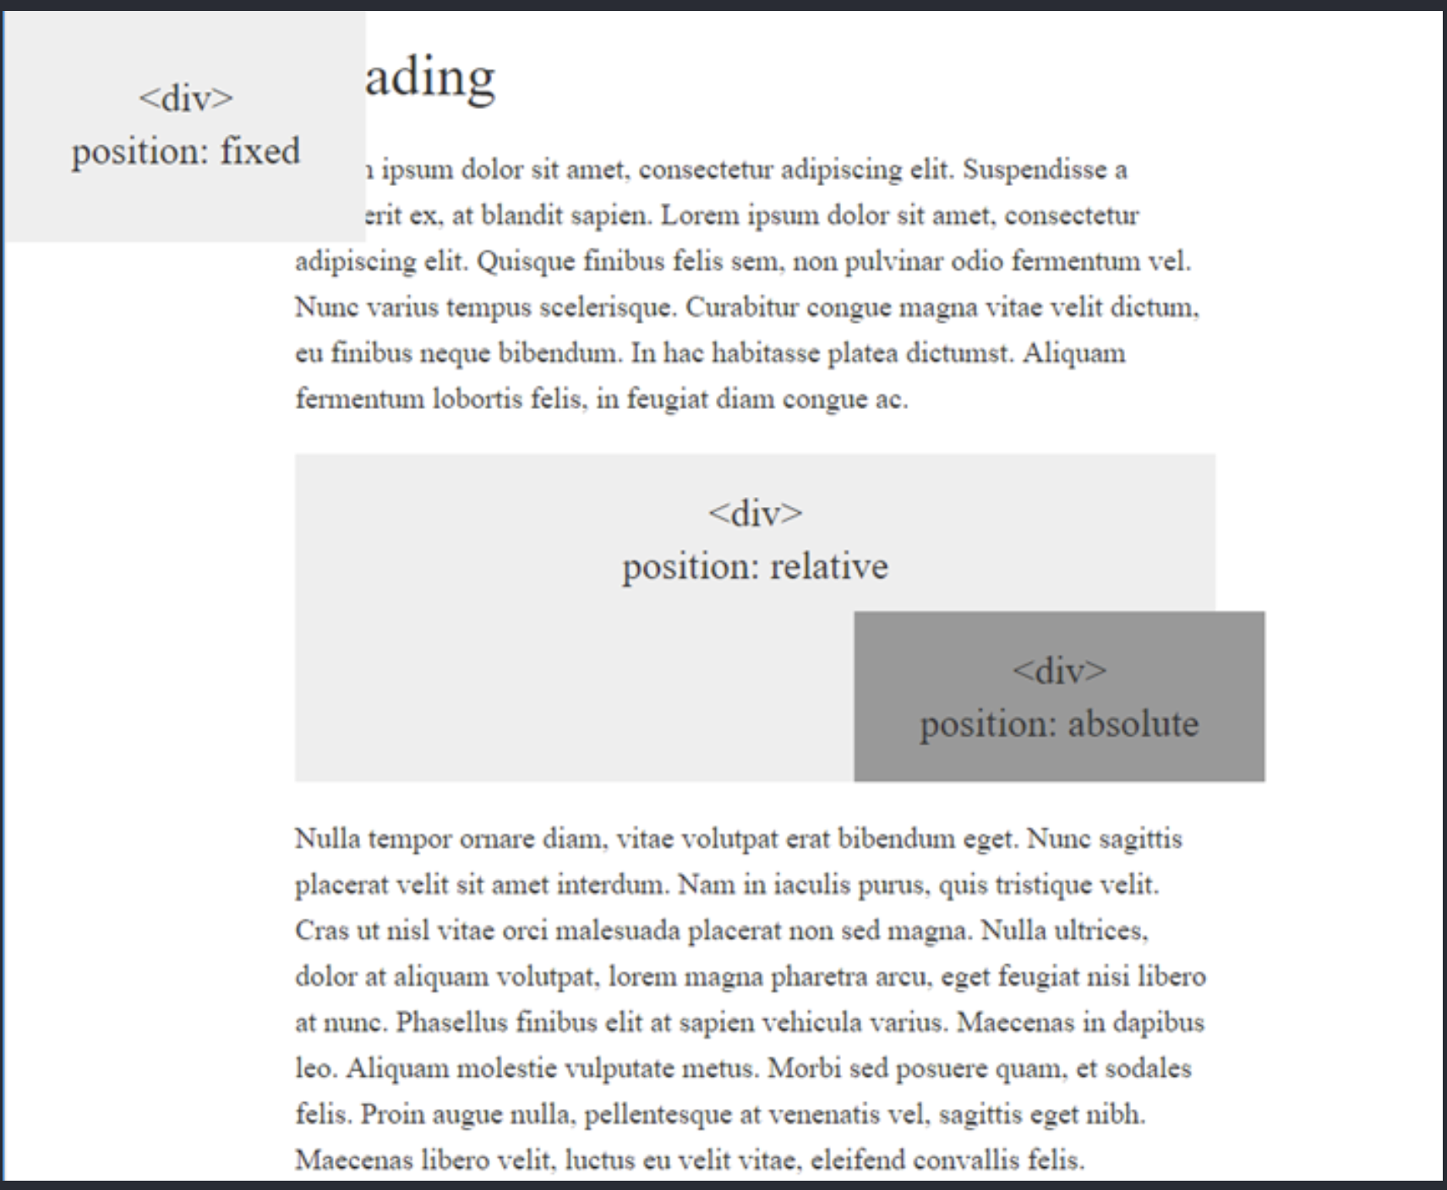
Your Turn!
Activity: CSS Positioning
Suggested Time: 15 min.
Assignment:
Create a file called positioning.css and link to it from the positioning.html file.
Using HTML/CSS, create the layout shown here.
For reference, the colors used on the screen are #eee and #999.
HINT: Use the code from the last few activities to help get you started.

Slide 10
Chrome Inspector

Slide 11
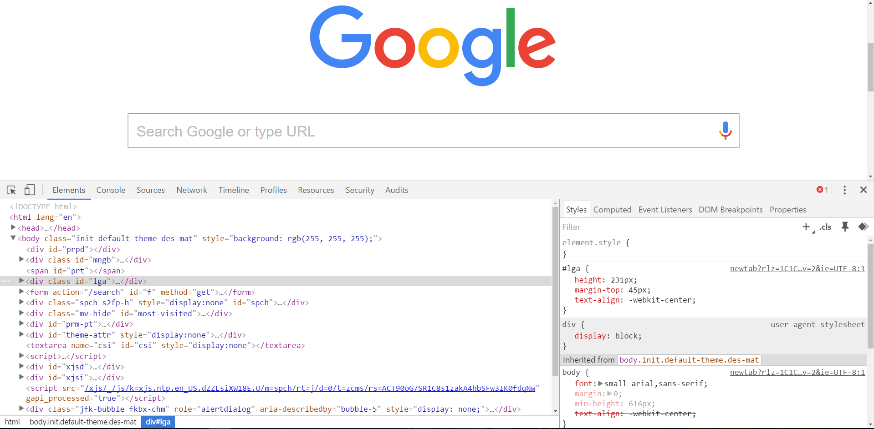
The Chrome Inspector = Friend
To access chrome inspector, right click on a page. Then hit “Inspect.”
It will allow you to inspect the HTML, CSS and more!
You can even edit the HTML/CSS of a webpage and instantly view your changes in the browser!
This works on any website, whether yours or not.

Slide 12
Demo

Slide 13
Your Turn!
Activity: Dev Tools
Suggested Time: 5 min
Assignment:
Assignment
Take a website you commonly visit (Amazon, Google, etc.) and heavily modify it with Google Developer Tools.
Try modifying:
Content (change words).
Colors.
Spacing.
Any other CSS style rules.
When you’re done, send a screenshot to Slack.

Slide 14
CSS Resets

Slide 15
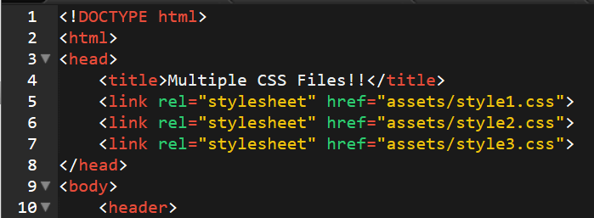
Loading Multiple CSS Files
We can link our documents to more than one stylesheet at a time—one of the most powerful features of CSS/HTML.
By tapping into different stylesheets simultaneously, we can create complex layouts with plenty of design rules.
Just remember: the loading order matters!!!

Slide 16

Battle of the Browsers
Under the hood, web browsers often render webpages differently than their competition.
These disparities could mean HTML/CSS displaying differently in each web client.
Because of these potential divergences, web developers need to make their websites cross-browser compatible.

Slide 17
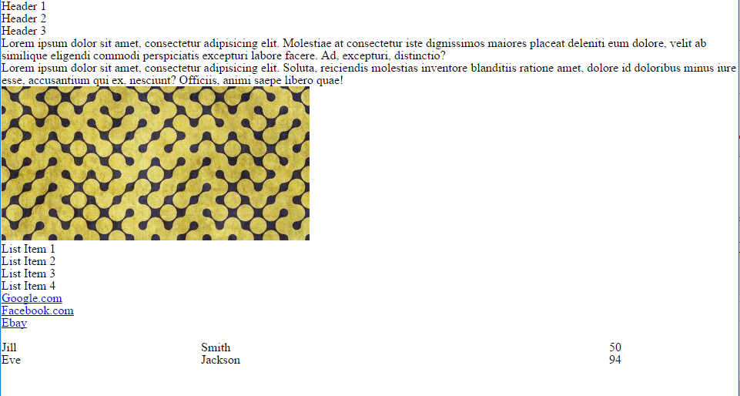
Battle of the Browsers
Reset.css will “reset” all browser-specific CSS. This means your site will appear the same in all browsers.
However, you will have to re-style everything yourself.

Slide 18
Why CSS Resets Matter
It’s important for creating browser-compatible websites.
It’s an example of using someone else’s CSS in your website!!!
It’s a common Front-End Developer Interview question.

Slide 19
Demo

