Slide 1
Jumping for JS
Chris Human ©2023

Slide 2
Recap

Slide 3
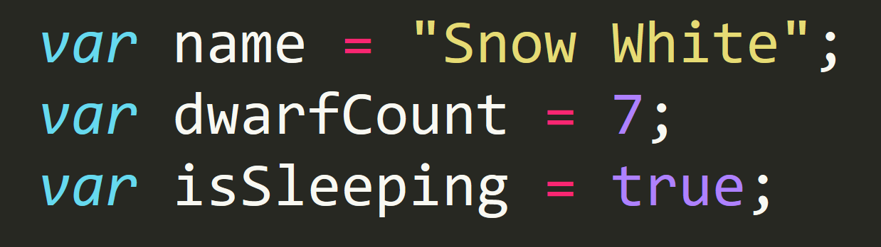
Variable Basics
Variables are the nouns of programming.
They are “things” (Numbers, Strings, Booleans, etc.)
They are composed of variable names and values

Slide 4
What are the differences?
console.log( )
alert( )
prompt( )
confirm( )

Slide 5
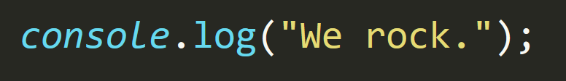
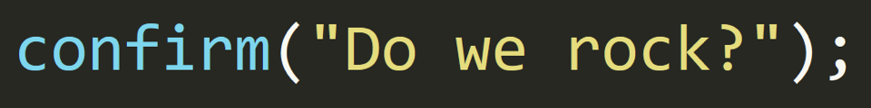
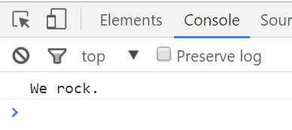
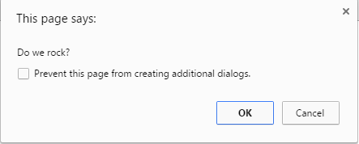
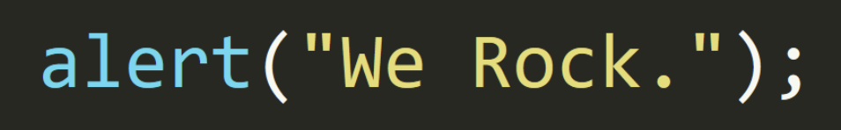
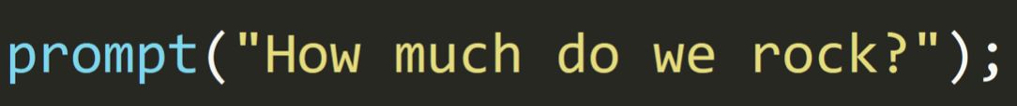
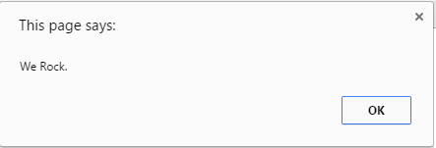
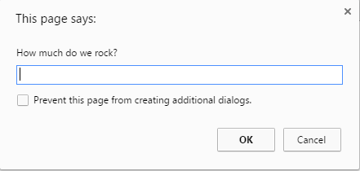
What are differences?

Slide 6
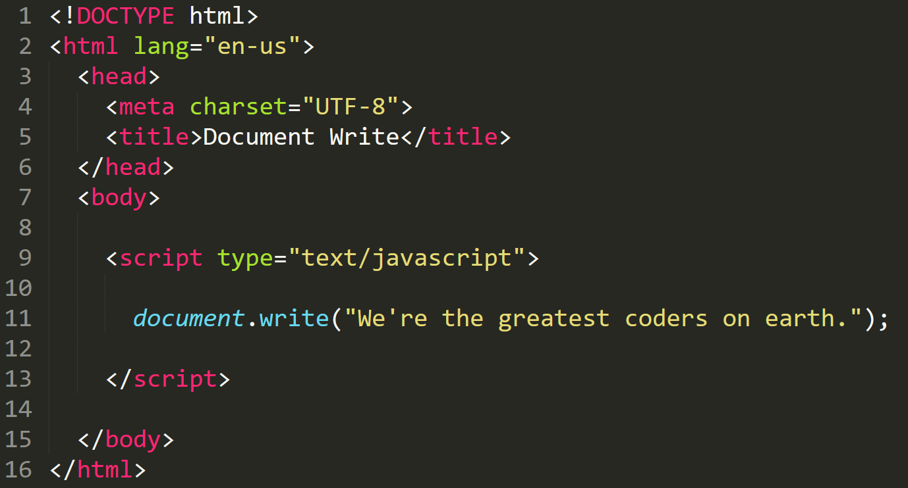

Writing to HTML
We can use JavaScript to directly write to the HTML page itself using document.write( ).
Later we will go over much more advanced approaches for writing HTML using JavaScript.

Slide 7
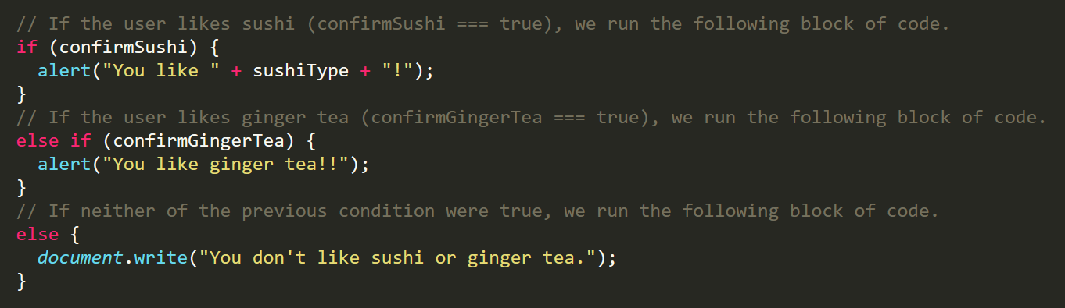
If/Else Statements (Conditionals)
If/Else statements are critical.
Each statement is composed of an if, else-if, or else (keyword), a condition, and the resulting code in { } braces.

Slide 8
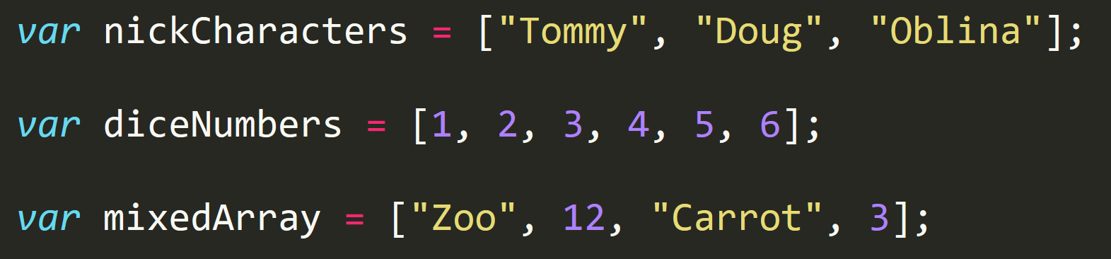
Array Basics
Arrays are a type of variable that are collections.
These collections can be made up of strings, numbers, booleans, other arrays, objects, anything.
Each element of the array is marked by an index. Indexes always start with 0.

Slide 9
Your Turn!
Activity: Array Accessing
Suggested Time: 5 min.
Assignment:
Follow the instruction in the HTML file to console.log each name from the array.

Slide 10
Your Turn!
Activity: Array Setting
Suggested Time: 10 min.
Assignment:
Follow the instructions in the file above to convert each item in the array to lower case.
Make sure to only add in lines of code where instructed.

Slide 11
For Loops

Slide 12
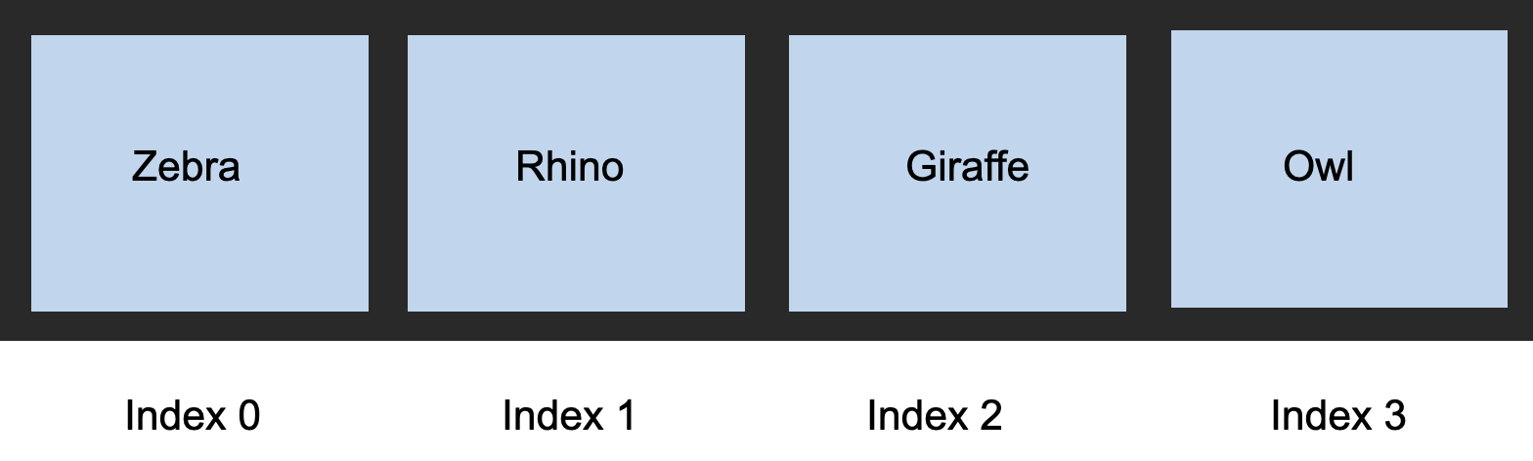
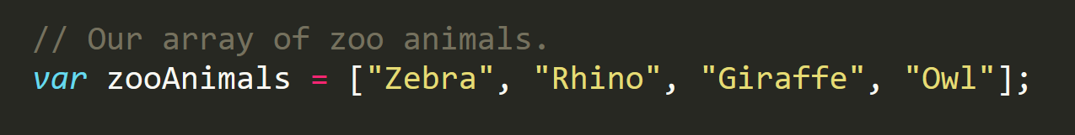
Back to the Zoo Pen

Slide 13
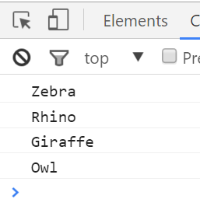
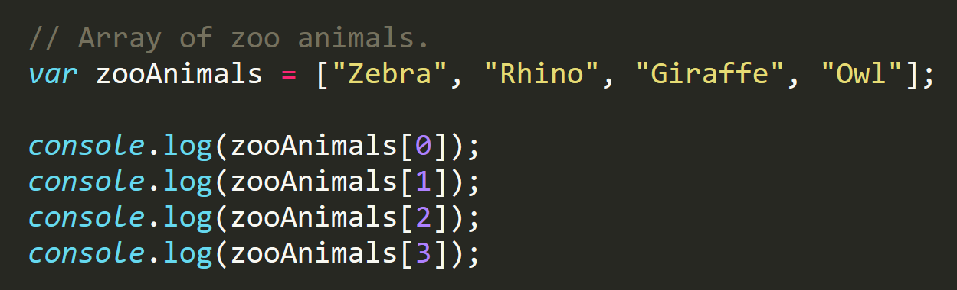
Back to the Zoo Pen (Logged)
What is wrong with this?
REPEATED CODE!

Slide 14
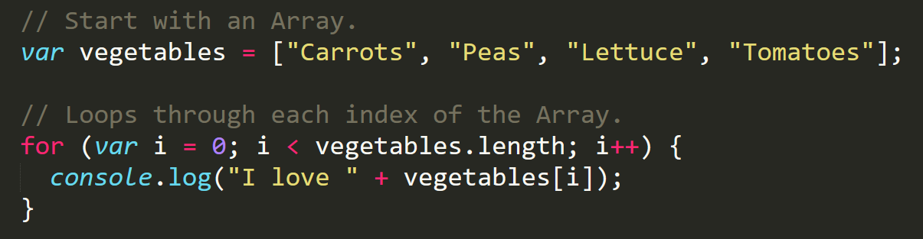
Enter the For-Loop
For loops are critical in programming.
We use for loops to run repeated blocks of code over a set period.
Each for loop is composed of a:
Variable declaration or counter (iterator)
A loop condition
An iteration

Slide 15
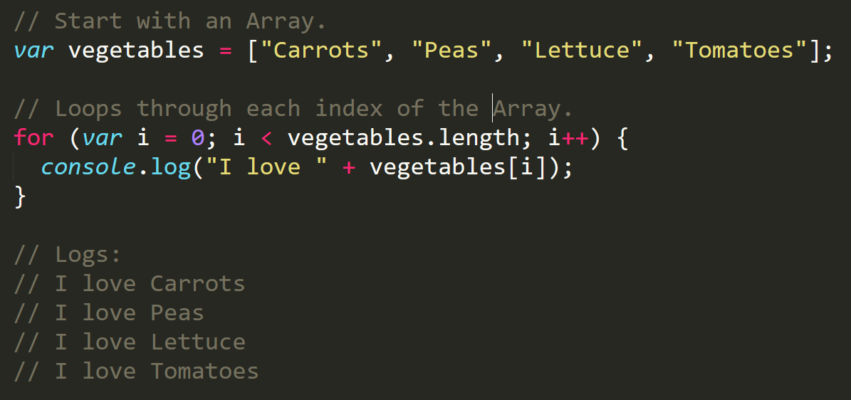
Enter the For-Loop
Iterator. Condition. Increment.

Slide 16
Enter the For-Loop
Code between the { } gets repeated each time the iterator meets the condition. (i.e. in this case i < 4)

Slide 17
Enter the For-Loop
Running the code “loops” through and prints each element in the array.

Slide 18
Run that Loop
When i = 0 …console.log(“I love Carrots”);
Carrots
Peas
Lettuce
Tomatoes
Index 0
Index 1
Index 2
Index 3

Slide 19
Run that Loop
When i = 1 …console.log(“I love Peas”);
Carrots
Peas
Lettuce
Tomatoes
Index 0
Index 1
Index 2
Index 3

Slide 20
Run that Loop
When i = 2 …console.log(“I love Lettuce”);
Carrots
Peas
Lettuce
Tomatoes
Index 0
Index 1
Index 2
Index 3

Slide 21
Run that Loop
When i = 3 …console.log(“I love Tomatoes”);
Carrots
Peas
Lettuce
Tomatoes
Index 0
Index 1
Index 2
Index 3

Slide 22
Your Turn!
Activity: Zoo Loop
Suggested Time: 15 min.
Assignment:
Use “for” loops to rewrite the file.
If you need help, use the code from the previous example as a guide.

Slide 23
Your Turn!
Activity: Looping Continued
Suggested Time: 15 min.
Assignment:
Starting from scratch, create a `for` loop that console logs the following lines:
I am 0
I am 1
I am 2
I am 3
I am 4
**NOTE:** Don't use an array!

Slide 24
Your Turn!
Activity: Hard Loop
Suggested Time: 10 min.
Assignment:
Starting from scratch, write code that loops through the following array and logs the name of each animal on the farm to the console:
var myFarm = ["chickens", "pigs", "cows", "horses", "ostriches"];
Then check if the first letter in the animal's name begins with a "c" or "o". If it does, create an alert saying, "Starts with 'c' or 'o'!"
** HINT ** - You can access the first character of a string as if it were the first element of an array.

Slide 25
Demo

Slide 26
Your Turn!
Activity: Pseudo Code RPS
Suggested Time: 15 min.
Assignment:
Spend a few moments outlining all the steps and conditions that go into a single game of rock paper scissors.
Try to break it down into steps that you could code out.
Think of basic elements like loops, if-else statements, arrays, alerts, etc.

Slide 27
Your Turn!
Activity: Rock, Paper, Scissors
Suggested Time: 1 hr.
Assignment:
Using the pseudo code you made in the previous activity, write the code for the game.
NOTE: A for-loop is not technically necessary to make our RPS game, but could be used. Focus on the topics we have just covered when thinking about how to build out the game.
NOTE: Don’t use document.write as it will delete the contents of your page including your JavaScript. Use document.querySelector or document.getElementById, alongside either innerHTML or textContent, to write to the DOM.
NOTE: Don't worry. I know this is a very challenging assignment. I also know that you won't know where to start. In fact, I haven't shown you EVERYTHING you need yet, but that's okay. Part of being a developer is figuring things out on your own through trial and error.

