Slide 1
More CSS
Chris Human ©2023

Slide 2

Typography
Typography can play a huge role in the visual aesthetic and emotional identity of a webpage.

Slide 3
Typography Properties
Line Height Distance between lines of text on a page (Golden Ratio of 1.5x font).
Font-Size Actual size of lettering. Should be at least 16 px on modern pages. https://www.smashingmagazine.com/2011/10/16-pixels-body-copy-anything-less-costly-mistake
Line Length Not a CSS property but rather a standard. Should be about 50-75 characters per line on a desktop . http://baymard.com/blog/line-length-readability
Letter Spacing Spacing between individual letters—try to avoid cramping.
Sans-Serif vs Serif Sans-serif are fonts sans their serifs—no tails. They’re easier to read online.

Slide 4
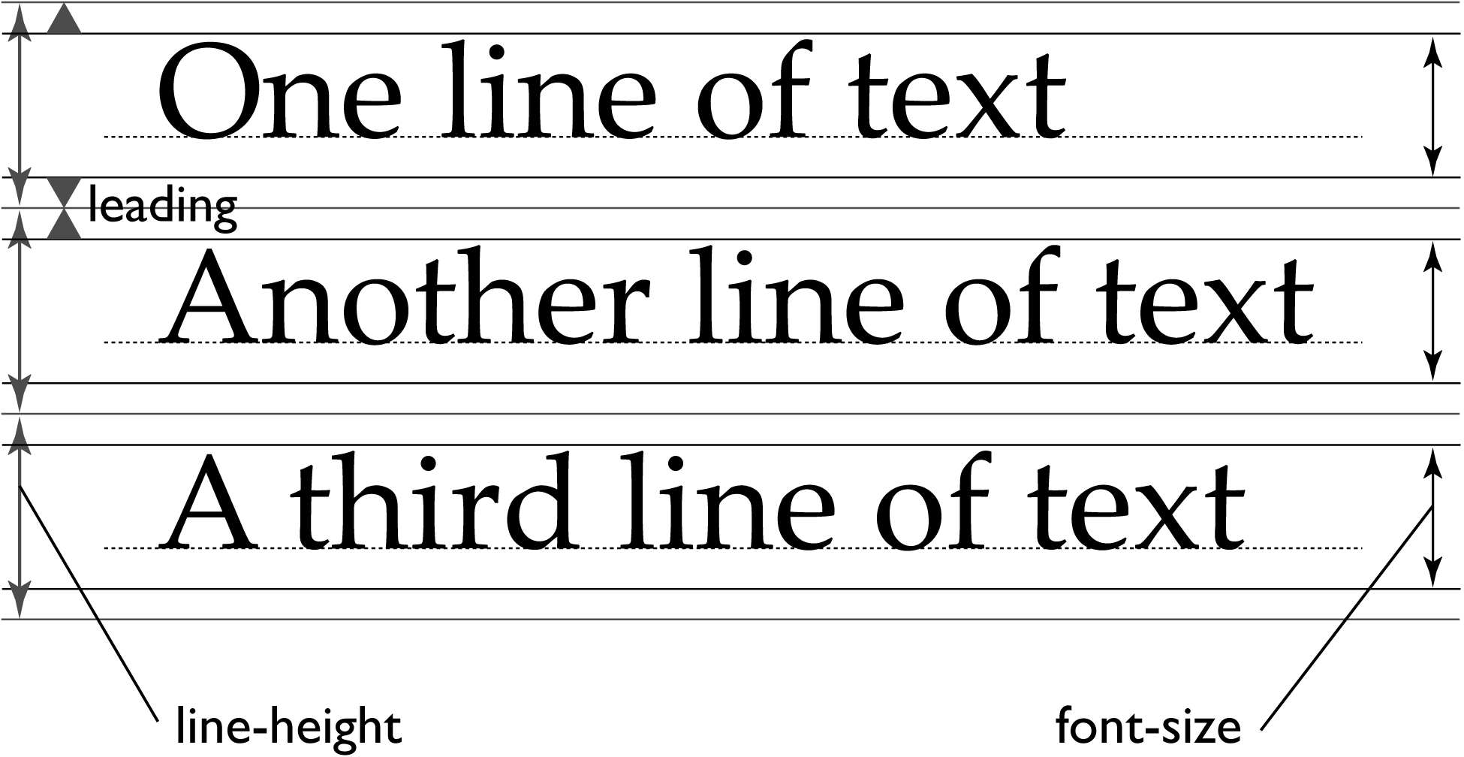
Line Height vs Font Size

Slide 5

Serif vs Sans Serif
Serif fonts include small lines attached to the end strokes of letters.
Sans-Serif (without serif) do not include such strokes.

Slide 6
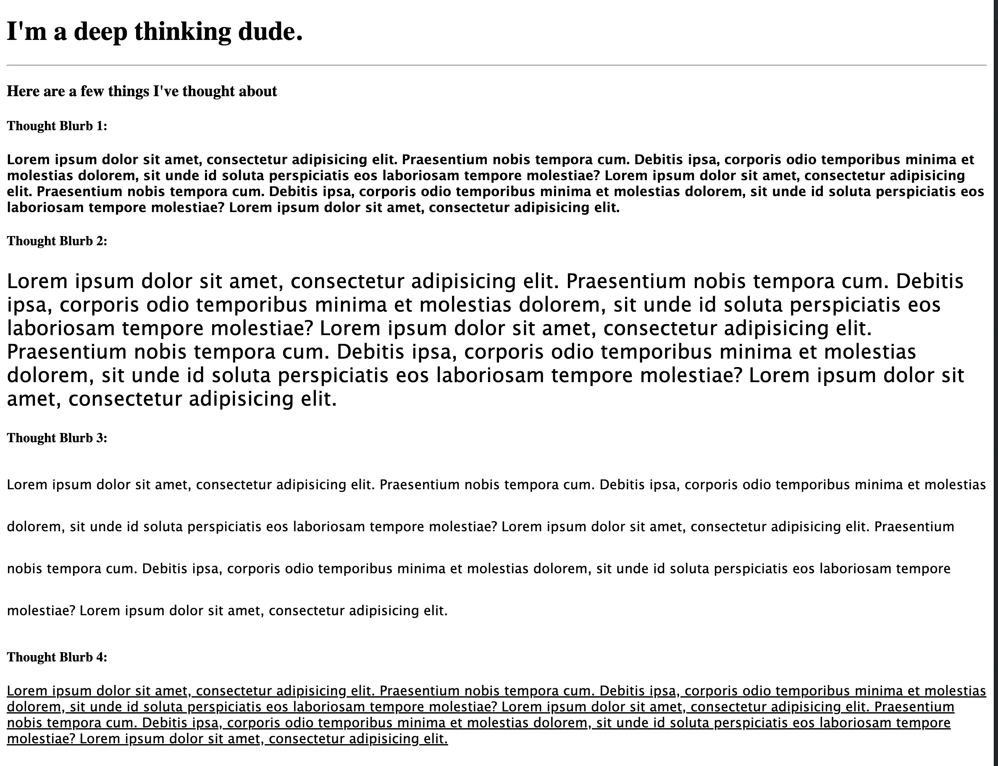
Your Turn!
Activity: CSS Typography
Suggested Time: 10 min.
Assignment:
Pull the latest changes from the class repo to your local machine.
Following the directions in the README modify the HTML and create the CSS to complete each step of the assignment

Slide 7
Google Fonts Demo

Slide 8
Your Turn!
Activity: CSS Typography pt. 2
Suggested Time: 10 min.
Assignment:
Link to the provided stylesheet
Get a font from Google Fonts
Use this font in a fifth paragraph

Slide 9
Pseudo Styles

Slide 10
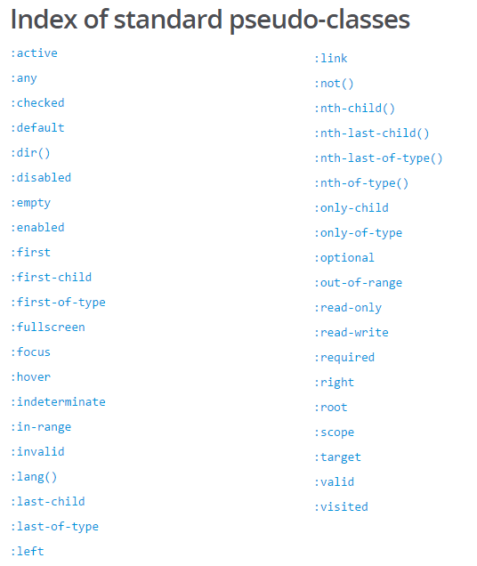
Pseudo Classes
CSS has keywords that can be added to selectors. These highlight the special states of the selected element.
Great example: CSS can hook onto the specific moment when a link is hovered over using the :hover pseudo-class.
Complete list of pseudo-classes found here: https://developer.mozilla.org/en-US/docs/Web/CSS/Pseudo-classes

Slide 11
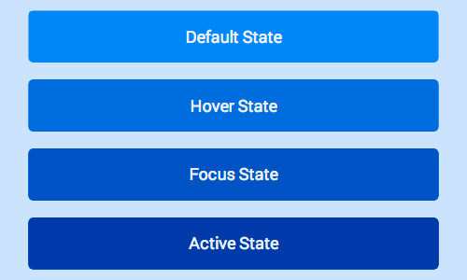
Button with Various States

Slide 12
Demo

Slide 13
Your Turn!
Activity: CSS Pseudo Classes
Suggested Time: 10 min.
Assignment:
Create an HTML and CSS file
Create a series of links and modify the pseudo-classes associated with their Default, Active, Hover and Focus States

Slide 14
Media Queries

Slide 15
Media Queries
Media Queries define how CSS styles are applied in relation to the characteristics of the device viewport.
Through media queries we can change the way a web page is displayed based on width, height, orientation, and even media type (screen, paper, braille, etc).
Bootstrap extensively uses media queries under the hood to help you create mobile responsive websites.
But remember! Media queries must be declared last.

Slide 16
Demo

Slide 17
Your Turn!
Activity: Media Queries
Suggested Time: 10 min.
Assignment:
Create a media query to change the following css when the viewport is 768px or less:
Change the background color of the body to #444
Make the wrapper take up 100% of the width of the viewport
Give the wrapper 20px of horizontal padding
Make the main content and sidebar take up 100% of the width of the parent element Give the main content and sidebar a solid green border with a width of 4px
Give the sidebar some vertical space from the main content
Create a media query to change the following css when the viewport is 480px or less:
Change the background color of the body to #f00
Give the main content and sidebar a solid black border with a width of 4px

