Slide 1
JS Juggernauts
Chris Human ©2023

Slide 2


Transformation to Come
Hang in There!

Slide 3
Your Turn!
Activity: Recap Warm-up
Suggested Time: 15 min.
Assignment:
Follow the instructions in the HTML file to complete the warmup.
Activities #1 & #2

Slide 4
Functions

Slide 5
Demo

Slide 6
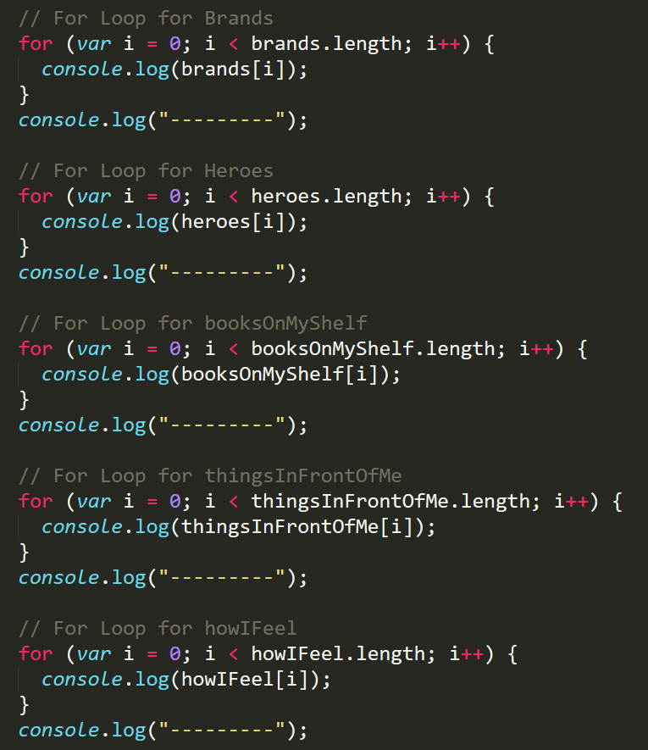
Keep your Code DRY
Who wants to maintain this?

Slide 7
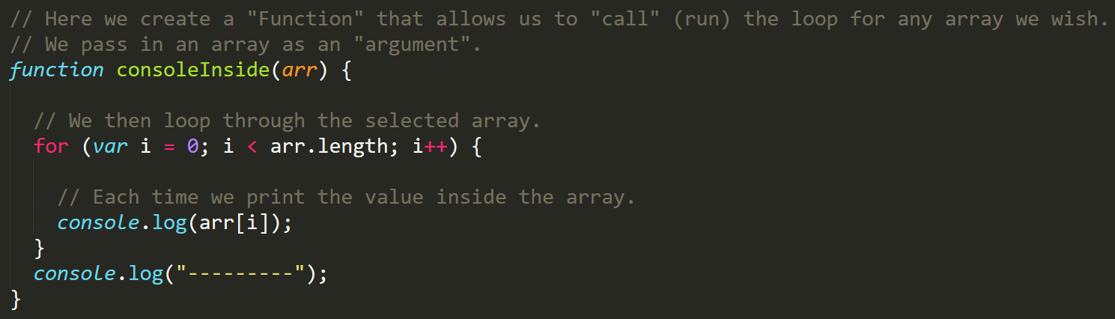
Keep your Code DRY
Clean Code
Minimal Repetition

Slide 8
Your Turn!
Activity: First Function
Suggested Time: 15 min.
Assignment:
Fill in the missing functions and function calls
Hints:
You will need to understand how to use “typeof” for the “isString” function
Bonus:
If you finish with the first four functions, create two additional functions, `adderReturn()` and `multiplierReturn()`, that return the value when you call the function rather than using console.log.

Slide 9
Demo

Slide 10
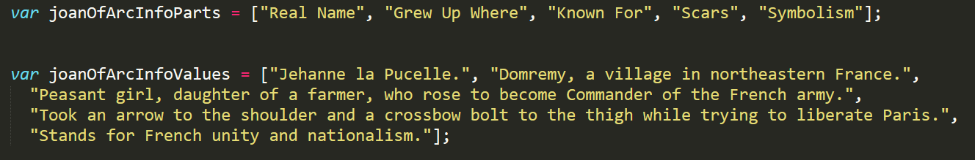
Associated Data ==/== Arrays
Relating separate arrays is not fun!

Slide 11
Objects

Slide 12
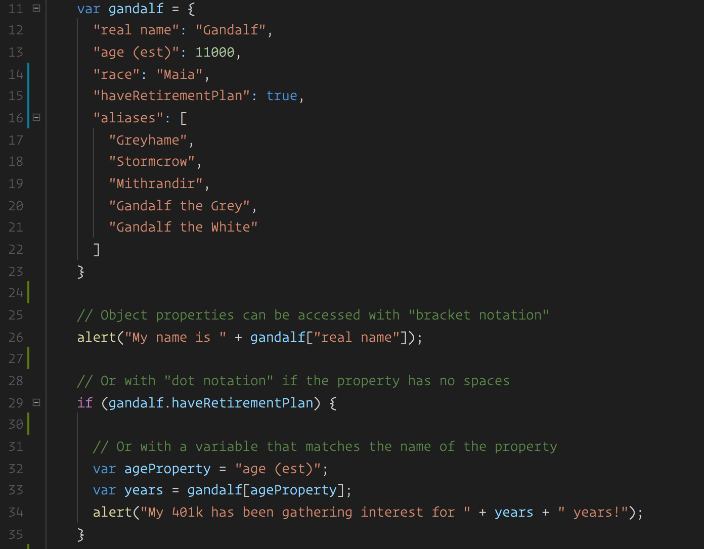
Gandalf - The Object
Gandalf’s “properties” and “values” are associated in object form, making it easy to recall specific data.

Slide 13
Object Visualized
var gandalf
=
{
“real name”
:
“Gandalf”
,
“age (est)”
:
11000
,
“race”
:
“Maia”
}
This is Gandalf. According to code… Gandalf is an Object.

Slide 14
Object Visualized
var gandalf
=
{
“real name”
:
“Gandalf”
,
“age (est)”
:
11000
,
“race”
:
“Maia”
}
These are Gandalf’s properties (like descriptors).

Slide 15
Object Visualized
var gandalf
=
{
“real name”
:
“Gandalf”
,
“age (est)”
:
11000
,
“race”
:
“Maia”
}
These are the “values” of Gandalf’s properties.

Slide 16
Object Visualized
var gandalf
=
{
“real name”
:
“Gandalf”
,
“age (est)”
:
11000
,
“race”
:
“Maia”
}
Thus: gandalf[“race”] = “Maia” OR gandalf.race = “Maia”

Slide 17
Your Turn!
Activity: Car Object
Suggested Time: 20 min.
Assignment:
Follow the instructions in the HTML file to complete the activity.

Slide 18
Demo

Slide 19
Your Turn!
Activity: Car Game
Suggested Time: 25 min.
Assignment:
Using the code from the previous activity as a starting point, create a complete application such that:
Users can enter keyboard input (letters).
Each of the car's methods are assigned to a key.
When the user presses a key it calls the appropriate function.
These letters also trigger a global function called reWriteStats() that logs the car’s make, model, color, mileage, and isWorking status to the console.
HINT
You will need to use the document.onkeyup() function to collect input from the user's keyboard.

Slide 20
Scope

Slide 21
Your Turn!
Activity: Trivia Game
Suggested Time: 35 min.
Assignment:
Starting from a blank HTML file, create an array with 10 question objects. Each object in the array should be structured as follows:
`{ question: "QUESTION", answer: "ANSWER" }`
Then create code that will ask the user questions, one by one. The user must answer by hitting t (for true) or f (for false).
Check the user's answer against the correct answer, and provide them with an alert telling them if they are right or wrong.
BONUS
Keep track of the user’s score
HINT
Don't worry about having DRY code to start with. Just focus on getting working code first.

