Slide 1
Flex & Grid
Chris Human ©2023

Slide 2
Credit Due
Material borrowed from Chris Coyier
https://css-tricks.com/snippets/css/a-guide-to-flexbox/
Material borrowed from Jon Suh
https://learncssgrid.com/

Slide 3
Flexbox

Slide 4
Why Flexbox?
Aims at providing a more efficient way to lay out, align and distribute space among items in a container
Alter its items’ width/height (and order) to best fill the available space
A flex container expands items to fill available free space or shrinks them to prevent overflow

Slide 5
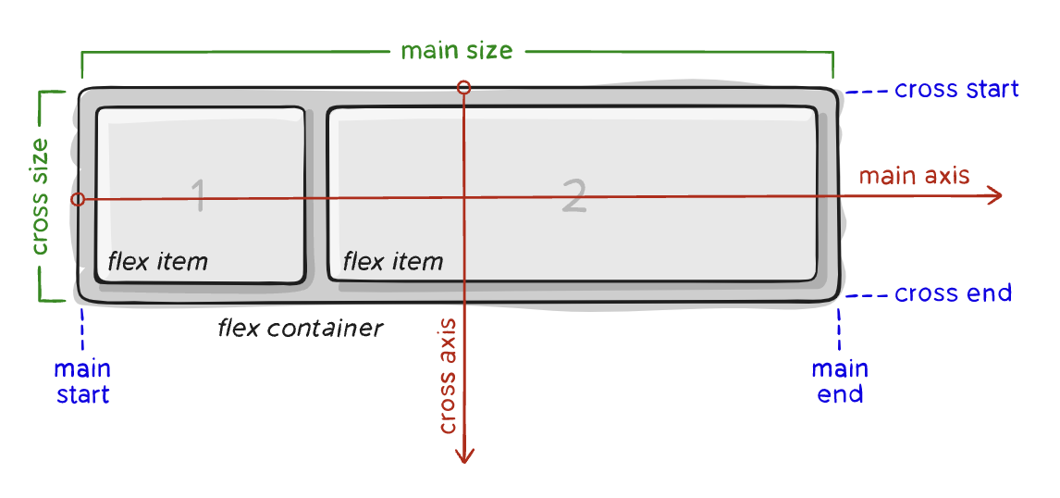
Basics & Terms
Container vs Items
Main/Cross axis – The axis along which flex items are laid out
NOT always horizontal! Depends on “flex direction”
main-[start|end] – The flex items are placed within the container starting from main-start and going to main-end.
Main/Cross size - a flex items width or height
Depends on direction

Slide 6
Demo

Slide 7
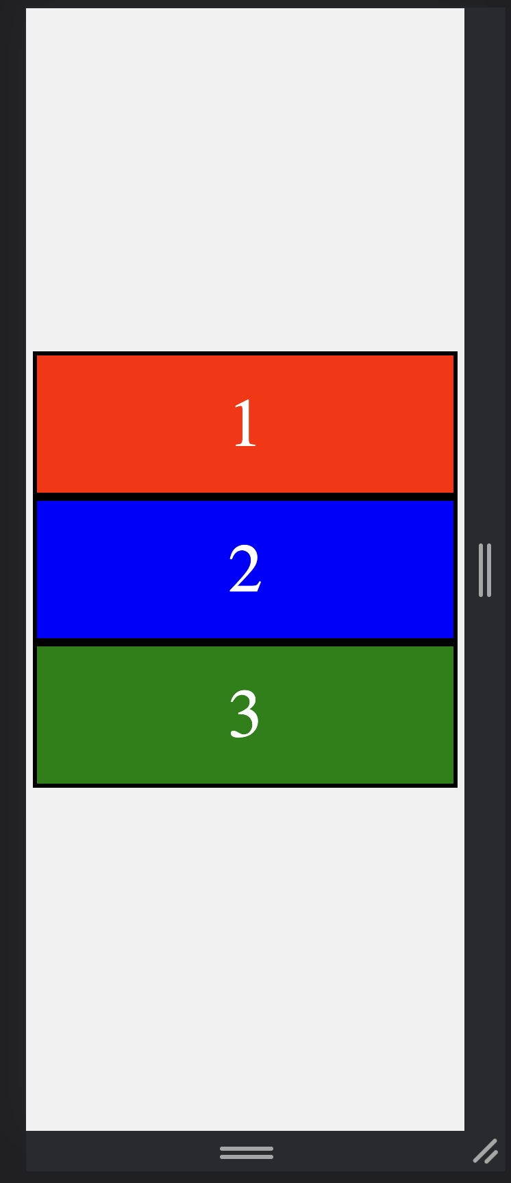
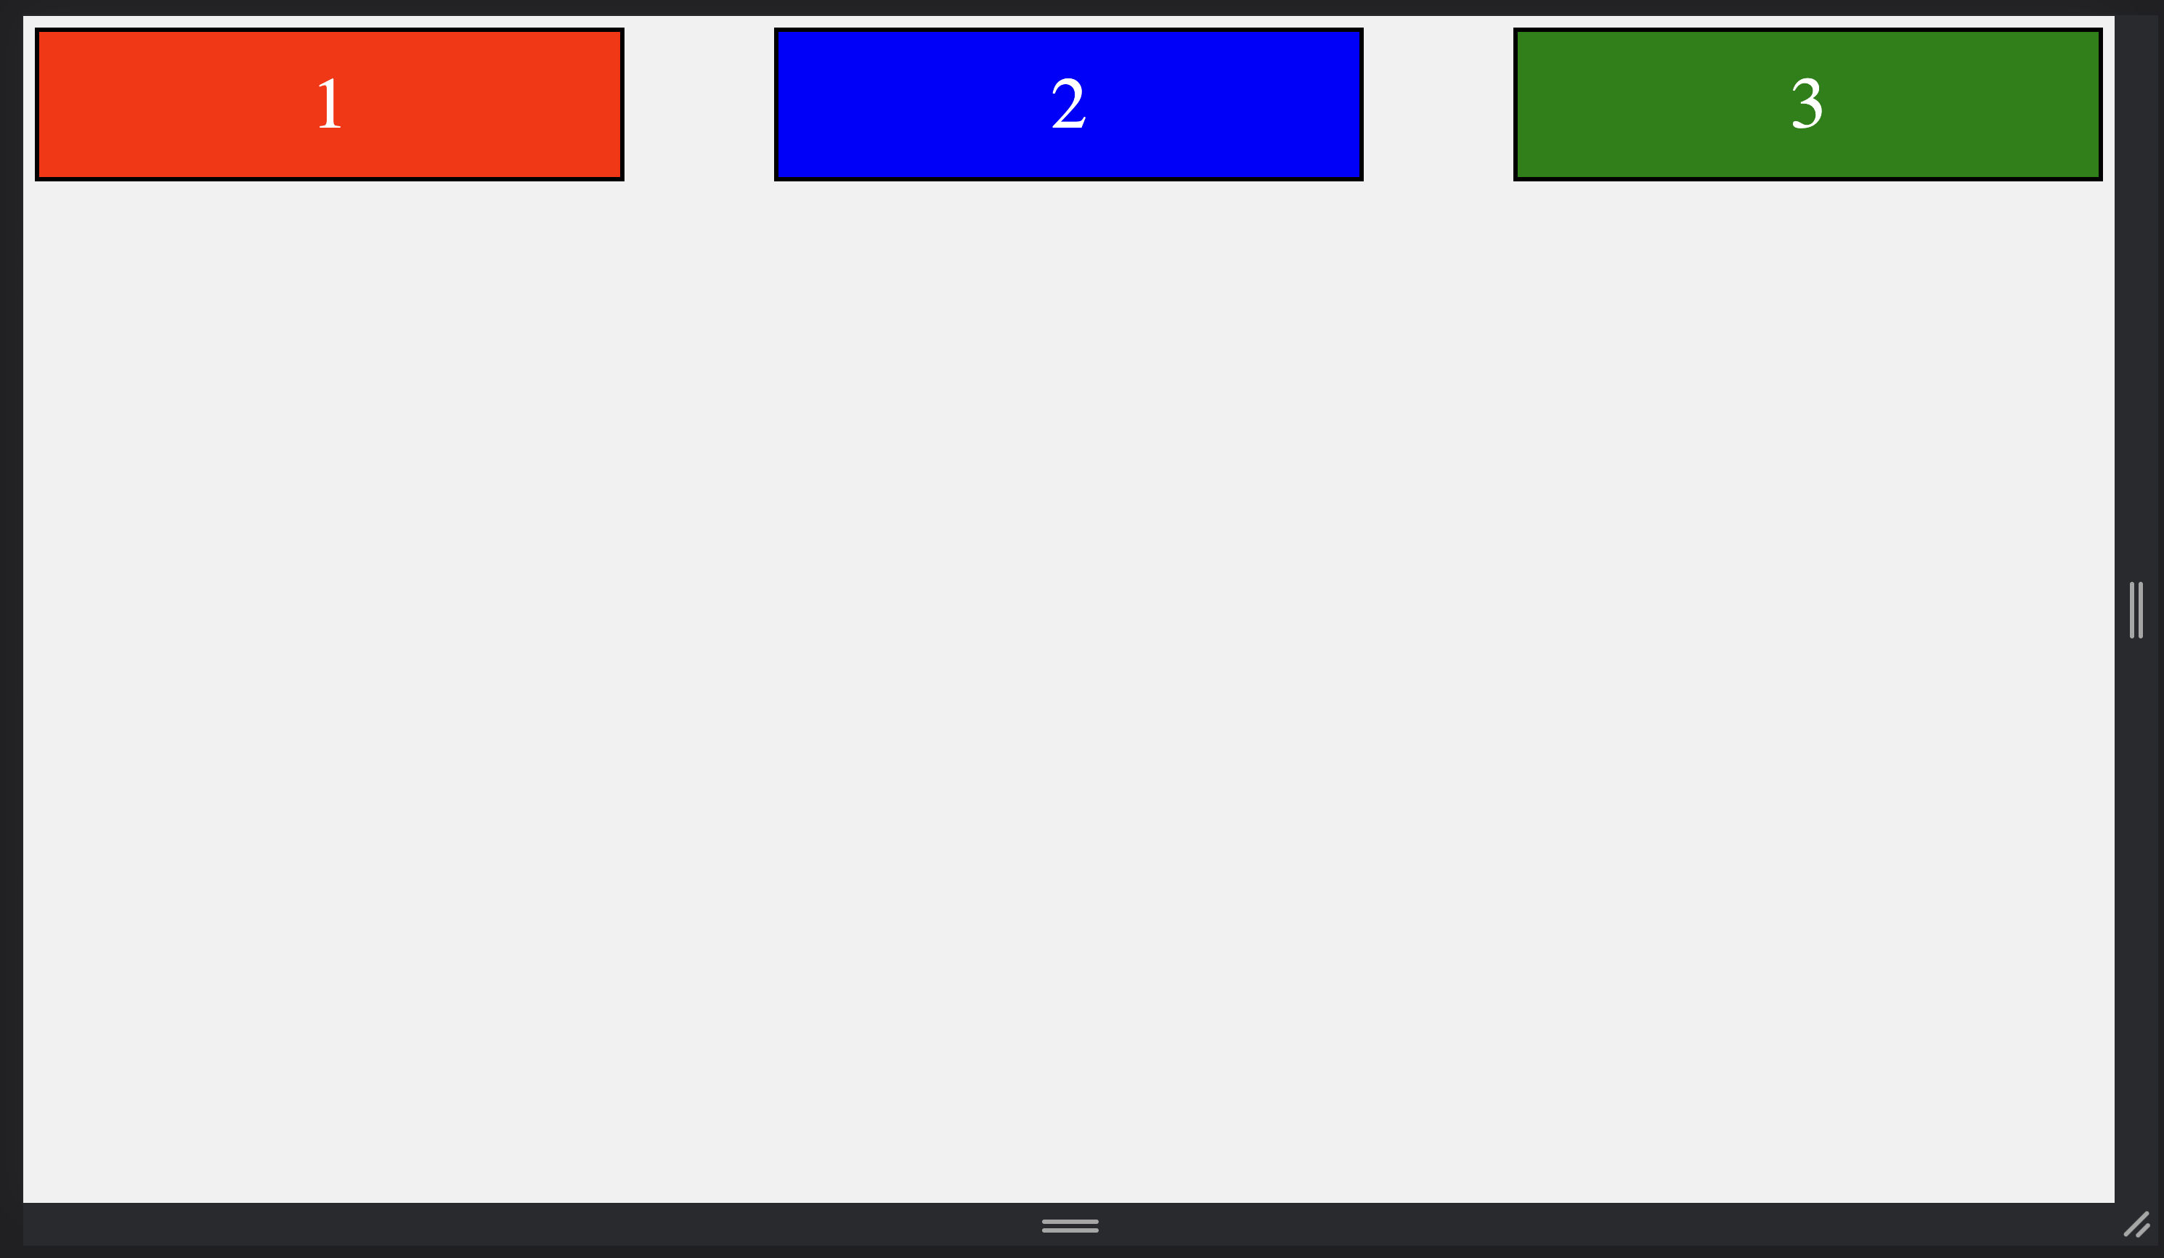
Your Turn!
Activity: Flexin’
Suggested Time: 20 min.
Assignment:
Using the files provided to you:
Write CSS using flexbox and its properties to create a dynamic layout that matches the screenshots below.

Slide 8
Grid

Slide 9
Why Grid?
Aims at providing a more efficient way to lay out, align and distribute space among items in a container in a 2D space.
One of the most powerful CSS modules introduced.
Pairs very well with flex box for complex layouts

Slide 10
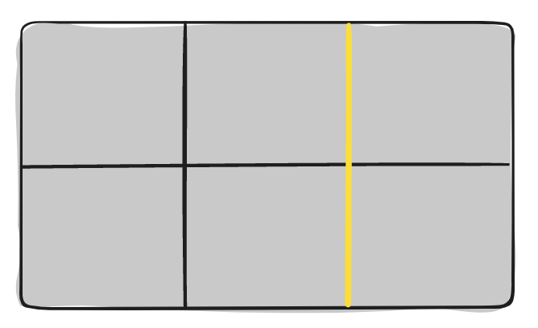
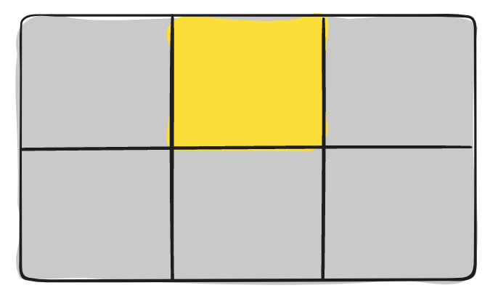
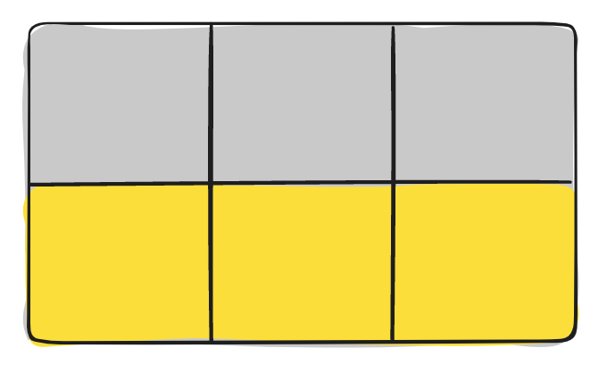
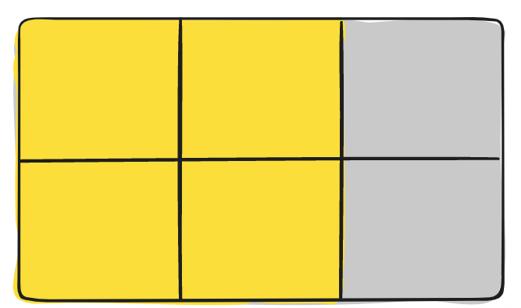
Basics & Terms
Aims at providing a more efficient way to lay out, align and distribute space among items in a container in a 2D space.
Grid Line - The dividing lines that make up the structure of the grid. They can be either vertical (“column grid lines”) or horizontal (“row grid lines”) and reside on either side of a row or column.
Grid Cell - The space between two adjacent row and two adjacent column grid lines. It’s a single “unit” of the grid.
Grid Track - The space between two adjacent grid lines. You can think of them as the columns or rows of the grid.
Grid Area - The total space surrounded by four grid lines. A grid area may be composed of any number of grid cells.

Slide 11
Demo

Slide 12
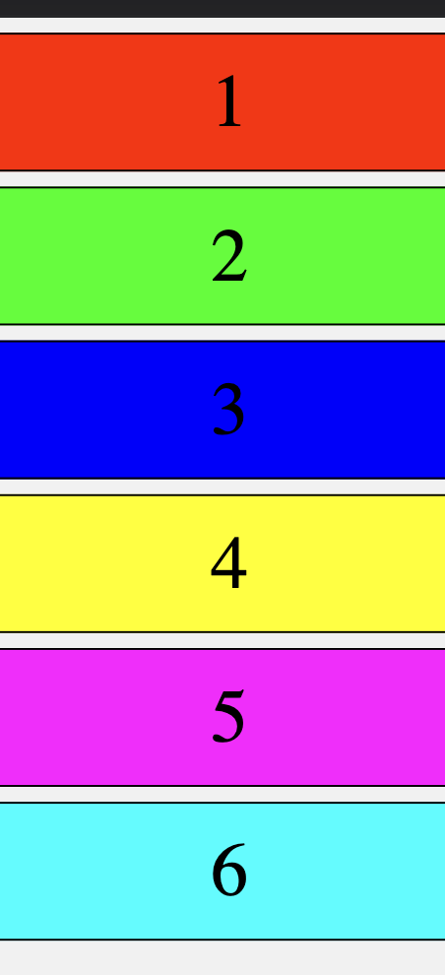
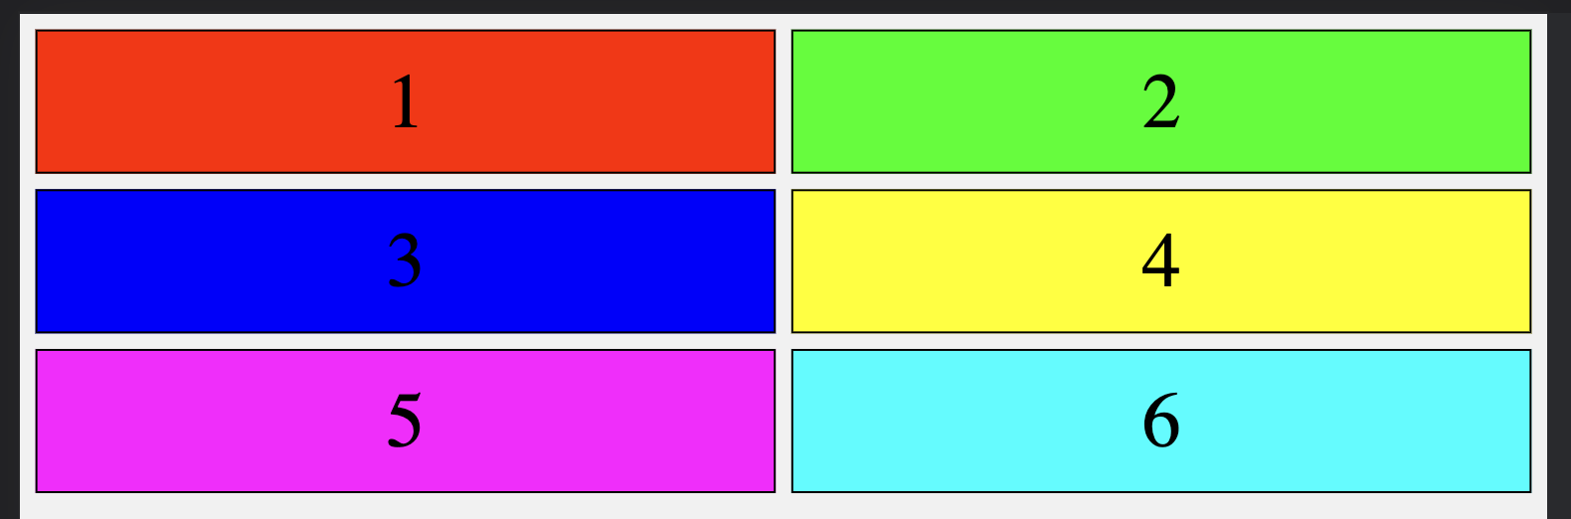
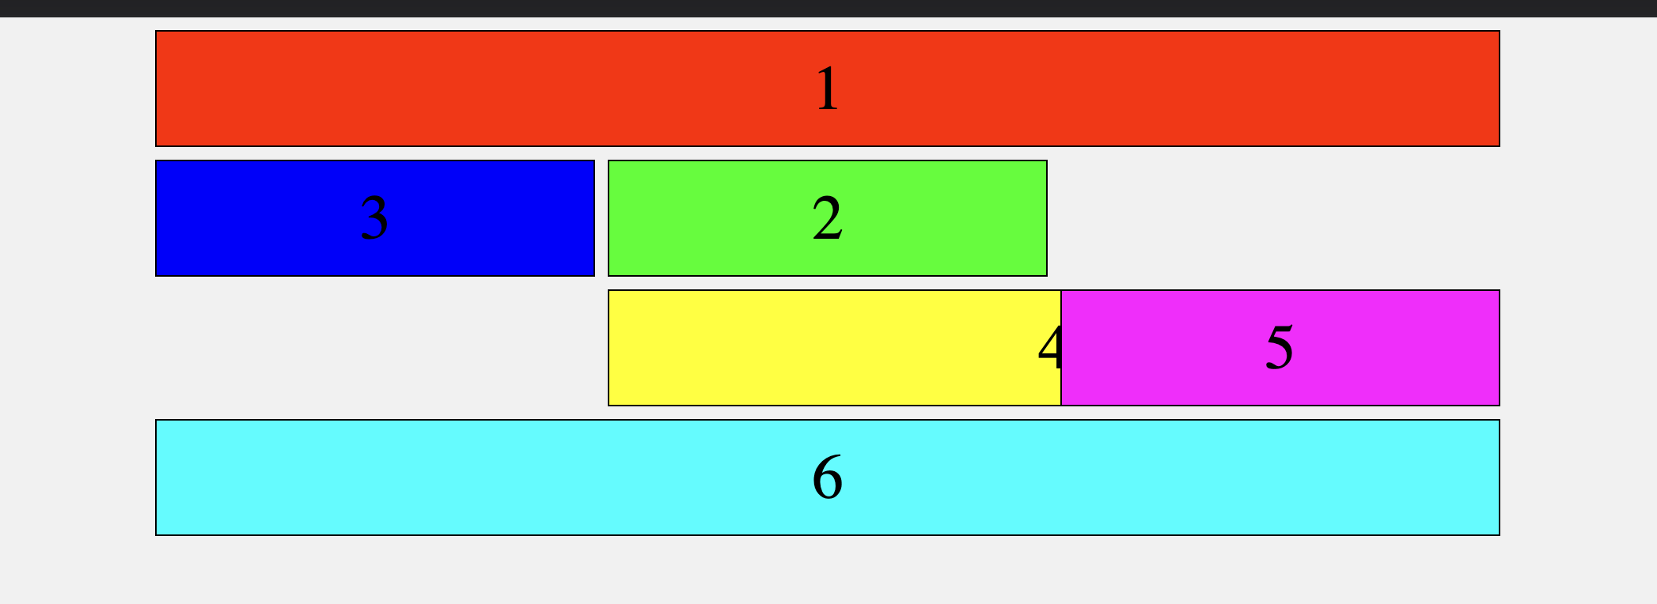
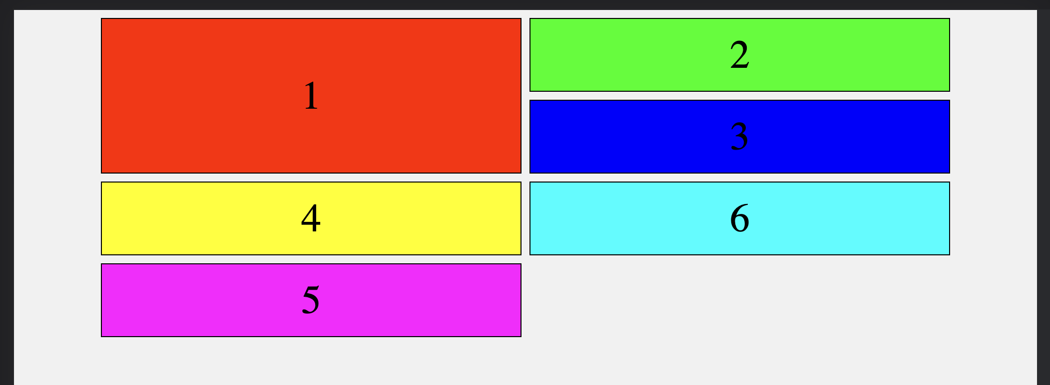
Your Turn!
Activity: CSS Grid
Suggested Time: 25 min.
Assignment:
Using the files provided to you:
Write CSS using CSS Grid and its properties to create a dynamic layout that matches the screenshots below.

