Slide 1
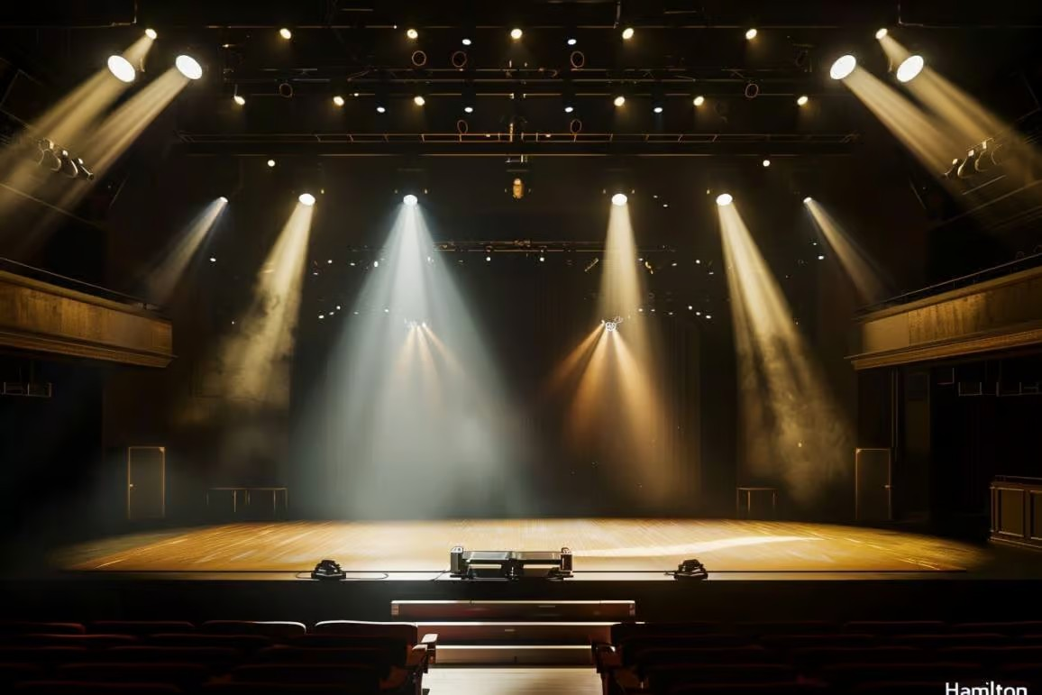
TEXT
VERSE
TIMER
LYRICS
MEDIA
TEXT
VERSE
TIMER
LYRICS
MEDIA
Paste lyrics here …
Write any text …
x
=
30
Background
Solid
apply
Background
Solid
apply
TEXT
VERSE
TIMER
LYRICS
MEDIA
TEXT
VERSE
TIMER
LYRICS
MEDIA
258 - Blessed assurance
x
Type a book of the Bible, e.g., ‘John 3:16’
=
30
1 Blessed assurance, Jesus is mine!
O, what a foretaste of glory divine!
Heir of salvation, purchase of God,
born of His Spirit, washed in His blood.
Background
Picture
Browse …
apply
Refrain:
This is my story, this is my song,
praising my Savior all the day long;
this is my story, this is my song,
praising my Savior all the day long.
TEXT
VERSE
TIMER
LYRICS
MEDIA
Time Now
=
x
Countdown
Pomodoro
2 Perfect submission, perfect delight,
visions of rapture now burst on my sight;
angels descending, bring from above
echoes of mercy, whispers of love.
Background
Video
Browse …
apply
TEXT
VERSE
TIMER
LYRICS
MEDIA
Background
Solid
apply
Time Now
=
x
TEXT
VERSE
TIMER
LYRICS
MEDIA
Countdown
24
59
Drag & drop or browse media
Pomodoro
HH
MM
x
Background
Video
Browse …
apply
Background
Solid
apply
TEXT
VERSE
TIMER
LYRICS
MEDIA
TEXT
VERSE
TIMER
LYRICS
MEDIA
Time Now
DSC_00123.JPG
x
Countdown
05
30
Count up
DSC_00125.JPG
Pomodoro
MM
SS
AVI_00126.AVI
Background
Video
Browse …
apply
Background
Preview
Solid
apply

