Slide 1
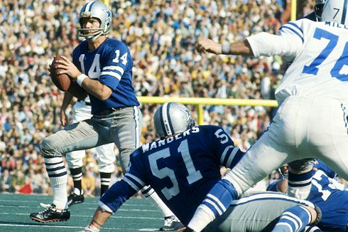

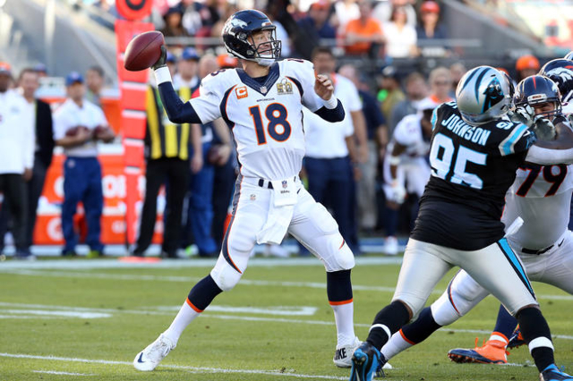
Has Quarterback Performance Increased Scoring in the NFL?
Analysis of Quarterback Performance on Average Team Scoring, 1970 – 2016
Notes:
https://www.britannica.com/biography/Terry-Bradshaw

Slide 2
Data, Research Questions & Hypothesis
Data
NFL quarterback game logs from www.nfl.com
Scraped by Kendall Gillies, https://www.kaggle.com/kendallgillies/nflstatistics
Research Questions
Team scores have increased since 1970 but why?
Has quarterback performance improved since 1970?
Is the increased scoring average result from improved quarterback performance?
Hypothesis
NFL team scoring averages since 1970 have increased as a result of improved quarterback performance.

Slide 3
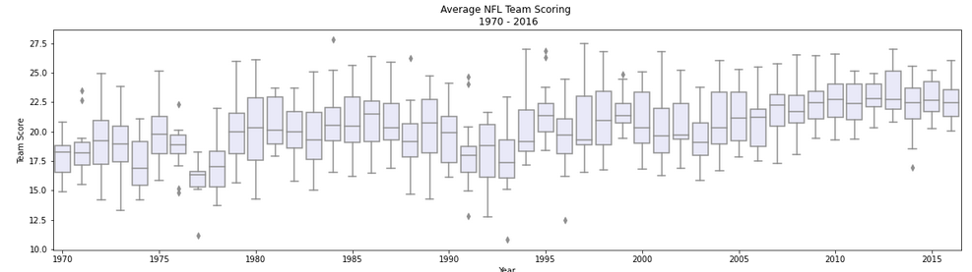
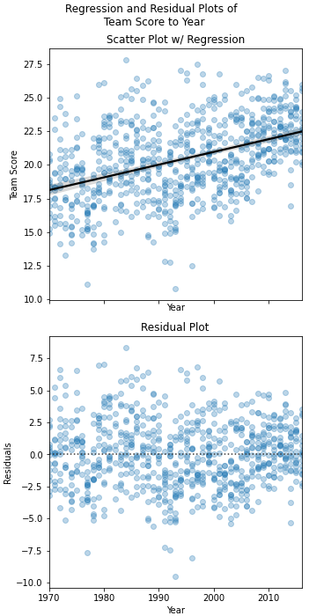
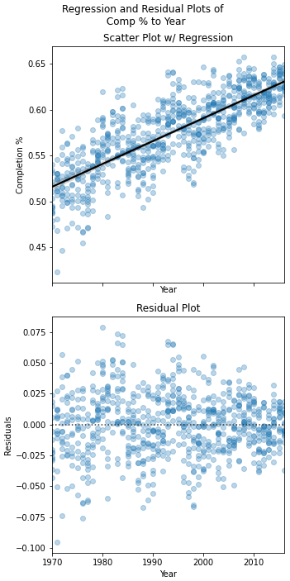
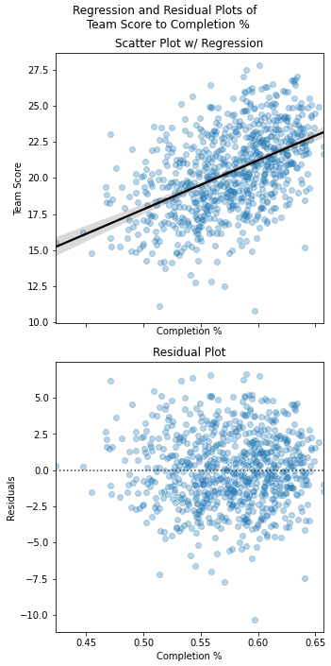
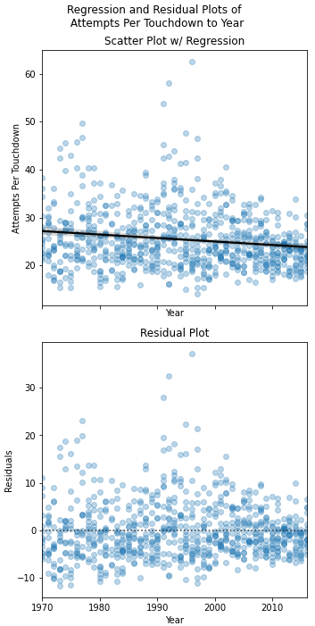
Exploratory Data Analysis
~22.5
~22.5
~18.5
Team Score by Year
Comp % by Year
Team Score by Comp %
Attempts per TD by Year

Slide 4
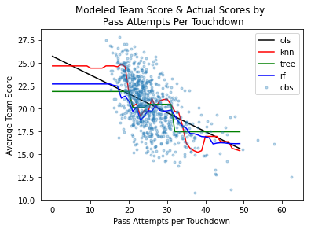
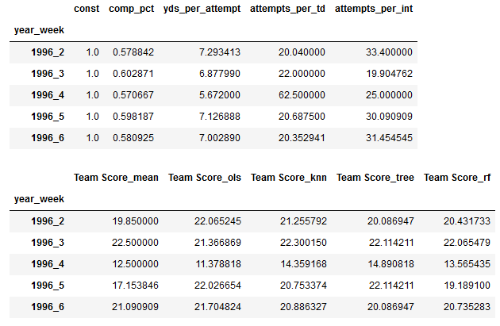
Supervised Learning Outcomes

Slide 5
Questions?

