Slide 1
Formula 1 Database Management

Slide 2
Team: Formula Data
Sooraj Swaminathan-CS23I1006
Chris Jason-CS23B1012
Barath Dharshan-CS23I1005

Slide 3
Introduction:
Our project is an interactive F1 analytics platform designed to provide insightful statistics, fun games, and a natural language interface for Formula 1 data. It integrates multiple engaging features, including:
Database Viewer: Full CRUD access to driver, constructor, and race result data (admin-only).
F1 Akinator: A fun game-like quiz that guesses the driver you're thinking of.
Stat Attack: Visual exploration of driver and constructor statistics.
NLP Search Engine: A powerful natural language interface that translates human-like questions into real-time SQL queries.

Slide 4
Motivation

Slide 5
Overview
1)Bridging Language and Data
Formula 1 is one of the most data-rich sports in the world. Every race weekend produces a wealth of statistics about drivers, teams, race results, standings, and performance metrics. While this data is readily available in structured formats such as SQL databases, accessing it typically requires knowledge of SQL, limiting usability for non-technical users.
The primary motivation for developing DBNATOR(NLP Model) was to build a system that allows users to interact with F1 data using plain simple English. Instead of learning complex SQL syntax, users can type simple queries like "Who won the constructors championship in 2022?" or "How many points did Lewis Hamilton score in 2020?“ and instantly get the information they were looking for.

Slide 6
2)Accessibility for all Users
3)Unified interface for Exploration and Play
F1 fans, students, or casual users often don't have database expertise. By creating a natural language interface, we provide a gateway for anyone to explore rich F1 data without technical barriers.
DBNATOR is not just a data tool. It integrates with an interactive Tkinter GUI that also features fun modules like "Stat Attack" and "Reverse Akinator." The goal was to create a unified app that is both informative and engaging.

Slide 7

4)Modular and Scalable Architecture
5) Educational Value
The NLP layer is designed with regex-based parsing that maps user questions to dynamic SQL queries. This makes the system easily extensible to other domains (e.g., cricket, football, academic databases) with minimal changes.
This project provided a real-world application of several key technologies and concepts including:
- Python and Tkinter for GUI development
- MySQL for relational data handling
- Natural Language Processing (NLP) with regex and pattern recognition
- Integrating frontend UI with backend databases

Slide 8
Future Scope

Slide 9
Impact and Future scope:
DBNATOR can evolve into a voice-enabled assistant.
Advanced NLP models can be integrated for better query understanding.
The interface can be extended to support data visualizations (charts/graphs) for insights.
The application can be deployed as a web app using Flask or Django.
DBNATOR is an effort to make Formula 1 data more approachable, interactive, and enjoyable. By turning rigid database access into a natural conversation, this project merges technology with the passion of F1 fandom, opening the doors to smarter and more intuitive data exploration.

Slide 10
Tools used in our Project

Slide 11

Languages, Tools, Modules, Api’s used in our Project:
Frontend: Python(Tkinter)
Backend: MYSQL (database) +Python
Modules and APIs:
Tkinter – GUI development framework for building windows, buttons, and layouts
mysql-connector-python – Handles database connectivity and SQL execution
Fastf1 API: For gathering and inserting formula 1 data into mysql.
Pillow: Effecient handling and loading of images
Os: Path management

Slide 12
Why we choose Tkinter over WeB Development:
Unified Python Environment:
Tkinter allows us to build both the frontend and backend entirely in Python, avoiding the need for multiple languages or frameworks.
Direct Database Access:
Seamless integration with MySQL makes it easy to implement CRUD operations and real-time data handling without separate APIs.
Offline & Lightweight:
The application runs locally as a standalone desktop app, with no need for a web server or internet connection.
Faster Prototyping:
Tkinter simplifies UI creation, making it easier to develop and test features like forms, games, and dashboards quickly.

Slide 13
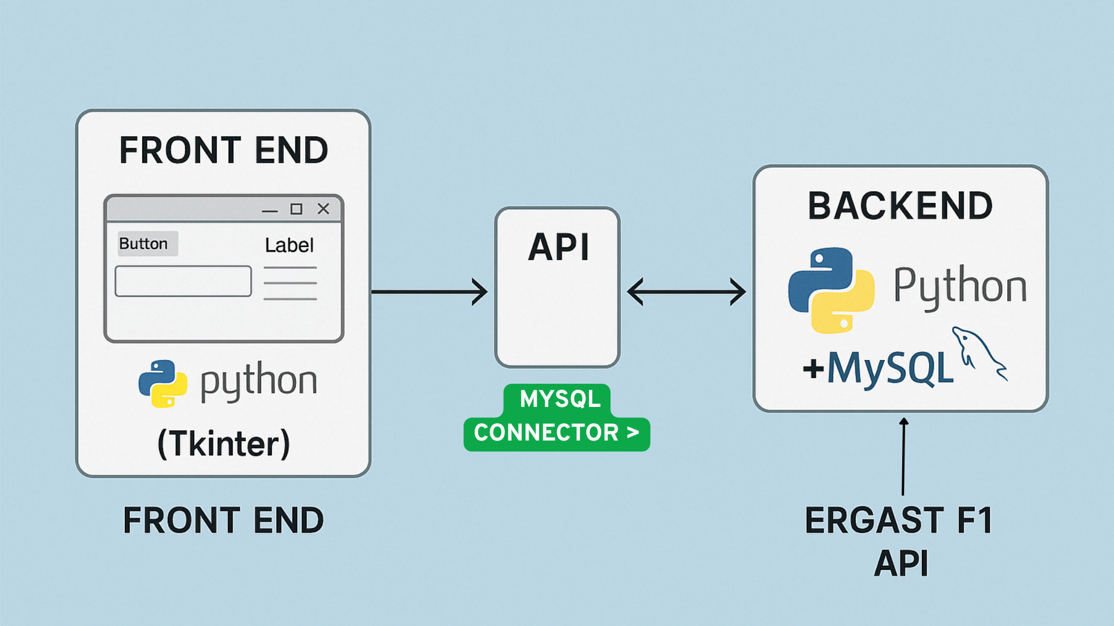
WORKFLOW

Slide 14
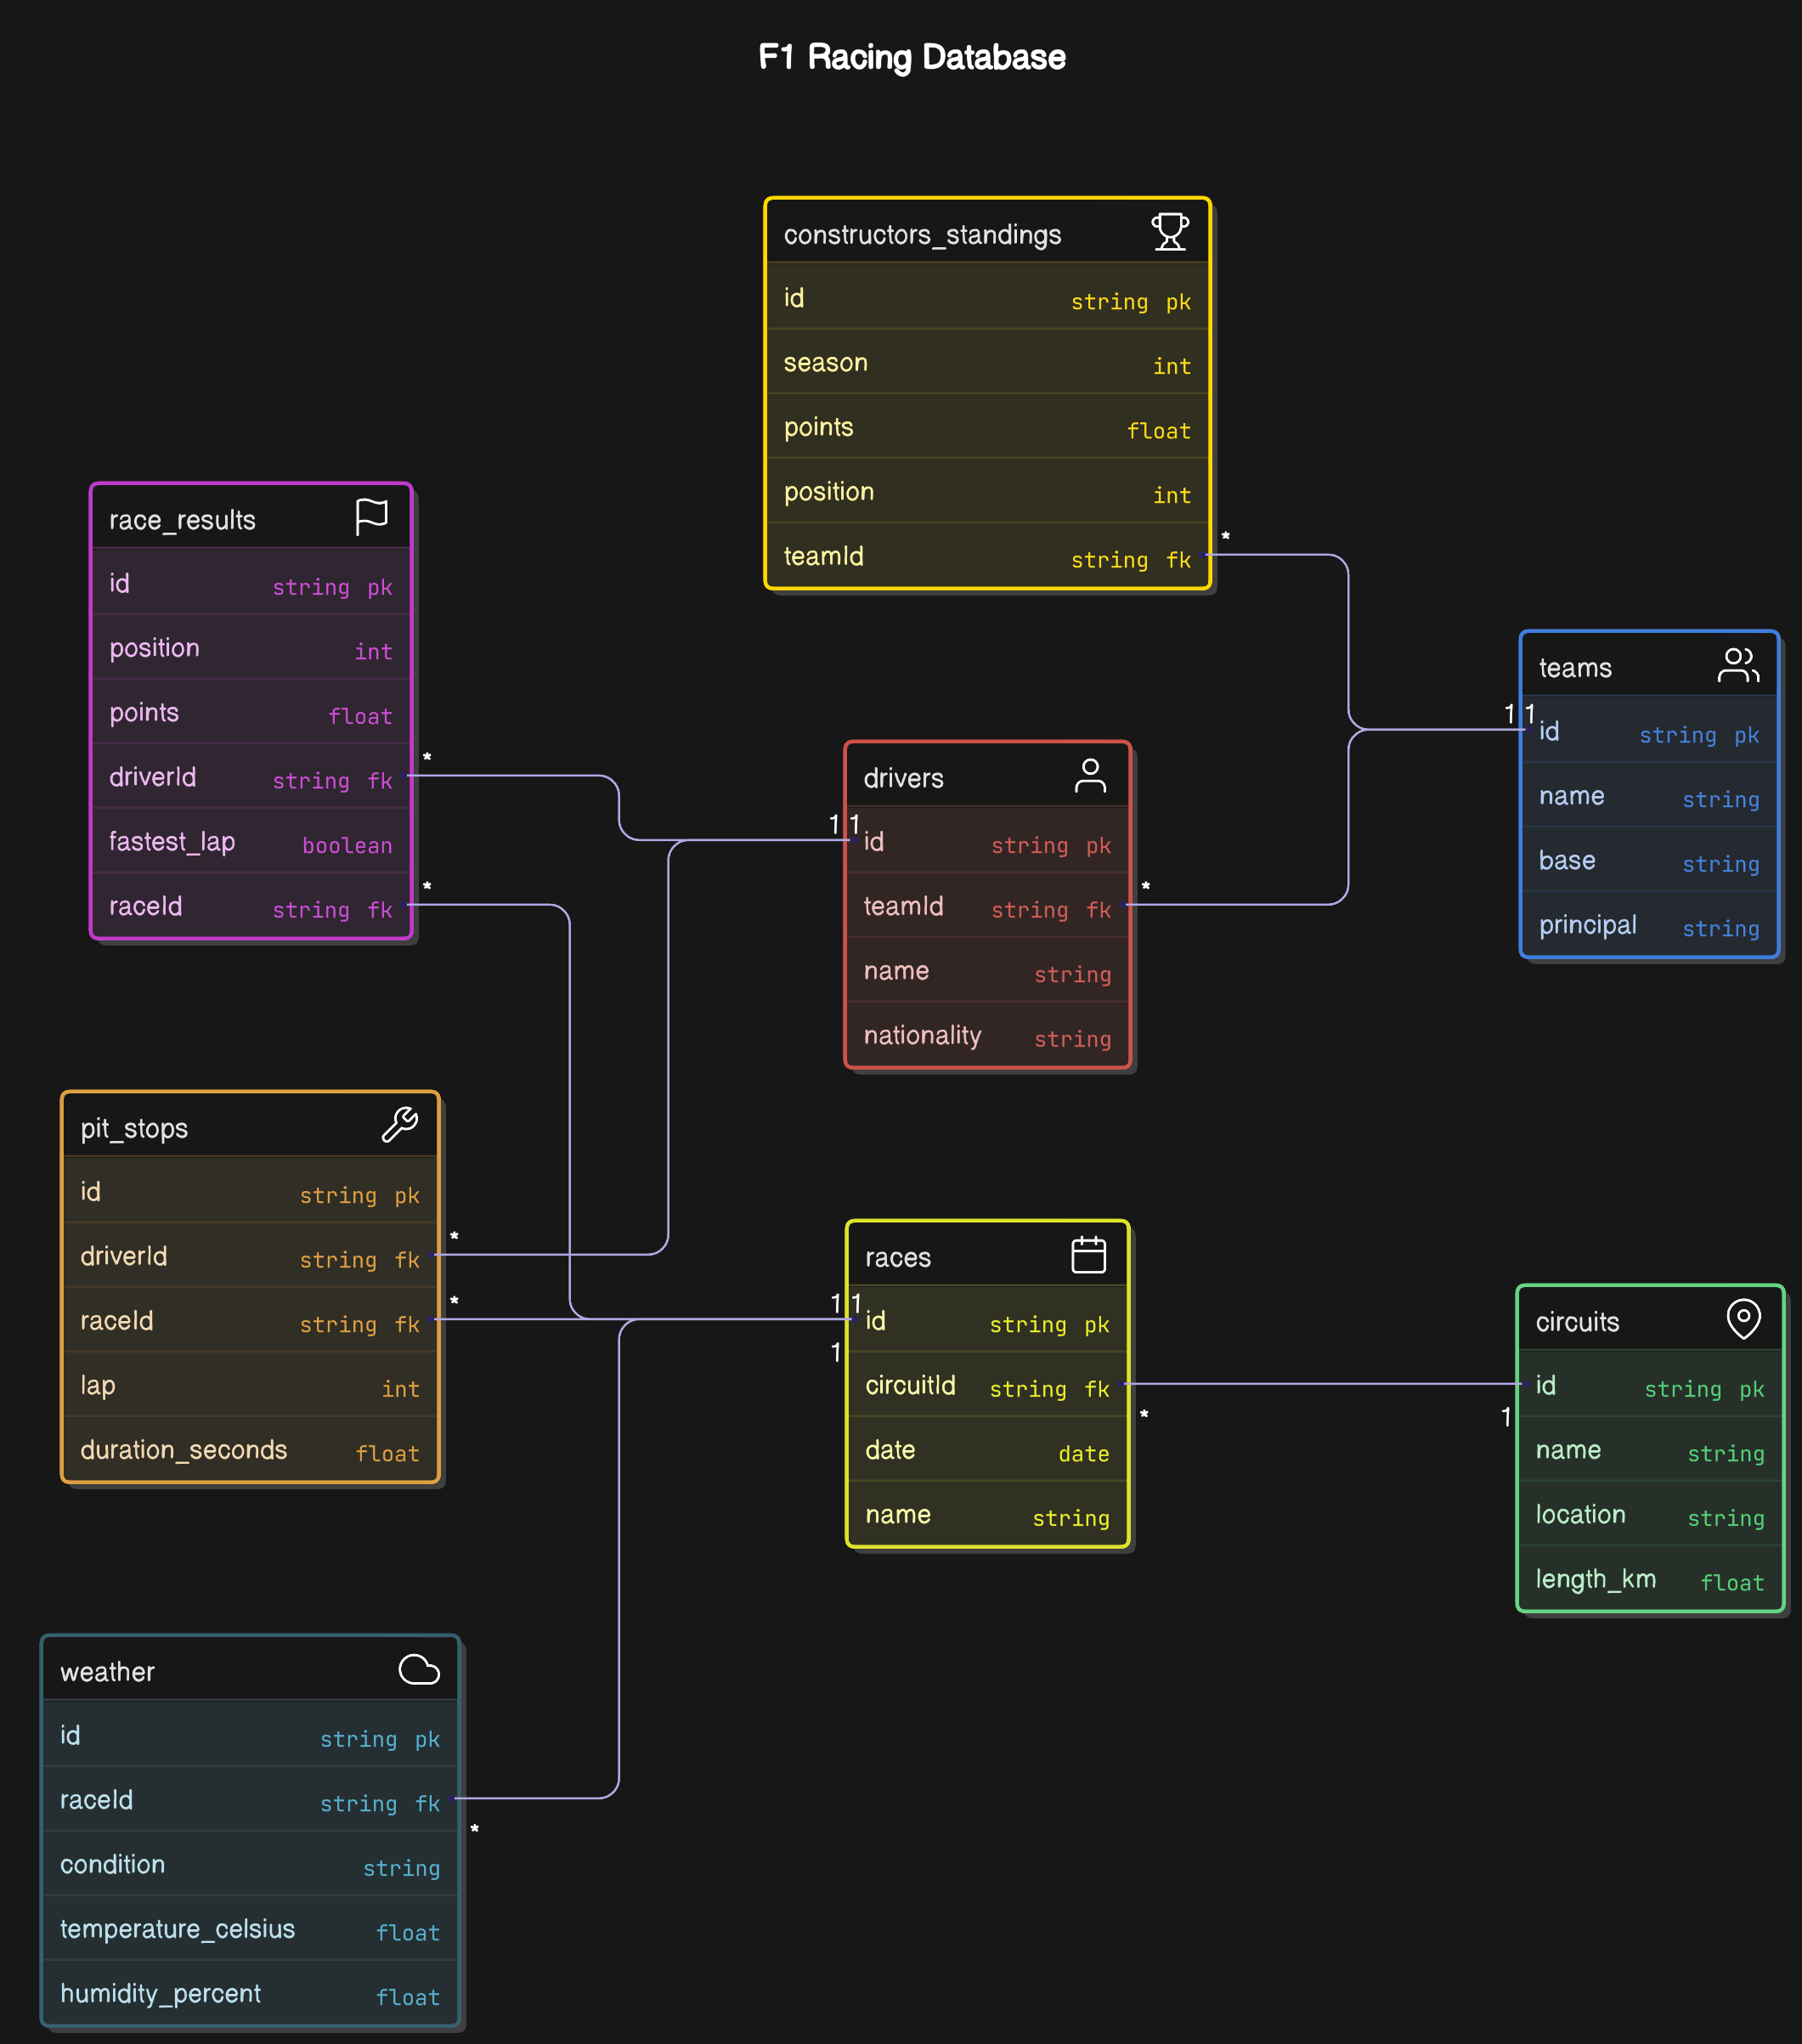
Er diagram

Slide 15
THANK YOU.
Team: Formula Data
Sooraj Swaminathan-CS23I1006
Chris Jason-CS23B1012
Barath Dharshan-CS23I1005

