Slide 1
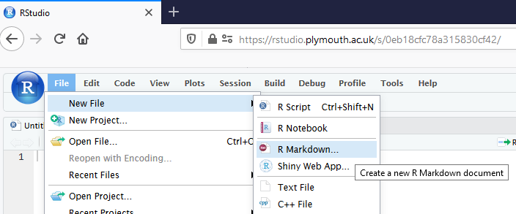
R Markdown files allow you to easily embed R code, tables, figures and text within a report
Go to File > New File > R Markdown
Using Rmd files. Chris Berry. 2023

Slide 2
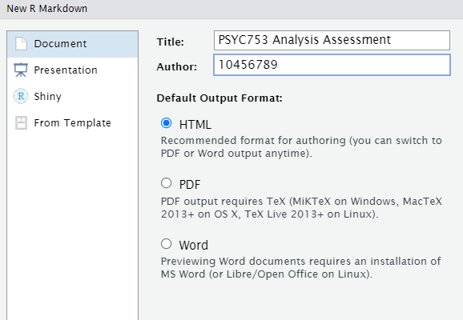
R Markdown files
Give your assignment a title
(you can change it later)
SRN
html
as output format (should be by default)

Slide 3
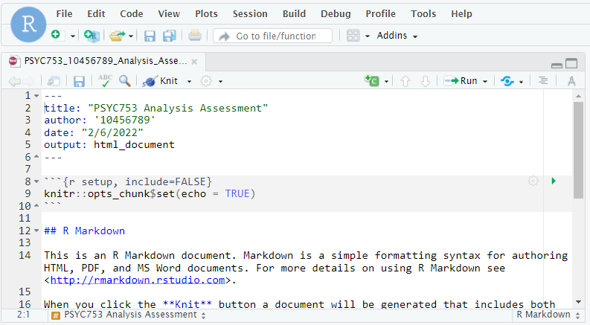
An Rmd document (text generated by default)

Slide 4
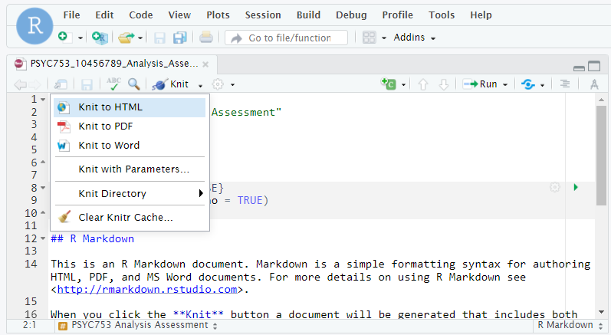
Click ‘Knit’ to generate an html report from the Rmd document
Check your code very carefully if you get an error

Slide 5
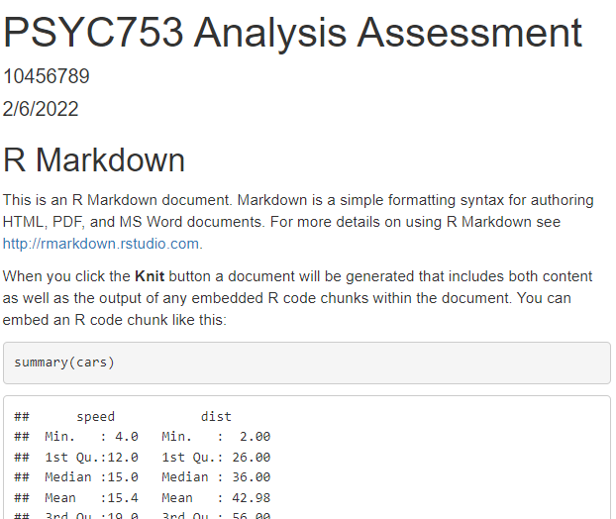
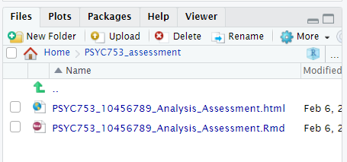
The html report will appear in the ‘Files’ panel of R studio
See how your html came out
Edit the Rmd
Repeat as required
Click on the html, select view in web browser

Slide 6
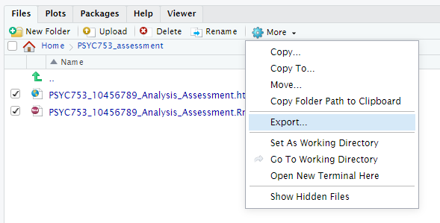
To submit to the DLE: Export the html file AND Rmd file from RStudio to your PC first
2
1
3
Once the files are on your hard drive, submit to the DLE with coversheet

Slide 7
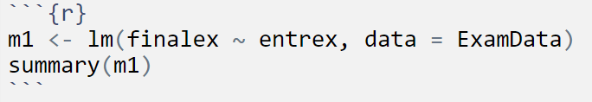
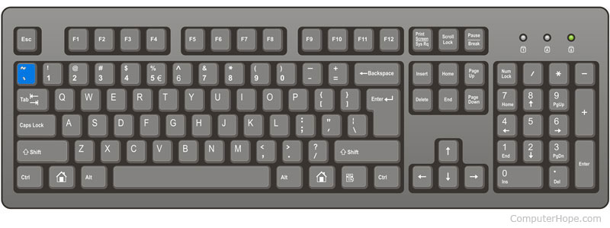
Tips on writing your Rmd file
R code is embedded in chunks.
Use CTRL + Alt + I to create a new chunk.
The “backtick” symbol `
is the top left key of most keyboards

Slide 8
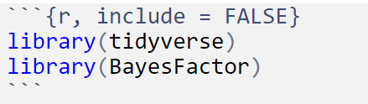
Tips on writing your Rmd file
Load up packages in a chunk at the start (you only have to load packages once), e.g.,
include = FALSE
means the code (and associated output) won’t appear in the html
Handy to hide unnecessary output in your report

Slide 9
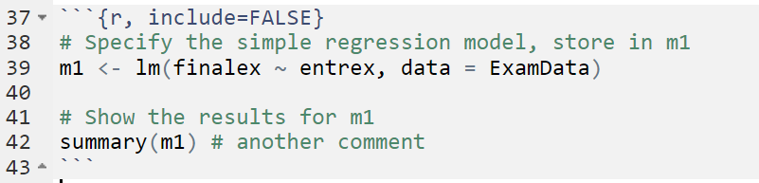
Tips on writing your Rmd file
You can add comments in chunks by using #

Slide 10
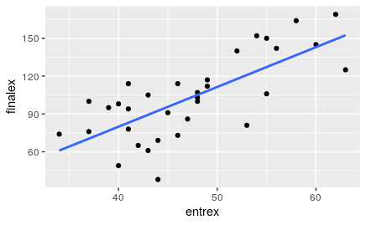
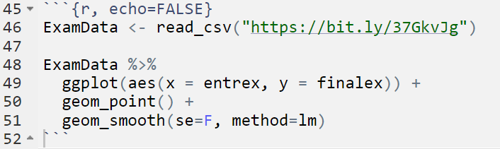
Tips on writing your Rmd file
Use echo = FALSE to show the output (e.g., a figure), but not the code in your report

Slide 11
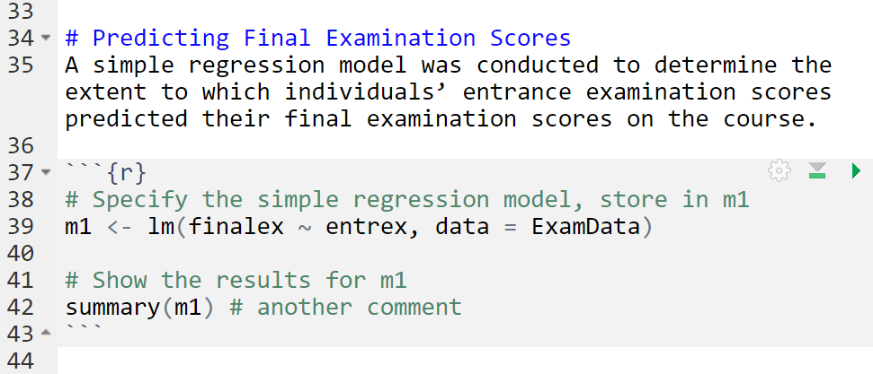
Tips on writing your Rmd file
Outside the code chunk: Write your text; use “#” to specify a heading.

Slide 12
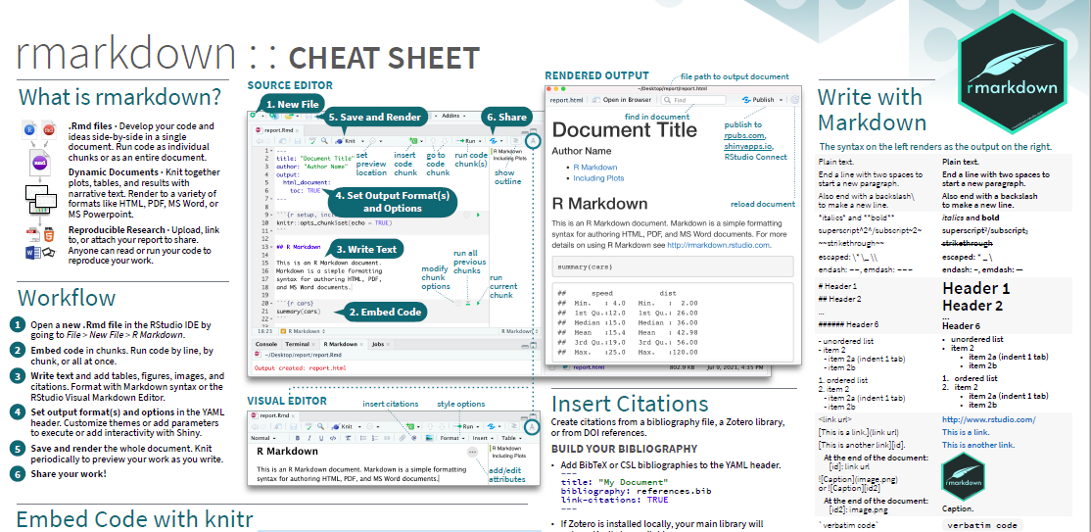
Useful R Markdown Cheatsheet
https://raw.githubusercontent.com/rstudio/cheatsheets/main/rmarkdown.pdf

Slide 13
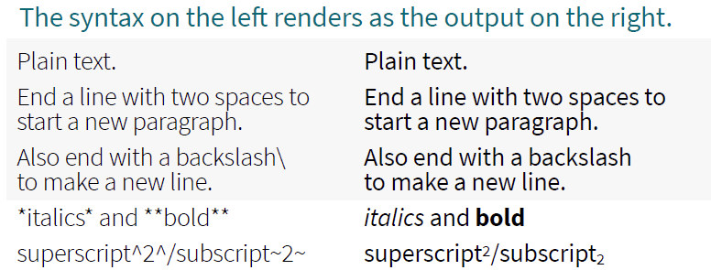
Tips on writing your Rmd file
_r_
r
_R_^2^ = 0.43
R² = 0.43
BF~10~ = 1.34 x 10^12^
BF₁₀ = 1.34 x 10¹²

Slide 14
Code at the top of a code chunk, e.g. ```{r, include=FALSE}
include = FALSE prevents code and results from appearing in the finished file. R Markdown still runs the code in the chunk, and the results can be used by other chunks
echo = FALSE prevents code, but not the results from appearing in the finished file. This is a useful way to embed figures.
message = FALSE prevents messages that are generated by code from appearing in the finished file.
warning = FALSE prevents warnings that are generated by code from appearing in the finished.
fig.cap = "...“ adds a caption to graphical results.

Slide 15
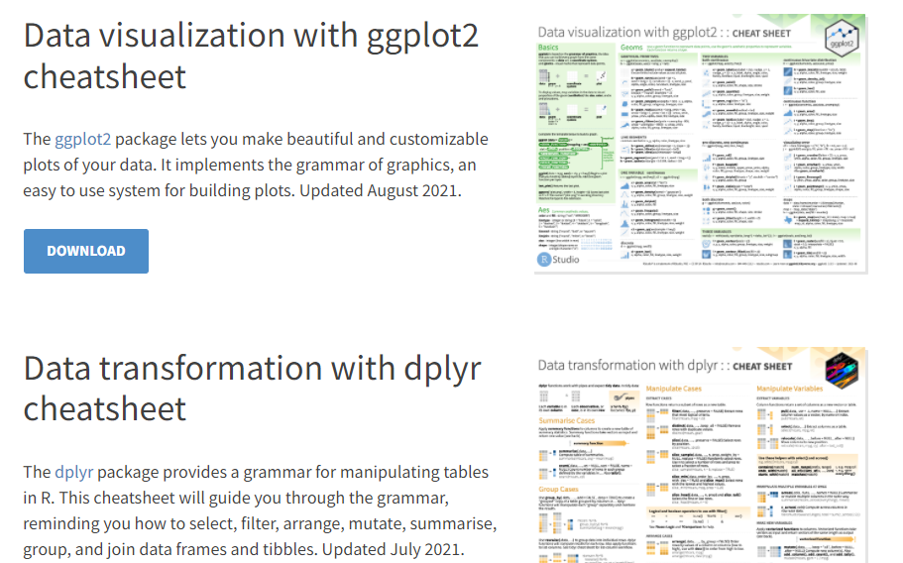
Other useful cheatsheets (e.g., ggplot2)
https://www.rstudio.com/resources/cheatsheets/

Slide 16
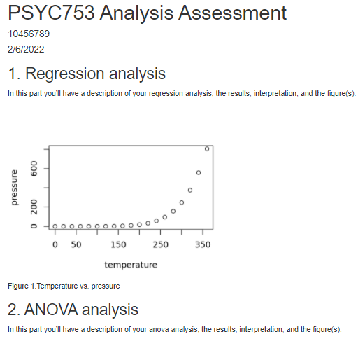
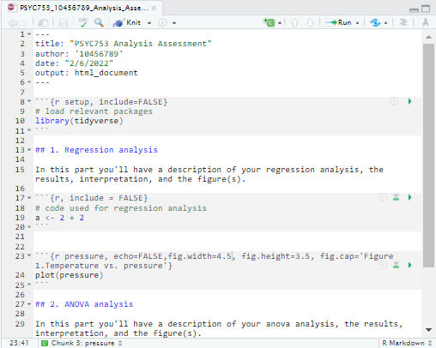
How your report might look – basic structure
html document
Rmd
Text visible
Key plots visible
No code visible

Slide 17
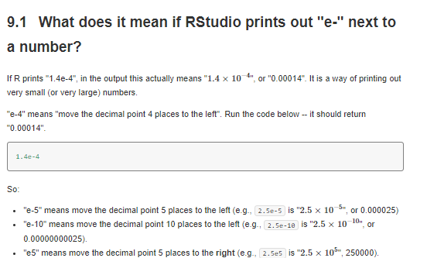
FAQs
https://chrisjberry.github.io/datafluencyCB/faqs.html

Slide 18
Importantly
Start early
Play around
Persevere!

