Slide 1


PSYC761
2: Multiple Regression
Multiple continuous predictors
Dr Chris Berry School of Psychology Plymouth University PSQ B212 christopher.berry@plymouth.ac.uk
Book an office appointment:
Usually Tue and Fri 1-2pm
Scan QR code or click here
Check in code
**-**-**

Slide 2
Simple Regression (recap)
One predictor variable (X)
One outcome variable (Y)
e.g., use Screen Time (X) to predict Anxiety (Y)
Simple regression equation:
Ŷ = a + bX
Ŷ the predicted value of Y
a the intercept
b the slope (the coefficient for X)
e.g., Predicted Anxiety = 5.59 + 0.13(Screen Time)
X
Y
eg, Screen Time
eg, Anxiety

Slide 3
Simple Regression (recap)
Y
Ŷ = a + bX
b
a
1
0
X
But, we often want to know whether Y is predicted by multiple variables →

Slide 4

Iani et al. (2019)
Used multiple regression to investigate whether worry and mindfulness (describing) is associated with wellbeing in 66 individuals with Generalised Anxiety Disorder
Iani, L., Quinto, R. M., Lauriola, M., Crosta, M. L., & Pozzi, G. (2019). Psychological well-being and distress in patients with generalized anxiety disorder: The roles of positive and negative functioning. PloS one, 14(11), e0225646.

Slide 5
Multiple Regression
More than one predictor variable (X₁, X₂, X₃…).
One outcome variable (Y).
E.g., use worry, describing and emotional intelligence to predict wellbeing
Subscripts label the different predictor (X) variables, eg
X₁ worry
X₂ describing
X₃ emotional intelligence
X₁
eg, worry
X₂
Y
eg, describing
eg, wellbeing
X₃
eg, emotional intelligence
…

Slide 6
Multiple regression: Visual representation
With two predictor variables, X₁ and X₂, the regression line is actually a flat plane in 3D space.
Y
X₂
0
X₁

Slide 7
The Multiple Regression Equation
Ŷ = a + b₁X₁ + b₂X₂ + …. b_{n}X_{n}
where
Ŷ the predicted value of the outcome variable Y (e.g., wellbeing)
a the intercept (constant)
X the predictor variables
b₁ the coefficient (‘slope’) for predictor X₁ (e.g., worry)
b₂ the coefficient (‘slope’) for predictor X₂ (e.g., describing)
b_{n} the coefficient (‘slope’) for predictor n
n the number of predictor variables
e.g.
Predicted wellbeing = 70.73 - 0.77(worry) + 1.25(describing)

Slide 8
Multiple Regression: Visual representation
Two predictor variables (X₁ and X₂)
The intercept a determines the ‘height’ of the plane
The coefficients b₁ and b₂ determine the ‘tilt’ of the plane
Ŷ = a + b₁X₁ + b₂X₂
b₁
Y
b₂
1
1
X₂
a
0
X₁

Slide 9
Multiple Regression: Steps
Visualise the data
Check correlations between variables
Fit the model
Check assumptions: residuals
Evaluate the model
R²
Bayes factor for the overall model
Assess the unique contribution of predictors

Slide 10
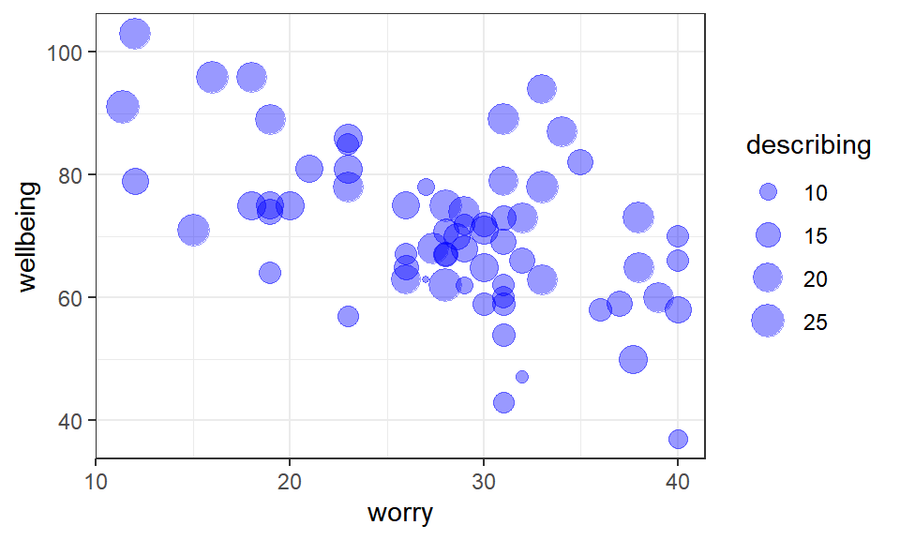
Visualisation and Correlations
ggplot()
correlate()
 | wellbeing | worry | describing
wellbeing | -
worry | -0.54 | -
describing | 0.54 | -0.25 | -

Slide 11
Fit the model (two predictor example)
lm(outcome_variable ~ predictor_1 + predictor_2, data = mydata)
No need to specify intercept a
Use ‘+’ to add predictors to the model
e.g.
lm(wellbeing ~ worry + describing, data = wellbeing_data)

Slide 12
Output
lm(wellbeing ~ worry + describing, data = wellbeing_data)
##
## Call:
## lm(formula = wellbeing ~ worry + describing, data = wellbeing_data)
##
## Coefficients:
## (Intercept) worry describing
## 70.7306 -0.7708 1.2484
Regression equation:
Predicted wellbeing = 70.73 − 0.77(worry) + 1.25(describing)

Slide 13
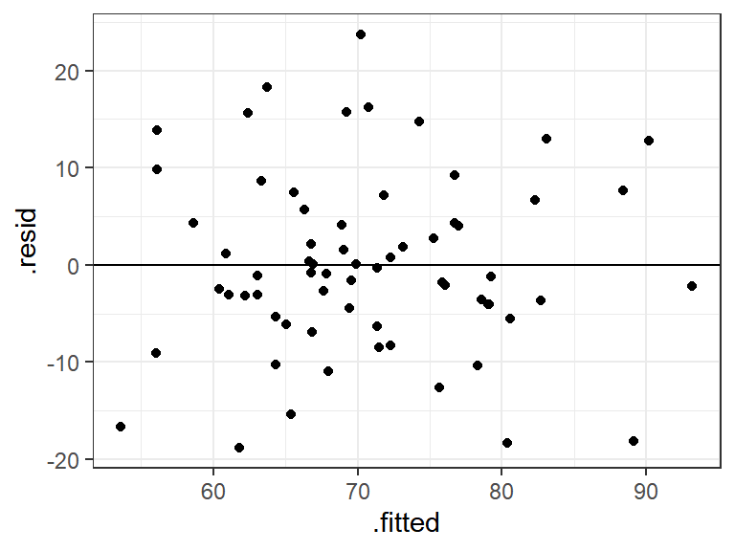
Check Assumptions: Residual Plot
The plot of the predicted (.fitted) values vs . the residuals (.resid).
Homoscedasticity and
independence of residuals
✓

Slide 14
Evaluate the model
R². The proportion of total variance in the outcome variable explained by the model.
e.g., 46.56 % of the variance in wellbeing is explained by the regression model containing worry and describing.
Adjusted R². An estimate of R² in the population, which takes the sample size and number of predictors into account.
e.g., adjusted R² = 44.83%

Slide 15
Evaluate the model
Bayes factor. Tells us how many times more likely the model is relative to an intercept-only model. In an intercept-only model, the coefficient for each predictor is zero.
lmBF(wellbeing ~ worry + describing, data = data.frame(wellbeing_data))
## Bayes factor analysis
## --------------
## [1] worry + describing : 4190994 ±0%
##
## Against denominator:
## Intercept only
## ---
## Bayes factor type: BFlinearModel, JZS
The model is 4,190,994 times more likely than an intercept only model. There’s therefore extreme evidence for the model overall.

Slide 16
The unique contribution of predictors
In multiple regression, the unique contribution of a predictor is its contribution to the model once the other predictors have been taken into account
Predictors are often correlated. This means the variance they explain in the outcome variable is shared.
This affects the amount of variance that is uniquely explained by a predictor
Care should be taken when interpreting the model:
“Worry is a predictor of wellbeing after taking describing into account”
“Describing is a predictor of wellbeing after taking worry into account”

Slide 17
Understanding the contribution of individual predictors
The unique contribution of the predictor after taking the other predictors into account.
worry
describing
Box = total variance in wellbeing to be explained
a
c
b
Overlap region (area c) = variation in wellbeing explained by both worry and describing
Crescent a
Unique contribution of worry to prediction of wellbeing
Crescent b
Unique contribution of describing to prediction of wellbeing

Slide 18
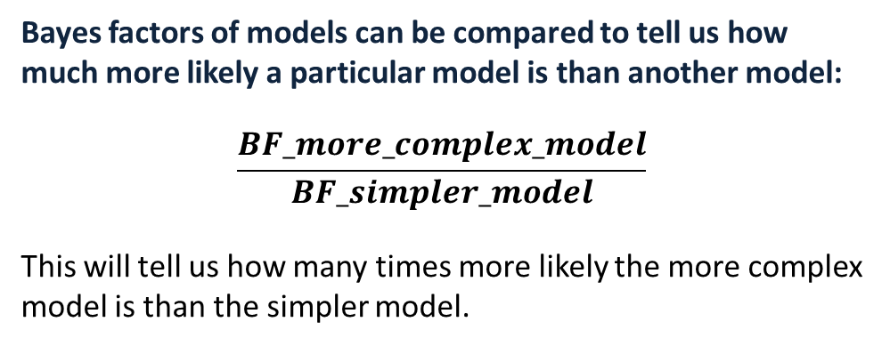
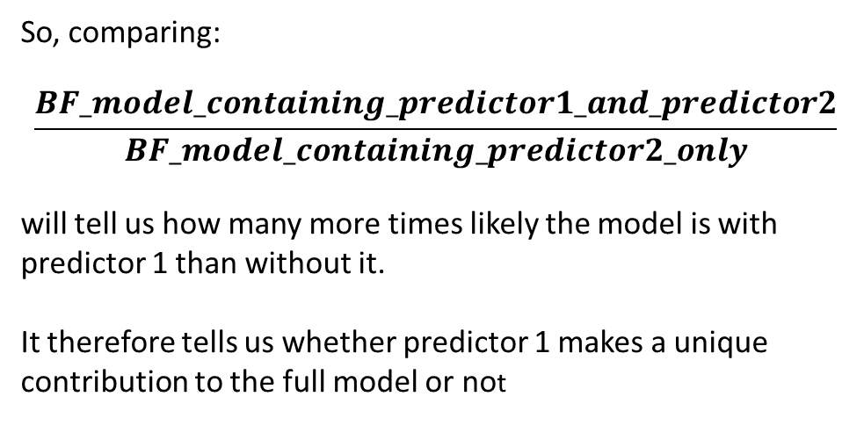
Using Bayes factors to assess the unique contribution of predictors
Bayes factors of models can be compared to tell us how much more likely a particular model is than another model:
$$\frac{BF_more_complex_model}{BF_simpler_model}$$
This will tell us how many times more likely the more complex model is than the simpler model.
So, comparing:
$$\frac{BF_model_containing_predictor1_and_predictor2}{BF_model_containing_predictor2_only}$$
will tell us how many more times likely the model is with predictor 1 than without it.
It therefore tells us whether predictor 1 makes a unique contribution to the full model or not

Slide 19
Using Bayes factors to assess the unique contribution of predictors
Steps:
Obtain BF full model
BF_worry_describing <- lmBF(wellbeing ~ worry + describing)
Obtain BF without predictor 1
BF_describing <- lmBF(wellbeing ~ describing)
Obtain BF without predictor 2
BF_worry <- lmBF(wellbeing ~ worry)
worry
describing
a
c
b
Evidence for the unique contribution of worry (crescent a) is:
BF_worry_describing / BF_describing
Evidence for unique contribution of describing (crescent b) is:
BF_worry_describing / BF_worry

Slide 20
Multicollinearity
If two predictor variables are highly correlated (above .80 or .below -0.80), this is known as multicollinearity, and can cause problems with interpretation of the regression.
If so, consider dropping one predictor from the model.
In the extreme scenario, although the model may explain the outcome overall, the unique contribution of each predictor may be negligible.
Example: Suppose that the variable BMI (Body Mass Index) is highly correlated with weight in kg (r = .85)

Slide 21
Understanding multicollinearity
Venn diagram of model of BMI and weight (kg)
BMI
Weight (kg)
High correlation = high overlap in variance explained
The proportion of variance in the outcome variable that is now uniquely explained by each predictor is very small.

Slide 22
Activity: Remainder of Session
Start Worksheet 2 and Exercises using RStudio
Finish for next session. Please ask me if you have any questions on the code or concepts.
Worksheet 2:
https://chrisjberry.github.io/datafluencyCB/
(or DLE)

