Slide 1


PSYC761
4: Multiple Regression
One continuous, one categorical
Dr Chris Berry School of Psychology Plymouth University PSQ B212 christopher.berry@plymouth.ac.uk
Book an office appointment:
Usually Tue and Fri 1-2pm
Scan QR code or click here
Check in code
**-**-**

Slide 2
Simple Regression (recap)
One predictor variable (X)
One outcome variable (Y)
e.g., use Screen Time (X) to predict Anxiety (Y)
Simple regression equation:
Ŷ = a + bX
Ŷ the predicted value of Y
a the intercept
b the slope (the coefficient for X)
e.g., Predicted Anxiety = 5.59 + 0.13(Screen Time)
X
Y
eg, Screen Time
eg, Anxiety

Slide 3
Simple Regression (recap)
Y
Ŷ = a + bX
b
a
1
0
X

Slide 4
Multiple Regression (recap)
More than one predictor variable (X₁, X₂, X₃…).
One outcome variable (Y).
E.g., use worry and mindfulness to predict wellbeing
Multiple regression equation:
Ŷ = a + b₁X₁ + b₂X₂
Ŷ the predicted value of the outcome variable Y (e.g., wellbeing)
a the intercept (constant)
X the predictor variables
b₁ the coefficient for predictor X₁ (e.g., worry)
b₂ the coefficient for predictor X₂ (e.g., mindfulness)
e.g., Predicted wellbeing = 4.52 – 0.25(worry) + 0.31(mindfulness)
X₁
eg, worry
Y
X₂
eg, wellbeing
eg, mindfulness

Slide 5
Multiple Regression
So far, we’ve looked at cases where the predictors are either all continuous (Sessions 1 and 2) or all categorical (Session 3).
A mixture of continuous and categorical predictors can be included in regression.
Today:
One continuous predictor
One categorical predictor (dichotomous)
(There’s still one continuous outcome variable)

Slide 6

Altenmuller et al. (2021)
Used multiple regression with both continuous and categorical variables to investigate factors influencing laypersons’ perceptions of trustworthiness in science.
Participants were told a researcher was either personally affected or not affected by the topic of their research, then rated the researcher in terms of their trustworthiness. Participants also indicated how positive their attitude towards the research topic was.
Altenmuller M.S., Lange L.L., Gollwitzer M. (2021). When research is me-search: How researchers’ motivation to pursue a topic affects laypeople’s trust in science. PLoS ONE, 16(7): e0253911. https://doi.org/10.1371/journal.pone.0253911

Slide 7
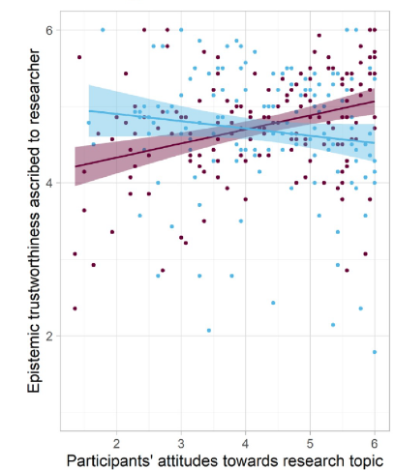

Altenmuller et al. (2021)
Outcome variable:
Trustworthiness
Predictor variables:
Attitude (continuous)
Group (categorical)
affected
not affected
Group
affected
Trustworthiness
not affected
Attitude
The relationship between trustworthiness and attitude appears to be different in each group (indicating an interaction between attitude and group)

Slide 8
Interaction
An interaction is where the relationship between the outcome and one predictor differs as a function of the other predictor.
The slopes of the simple regression lines appear different in each group:
Affected group: The association between trustworthiness and attitude appears positive (i.e., a positive regression slope)
Not affected group: The association between trustworthiness and attitude appears negative. (i.e., a negative regression slope)
If there were no interaction between predictors, then the relationship between trustworthiness and attitude would be the same in each group, and the lines for each group would be parallel.

Slide 9
When might there be an interaction? Visual inspection
Group 1
Group 2
Group 1 positive
Group 2 negative
Group 1 positive
Group 2 weaker positive
Group 1 negative
Group 2 stronger negative
Group 1 positive
Group 2 positive
Group 1 negative
Group 2 negative
✓ Interaction
✓ Interaction
✓ Interaction
✗ No interaction
✗ No interaction
Lines not parallel
Lines parallel

Slide 10
Evidence for the interaction term
A predictor representing the interaction can be added to the multiple regression model.
Evaluate evidence for this interaction term just as we would for any other predictor
Interaction terms are created by multiplying together values of predictors
e.g., score for predictor1 x predictor2 = interaction score
Ŷ = a + b₁X₁ + b₂X₂ + b₃X₁X₂
X₁
eg, attitude
Ŷ the predicted value of the outcome variable Y (e.g., trustworthiness)
a the intercept (constant)
X the predictor variables
b₁ the coefficient for predictor X₁ (e.g., attitude)
b₂ the coefficient for predictor X₂ (e.g., group)
b₃ the coefficient for interaction (e.g., attitude x group)
X₂
Y
eg, group
eg, trustworthiness
X₁X₂
eg, attitude x group
e.g., Predicted trustworthiness = 4.52 – 0.25(attitude) + 0.31(group) + 0.03(attitude x group)

Slide 11
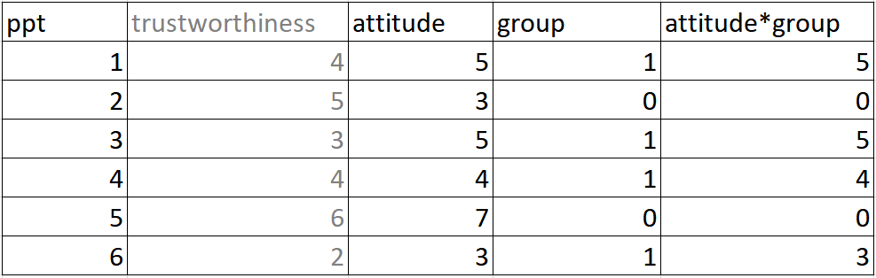
Beneath the surface: R
Y
X₁
X₂
X₁X₂
0 = affected
1 = not affected
_{(dummy coded)}
Interaction term

Slide 12
Interaction term: lm() and lmBF()
To add an interaction term to a model containing predictor1 and predictor2 use: + predictor1*predictor2
model_without_interaction
lm(outcome ~ predictor1 + predictor2, data = mydata)
model_with_interaction
lm(outcome ~ predictor1 + predictor2 + predictor1*predictor2, data = mydata)

Slide 13
Interaction term: lm() and lmBF()
Obtain Bayes factors for each model using lmBF()
BF_model_without_interaction
lmBF(outcome ~ predictor1 + predictor2, data = mydata)
BF_model_with_interaction
lmBF(outcome ~ predictor1 + predictor2 + predictor1*predictor2)

Slide 14
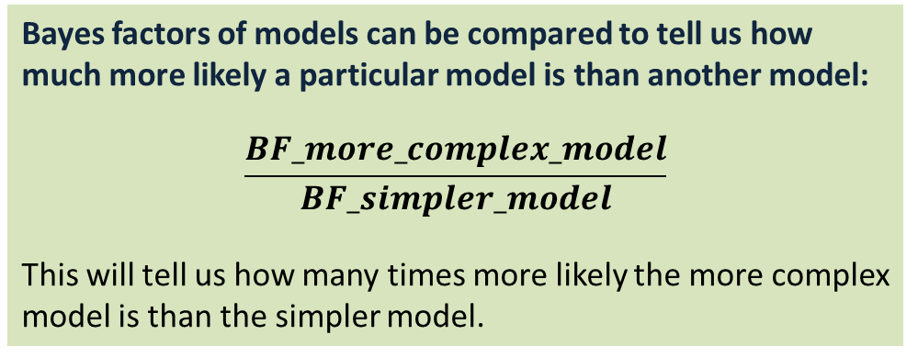
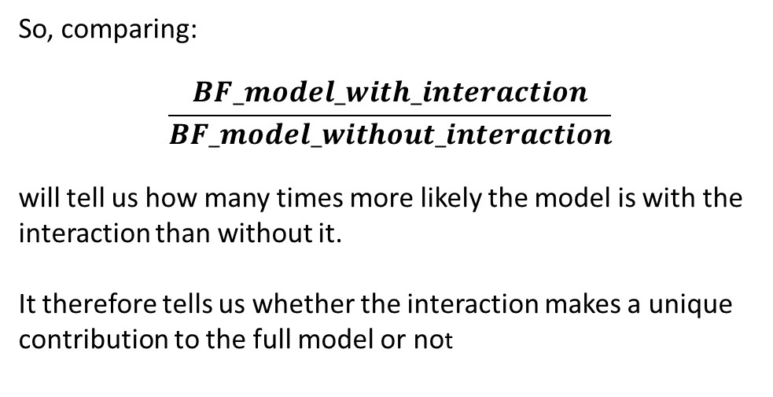
Using Bayes factors to assess the unique contribution of predictors
Bayes factors of models can be compared to tell us how much more likely a particular model is than another model:
$$\frac{BF_more_complex_model}{BF_simpler_model}$$
This will tell us how many times more likely the more complex model is than the simpler model.
So, comparing:
$$\frac{BF_model_with_interaction}{BF_model_without_interaction}$$
will tell us how many times more likely the model is with the interaction than without it.
It therefore tells us whether the interaction makes a unique contribution to the full model or not

Slide 15
Variance explained by the model
Section a
Unique contribution of attitude to prediction of trustworthiness
Box = total variance in trustworthiness to be explained
attitude
group
a
b
Overlap regions = correlations between variables
Section b
Unique contribution of group to prediction of trustworthiness
c
attitude x group
Areas of sections correspond to increases in R² when predictor added to the model
Section c
Unique contribution of the attitude x group interaction term to prediction of trustworthiness

Slide 16
Follow up tests: Simple slopes analysis
Given evidence for the interaction term (BF > 3)
Split the dataset by group
affected group data:
Conduct a simple regression of trustworthiness on basis of attitude (red line)
not affected group data:
Conduct a simple regression of trustworthiness on basis of attitude (blue line)
Group
affected
Trustworthiness
not affected
Attitude

Slide 17
Additive Model
If there’s insufficient evidence for the interaction term (BF < 3) or evidence for the model without the interaction (BF < 0.33)
Assume the model without the interaction is true
i.e., an “additive” model
Ŷ = a + b₁X₁ + b₂X₂
Test for unique contribution of attitude and group to the model using BFs (as in Session 2)
Group
Trustworthiness
affected
not affected
Attitude
✗ no interaction
Lines parallel

Slide 18
Activity: Remainder of Session
Start Worksheet 4 and Exercises using RStudio
Finish for next session. Please ask me if you have any questions on the code or concepts.
Worksheet 4:
https://chrisjberry.github.io/datafluencyCB/
(or DLE)

