Slide 1

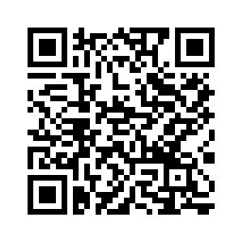
PSYC761
6: ANOVA
Repeated measures
Dr Chris Berry School of Psychology Plymouth University PSQ B212 christopher.berry@plymouth.ac.uk
Book an office appointment:
Usually Tue and Fri 1-2pm
Scan QR code or click here
Check in code
**-**-**

Slide 2
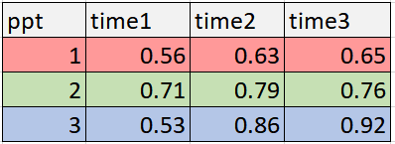
Repeated measures or within-subjects designs
In a within-subjects design, each participant takes part in every condition in the design. e.g., performance on a cognitive task at time 1, time 2, and time 3.
Each participant therefore contributes multiple scores
The terms repeated measures and within-subjects are used interchangeably.
Three scores per participant
on the dependent variable (e.g., accuracy on a task)

Slide 3
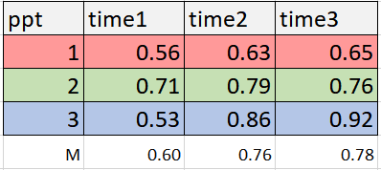
Repeated measures or within-subjects designs
The levels of the independent variable are usually referred to as conditions
E.g., Time has 3 levels or conditions,
time 1, time 2, time 3
ANOVA can be used to determine whether there’s evidence that the Ms (means) of the conditions differ.

Slide 4
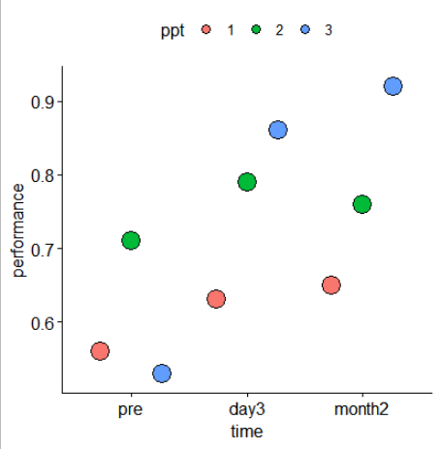
Individual differences
Participants’ performance is often correlated across conditions: e.g., if perform well at time 1, likely perform well at time 2, and time 3.
Thus, some variability in the dependent variable is explained by the participants themselves.
We’d like to account for this in some way, before looking at the effect of the independent variable
Consistencies within participants evident

Slide 5
Repeated measures ANOVA: representation
In a repeated measures ANOVA:
1. The variance explained by the participant is first accounted for.
2. Then the unique contribution of the independent variable (e.g., Time) is assessed.
Once participant has been accounted for, the independent variable explains a greater proportion of the remaining variance, compared to a model that does not include participant.
It’s therefore more likely there’s evidence for independent variable’s unique contribution to the prediction of the outcome.
1
Participant
2
Participant
Time
Area of box = variance in DV to be explained.
Area outside circle = the remaining variance to be explained, also called the residual or error variance

Slide 6
Fixed vs. Random Factors
Random factors: explain variance in outcome variable, but are treated as nuisance background variables and are not individually assessed (e.g., participant).
Fixed factors: manipulated independent variable (e.g., time).
Participant is therefore treated as a random factor in the repeated measures ANOVA model.
Benefit: statistical power of repeated measures designs tends to be greater (you’re more likely to detect an effect of the fixed factor if there is a genuine one to be detected).

Slide 7
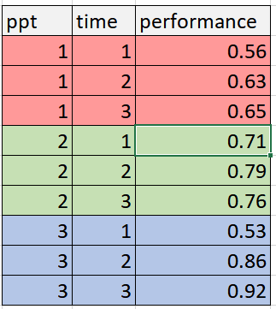
Practicalities:
Data for repeated measures ANOVA need to be in long format
Wide format
Long format
Each row = one participant
Each column is one variable
Each row is one observation or trial
Observations for a given participant stacked row-on-row
pivot_longer()

Slide 8
Repeated measures ANOVA in R
BayesFactor package: anovaBF()
You must first convert ppt and independent variable columns to factors.
The column coding for the ppt is entered to the model as another predictor, with the other predictors.
You must also specify ppt as a random factor using whichRandom = “ppt”
ppt
time(IV)
performance(DV)
anovaBF(performance ~ ppt + time, whichRandom = “ppt”)

Slide 9
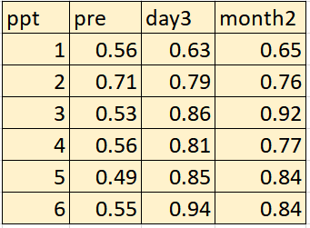
Example: One-way repeated measures
Chang et al. (2021)
Administered neuro-feedback training to N = 6 participants in a language learning task. A one-way repeated measures ANOVA was used to compare performance (proportion correct) at three time points:
Pre-training
3 days after training
2 months after training

Slide 10
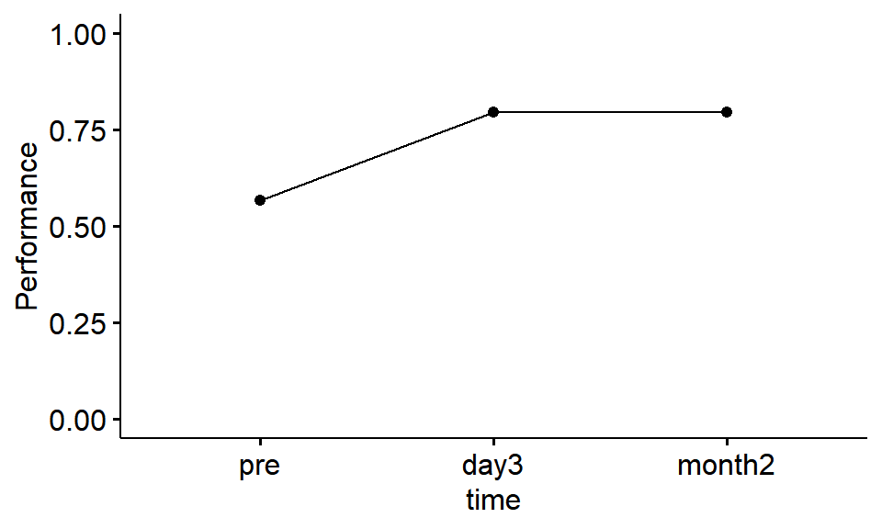
Figure
Does there seem to be an effect of time on performance?

Slide 11
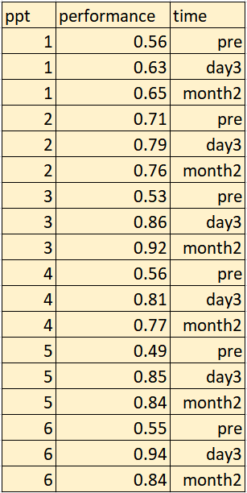
Convert to long format
pivot_longer()

Slide 12
Bayes Factor
anovaBF(performance ~ time + ppt, whichRandom = "ppt")
Bayes factor analysis
--------------
[1] time + ppt : 331.4158 ±0.66%
Against denominator:
performance ~ ppt
---
Bayes factor type: BFlinearModel, JZS
Notice that the model is assessed relative to the null model of ppt on its own (NOT intercept only model)
The model with time + ppt is over 300 times more likely than the model with ppt only.
It’s over 300 times more likely that there’s a difference between the time conditions, than there is no difference.
There’s evidence for an effect of time on performance, BF = 331.42.

Slide 13
Follow-up comparisons
If BF > 3
Pairwise comparisons:
Is the mean of pre different from day3?
Is the mean of pre different from month2?
Is the mean of day3 different from month2?
filter() the data for the pairs of conditions we want, then use anovaBF() again but with the filtered data

Slide 14
Example: Two-way repeated measures ANOVA
Kreysa et al. (2016)
Analysed RTs of “no” and “yes” decisions made to statements spoken by faces according to whether the eyes were averted to the left, right, or were looking directly at the participant.
Dependent variable: log RT
Independent variable 1: Agreement (2 levels)
Independent variable 2: Gaze Direction (3 levels)
Gaze Direction
averted_left
averted_right
direct
2 x 3 = 6 cells of the design
Agree with statement?
No
• | • | •
• | • | •
Yes

Slide 15
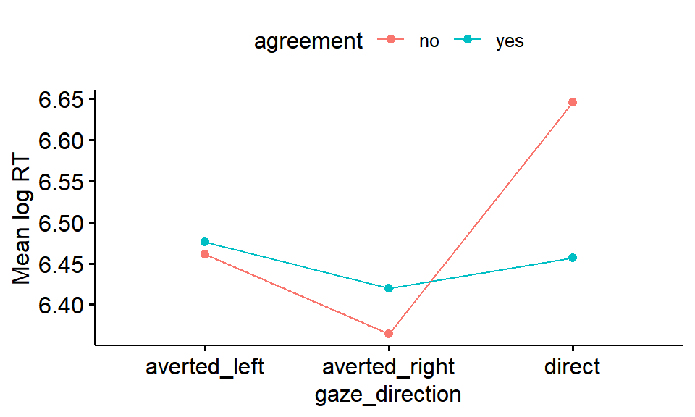
Figure
Is an interaction evident?
Does the effect of agreement seem to be the same at each level of gaze direction?

Slide 16
Bayes Factor
anovaBF(logRT ~ gaze_direction * agreement + ppt, whichRandom = "ppt“)
Bayes factor analysis
--------------
[1] gaze_direction + ppt : 25.97482 ±0.59%
[2] agreement + ppt : 0.2666747 ±1.02%
[3] gaze_direction + agreement + ppt : 7.263328 ±1.39%
[4] gaze_direction + agreement + gaze_direction:agreement + ppt : 48.13779 ±7.26%
Against denominator:
logRT ~ ppt
---
Bayes factor type: BFlinearModel, JZS
Again, notice that the model is assessed relative to the null model of ppt on its own.
[1]: Evidence for a main effect of gaze_direction, BF = 25.97
[2]: Evidence against a main effect of agreement, BF = 0.27

Slide 17
Bayes Factor: Interaction
anovaBF(logRT ~ gaze_direction * agreement + ppt, whichRandom = "ppt“)
Bayes factor analysis
--------------
[1] gaze_direction + ppt : 25.97482 ±0.59%
[2] agreement + ppt : 0.2666747 ±1.02%
[3] gaze_direction + agreement + ppt : 7.263328 ±1.39%
[4] gaze_direction + agreement + gaze_direction:agreement + ppt : 48.13779 ±7.26%
Against denominator:
logRT ~ ppt
---
Bayes factor type: BFlinearModel, JZS
Evidence for the interaction is assessed by comparing [4] and [3]
bf[4] / bf[3]
There’s substantial evidence for an interaction between gaze_direction and agreement, BF ≈ 6

Slide 18
Follow-up comparisons
If there’s evidence for an interaction (BF > 3), follow-up comparisons can be conducted to determine whether there’s evidence for an effect of a factor at each level of the other factor.
e.g.,
is there evidence of an effect of agreement in:
the averted_left condition?
the averted_right condition?
the direct condition?
filter the data for the condition we want, then use anovaBF() again but with the filtered data

Slide 19
Activity: Remainder of Session
Start Worksheet 6 and Exercises using RStudio
Finish for next session. Please ask me if you have any questions on the code or concepts.
Worksheet 6:
https://chrisjberry.github.io/datafluencyCB/
(or DLE)

