Slide 1

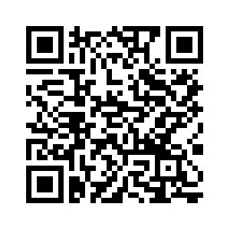
PSYC761
8: Mixed Models (an introduction)
Dr Chris Berry School of Psychology University of Plymouth PSQ B212 christopher.berry@plymouth.ac.uk
Book an office appointment:
Usually Tue and Fri 1-2pm
Scan QR code or click here
Check in code
**-**-**

Slide 2
Activity: Remainder of Session
Start Worksheet 8 and Exercises using RStudio
Please ask me if you have any questions on the code or concepts.
Worksheet 8:
https://chrisjberry.github.io/datafluencyCB/
(or DLE)
Good luck in the assignment, don’t forget instructions on DLE and FAQ webpage ☺

