Slide 1

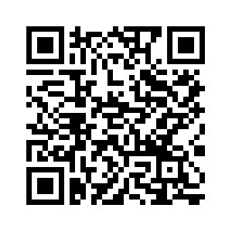
PSYC761
3: ANOVA: between-subjects
Dr Chris Berry School of Psychology Plymouth University PSQ B212 christopher.berry@plymouth.ac.uk
Book an office appointment:
Usually Tue and Fri 1-2pm
Scan QR code or click here
Check in code
**-**-**

Slide 2
ANOVA (Analysis Of Variance)
ANOVA is a special case of regression in which the predictor variable is categorical (nominal)
Used to test whether there are differences in the means of groups
Outcome variable
Continuous
In ANOVA, usually referred to as the dependent or response variable
Predictor variable
Categorical
In ANOVA, usually referred to as the independent variable

Slide 3



Meidenbauer et al. (2020)
Used a one-way between subjects ANOVA to look at the effects of viewing images of different aesthetic value (High, Low, or Very Low) on mood scores.
High Aesthetic Value
n=104 participants
Low Aesthetic Value
n =100 participants
Very Low Aesthetic Value
n = 102 participants
Does the aesthetic value of the image have an effect on mood score?

Slide 4
One-way between subjects ANOVA
One independent variable: categorical
e.g., aesthetic value of image
Two or more levels (e.g., High, Low, Very Low)
One dependent variable: continuous
e.g., mood score
Between subjects: A separate group of participants for each level of the independent variable. Each participant contributes exactly one score to the design
Key Q: Do the mean scores on the dependent variable differ between groups?
e.g., Do mood scores differ between the three aesthetic value groups?

Slide 5
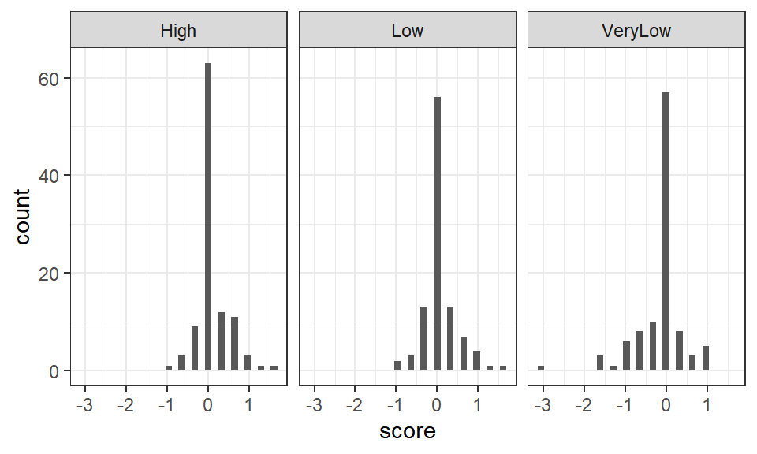
Distribution of scores
geom_histogram()
Inspect
Scores approximately normal in each group
Spread of scores (variance) approximately equal (homogeneity of variance)
[In practice, ANOVA is reasonably robust against violations of these assumptions]

Slide 6
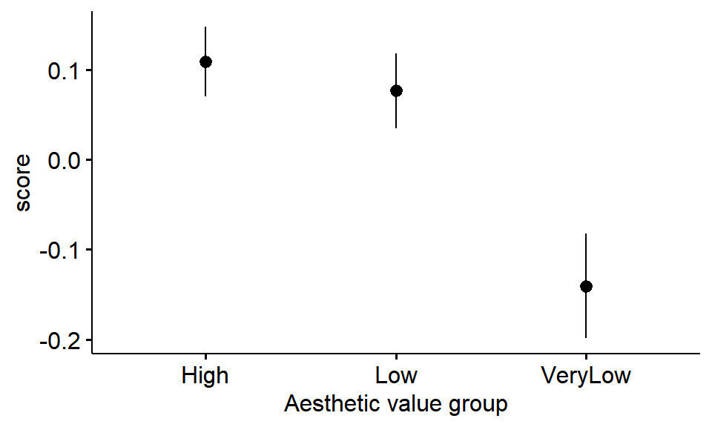
Plot the means
ggerrorplot()
In ggpubr package
Mean change in mood score
Bars indicate standard error of the mean
Look at ordering of the means

Slide 7
ANOVA: Bayes factor
The Bayes factor tells us whether there’s evidence that the means of our groups differ or not.
The BF is how much more likely the model with group means is, relative to the intercept only model (a model with one grand mean), given the data.
Grand mean =
Mean score (ignoring group)
vs.
Model with group means
Intercept only model

Slide 8
anovaBF(score ~ group, data = data.frame(affect_data))
## Bayes factor analysis
## --------------
## [1] group : 66.65842 ±0.04%
##
## Against denominator:
## Intercept only
## ---
## Bayes factor type: BFlinearModel, JZS
It’s over 66 times more likely that there is a difference between the means than no difference.

Slide 9
Coding categorical variables
It would be wrong to simply enter one column with codes, 0, 1, 2 (or 1, 2, 3) to the model. The regression would treat this as being continuous.
Categorical variables have to be added to a regression model using a special coding scheme.
N – 1 columns are required to code N categories (e.g., 2 columns for 3 categories)
In dummy coding, one group is coded with zeros, and the others 0s and 1s
If the variable is first converted with factor(), R automatically creates coded variables behind the scenes
Dummy coding of three groups:
 | Dummy variable 1 | Dummy variable 2
Group 1 | 0 | 0
Group 2 | 1 | 0
Group 3 | 0 | 1

Slide 10
Follow-up tests
If the BF for ANOVA is greater than 3:
Pairwise comparisons:
Is the mean of High different from Low?
Is the mean of High different from VeryLow?
Is the mean of Low different from VeryLow?
Mean change in mood score
Subset the data for the groups we want, then use anovaBF() again but with the subsetted data

Slide 11
Two-way between subjects ANOVA

Slide 12

Beutel et al. (2017)
Used two-way between subjects ANOVA to analyse the distress scores from individuals who were either low or high in trait resilience and had experienced either low or high levels of childhood adversity.
2 x 2 between-subjects design

Slide 13
Two-way between subjects ANOVA
Two independent variables (factors): both categorical
e.g., Resilience (high / low) Adversity (high / low)
One dependent variable: continuous
e.g., Distress
Between subjects: Each participant contributes exactly one score to the design
Resilience
 | High | Low
High | n = 106 | n = 284
Low | n = 997 | n = 1050
Adversity
Researchers look for: - Main effect factor 1 (Resilience)
Main effect factor 2 (Adversity)
Interaction between factors

Slide 14
Main effect of Resilience
Resilience
 | High | Low
High
Low
Adversity
Is there a difference between levels of Resilience, ignoring levels of Adversity?

Slide 15
Main effect of Adversity
Resilience
 | High | Low
High
Low
Is there a difference between levels of Adversity, ignoring levels of Resilience?
Adversity

Slide 16
Interaction between Resilience and Adversity
Resilience
 | High | Low
High
Low
Adversity
Two factors interact if the effect of one factor is different at each level of the other.
Is the effect of adversity different at each level of resilience? (sometimes easier to understand by looking at a plot of means→)

Slide 17
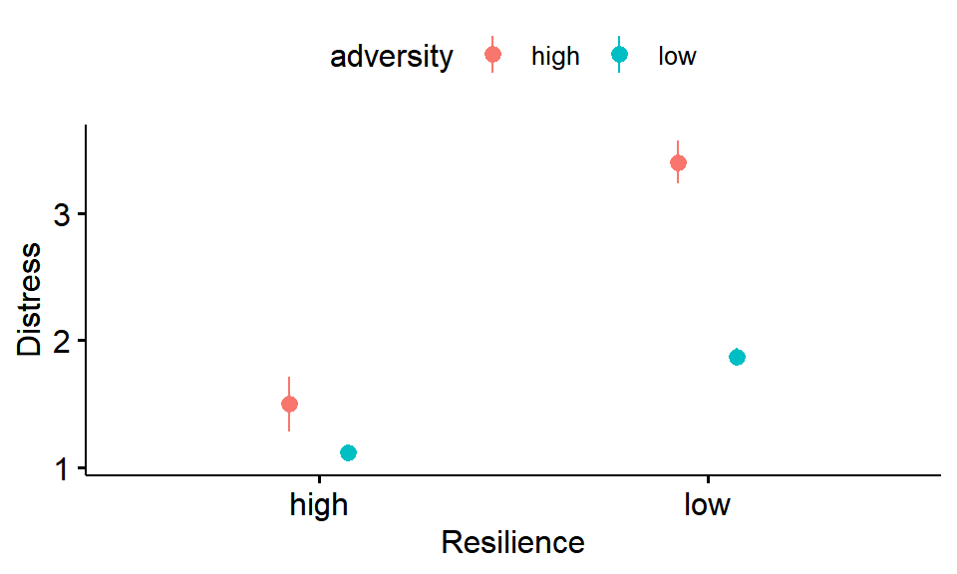
Plot of the means
ggerrorplot()
Main effect Resilience:
Are the distress scores on the left lower than those on the right?

Slide 18
Plot of the means
ggerrorplot()
Main effect Resilience:
Are the distress scores on the left lower than those on the right?
Main effect of Adversity:
Are the distress scores in red, higher than those in blue?

Slide 19
Plot of the means
ggerrorplot()
Main effect Resilience:
Are the distress scores on the left lower than those on the right?
Main effect of Adversity:
Are the distress scores in red, higher than those in blue?
Interaction between Resilience and Adversity (arrows)
Is the effect of adversity different at each level of resilience? (Is the difference between red and blue points the same on the left as on the right?)

Slide 20
anovaBF(distress ~ resilience * diversity, data = data.frame(resilience_data))
Two-way Bayesian ANOVA with anovaBF()
Using * tells R to automatically include the interaction in the model
## Bayes factor analysis
## --------------
## [1] resilience : 1.822053e+27 ±0%
## [2] adversity : 7.870878e+25 ±0%
## [3] resilience + adversity : 3.465475e+46 ±0.77%
## [4] resilience + adversity + resilience:adversity : 3.183135e+49 ±4.65%
##
## Against denominator:
## Intercept only
## ---
## Bayes factor type: BFlinearModel, JZS

Slide 21
If there’s evidence for an interaction (BF > 3), follow-up comparisons can be conducted to determine whether there’s evidence for an effect of a factor within each level of the other factor.
e.g.,
is there evidence of an effect of adversity within high resilience individuals?
is there evidence of an effect of adversity within low resilience individuals?
Subset the data for the groups we want, then use anovaBF() again but with the subsetted data

Slide 22
Activity: Remainder of Session
Start Worksheet 3 and Exercises using RStudio
Finish for next session. Please ask me if you have any questions on the code or concepts
Worksheet 3:
https://chrisjberry.github.io/datafluencyCB/
(or DLE)
Remember, there’s no session next Monday!
Catch up on worksheets
Look at the assessment

