Slide 1

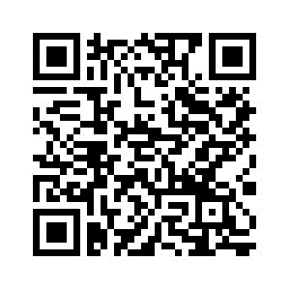
PSYC761
8: Mixed Models (an introduction)
Dr Chris Berry School of Psychology University of Plymouth PSQ B212 christopher.berry@plymouth.ac.uk
Book an office appointment:
Usually Tue and Fri 1-2pm
Scan QR code or click here
Check in code
**-**-**

Slide 2
Dependency in data
Dependencies often exist in psychological data
There may be:
Multiple data points per participant
Data from students in different classrooms
Data from different hospitals
Data from the same items in a stimulus set
We can expect data within each of these groupings to be correlated
e.g., some participants may tend to do better than others
particular stimuli tend to be easy/difficult
Technically, such dependencies violate the assumption of independence of data points in regression/ANOVA. A traditional approach is to average over data points prior to analysis (e.g., average RTs across items then do an ANOVA).

Slide 3
Mixed Models
Short for Linear Mixed Models (LMM)
Also referred to as multi-level models (MLM)
An extension/generalisation of multiple regression
Becoming more popular in psychology
A way of explicitly accounting for the dependencies between groupings or clusters in the data
Unit of cluster can be single participant, classroom, hospital, etc.
Other advantages
Provides more accurate and generalisable estimates of effects
Greater statistical power
Non-inflated Type I errors

Slide 4
Fixed vs. Random Effects
Fixed effect:
An effect we think generalises to the population (and would replicate).
Usually a manipulated independent variable (e.g., difficulty).
Random effect:
May also explain variance in the outcome variable
but is treated as a ‘nuisance’ background variable and is not (typically) individually assessed (although you can in LMMs).
Sometimes referred to as a grouping factor or grouping variable.
Always a categorical/nominal variable, e.g.,
Participant
Item
Classroom
Hospital

Slide 5
Fixed vs. Random Effects
We usually want to know the fixed effect after accounting for any random effects.
e.g. what is the effect of difficulty, generalised across participants?
You can have several fixed and random effects in an LMM
Repeated measures ANOVA is a special case of LMM where participant is a random effect.

Slide 6
Conceptual representation: Venn Diagram
The variance explained by the random effect (e.g., participant, item, testing location) is first accounted for.
Then the unique contribution of the fixed effect (e.g., Difficulty) is assessed.
Once the random effects have been accounted for, the fixed effect explains a greater proportion of the remaining variance, compared to a model that does not include the random effect.
It’s therefore more likely there’s evidence for the fixed effect’s unique contribution to the prediction of the outcome
i.e., greater power to detect fixed effect
1
Participant
Item
2
Participant
Difficulty
Item
More →
Area of box = variance in DV to be explained.
Area outside circle = the remaining variance to be explained, also called the residual or error variance

Slide 7
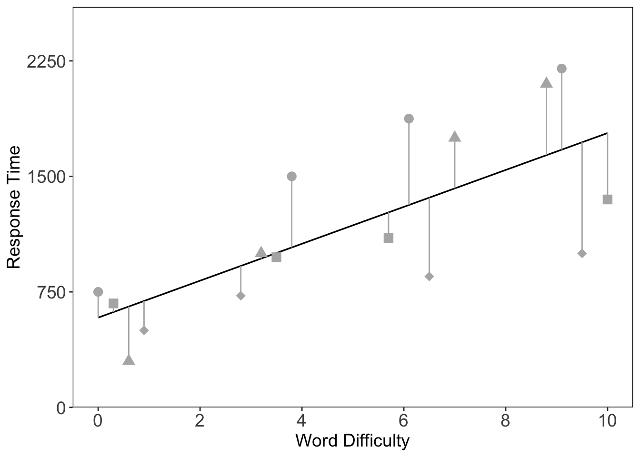
Conceptual representation: Regression Line Fixed effects model
Simple example:
The effects of word difficulty on RT
Each ppt represented by diff type symbol
Large residual error (vertical distances)
Brown, V. A. (2021). An introduction to linear mixed-effects modeling in R. Advances in Methods and Practices in Psychological Science, 4(1), Article 2515245920960351. https://doi.org/10.1177/2515245920960351

Slide 8
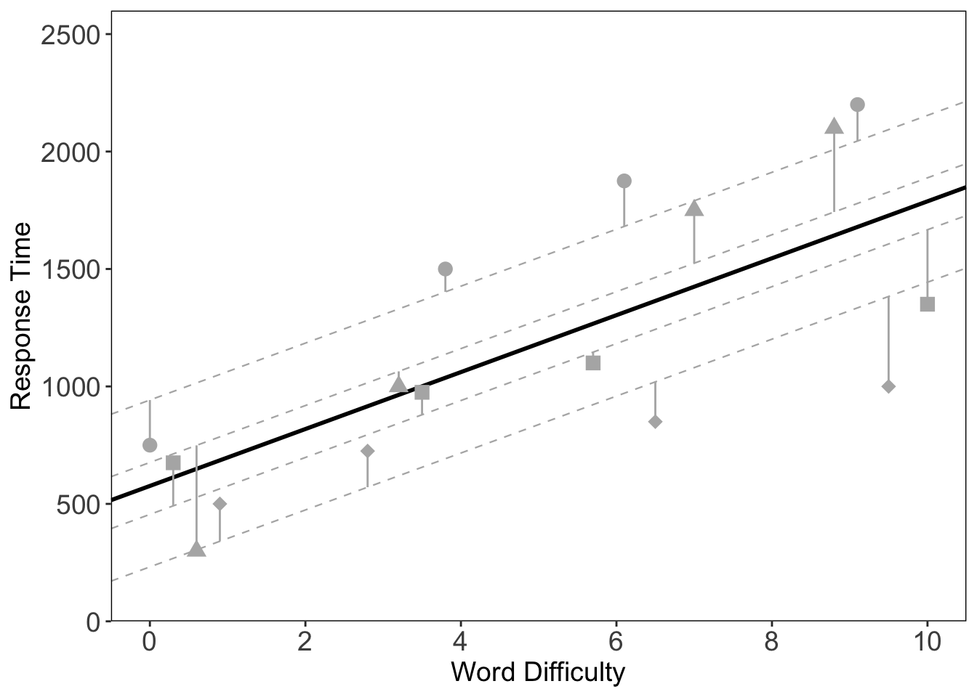
Conceptual representation: Regression Line + Random Intercepts
Each participant now modelled as having their own intercept (own regression line)
Smaller residual error (vertical distances)
Brown, V. A. (2021). An introduction to linear mixed-effects modeling in R. Advances in Methods and Practices in Psychological Science, 4(1), Article 2515245920960351. https://doi.org/10.1177/2515245920960351

Slide 9

Conceptual representation: Regression Line + Random slopes
Each participant is now modelled as also having their own slope
Even smaller residual error (vertical distances)
“By-participant”
Random intercepts and slopes
Brown, V. A. (2021). An introduction to linear mixed-effects modeling in R. Advances in Methods and Practices in Psychological Science, 4(1), Article 2515245920960351. https://doi.org/10.1177/2515245920960351

Slide 10
More on Random Intercept and Slopes
Random Intercepts
Represent individual differences in the mean across all conditions
By-participant
By-item
Random slopes
Represent individual difference in the effect of a predictor
By-participant
By-item

Slide 11
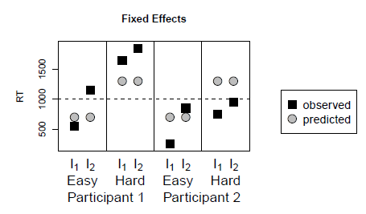
Another example with items…
Imagine a reaction time (RT) experiment:
Two conditions: Easy, Hard
Two participants: 1, 2
Two items: I₁, I₂
Trends evident in the observed data (squares)
RTs tend to be longer in the hard vs easy condition
RTs tend to be longer for participant 1 vs 2.
RTs tend to be longer for item 2 vs. 1
What are the fixed and random effects?
Fixed: Condition (difficulty)
Random: Participants, Items
From:
Singmann, H., & Kellen, D. (2019). An Introduction to Mixed Models for Experimental Psychology. In D. H. Spieler & E. Schumacher (Eds.), New Methods in Cognitive Psychology (pp. 4–31). Psychology Press.

Slide 12
Fixed Effects Model
Accounts for the effects of difficulty
- The difference in easy vs. hard (grey circles)
BUT ignores the trends / dependencies in
Participant
Item
A more realistic account of data involves including Participant and Item as random effects
From:
Singmann, H., & Kellen, D. (2019). An Introduction to Mixed Models for Experimental Psychology. In D. H. Spieler & E. Schumacher (Eds.), New Methods in Cognitive Psychology (pp. 4–31). Psychology Press.

Slide 13
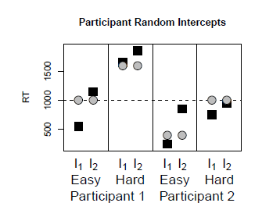

Random Intercepts Model (Participant)
In addition to the fixed effect, each participant also has their own mean RT
Participant 1 is slower than Participant 2
From:
Singmann, H., & Kellen, D. (2019). An Introduction to Mixed Models for Experimental Psychology. In D. H. Spieler & E. Schumacher (Eds.), New Methods in Cognitive Psychology (pp. 4–31). Psychology Press.

Slide 14
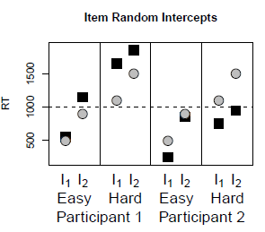
Random Intercepts Model (Item)
Each item now has its own mean RT
RTs for Item 2 are slower than Item 1
From:
Singmann, H., & Kellen, D. (2019). An Introduction to Mixed Models for Experimental Psychology. In D. H. Spieler & E. Schumacher (Eds.), New Methods in Cognitive Psychology (pp. 4–31). Psychology Press.

Slide 15
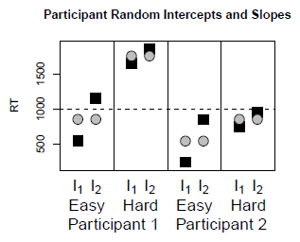
Random Intercepts and Slopes Model (Participant)
Each participant has their own mean RT (random intercepts)
BUT ALSO
The fixed effect (of difficulty) can be different for each participant (random slopes)
- Smaller for Participant 1 vs. 2
From:
Singmann, H., & Kellen, D. (2019). An Introduction to Mixed Models for Experimental Psychology. In D. H. Spieler & E. Schumacher (Eds.), New Methods in Cognitive Psychology (pp. 4–31). Psychology Press.

Slide 16
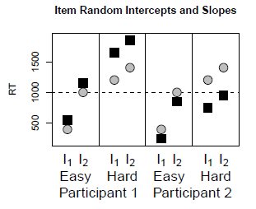
Random Intercepts and Slopes Model (Item)
Again, each item now has its own mean RT (random intercepts)
BUT ALSO
The fixed effect (of difficulty) is now different for each item (random slopes)
Difficulty has a smaller effect on Item 2 vs. 1
From:
Singmann, H., & Kellen, D. (2019). An Introduction to Mixed Models for Experimental Psychology. In D. H. Spieler & E. Schumacher (Eds.), New Methods in Cognitive Psychology (pp. 4–31). Psychology Press.

Slide 17
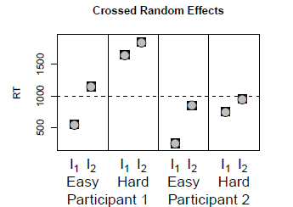
Crossed Random Effects Random Intercepts and Slopes Model (Participant AND Item)
Each participant AND item now has its own mean RT (random intercepts)
AND
The fixed effect (difficulty) is different for each participant AND item and (random slopes)
The model perfectly describes the data, but is “non-identifiable”.
There are too many parameters relative to data points necessary to identify them
From:
Singmann, H., & Kellen, D. (2019). An Introduction to Mixed Models for Experimental Psychology. In D. H. Spieler & E. Schumacher (Eds.), New Methods in Cognitive Psychology (pp. 4–31). Psychology Press.

Slide 18
More on Random Intercept and Slopes
Random effects (intercepts and slopes) can be correlated.
This correlation is explicitly modelled.
e.g., slower participants have a larger difficulty effect.
There would therefore be a correlation between the random intercepts and slopes across participants.
The correlation can be constrained to be zero
Omitting random slopes can inflate the Type I error rate.
i.e., More likely falsely finding that a fixed effect is significant

Slide 19
Lots of choices on what to include in the model. Recommendation: Keep it maximal (Bar et al., 2013)
Crossed random effects model provides the most complete account but is non-identifiable.
In general, most recommend adopting the maximal random effects structure justified by the design.
Provides more accurate account data
Estimate random intercepts, slopes, and their correlation for a given random effect as a starting point
You must have at least 5 or 6 levels of your random effect grouping variable (Bolker, 2015).

Slide 20
Mixed Models in R
R package for mixed models:
lme4 (Bates, Mächler, et al., 2015).
The function for linear mixed model (LMM):
lmer()
Specify formula
Data needs to be in long format (each observation is one row)
In LMM, the outcome is continuous

Slide 21
Other Types of Mixed Models
For a binary outcome variables, e.g.,
Correct vs. incorrect
Success vs. failure
Attended vs. absent
The model is called a generalised linear mixed effects model (GLMM)
glmer() function in lme4 package
For further information see References on the worksheet

Slide 22
Some examples of mixed models used in the literature
LMMs
Effects of difficulty and signal-to-noise ratio on RT after accounting for participant and item effects (Brown, 2021).
Predicting hallucinatory experiences from demographic variables (e.g., age, gender), and measures of cognitive performance (e.g., digit span), controlling for data-collection site (Moseley et al., 2021).
GLMMs
Effects of predictability and sequence position on a binary memory accuracy measure, controlling for participant (Gasser & Davachi, 2023)
Effects of experimental condition on binary accuracy measure, controlling for participant and trial (Bryant et al., 2018).

Slide 23
Activity: Remainder of Session
Start Worksheet 8 and Exercises using RStudio
Please ask me if you have any questions on the code or concepts.
Worksheet 8:
https://chrisjberry.github.io/datafluencyCB/
(or DLE)
Good luck in the assignment, don’t forget instructions on DLE and FAQ webpage ☺

