Slide 1
PSYC753
1. Simple Regression
2022
Dr Chris Berry School of Psychology Plymouth University PSQ B212 christopher.berry@plymouth.ac.uk

Slide 2
Overview
Sessions
7 sessions, weekly until 07/03/22
No session on 21/02/22
Format
Mondays
Short lecture
Worksheet
Fridays
Support session (4-5pm first two wks, then 1-2pm after)
Analysis Assessment (50%)
Details released in third session
31/03/22. Submission deadline

Slide 3
Why Are We Doing This?
Become better psychologists
Draw sound inferences from data
To better understand the literature

Slide 4
Simple Regression
Closely related to correlation, which describes the strength of association between two variables (X and Y).
Regression: enables the prediction of values of Y from values of X.
A linear equation relates scores of X (e.g., Anxiety) to scores of Y (e.g., Screen Time).
The equation is a statistical model of the relationship between X and Y.
Widely used in psychology

Slide 5

Teychenne & Hinkley (2016)
Used regression to investigate whether screen time is associated with anxiety symptoms in 528 mothers with young children

Slide 6
Simple Linear Regression
The relation between variables X and Y is described as a straight line (i.e., a linear relationship).
The line is described by an equation that relates the values of X to the values of Y.
Y
(e.g., Anxiety)
X
(e.g., Screen Time)

Slide 7
The Simple Regression Equation
Ŷ = a + bX
Ŷ The predicted value of the outcome variable (e.g., Anxiety score) (pronounced “y-hat”)
a The intercept
b The slope
X The predictor variable (e.g., Screen Time score)

Slide 8
The Intercept a
The intercept a is the value of Y when X equals zero.
The point where the line ‘cuts’ the y-axis
Y
a
0
X

Slide 9
The intercept (a) determines the “height” of the line
Y
Y
Y
50
0
X
X
X
-50
a = 50
a = 0
a = -50

Slide 10
Anxiety Example: The Intercept a
If a = 5.59, this means that if the Screen Time score were equal to zero, the Anxiety score would be 5.59
5.59

Slide 11
The Slope b
b is the amount of change in Y with a one unit increase in X.
b can be positive or negative.
Y
b
1
0
X

Slide 12
The slope (b) determines how steep the line is
Y
Y
Y
0
0
0
X
X
X
b = 10
b = 0
b = -10

Slide 13
Anxiety Example: Slope b
If b = 0.13, this means that for each unit (1) increase in Screen Time, the predicted Anxiety Score increases by 0.13.
7.02
6.89
0.13
1

Slide 14
Writing the Regression Equation
Using the general regression equation:
Ŷ = a + bX
if the intercept a = 5.59
and the slope b = 0.13,
then the regression equation for Anxiety and Screen Time is
Predicted Anxiety = 5.59 + 0.13*Screen Time

Slide 15
Residuals
Residual: the error in the prediction of Y for a given data point.
This is the difference between a data point’s Y value and the Y value predicted by the line (Ŷ):
Residual = Observed - Predicted
Residual = Y - Ŷ
Y
Residual
Ŷ

Slide 16
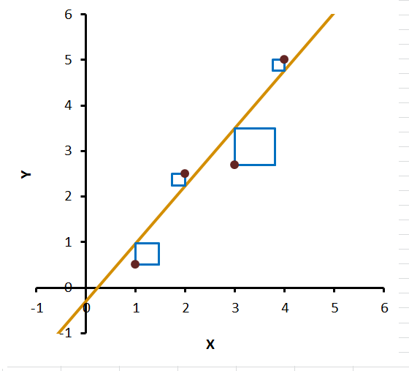
Method of Least Squares
The goal of regression is to find the values of the intercept a and slope b that minimise the residuals (errors).
Specifically, we want to minimise the sum of the squared residuals
This method of finding the “best fitting line” is called the method of least squares.
Automatically performed by statistical software (e.g., R Studio)

Slide 17
Interim Summary
The regression equation is
Ŷ = a + bX
This is a linear model of our data
The values of a (the intercept) and b (the slope) are the values that minimize the sum of the squared residuals
a and b are automatically calculated by RStudio.

Slide 18
Using the regression equation for prediction
The regression equation can be used to predict the value of Y for a given value of X.
If a person’s Screen Time score = 4 hours, what is their predicted Anxiety score?
Anxiety = 5.59 + 0.13*Screen Time
Anxiety = 5.59 + (0.13*10)
Anxiety = 6.89
The predicted Anxiety Score is 6.89
6.89

Slide 19
Assumptions of Regression
Linearity
There should be a linear relationship between the values of X and values of Y (at least over the range of X considered).
Check with a scatterplot.
✗

Slide 20
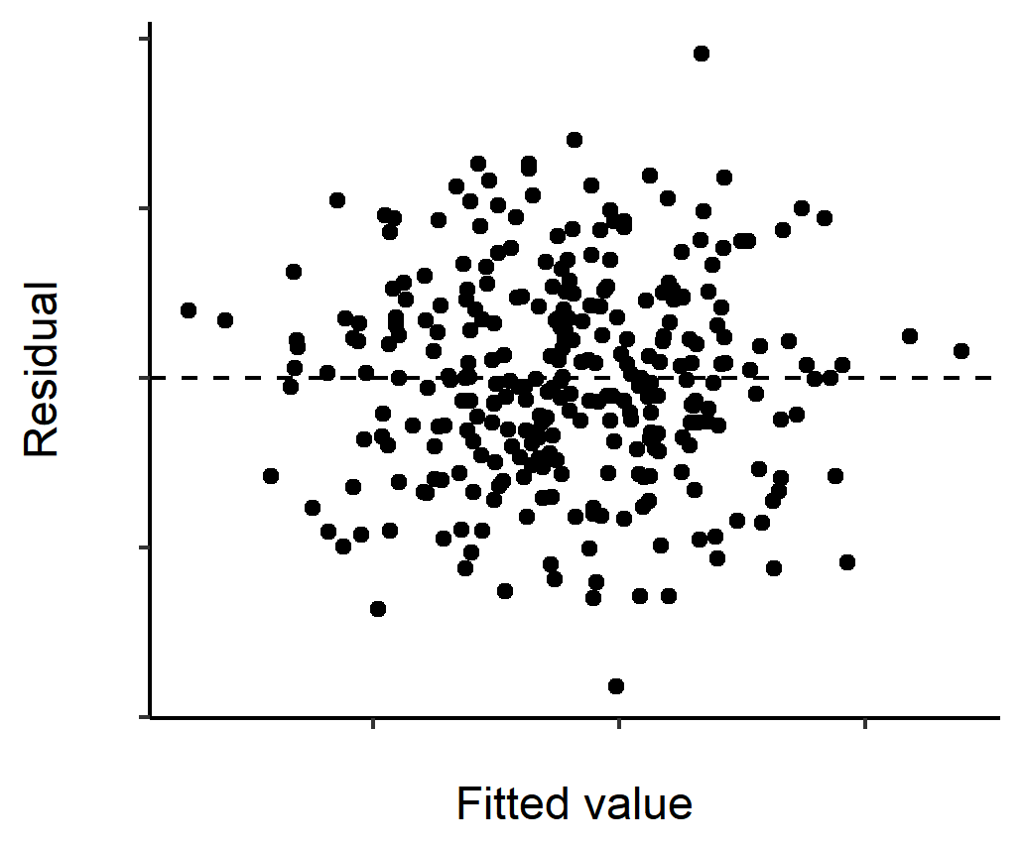
Assumptions of Regression
Constant variance of the residuals (homoscedasticity)
For each value of X, the residuals should have the same variance.
Check with scatterplot of predicted values vs. residuals:
ok✓

Slide 21
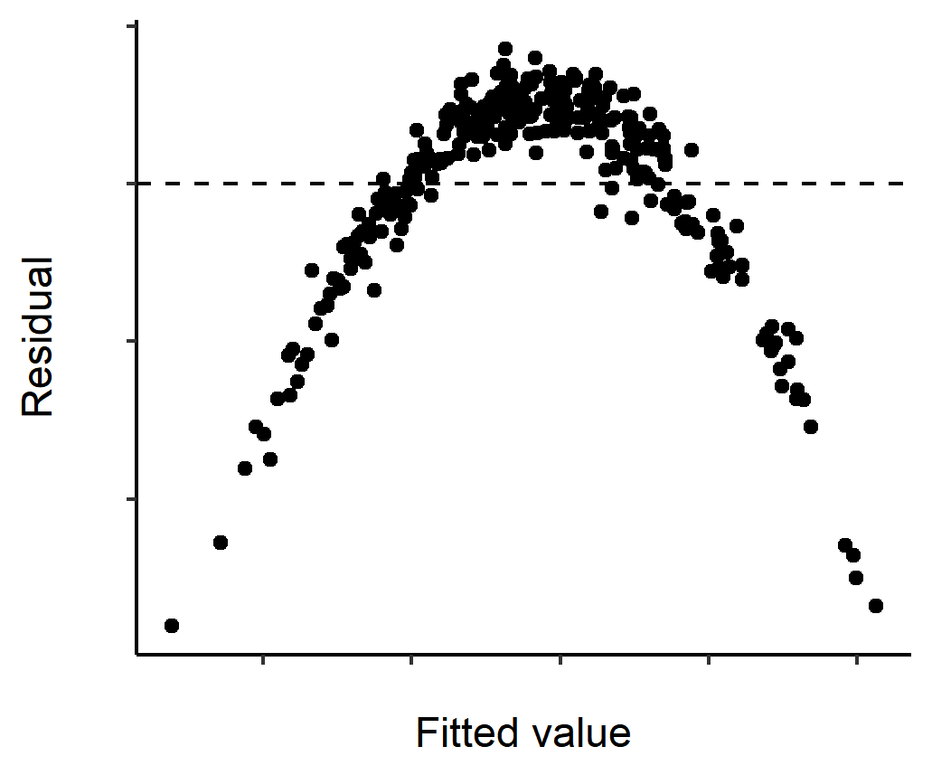
Assumptions of Regression
Independence of residuals
The value of one residual should not be correlated with the next (the value of one residual does not predict another).
Check with scatterplot of residuals vs. predicted values
✓ Pattern ok
✗ non-independence evident

Slide 22
Evaluating the Regression Model: R²
The proportion of the total variability in the outcome variable that can be accounted for by the model is given by R²
Multiply R² by 100 to report as a percentage.
For example, if R² = .34, then 34% of the total variability in the outcome variable (anxiety) can be accounted for by the regression model (screen time).

Slide 23
Evaluating the Regression Model: Intercept-only model
If we only had the outcome variable (and no predictor), the best estimate or “model” of the outcome would be its mean value (e.g., the mean Anxiety Score).
This is called the null model or Intercept-only model.
It is the scenario where the predictor does not predict the outcome at all and has a zero-slope (a flat regression line).

Slide 24
Evaluating the Regression Model: Bayes Factor
A Bayes Factor can be obtained to tell us whether our regression model does a better job than the intercept-only model.
The BF is the likelihood of the model given the data, relative to that of another model (Rouder & Morey, 2013)
For example, if the BF for a simple regression model is 3, then it is three times more likely than the intercept only model.
BF greater than 1 = evidence for the regression model
BF less than 1 = evidence for the intercept-only model
BF greater than 3 = strong evidence for the regression model
BF less than 0.33 = strong evidence for the intercept-only model
BF between 0.33 and 3 considered inconclusive evidence
Rouder, J. N., & Morey, R. D. (2012). Default Bayes factors for model selection in regression. Multivariate Behavioral Research, 47(6), 877-903.
*Other approaches exist (e.g., frequentist approaches using p-values)

Slide 25
Activity: Remainder of Session
Complete Worksheet 1 and Exercises on Simple Regression using RStudio
Key functions:
Visualise the data ggplot()
Simple regression lm()
R² glance()
Residuals augment()
Bayes Factor lmBF()

