Slide 1


PSYC761 Data Analysis
1. Simple Regression
2024
Dr Chris Berry School of Psychology Plymouth University PSQ B212 christopher.berry@plymouth.ac.uk
Book an office appointment:
Usually Tue and Fri 1-2pm
Scan QR code or click here
Check in code
**-**-**

Slide 2
Overview
Sessions
8 sessions, weekly until 4
No session on 12/02/24
Format
First session in each week
Short lecture
Worksheet
Analysis Assessment (50%)
Details released in third session
18/04/24. Submission deadlines

Slide 3
Topics
1. Simple regression
2. Multiple regression 1: multiple continuous predictors
3. ANOVA 1: Between-subjects designs
4. Multiple regression 2: one continuous, one categorical
5. Multiple regression 3: Hierarchical regression
6. ANOVA 2: Repeated measures designs
7. Pre-post designs and clinically significant change
8. Mixed models

Slide 4
Why Are We Doing This?
Become better psychologists
Draw sound inferences from data
To better understand the literature

Slide 5
Simple Regression
Closely related to correlation, which describes the strength of association between two variables (X and Y).
Regression: enables the prediction of values of Y from values of X.
A linear equation relates scores of X (e.g., Screen Time) to scores of Y (e.g., Anxiety).
The equation is a statistical model of the relationship between X and Y.
Widely used in psychology

Slide 6

Teychenne & Hinkley (2016)
Used regression to investigate whether screen time is associated with anxiety symptoms in 528 mothers with young children

Slide 7
Simple Linear Regression
The relation between variables X and Y is described as a straight line (i.e., a linear relationship).
The line is described by an equation that relates the values of X to the values of Y.
Y
(e.g., Anxiety)
X
(e.g., Screen Time)

Slide 8
The Simple Regression Equation
Ŷ = a + bX
Ŷ The predicted value of the outcome variable (e.g., Anxiety score) (pronounced “y-hat”)
a The intercept
b The slope
X The predictor variable (e.g., Screen Time score)

Slide 9
The Intercept a
The intercept a is the value of Y when X equals zero.
The point where the line ‘cuts’ the y-axis
Y
a
0
X

Slide 10
The intercept (a) determines the “height” of the line
Y
Y
Y
50
0
X
X
X
-50
a = 50
a = 0
a = -50

Slide 11
Anxiety Example: The Intercept a
If a = 5.59, this means that if the Screen Time score were equal to zero, the Anxiety score would be 5.59
5.59

Slide 12
The Slope b
b is the amount of change in Y with a one unit increase in X.
b can be positive or negative.
Y
b
1
0
X

Slide 13
The slope (b) determines how steep the line is
Y
Y
Y
0
0
0
X
X
X
b = 10
b = 0
b = -10

Slide 14
Anxiety Example: Slope b
If b = 0.13, this means that for each unit (1) increase in Screen Time, the predicted Anxiety Score increases by 0.13.
7.04
0.13
6.91
1

Slide 15
Writing the Regression Equation
Using the general regression equation:
Ŷ = a + bX
if the intercept a = 5.59
and the slope b = 0.13,
then the regression equation for Anxiety and Screen Time is
Predicted Anxiety = 5.59 + 0.13(Screen Time)

Slide 16
Residuals
Residual: the error in the prediction of Y for a given data point.
This is the difference between a data point’s Y value and the Y value predicted by the line (Ŷ):
Residual = Observed - Predicted
Residual = Y - Ŷ
Y
Residual
Ŷ

Slide 17
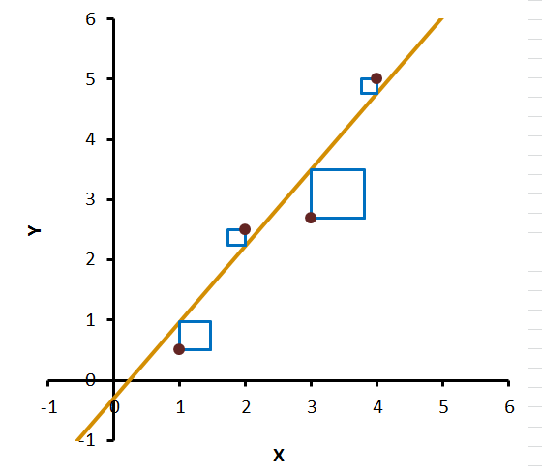
Method of Least Squares
The goal of regression is to find the values of the intercept a and slope b that minimise the residuals (errors).
Specifically, we want to minimise the sum of the squared residuals
This method of finding the “best fitting line” is called the method of least squares.
Automatically obtained by statistical software, e.g., R Studio, with lm()

Slide 18
Interim Summary
The regression equation is
Ŷ = a + bX
This is a linear model of our data
The values of a (the intercept) and b (the slope) are the values that minimize the sum of the squared residuals
a and b are automatically calculated by RStudio.

Slide 19
Using the regression equation for prediction
The regression equation can be used to predict the value of Y for a given value of X.
If a person’s Screen Time score = 7 hours, what is their predicted Anxiety score?
Anxiety = 5.59 + 0.13(Screen Time)
Anxiety = 5.59 + (0.13)(7)
Anxiety = 6.5
The predicted Anxiety Score is 6.5
6.5
7

Slide 20
Assumptions of Regression
Linearity
There should be a linear relationship between the values of X and values of Y (at least over the range of X considered).
Check with a scatterplot.
✗

Slide 21
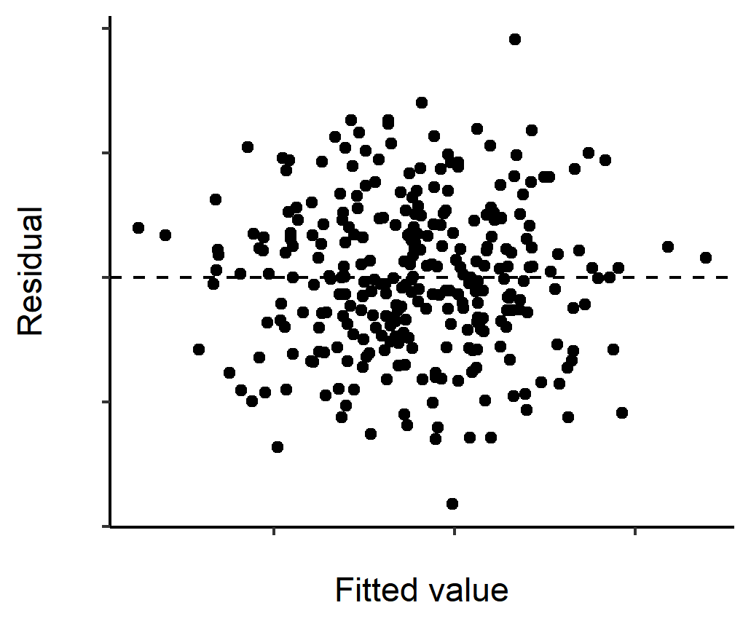
Assumptions of Regression
Constant variance of the residuals (homoscedasticity)
For each value of X, the residuals should have the same variance.
Check with scatterplot of predicted (fitted) values vs. residuals:
ok✓

Slide 22
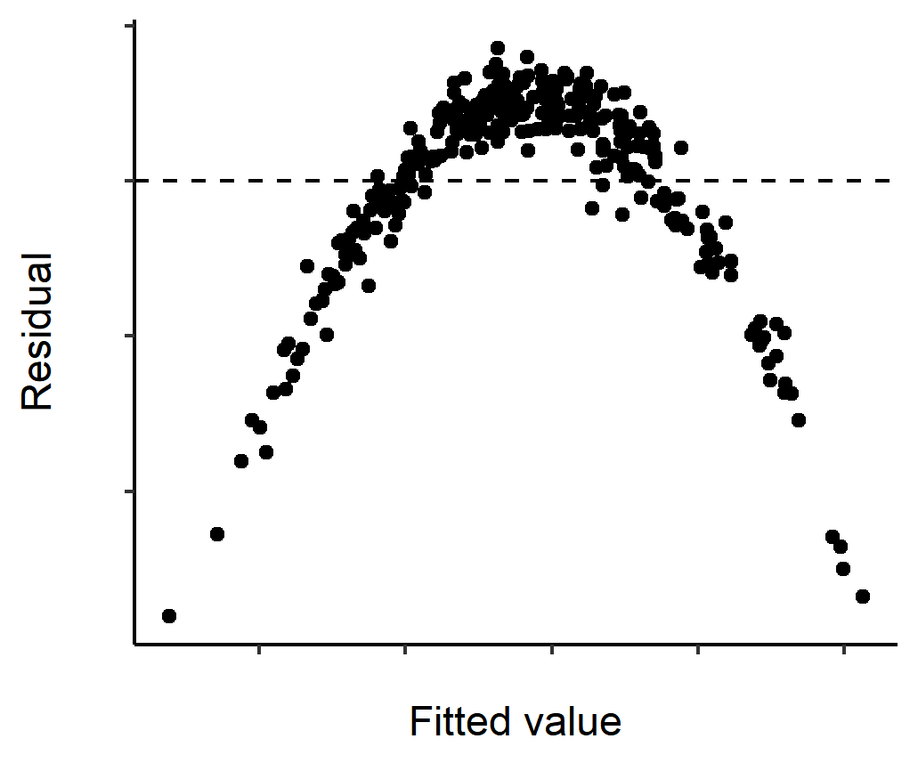
Assumptions of Regression
Independence of residuals
The value of one residual should not be correlated with the next (the value of one residual does not predict another).
Check with scatterplot of residuals vs. predicted values
✓ Pattern ok
✗ non-independence evident

Slide 23
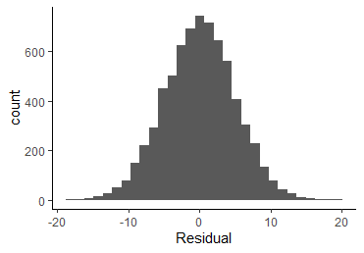
Assumptions of Regression
Normality of residuals
The residuals should be normally distributed.
Check with e.g., histogram

Slide 24
Evaluating the Regression Model: R²
The proportion of the total variability in the outcome variable that can be accounted for by the model is given by R²
Multiply R² by 100 to report as a percentage.
For example, if R² = .3412, then 34.12% of the total variability in the outcome variable (anxiety) can be accounted for by the regression model (screen time).

Slide 25
Evaluating the Regression Model: Intercept-only model
If we only had the outcome variable (and no predictor), the best prediction or “model” of the outcome would be its mean value (e.g., the mean Anxiety Score).
This is called the null model or Intercept-only model.
It is the scenario where the predictor does not predict the outcome at all and the regression line has a slope of zero.

Slide 26
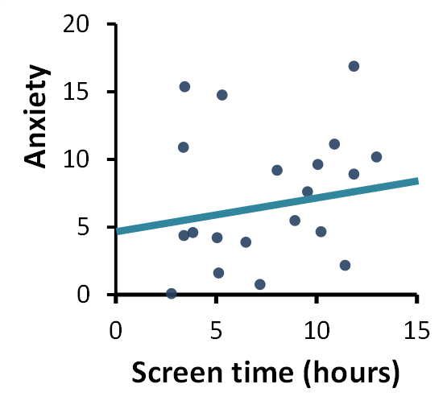
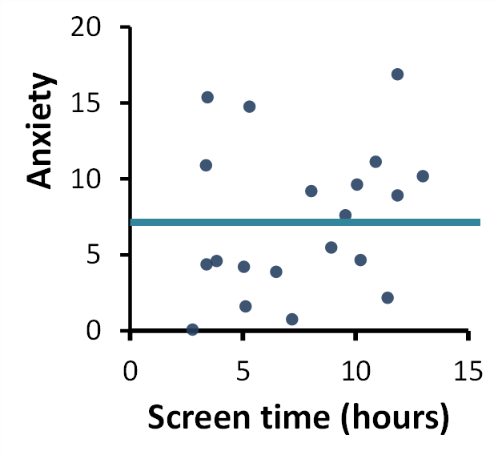
Evaluating the Regression Model: Bayes Factor
A Bayes factor (BF) can tell us whether there’s more evidence for the regression model than the intercept-only model.
More formally, the BF is the likelihood of the model given the data, relative to that of another model (Rouder & Morey, 2012).
BF₁₀ is the likelihood of the alternative model given the data, relative to that of the null model.
Alternative model
Null model
(intercept-only)
vs.
For example, if the BF₁₀ for a simple regression model is 3, then it is three times more likely than the intercept-only model.
Rouder, J. N., & Morey, R. D. (2012). Default Bayes factors for model selection in regression. Multivariate Behavioral Research, 47(6), 877-903. https://doi.org/10.1080/00273171.2012.734737

Slide 27
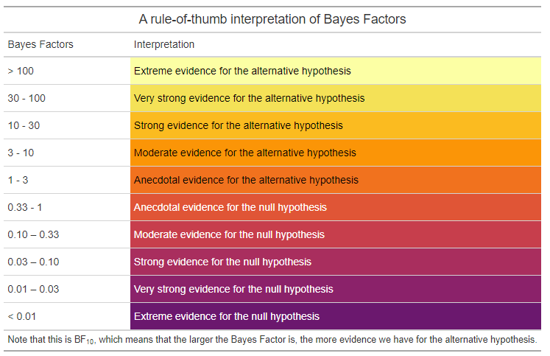
Bayes Factor Interpretation
Guidance from Andraszewicz et al. (2014)
Evidence for the alternative
BF₁₀ > 3 and
BF₁₀ < 0.33
are common cut offs for
“statistical significance”
Evidence for the null
Andraszewicz, S., Scheibehenne, B., Rieskamp, J., Grasman, R., Verhagen, J., & Wagenmakers, E. J. (2015). An introduction to Bayesian hypothesis testing for management research. Journal of Management, 41(2), 521-543. https://doi.org/10.1177/0149206314560412
Table from https://www.andywills.info/rminr/evidence.html
Other inferential approaches exist, e.g., frequentist ones using p-values.
[Not covered on this course.]

Slide 28
Activity
Remainder of Session
Worksheet 1 and Exercises using R Studio
(link on DLE)
Finish for next session.
https://chrisjberry.github.io/datafluencyCB/

