Slide 1
PSYC753
2: Multiple Regression
Multiple continuous predictors
Dr Chris Berry School of Psychology Plymouth University PSQ B212 christopher.berry@plymouth.ac.uk

Slide 2
Simple Regression (recap)
One predictor variable (X)
One outcome variable (Y)
e.g., use Screen Time (X) to predict Anxiety (Y)
Simple regression equation:
Ŷ = a + bX
Ŷ the predicted value of Y
a the intercept
b the slope (the coefficient for X)
e.g., Predicted Anxiety = 5.59 + 0.13*Screen Time
X
Y
eg, Screen Time
eg, Anxiety
Notes:
Let’s recap what we were looking at in simple regression
In simple regression we have one predictor variable and one outcome variable
The model of the relationship between the variables is given by the regression line

Slide 3
Simple Regression (recap)
Y
Ŷ = a + bX
b
a
1
0
X
But, we often want to know whether Y is predicted by multiple variables →
Notes:
The line represents the predicted values of Y at each value of X
E.g., predicted GPA at each level of Grit
a the intercept is the predicted value of Y when X = 0
b is the slope, this affects the height of the line.
The line is a straight line, the characteristics of which are determined by the values of a and b
The line is the line that minimises the sum of the square residuals.
This is the method of least squares we talked about last week/
Things are far too complicated in the world to just be measured with two variables.
We often want to know whether some outcome variable can be predicted by a number of variables

Slide 4

Iani et al. (2019)
Used multiple regression to investigate whether worry and mindfulness is associated with wellbeing in 66 individuals with Generalised Anxiety disorder
Iani, L., Quinto, R. M., Lauriola, M., Crosta, M. L., & Pozzi, G. (2019). Psychological well-being and distress in patients with generalized anxiety disorder: The roles of positive and negative functioning. PloS one, 14(11), e0225646.

Slide 5
Multiple Regression
More than one predictor variable (X₁, X₂, X₃…).
One outcome variable (Y).
E.g., use worry, mindfulness and emotional intelligence to predict wellbeing
Subscripts label the different predictor (X) variables, eg
X₁ worry
X₂ mindfulness
X₃ emotional intelligence
X₁
eg, worry
X₂
Y
eg, mindfulness
eg, wellbeing
X₃
eg, emotional intelligence
…
Notes:
In multiple regression we have a number of predictor variables.
We want to see whether the outcome variable can be predicted by a number of predictor variables.
So for example, can we predict GPA from Grit and IQ
If we knew someone’s Grit and IQ, would these two things help us to predict their GPA score.
In simple regression we had a model of the relationship between one predictor and the outcome.
In multiple regression we have a model of the relationship between a number of predictors and the outcome.
In terms of variance, we’re asking, do Grit, IQ and Extraversion help to explain the variance in GPA scores.
Multiple regression can help us to answer questions about which of these variables are important for predicting GPA.
We know that Grit is important
Is IQ?
Is Extraversion?
Multiple regression allows us to look at a whole bunch of variables and ask which of these predicts a certain outcome variable.
Which are the important variables for explaining GPA?

Slide 6
Multiple regression: Visual representation
With two predictor variables, X₁ and X₂, the regression line is actually a flat plane in 3D space.
Y
X₂
0
X₁
Notes:
In simple regression, the equation refers to a straight line in 2D space
In multiple regression, with two predictor variables, the equation refers to a flat plane in 3D space.
The regression line is now a flat surface.
If you imagine that each one of these dots is actually a point in a cube
These two axes are the sides of the cube.
What we are trying to do is to fit a flat plane through all the points
The plane of best fit is still the plane that minimises the sum of the squared residuals.
We still fit the plane using least squares analysis.
This is how the plane looks with two dimensions, but in reality we can have more predictor variables, and there will be more dimensions.
This visualisation only works with two predictors.
You have a new dimension for each predictor.
With three predictor variables, we have 4 dimensions.
But it becomes much harder to visualise 4 and 5 dimensional models.
This only works for imagining examples with two predictor variables and one criterion variable. With more than two predictor variables, we are into four-dimensional space. I don’t advise you to imagine this!

Slide 7
The Multiple Regression Equation
Ŷ = a + b₁X₁ + b₂X₂ + …. b_{n}X_{n}
where
Ŷ the predicted value of the outcome variable Y (e.g., wellbeing)
a the intercept (constant)
X the predictor variables
b₁ the coefficient (‘slope’) for predictor X₁ (e.g., worry)
b₂ the coefficient (‘slope’) for predictor X₂ (e.g., mindfulness)
b_{n} the coefficient (‘slope’) for predictor n
n the number of predictor variables
e.g.
Predicted wellbeing = 70.73 - 0.77(worry) + 1.25(mindfulness)
Notes:
The formula for multiple regression is a tad more complex.
There are a lot of terms here, but it is just an extension of the simple regression equation though
In simple regression, we used the term slope to refer to the thing that we multiply by X
In multiple regression we use the term coefficient.
In MR, because we have multiple predictors, each with their own slope, we call them coefficients.
The coefficient is basically the number we multiply X by.
You can see that the first part of this equation is the simple regression equation.
We have an extra b*X term for each additional predictor.
We want to end up with an equation like this
Predicted GPA – our predicted Y value
Intercept is 15.96 – can be positive or negative
B1 is 7.76
X1 is grit
B2 is 0.36
X2 is IQ
B3 is 1.2
X3 is Age

Slide 8
Multiple Regression: Visual representation
Two predictor variables (X₁ and X₂)
The intercept a determines the ‘height’ of the plane
The coefficients b₁ and b₂ determine the ‘tilt’ of the plane
Ŷ = a + b₁X₁ + b₂X₂
b₁
Y
b₂
1
1
X₂
a
0
X₁
Notes:
In simple regression, the slope determined the steepness of the line
In multiple regression, the coefficients determine the tilt of the plane (2 dimensions)
B1 and b2 describe the tilt of the plane
If we have the following regression equation
Ŷ = a + b1X1 + b2X2
a determines the height of the line
B1 is the change in Y with a one unit change in X1
B2 is the change in Y with a one unit change in X2
For a one unit change in X1, the plane shifts up on one dimension by a certain amount
For a one unit change in X2, the plane shifts up on one dimension by a certain amount
The plane passes through the point MX1, MX2, MY

Slide 9
Multiple Regression: Steps
Visualise the data
Check correlations between variables
Fit the model
Check assumptions: residuals
Evaluate the model
R²
Bayes Factor for the overall model
Assess the unique contribution of predictors

Slide 10
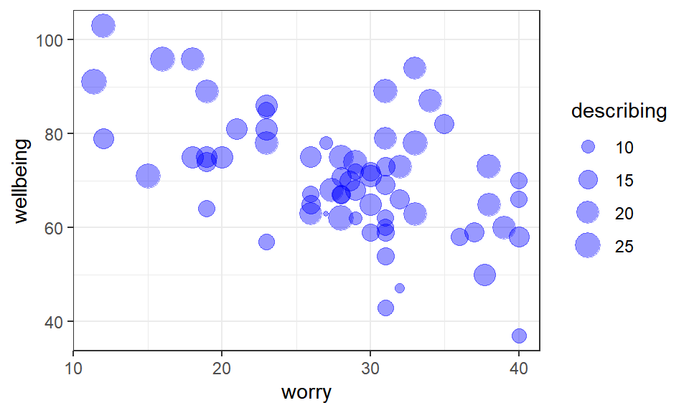
Visualisation and Correlations
ggplot()
correlate()
 | wellbeing | worry | describing
wellbeing | -
worry | -0.54 | -
describing | 0.54 | -0.25 | -
Notes:
When we have multiple variables, the scatterplot matrix can be useful for viewing relationships between multiple variables
Correlation matrix symmetric so only need look above or below diagonal
GPA and Grit look positively correlated
This is mirrored in the correlation matrix
IQ and Grit are not correlated
Again, we can get some indication of this by the relatively flat line in the scatterplot
IQ and GPA are positively correlated, we can see this in the correlation matrix

Slide 11
Fit the model
lm(outcome_variable ~ predictor_1 + predictor_2 + predictor_3, data = mydata)
No need to specify intercept
Use ‘+’ to add predictors
e.g.
lm(wellbeing ~ worry + describing + emotional_iq, data = wellbeing_data)

Slide 12
Output
lm(wellbeing ~ worry + describing, data = wellbeing_data)
##
## Call:
## lm(formula = wellbeing ~ worry + describing, data = wellbeing_data)
##
## Coefficients:
## (Intercept) worry describing
## 70.7306 -0.7708 1.2484
Regression equation:
Predicted wellbeing = 70.73 − 0.77(worry) + 1.25(describing)

Slide 13
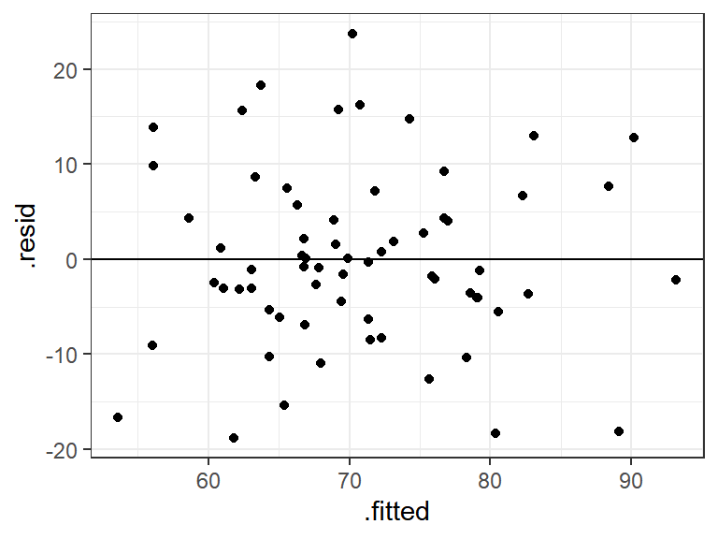
Check Assumptions: Residual Plot
The plot of the predicted (.fitted) values vs . the residuals (.resid).
Homoscedasticity and
independence of residuals
✓
Notes:
The histogram of standardised residuals is approximately normal.
We are looking for a nice normal distribution
Homoscedasticity
The assumption of constant variance in the residuals
Remember the residual is the vertical distance of each data point from the regression line
The points should be randomly and evenly scattered around the zero line, #
Independence of residuals
There should be no trends evident in the residuals
No obvious linear relationships or a positive or negative nature
No curvilinear relationships
Their scatter should be random with no systematic trends evident

Slide 14
Evaluate the model
R². The proportion of total variance in the outcome variable explained by the model.
e.g., 46.56 % of the variance in wellbeing is explained by the regression model containing worry and mindfulness.
Adjusted R Square. An estimate of R² in the population, which takes the sample size and number of predictors into account.
e.g., adjusted R² = 44.83%
Notes:
Could also say that it is significant and give the n
The adjusted R squared is actually a less biased estimate of the true squared correlation in the population; it takes the number of predictors into account. But we never report it. Most people simply report R-square (Howell)
The multiple correlation coefficient R is the correlation between the observed Y scores and the predicted values of Y derived from the regression equation (R = .756)
It is more common to report R-squared. This is the proportion of the variability in Y that can be accounted for by the predictor variables X. Thus, approximately 57.2% of the variability can be accounted for by the regression model.

Slide 15
Evaluate the model
Bayes Factor. Tells us how many time more likely the model is relative to an intercept-only model. In an intercept-only model, the coefficient for each predictor is zero.
lmBF(wellbeing ~ worry + describing, data = data.frame(wellbeing_data))
## Bayes factor analysis
## --------------
## [1] worry + describing : 4190994 ±0%
##
## Against denominator:
## Intercept only
## ---
## Bayes factor type: BFlinearModel, JZS
The model is 4,190,994 times more likely than an intercept model. There’s therefore strong evidence for the model.
Notes:
Could also say that it is significant and give the n
The adjusted R squared is actually a less biased estimate of the true squared correlation in the population; it takes the number of predictors into account. But we never report it. Most people simply report R-square (Howell)
The multiple correlation coefficient R is the correlation between the observed Y scores and the predicted values of Y derived from the regression equation (R = .756)
It is more common to report R-squared. This is the proportion of the variability in Y that can be accounted for by the predictor variables X. Thus, approximately 57.2% of the variability can be accounted for by the regression model.

Slide 16
The unique contribution of predictors
In multiple regression, the unique contribution of a predictor is its contribution to the model only after the other predictors have been taken into account!
Predictors are often correlated. This means the variance they explain in the outcome variable is shared.
This affects the amount of unique variance explained by a predictor
Care should be taken when interpreting the model:
Worry is a predictor of wellbeing after taking mindfulness into account.
Mindfulness is a predictor of wellbeing after worry into account.
Notes:
Things are getting a bit more abstract now
<Point 1>
Strictly speaking, they should be called “partial regression coefficients”
To put another, way: Grit is a significant predictor of GPA, given the presence of the other predictors in the model.
IQ is a significant predictor of GPA, given the other presence of the other predictors in the regression equation.
It’s NOT the same as asking whether a given variable is a good predictor of the DV.
Any statements about a particular predictor are only valid for the particular model under consideration.
For example, take the value of the standardized coefficient for Grit
This value will differ according to which other variables are in the model
If we ran a simple regression, it’s coefficient would NOT necessarily be the same

Slide 17
Understanding the contribution of individual predictors
The unique contribution of the predictor after taking the other predictors into account.
mindfulness
worry
Box = total variance in wellbeing to be explained
Overlap region (area c) = variation in wellbeing explained by both worry and mindfulness
a
c
b
Crescent a
Unique contribution of mindfulness to prediction of wellbeing
Crescent b
Unique contribution of worry to prediction of wellbeing
Notes:
Box outline:
The total variability in Y . We’d like to explain this (SStotal)
Blue circle:
The proportion of the variability in Y that is explained by Grit.
Remainder of the box:
The residual variation (not explained by Grit) (SSresidual)
The unexplained variance
The circles overlap. They overlap because the variables are correlated.
a is the unique portion of variability in GPA explained by Grit.
b is the unique portion of variability in GPA explained by IQ.
T-test on a: this tests a / white area remaining in square
T-test on b: this tests b / white area remaining in square
Is area a significant? (excluding c and b)
Is area b significant? (excluding a and c)
One way of doing regression that allows us to see the unique variance explained by predictors in the model is called Hierarchical Regression.

Slide 18
Using Bayes Factors to assess the unique contribution of predictors
Steps:
Obtain BF full model
BF predictor 1 alone
BF predictor 2 alone
Unique contribution of predictor:
BF_complex_model / BF_simpler_model
Tells us how many times more likely the model is with the predictor than without it.
lmBF(wellbeing ~ worry + mindfulness)
lmBF(wellbeing ~ worry)
mindfulness
worry
lmBF(wellbeing ~ mindfulness)
a
c
b
Crescent a
Unique contribution of mindfulness to prediction of wellbeing
BF_worry_mindfulness / BF_worry
Crescent b
Unique contribution of worry to prediction of wellbeing
BF_worry_mindfulness / BF mindfulness
Notes:
Box outline:
The total variability in Y . We’d like to explain this (SStotal)
Blue circle:
The proportion of the variability in Y that is explained by Grit.
Remainder of the box:
The residual variation (not explained by Grit) (SSresidual)
The unexplained variance
The circles overlap. They overlap because the variables are correlated.
a is the unique portion of variability in GPA explained by Grit.
b is the unique portion of variability in GPA explained by IQ.
T-test on a: this tests a / white area remaining in square
T-test on b: this tests b / white area remaining in square
Is area a significant? (excluding c and b)
Is area b significant? (excluding a and c)
One way of doing regression that allows us to see the unique variance explained by predictors in the model is called Hierarchical Regression.

Slide 19
Multicollinearity
If two predictor variables are highly correlated (above .80 or .below -0.80), this is known as multicollinearity, and can cause problems with interpretation of the regression.
If so, consider dropping one predictor from the model.
In the extreme scenario, although the model may explain the outcome overall, the unique contribution of each predictor may be negligible.
Example: Suppose that the variable BMI (Body Mass Index) is highly correlated with weight in kg (r = .85)
Notes:
Conscientiousness: “Conscientiousness is the personality trait of being thorough, careful, or vigilant. Conscientiousness implies a desire to do a task well.Conscientious people are efficient and organized as opposed to easy-going and disorderly.”
Extreme example
This can mean that even though a variable explains an outcome variable it will appear that it is not an important predictor because it is not significant.
It is also hard to rank predictors by importance.
Higher conscientiousness scores denote greater levels of conscientiousness.
Conscientiousness data is in the spreadsheet if you want to explore that

Slide 20
Understanding multicollinearity
Venn diagram of model of BMI and weight (kg)
BMI
Weight (kg)
High correlation = high overlap in variance explained
The proportion of variance in the outcome variable that is now uniquely explained by each predictor is very small.
Notes:
Because the two variables are so highly correlated, if we were to imagine their representation on a Venn diagram, the two circles would be highly overlapping.
Now, the unique variance in GPA that each variable explains is very small. So small in fact that the t-test on this is not significant.
The overall area (the outline of the overlapping circles) is still, however, a significant proportion of the rectangle and is significant.
This can create complications in the interpretation
The model is clearly a significant proportion of the variance in GPA, as indicated by the ANOVA
However, the analysis is saying that neither predictor is significant.
The proportion of unique variance in GPA that is uniquely explained by each predictor is very small.
But together, the area of the circle (figure of eight?) is a significant proportion of the variability in Y
This highlights the problem that can arise when predictor variables are correlated in some way.
Because Grit or IQ serve equally well in explaining the variance in GPA and are so highly correlated, one could replace the other.
Most texts recommend dropping one of the variables from the model.
The easiest thing to do to prevent this kind of problem is to look at the correlations between your predictor variables. If you have any high correlations, you may have a problem with multicolinearity. Consider dropping one of the variables from the model.
Indeed, there is currently a big debate going on regarding whether the construct of Grit is useful at all. Psychologists have been measuring conscientiousness for many years, and some say that the construct of grit is actually like old wine in new bottles. The debate continues.
That’s it for today. Don’t forget about the asssessment. I’m happy to take any questions in the time remaining.

Slide 21
Activity: Remainder of Session
Start Worksheet 2 and Exercises using RStudio
Support session Friday 4-5pm on Zoom (Paul)

