Slide 1


PSYC761
5: Multiple Regression
Hierarchical Regression
Dr Chris Berry School of Psychology University of Plymouth PSQ B212 christopher.berry@plymouth.ac.uk
Book an office appointment:
Usually Tue and Fri 1-2pm
Scan QR code or click here
Check in code
**-**-**

Slide 2
Hierarchical Regression
In hierarchical regression, predictor variables are entered in different steps (or blocks) in a multiple regression.
Sometimes called sequential regression
Can have many steps, and several predictors on each step.
Look at:
change in R² between steps
evidence that predictors in successive steps make unique contribution to the model (BF)
Reasons for use:
Theoretical considerations
Controlling the influence of variables
Determine contribution particular set of predictors
Step 1
X₁
Y
X₂
Step 2
X₁
Y
X₂
X₃
X₄

Slide 3

Iani et al. (2019)
Used a hierarchical regression approach with continuous variables to investigate whether mindfulness and emotional intelligence explain wellbeing in 66 individuals with Generalised Anxiety Disorder, but after controlling for brooding and worry.
The relationship between brooding, worry and wellbeing is already established.
Mindfulness variables:
Observing
Describing
Acting
Nonreactivity
Nonjudging
Emotional intelligence variables:
Attention
Clarity
Repair-
Iani, L., Quinto, R. M., Lauriola, M., Crosta, M. L., & Pozzi, G. (2019). Psychological well-being and distress in patients with generalized anxiety disorder: The roles of positive and negative functioning. PloS one, 14(11), e0225646. https://doi.org/10.1371/journal.pone.0225646

Slide 4
Do mindfulness and emotional intelligence predict psychological wellbeing, after controlling for brooding and worry?
Outcome variable = wellbeing
 | Predictors | R² | ΔR²
Step 1 | brooding | 0.19
Step 2 | brooding + worry | 0.33 | 0.14
Step 3 | brooding + worry + observing + describing + acting + nonreactivity + nonjudging | 0.53 | 0.20
Step 4 | brooding + worry + observing + describing + acting + nonreactivity + nonjudging + attention + clarity + repair | 0.60 | 0.07
On each step:
Run the model using lm()
Obtain R² using glance()
Work out the change in R² at each step (ΔR²)
e.g., Step 2: 0.33 – 0.19 = 0.14

Slide 5
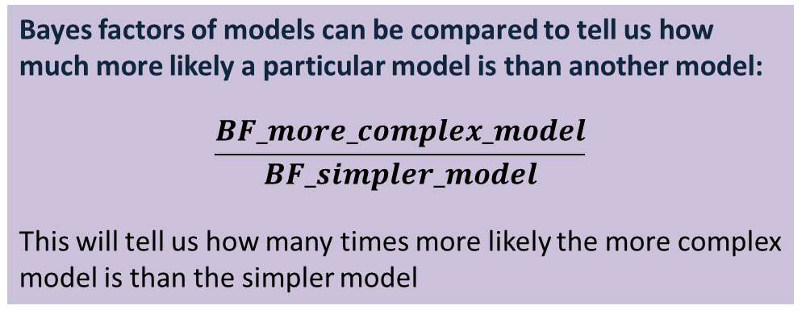
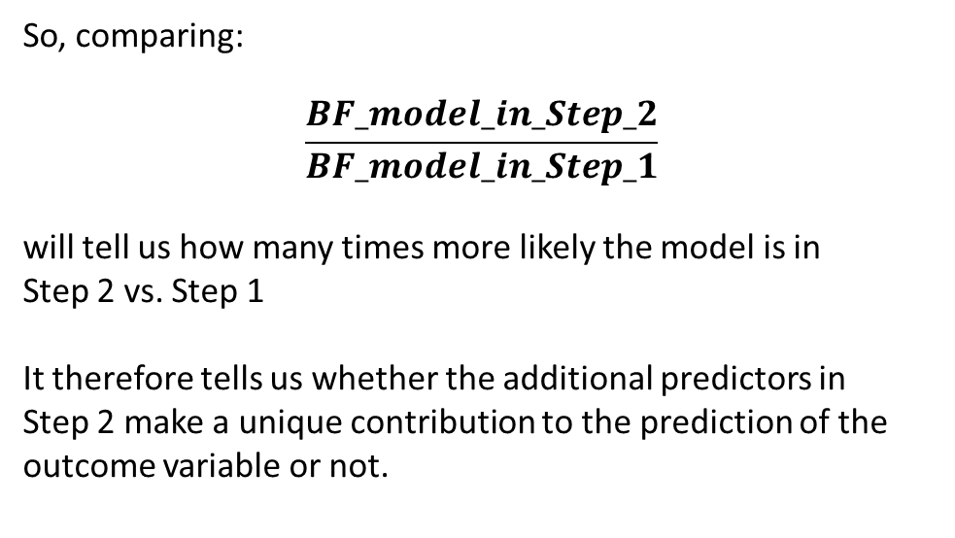
Evidence for the contribution of the predictors on each step
Bayes factors of models can be compared to tell us how much more likely a particular model is than another model:
$$\frac{BF_more_complex_model}{BF_simpler_model}$$
This will tell us how many times more likely the more complex model is than the simpler model
So, comparing:
$$\frac{BF_model_in_Step_2}{BF_model_in_Step_1}$$
will tell us how many times more likely the model is in Step 2 vs. Step 1
It therefore tells us whether the additional predictors in Step 2 make a unique contribution to the prediction of the outcome variable or not.

Slide 6

Evidence for the contribution of the predictors on each step
$$\frac{BF_model_in_Step_2}{BF_model_in_Step_1}$$
Bayes factor analysis
--------------
[1] brooding + worry : 56.11175 ±0%
Against denominator:
wellbeing ~ brooding
---
Bayes factor type: BFlinearModel, JZS
The model with both brooding and worry is over 50 times more likely than the model with only brooding in.
There’s substantial evidence that worry makes a unique contribution to the prediction of wellbeing, after controlling for brooding.
Follow same process for each subsequent step →

Slide 7
Do mindfulness and emotional intelligence predict psychological wellbeing, after controlling for brooding and worry?
Outcome variable = wellbeing
 | Predictors | R² | ΔR² | BF | BF
Step 1 | brooding | 0.19 |  | 95.76
Step 2 | brooding + worry | 0.33 | 0.14 | 5373 | 56.11
Step 3 | brooding + worry + observing + describing + acting + nonreactivity + nonjudging | 0.53 | 0.20 | 190716 | 35.49
Step 4 | brooding + worry + observing + describing + acting + nonreactivity + nonjudging + attention + clarity + repair | 0.60 | 0.07 | 410047 | 2.15
On each step,
Run a model using lmBF()
Obtain the BF for the model vs. intercept-only model
Obtain the BF for model on step vs. previous step

Slide 8
Intercept only model wellbeing ~ intercept
The box represents all of the variance in the wellbeing scores relative to the mean wellbeing score (the intercept-only model).

Slide 9
Step 1 wellbeing ~ brooding
brooding explains R² = 0.19 of the variance in wellbeing scores
brooding
The BF for the model in Step 1 vs. an intercept only model is 95.76. This model is over 90 times more likely than an intercept-only model.
Area of box = variance in wellbeing to be explained

Slide 10
Step 2 wellbeing ~ brooding + worry
The model with brooding and worry explains R² = 0.33 of the variance in wellbeing scores
worry
brooding
The change in R² associated with the addition of worry to the model is
0.33 – 0.19 = 0.14
The BF for the model in Step 2 vs. intercept only is 5373.32.
The BF comparing the model in Step 2 vs. Step 1 is 56.11
There’s substantial evidence for the model in Step 2 vs. Step 1.
Area of box = variance in wellbeing to be explained
Overlap = correlation between predictor variables

Slide 11
Step 3 wellbeing ~ brooding + worry + observing + describing + acting + nonjudging + nonreactivity
The model with brooding, worry, and the mindfulness variables explains R² = 0.53 of the variance in wellbeing scores
worry
brooding
The change in R² associated with the addition of mindfulness the model is
0.53 – 0.33 = 0.20
mindfulness
The BF for the model in Step 3 vs. intercept only is 190716.
The BF representing evidence for the model in Step 3 vs. Step 2 is 35.49
Area of box = variance in wellbeing to be explained
Overlap = correlation between predictor variables (note, all overlap to some degree)

Slide 12
Step 4 wellbeing ~ brooding + worry + observing + describing + acting + nonjudging + nonreactivity + attention + clarity + repair
The model with brooding, worry, mindfulness and emotional intelligence explains R² = 0.60 of the variance in wellbeing scores
worry
brooding
The change in R² associated with the addition of emotional intelligence to the model is therefore
0.60 – 0.53 = 0.07
mindfulness
The BF for the model in Step 4 vs. intercept only is 41007
emotional intelligence
The BF representing evidence for the model in Step 4 vs. Step 3 is: 2.15
The evidence for the model in Step 4 vs. Step 3 is inconclusive.
Area of box = variance in wellbeing to be explained
Overlap = correlation between predictor variables (note, all overlap to some degree)
12

Slide 13
Do mindfulness and emotional intelligence predict psychological wellbeing, after controlling for brooding and worry?
Outcome variable = wellbeing
 | Predictors | R² | ΔR² | BF | BF
Step 1 | brooding | 0.19 |  | 95.76
Step 2 | brooding + worry | 0.33 | 0.14 | 5373 | 56.11
Step 3 | brooding + worry + observing + describing + acting + nonreactivity + nonjudging | 0.53 | 0.20 | 190716 | 35.49
Step 4 | brooding + worry + observing + describing + acting + nonreactivity + nonjudging + attention + clarity + repair | 0.60 | 0.07 | 410047 | 2.15
Using a Bayes factor analysis:
There’s substantial evidence that mindfulness predicts wellbeing after controlling for brooding and worry.
There’s insufficient evidence that emotional intelligence predicts wellbeing after controlling for brooding, worry and mindfulness.

Slide 14
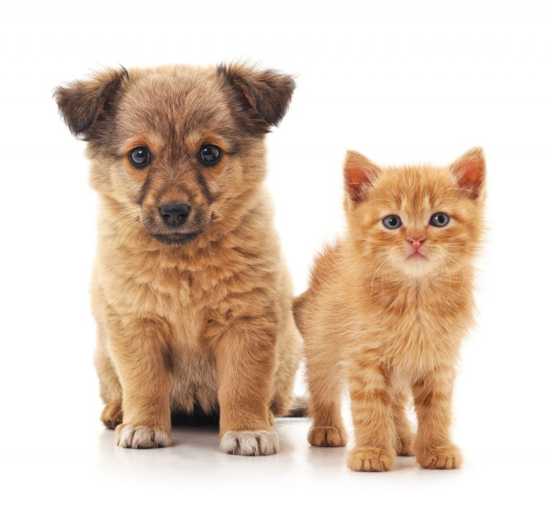
Ratschen et al. (2021)
Investigated whether comfort from animal companions predicted mental health of individuals before and during the Covid-19 lockdown once background variables had been controlled for.
Because the variables controlled for are assumed to co-vary with the outcome variable to some degree, they are often called covariates
Outcome variable: mental health
Categorical covariates:
Gender
Age group
Living with partner or not
Species of animal
Continuous covariate:
Loneliness
Predictor variable: comfort
Ratschen E., Shoesmith E., Shahab L., Silva K., Kale D., Toner P., et al. (2020) Human-animal relationships and interactions during the Covid-19 lockdown phase in the UK: Investigating links with mental health and loneliness. PLoS ONE, 15(9):e0239397. https://doi.org/10.1371/journal.pone.0239397

Slide 15
Step 1 mental_health ~ gender + age + partner + loneliness + species
Model with covariates
R² = 0.119
gender
age
species
loneliness
partner
Area of box = variance in wellbeing to be explained

Slide 16
Step 2 mental_health ~ gender + age + partner + loneliness + species + comfort
Model with addition of comfort
R² = 0.121
comfort
gender
age
ΔR² = 0.002
The BF for the model in Step 3 vs. Step 2 is 4.97.
There’s substantial evidence for unique contribution of comfort to the model (even though associated R² is so low)
species
loneliness
partner
Area of box = variance in wellbeing to be explained

Slide 17
Activity: Remainder of Session
Start Worksheet 5 and Exercises using RStudio
Finish for next session. Please ask me if you have any questions on the code or concepts.
Worksheet 5:
https://chrisjberry.github.io/datafluencyCB/
(or DLE)

