Slide 1
PSYC753: Data Fluency
Fitting Curves
Dr Chris Berry School of Psychology University of Plymouth christopher.berry@plymouth.ac.uk
www.plymouth.ac.uk/staff/christopher-berry

Slide 2
Today Overview: - Intro to Fitting Curves - Workbook Don’t forget! - Supplementary sessions - Data Analysis and Visualisation Assignment

Slide 3
Fitting Curves

Slide 4

Fitting Curves
So far, we’ve only fit linear models of the form:
Ŷ = a + b₁X₁ + b₂X₂
But, maybe non-linear relationships exist in the world!

Slide 5
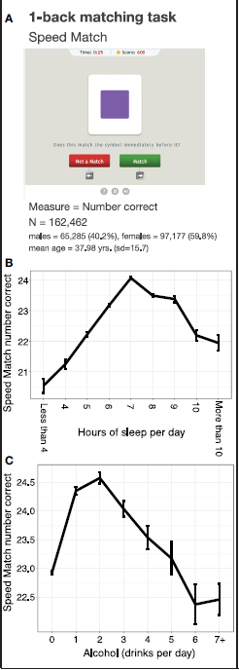
Sternberg et al. (2013) Lifestyle factors and cognitive performance
Sternberg, D. A., Ballard, K., Hardy, J. L., Katz, B., Doraiswamy, P. M., & Scanlon, M. (2013). The largest human cognitive performance dataset reveals insights into the effects of lifestyle factors and aging. Frontiers in Human Neuroscience, 7, 292

Slide 6
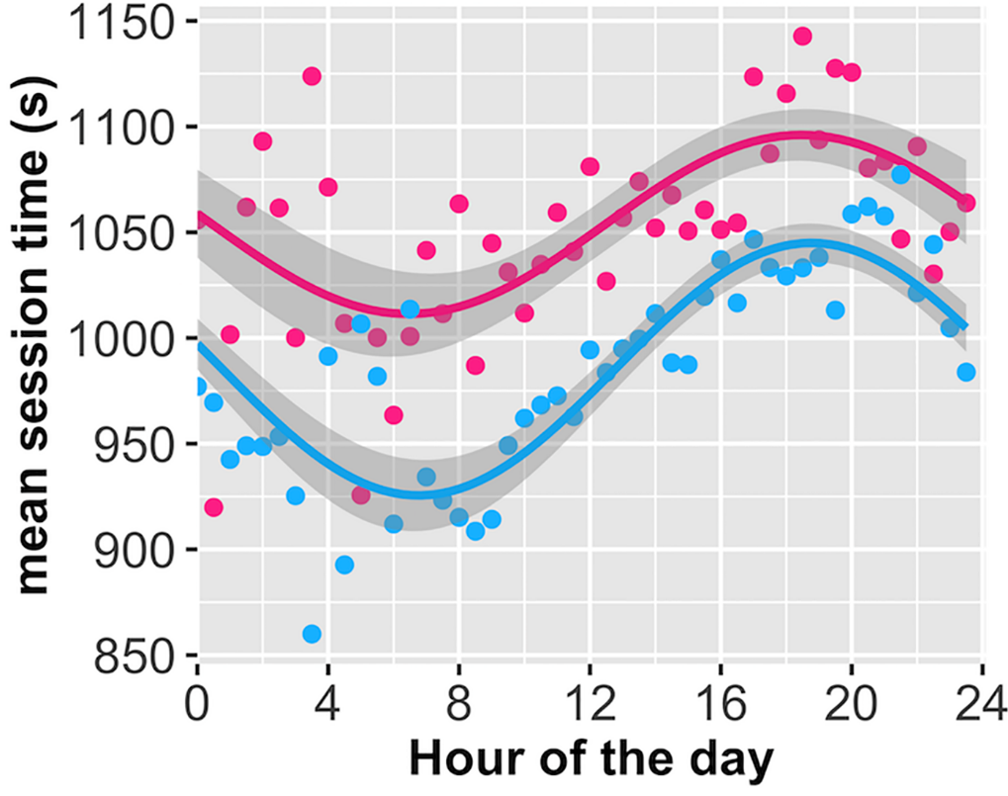
Randles et al. (2017) Online session length vs. time of day
Randles, D., Harlow, I., & Inzlicht, M. (2017). A pre-registered naturalistic observation of within domain mental fatigue and domain-general depletion of self-control. PloS one, 12(9), e0182980.

Slide 7
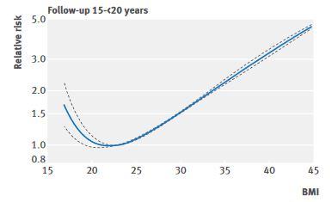
Aune et al. (2016) BMI vs Mortality
Aune, D., Sen, A., Prasad, M., Norat, T., Janszky, I., Tonstad, S., ... & Vatten, L. J. (2016). BMI and all cause mortality: systematic review and non-linear dose-response meta-analysis of 230 cohort studies with 3.74 million deaths among 30.3 million participants. BMJ, 353.

Slide 8
Fitting curves rather than straight lines
Ŷ =a + b₁x + b₂x² + b₃x³ + b₄x⁴ ...
Any curve can be fitted with a polynomial
We can think of a curve as being made up of these components…

Slide 9
y = 1
“Constant”
0

Slide 10
y = 0.5x
“Linear”
0

Slide 11
y = 1 + 0.5x
0
“Constant”
+ “Linear”

Slide 12
y = x²
“Quadratic”
0

Slide 13
y = -x²
0

Slide 14
y = 1 + 0.5x - x²
“Linear”
“Constant”
0
“Quadratic”

Slide 15
Using polynomials
Assess statistical significance using a hierarchical modelling approach
ANOVA and Bayes Factors
anova()
lmBF()

Slide 16
Assessing statistical significance of polynomial components
Step 1: Enter the linear component, x, into the model
Step 2: Enter the quadratic component, x², into the model.
Step 3: Enter the cubic component, x³, into the model.
Test x² by seeing if change in variance explained is significant
(Model 2 vs Model 1)
Test x³ by seeing if change in variance explained is significant
(Model 3 vs Model 2)
Supplement with comparison of Bayes Factors

Slide 17
Some cautions
Be careful if extrapolating (making predictions) beyond the range of data.
The same trend may not apply!
A complex model may fit the data very well, but could be overfitting and may not generalise to new data well.

Slide 18
Prevalence
0
Age
y = a + b₁x + b₂x² + b₃x³ + b₄x⁴

Slide 19
Don’t extrapolate outside range of data!
Prevalence
0
Age
y = a + b₁x + b₂x² + b₃x³ + b₄x⁴

Slide 20
Workshop Go to PSYC753 DLE page Locate link for my workshops Today’s worksheet: “Week 18 - Fitting Curves”

