Slide 1


PSYC761
7: Pre-post data, clinically sig change
Dr Chris Berry School of Psychology University of Plymouth PSQ B212 christopher.berry@plymouth.ac.uk
Book an office appointment:
Usually Tue and Fri 1-2pm
Scan QR code or click here
Check in code
**-**-**

Slide 2
Pre-post design
A dependent variable can be measured at two time points (pre-test and post test)
e.g., symptoms of depression before and after therapy
A Control group can be included.
 | Pre-test | Post-test
Treatment group | • | •
Control group | • | •
Group
Time
Pre-post designs can be analysed in multiple ways →

Slide 3

Francis et al. (2019)
Administered a healthy diet intervention to a n = 38 individuals with elevated levels of depression symptoms and a poor diet.
Depressive symptoms measured before and 3 weeks after the intervention.
Performance compared to a control group (n = 38) who did not receive the dietary intervention.
Factors (IVs):
Group: between subjects, 2 levels (diet_change, habitual_diet)
Time: within-subjects, 2 levels, (baseline, week 3)
Dependent variable (DV):
Depressive symptoms

Slide 4
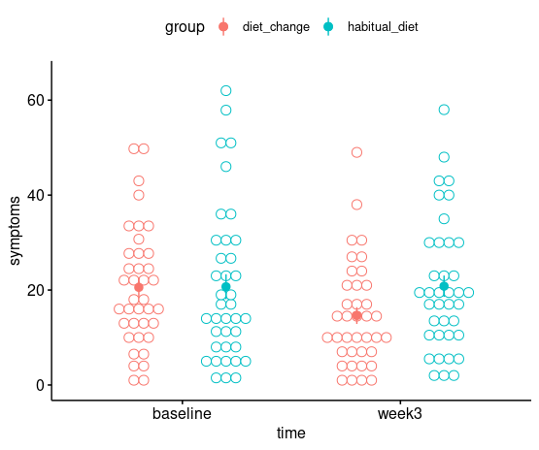
ggdotplot()
(in ggpubr)
Depressive symptoms appear lower after 3 weeks in the diet change group, but not the habitual diet group.
Solid dots = means
Intervals = SE
Open dots = single ppt

Slide 5
Approach 1: Change scores
If we are concerned with the change in symptoms between groups, the difference in the mean change score can be compared.
Design for this analysis
DV: change score
IV: group
Analysis type
One-way between subjects ANOVA
Group | Baseline (pretest) | Week 3 (posttest) | Change (post minus pre)
Diet change | • | • | •
Habitual diet | • | • | •
Compare these scores between groups

Slide 6
Approach 1: Change scores
anovaBF(change ~ group)
Group | Change (post minus pre)
Diet change | •
Habitual diet | •
Bayes factor analysis
--------------
[1] Alt., r=0.707 : 2.262527 ±0%
Against denominator:
Null, mu1-mu2 = 0
---
Bayes factor type: BFindepSample, JZS
Although the Bayes factor indicates weak evidence for a difference in the mean change score between groups, the evidence is inconclusive, BF = 2.26.

Slide 7
Approach 2: Mixed ANOVA
Alternatively, the design could be treated as a 2 x 2 mixed factorial design:
Between-subjects: group
Within-subjects: time
Allows assessment of:
Main effect of group
Main effect of time
Group x time interaction
Group | Baseline | Week 3
Diet change | • | •
Habitual diet | • | •
Group
time
Of key interest
Are the change scores different between groups?

Slide 8
Approach 2: Mixed ANOVA
anovaBF(symptoms ~ group * time + ppt, whichRandom = "ppt“)
ppt must be included as a random factor in the model (see Session 6)
Group | Baseline | Week 3
Diet change | • | •
Habitual diet | • | •
Bayes factor analysis
--------------
[1] group + ppt : 0.5156914 ±0.58%
[2] time + ppt : 1.3727 ±0.83%
[3] group + time + ppt : 0.7196471 ±1.13%
[4] group + time + group:time + ppt : 1.706539 ±4.44%
Against denominator:
symptoms ~ ppt
---
Bayes factor type: BFlinearModel, JZS
time
BF main effect of group
BF main effect of time
BF for the interaction
= [4] / [3]
= 1.71 / 0.72
= 2.38
Again, there’s insufficient evidence that change scores differ between groups.

Slide 9
Approach 3: ANCOVA
Alternatively, the design can be treated as a multiple regression with one continuous variable (a covariate) and one categorical variable (Session 4). This is known as ANCOVA (Analysis of Covariance).
Key Q: Is there an effect of group on week 3 scores after the variance associated with baseline scores has been accounted for?
Group | Baseline | Week 3
Diet change | • | •
Habitual diet | • | •
predictor
covariate
outcome variable
X₁
group
Y
X₂
week3
baseline

Slide 10
Approach 3: ANCOVA
# The model with both group and baseline
full <- lmBF(week3 ~ group + baseline)
# The model with baseline only
baseline <- lmBF(week3 ~ baseline)
# The unique contribution of group
full / baseline
Group | Baseline | Week 3
Diet change | • | •
Habitual diet | • | •
predictor
Bayes factor analysis
--------------
[1] group + baseline : 6.079873 ±0.83%
Against denominator:
week3 ~ baseline
---
Bayes factor type: BFlinearModel, JZS
covariate
outcome variable
There’s substantial evidence for an effect of group on depression symptoms at week3 after accounting for severity at baseline, BF = 6.08

Slide 11
Which approach?
Depends on research question:
Approaches 1 & 2 are concerned with differences in change scores between groups
Approach 3 is concerned with scores between groups after the intervention (posttest).
By accounting for the pretest scores as a covariate first, the statistical power of the test of group on posttest is increased.
Widely recommended and adopted in clinical literature (O’Connell et al., 2017)
Pre-test
Group
O'Connell, N. S., Dai, L., Jiang, Y., Speiser, J. L., Ward, R., Wei, W., ... & Gebregziabher, M. (2017). Methods for analysis of pre-post data in clinical research: a comparison of five common methods. Journal of Biometrics & Biostatistics, 8(1), 1.
Variance in posttest to explain

Slide 12
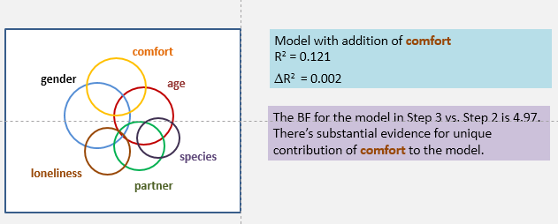
Statistical significance
We’ve used Bayes factors to tell us whether we have evidence for one model relative to another.
If BF > 3, then substantial evidence for the alternative model
If BF < 0.33, then substantial evidence for the null model
Note, because our BFs are always calculated for the alternative (more complex) model vs. the null (simpler model), the BFs has subscripts ‘10’, i.e., BF₁₀ = 3.23
Occasionally, BF₀₁ is reported in articles, which refers to the evidence for the null model. It’s equal to 1 / BF₁₀
p-values also widely used (i.e., p < .05)
The BF (and p-value) in itself does not tell us about the size or magnitude of the effect of difference between conditions
From Session 5:
BF > 3
But R² is tiny! (= 0.002, or 0.2%)
How practically or clinically relevant is this?

Slide 13
Effect Size
Measures of effect size such as R² and Cohen’s d tell us about the magnitude of the effect.
Cohen’s d is the standardised difference between two means.
Various packages exist for measuring d and other effect sizes in R, e.g., effsize
see http://www.andywills.info/rminr/
(Press CTRL + F and search for “effect size”)
But, a large effect size still doesn’t necessarily translate to practical or clinical significance (however, like statistical significance, might be theoretically important)
Hypothetical study of a weight loss intervention:
BF > 3 for treatment vs. control
Cohen’s d = 2.5
But the average weight loss difference between groups could be only 50 g after 1 year
How practically or clinically relevant is this?

Slide 14
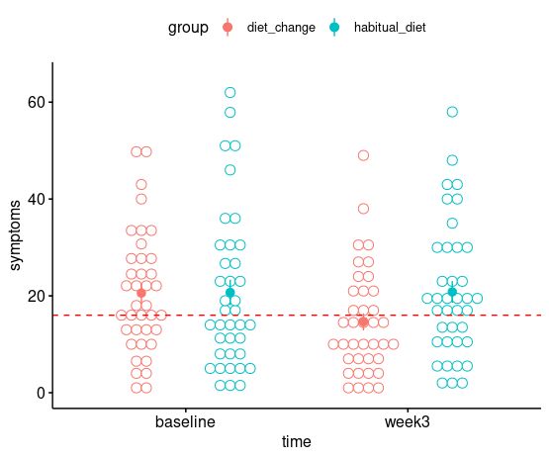
Clinical significance
Clinical significance refers to whether an intervention leads to an outcome that is clinically meaningful.
e.g., whether therapy results in a change in diagnosis of a disorder in a client or not
Some scales have an established cutoff for a diagnosis of a disorder or not.
e.g., on the CES-D depression scale, scores 16 or greater are considered as showing enhanced symptoms of depression (Radloff, 1977).
Francis et al. (2019)
CES-D = 16
On average, a shift to a healthy diet resulted in a change in diagnosis

Slide 15
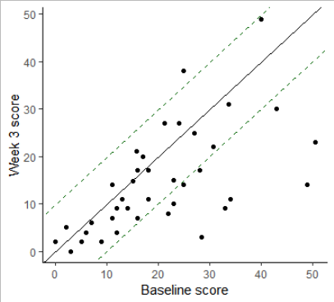
Going further: Clinical significance
diagonal = no change
Jacobson and Truax (1991)
Tried to establish a more general method of determining whether intervention led to clinically significant change or not.
An individual’s improvement may be due to measurement error, and may not necessarily be reliable.
Reliable change (RC) index – used to establish whether individuals have a reliable change score between baseline and follow-up.
For each participant:
RC = (pretest – posttest) / SE_difference
If RC > 1.96 or RC < -1.96, then reliable change.
See Further Knowledge section in Worksheet 7
Francis et al. (2019). Dietary change group
RC index lower
RC index lower
10 ppts below lower RC index, therefore show reliable change

Slide 16
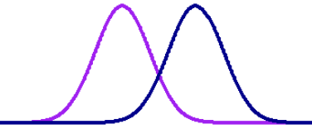
Going further: Clinical significance
c
Jacobson and Truax (1991)
Suggested these treatment outcomes on the basis of a participant’s RC index and criterion for diagnosis:
Recovered
Reliable change and posttest crosses criterion
Improved
Reliable change and posttest does not cross criterion
Unchanged
No reliable change
Deteriorated
Reliable change and posttest below pretest
In absence of established criterion, if M₁ and M₂ are known, the midpoint between them can be used as a cutoff (c).
Dysfunctional
population
Functional
population
M₁
M₂
c
Pretest
score
Posttest
score
Jacobson, N. S., & Truax, P. (1991). Clinical significance: A statistical approach to defining meaningful change in psychotherapy research. Journal of Consulting and Clinical Psychology, 59(1), 12–19. https://doi.org/10.1037/0022-006X.59.1.12

Slide 17
Activity: Remainder of Session
Start Worksheet 7 and Exercises using RStudio
Please ask me if you have any questions on the code or concepts.
Worksheet 7:
https://chrisjberry.github.io/datafluencyCB/
(or DLE)
Remember, next week is our last session! ☹ (Please bring your questions!)

