Slide 1
Multiple regression

Slide 2
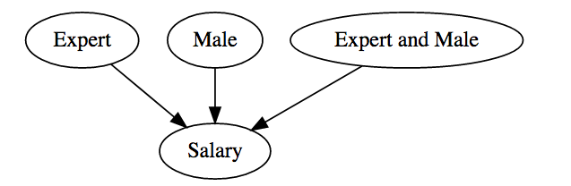
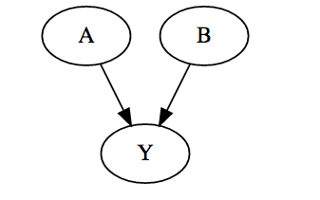
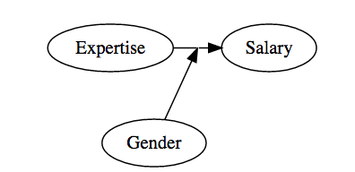

Slide 3
Formulas
lm(outcome~predictor, data=…)
outcome ~ predictor
outcome ~ x1 + x2
outcome ~ x1 * x2
outcome ~ x1 + x2 + x1:x2

Slide 4
